Slide 1



WOD
Operational and On Demand
Weather Forecasts
Ólafur Rögnvaldsson
ISOR/Belgingur and University of Bergen
or@belgingur.eu
Notes:
Introduction to the Forecast On Demand solution, of which SARWeather is but one branch

Slide 2
Outline of this talk
Design philosophy
Hardware configuration
WOD overview
Step by step demonstration of how to set up a routine forecast in the WOD system
Examples of forecast post-processing
Summary

Slide 3
Design philosophy
Based on Open Source components
  WRF/WPS weather model and accompanying software
  Python language and libraries
  Linux, PostgreSQL, and nginx webservices
Event Driven
  Processing starts as soon as possible
  Computing resources don’t stand idle out of fear
Scalable and Resilient
  Just add computing nodes for increased throughput
  Other nodes step in if one is removed
Notes:
The design philosophy of the WOD system can not be described in full in one slide, but it embraces the open source philosophy. This makes it possible to update, scale out and deploy without having to worry about licensing fees.
Scientific libraries from the NumPy family. It is run on clusters of linux machines, uses PostgreSQL and Ngnx webservices. The system code is event driven; processes wait until they get an event from an external source before they do any kind of processing at all. Don’t have to wait until we are certain of a certain process can take place because we know exactly when the conditions for said process to take place are fulfilled. This also means that throughput can be added as needed to handle increased workload.

Slide 4
Current Hardware Configuration

Slide 5
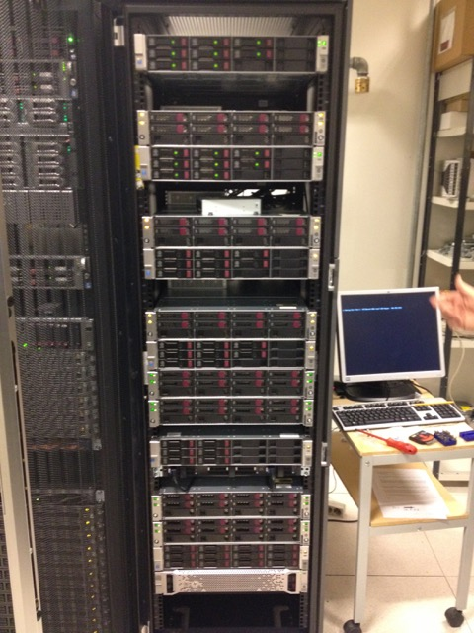
Current Hardware Configuration

Slide 6
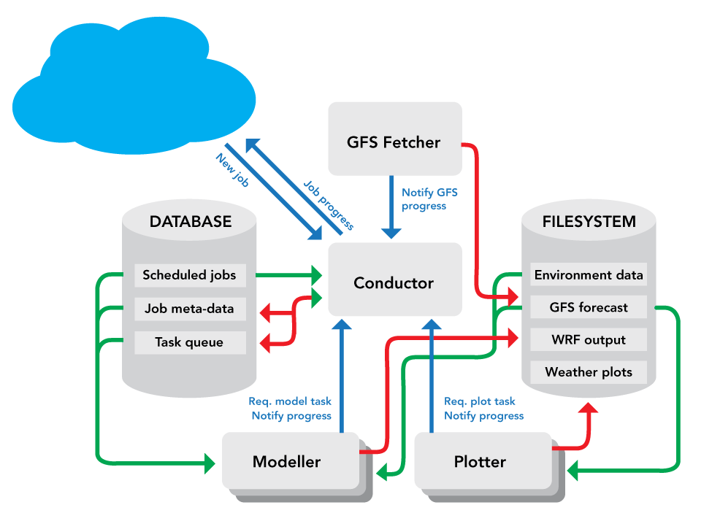
WOD Overview
Notes:
Schematic of the main components of the WOD system. Red lines indicate data being written whilst green lines show data being read. Blue lines represent messages being sent and blue boxes show individual tasks within the WOD system. The cylinders are databases, to the left is the meta-database and to the right is the shared file-system database. The black boxes represent components of the WOD system that perform specific tasks, such are running the weather model (i.e. Modeller) or create weather charts (i.e. Plotter). See text for more detailed description of each component.

Slide 7
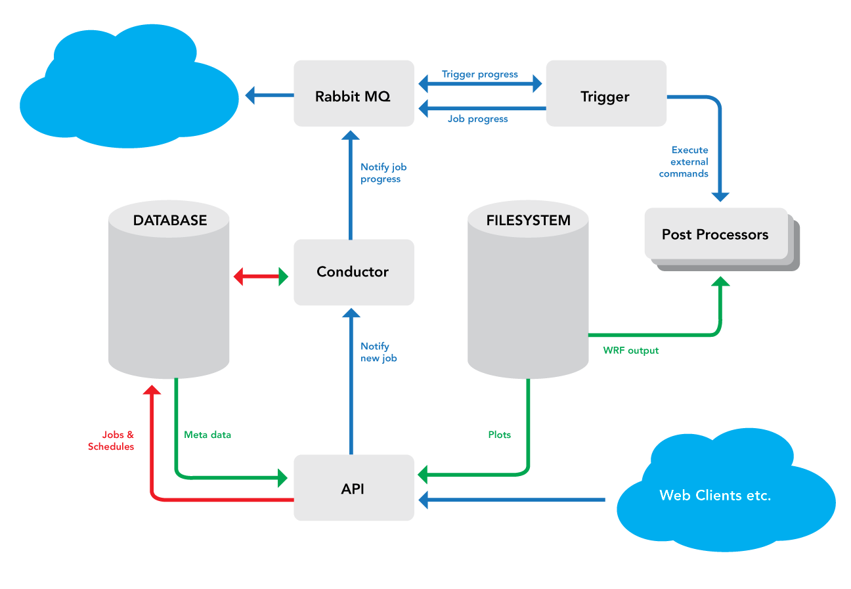
WOD Overview cont.

Slide 8
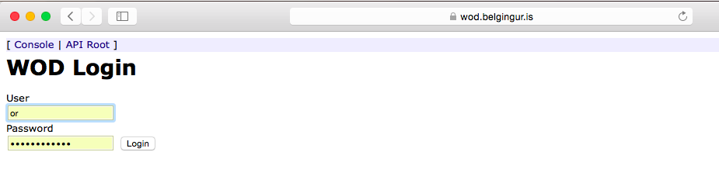
Setting up forecasts
Notes:
The simplest way to set up a routine forecast in the WOD system is go through the API, i.e. the web interface

Slide 9
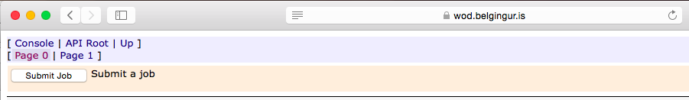
Setting up forecasts
Notes:
First of all we must submit a Job

Slide 10
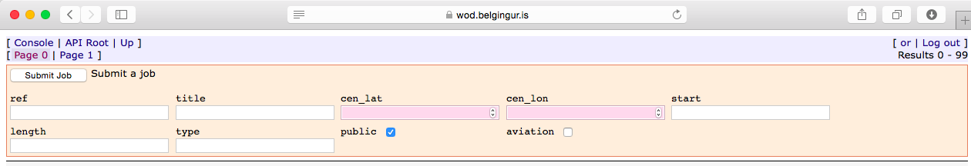
Setting up forecasts
Notes:
We suggest that you leave the “ref” box empty but put something descriptive in the “title” box. Then fill in the lat/lon boxes

Slide 11
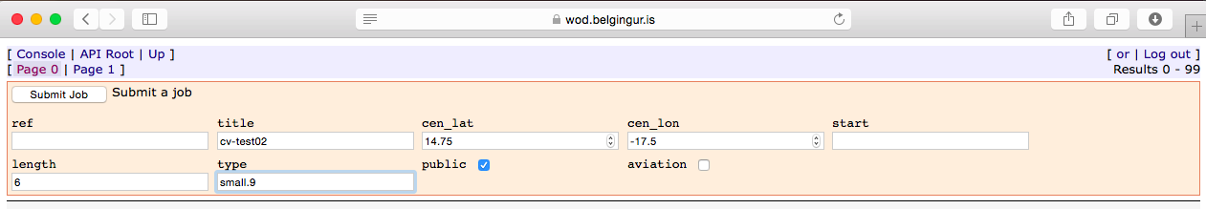
Setting up forecasts
Notes:
The forecast type is an important one, here the user is defining

Slide 12
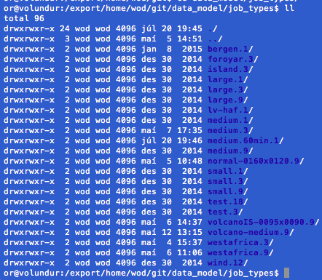
Setting up forecasts
Notes:
There are a number of pre-defined forecast types, but the user can easily add new ones to fit his/her specifics

Slide 13
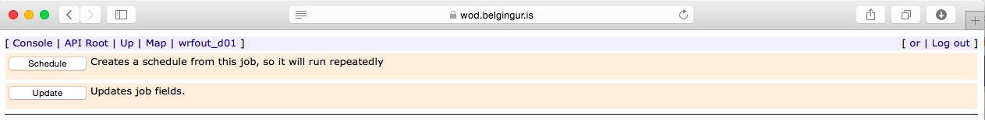
Setting up forecasts

Slide 14
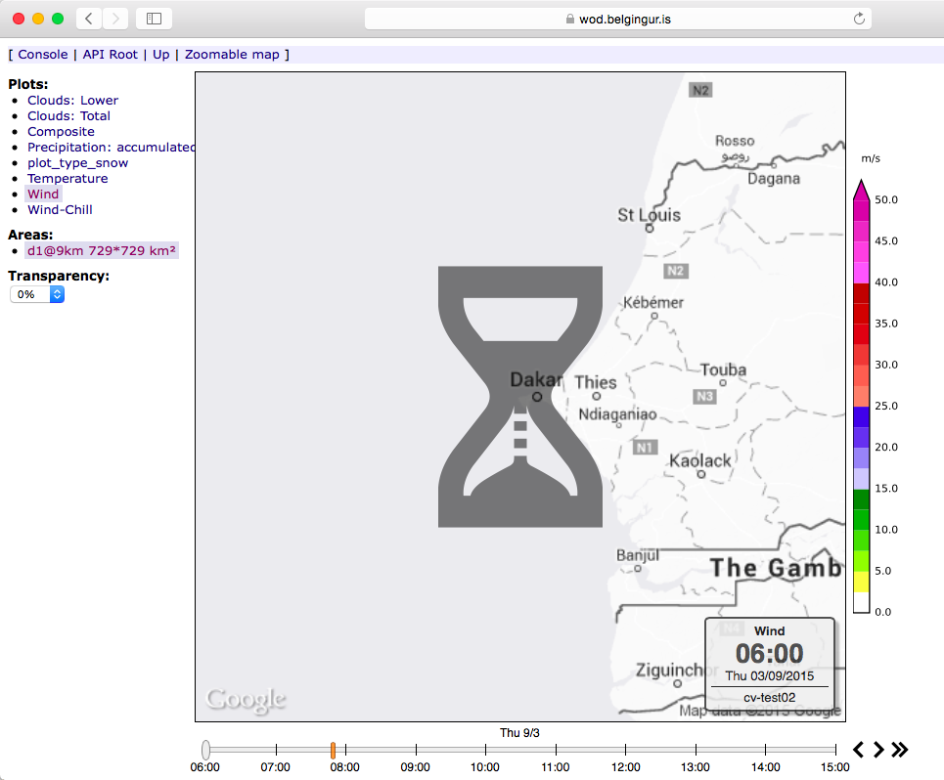
Setting up forecasts

Slide 15
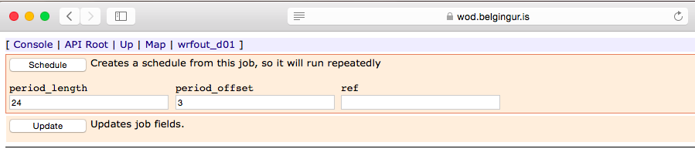
Setting up forecasts

Slide 16
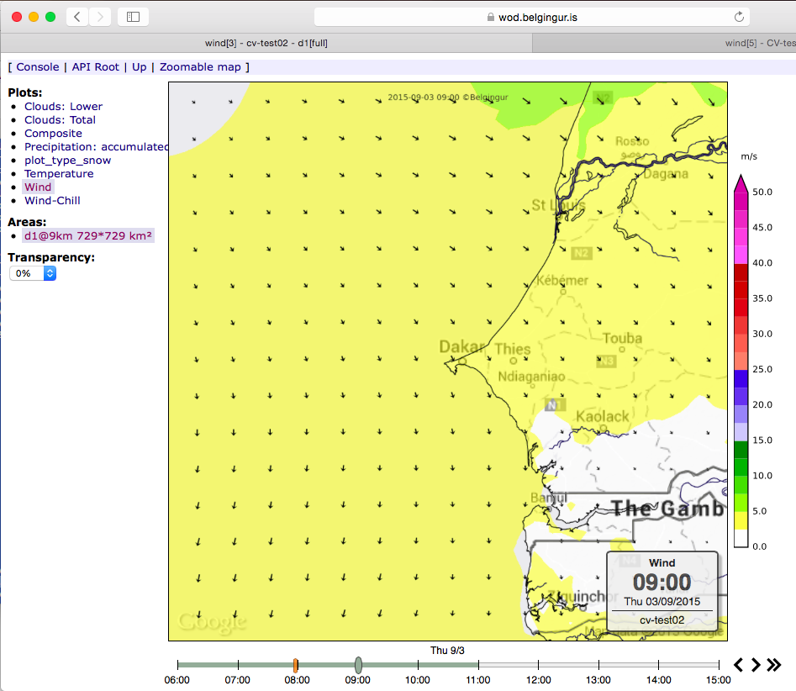
Setting up forecasts

Slide 17
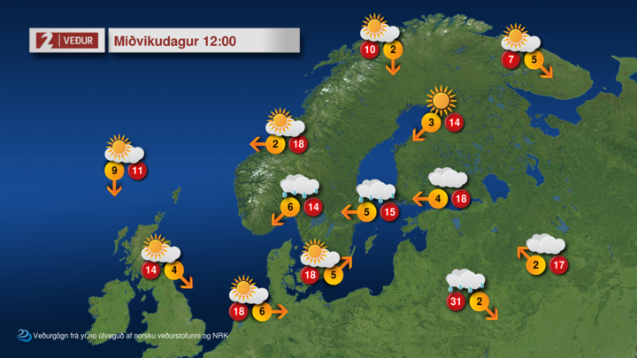
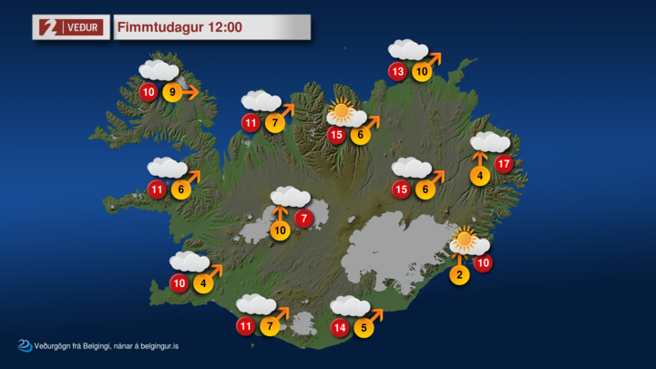
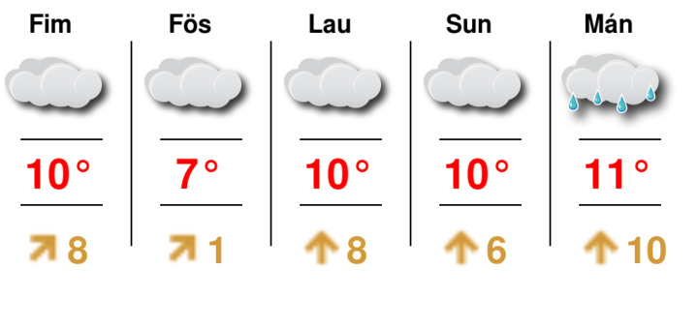
Post-processing via Triggers

Slide 18
Remember this one ☺

Slide 19
Post-processing via Triggers

Slide 20
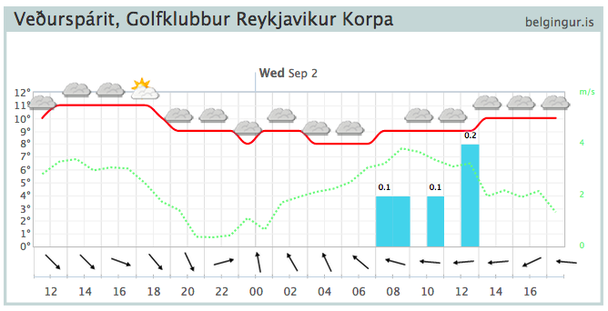
Triggers

Slide 21
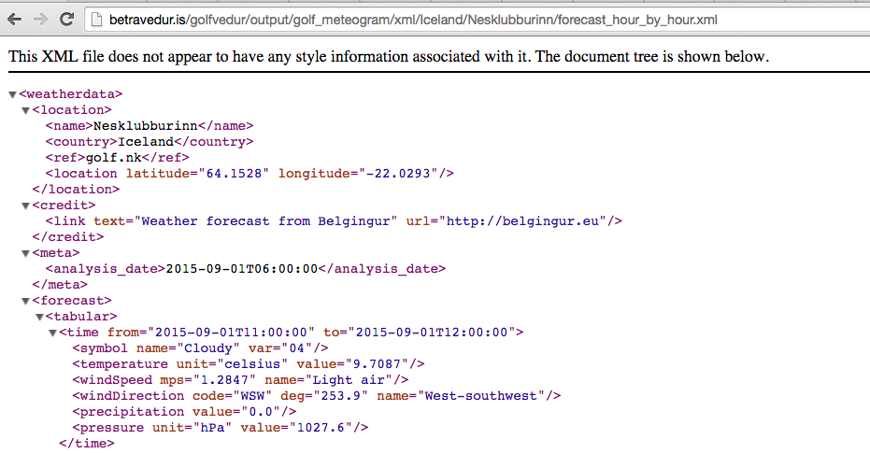
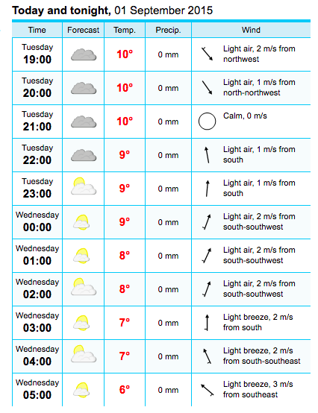
Triggers

Slide 22
Summary
The WOD system can be used to create conventional short- to medium-range weather forecasts for any location on the globe
It is based on Open Source components
It is Event Driven
It is Scalable and Resilient
Output can be used as input into other decision support software
Currently being implemented in Cape Verde
  Mauritius, Guinea-Bissau, and UNECA soon to follow

Slide 23
Additional slides follow

Slide 24
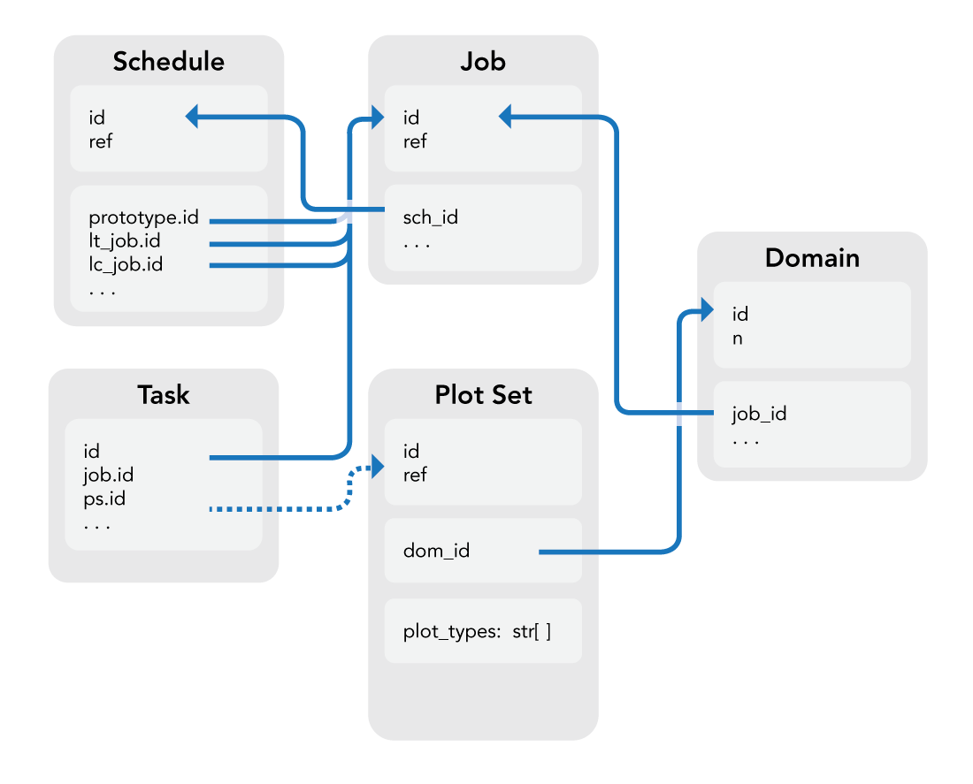
Job Meta Data
Lives in an SQL Database
Small and searchable
Job Hierarchy: Schedule, Job, Domain, PlotSet
Queue of Tasks
Internal ID and external ref values

Slide 25
Changes can be done
Entries in the meta-data base can be modified using standard SQL commands
wod=> update schedule set period_length='{2 days, 2 days}' where prototype_id=4724;

Slide 26
Changes can be done
Entries in the meta-data base can be modified using standard SQL commands
wod=> update schedule set expires=lt_analysis where prototype_id=4724;
Notes:
Proceed with caution !!!

Slide 27
GFS Fetcher
Retrieves GFS global forecast 4x per day
  Analysis at 00, 06, 12, and 18 UTC
  Data starts arriving 3½ – 4 hours later
Launch externally via cron
Sends a message to Conductor on incremental progress
  Start Jobs before global forecast completes
  Shorter Jobs can start earlier

Slide 28
Job Meta Data
Lives in an SQL Database
Small and searchable
Job Hierarchy: Schedule, Job, Domain, PlotSet
Queue of Tasks
Internal ID and external ref values

Slide 29
Schedule Records
Indicates that a forecast should be launched when new data arrives
Optional rule to decide on which global GFS forecast to run
Links to prototype Job used to create new jobs
Links to last completed Job
Links to last triggered Job

Slide 30
Job Records
Meta-data about a single forecast run
Priority value to help with scheduling
A Job is of a JobType specifying model settings and dimensions
Jobs contain one or more Domains which mark nested rectangular forecast regions
Domains usually contain one or more PlotSets
  Geographic region
  Plot types to create
  Plot size to create

Slide 31
Conductor
Central component of the system
Only reacts to messages from other components
  No heavy processing
  Never initiates processing
  Does not “know” about other components
Creates new Jobs from Schedule on message from the GFS Fetcher
Updates Job state in DB on messages from Workers
Assigns Tasks to Workers who request it
  Using Task priority inherited from Job priority inherited from Schedule priority
Recovers Jobs and Tasks which fail or time out

Slide 32
Model Data
Lives in networked file-system
Config files for each model run
Large data files
  Static input for weather model
  Global weather data
  Weather model output
  Weather images
Can be located from Job meta-data, but not (easily) searchable
  Data-based directory structure
  Directory for each Job

Slide 33
System Overview

Slide 34
Triggers
Connected by RabbitMQ message bus
  Can be run remotely
  Unable to interfere with core system processing
  Requests queue up if Trigger goes down
Runs custom post-processors when Jobs complete
  Create specialized plots
  Generate point forecasts
  Generate custom reports for industry
Triggers jobs when another triggered job completes
  Intermediate data format used for multiple final products
  Data processing detached from delivery
Gives post-processors access to model output

Slide 35
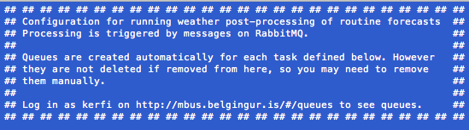
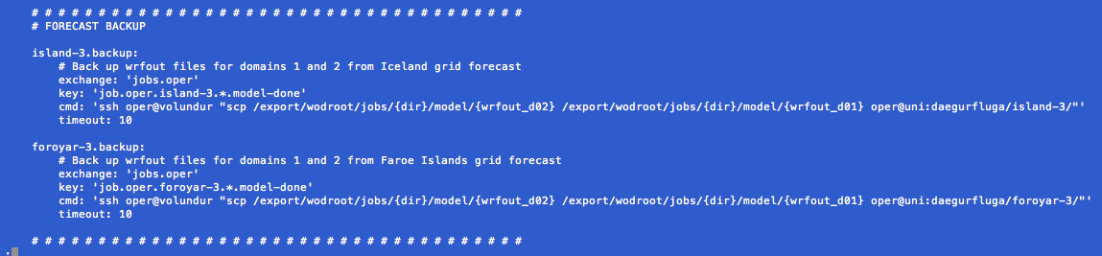
Triggers

Slide 36
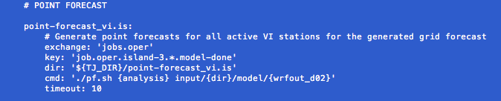
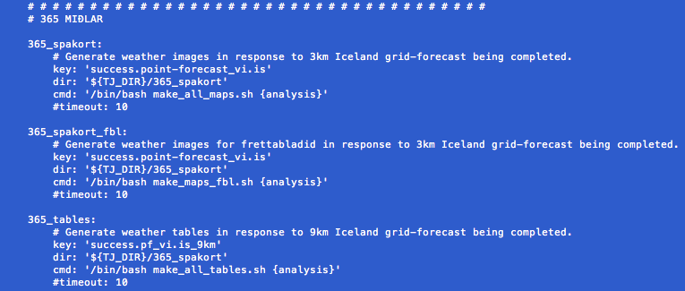
Triggers

Slide 37
Triggers

Slide 38
Triggers

Slide 39
Triggers

Slide 40
Job Life Cycle I
GFS Fetcher has fetched 48 hours of data and send a message to Conductor
Conductor sees that a Schedule record needs 48 hours of global weather data, clones the prototype Job with updated date fields
Conductor creates Model Task for the Job and puts in the queue
Model Task waits in queue until it reaches the front of the queue and …
an idle Modeller requests a Model Task from the Conductor and is assigned the one for our Job

Slide 41
Job Life Cycle II
Modeller works on the Model Task, writes a frame of model output and sends a message notifying the Conductor
Conductor creates a Plot Task for each PlotSet for which there is new data and places them in the queue
Each Plot Task waits in the queue until it reaches the front of the queue and …
an idle Plotter requests a Plot Task from the Conductor and is assigned the one for our Job
The above steps are repeated until the Plot Task is completed
The Job is marked as completed
The Schedule is update with the new last-completed Job

Slide 42
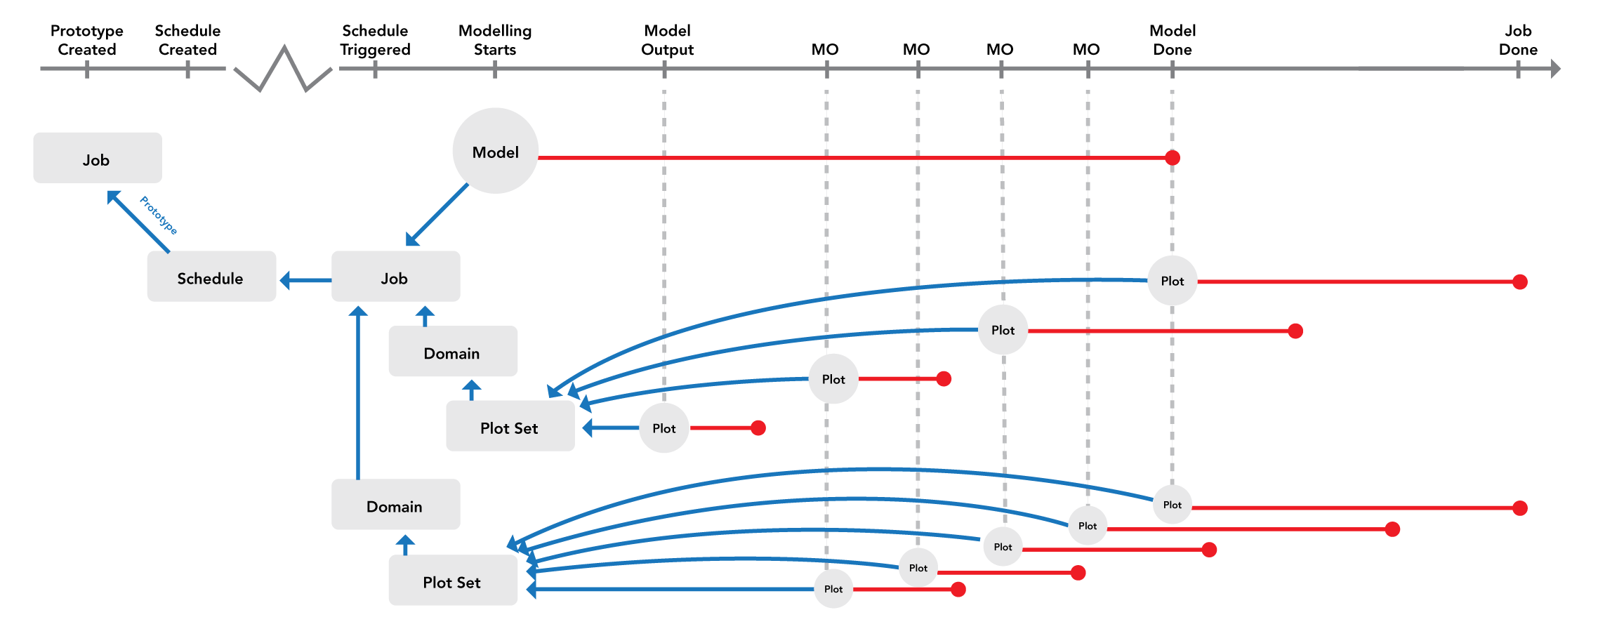
Job Life Cycle III

Slide 43
API
A RESTful API with discoverable web interface https://wod.belgingur.is/wod/api/1.0
Can be used to create Jobs and Schedules
Can be used to Trigger Schedules
Reads Job/Schedule meta-data given the reference value for the object https://wod.belgingur.is/wod/api/1.0/jobs/20150901-160225-6829ceb37474 https://wod.belgingur.is/wod/api/1.0/schedules/capoverde-9
Reads weather images
https://wod.belgingur.is/wod/api/1.0/jobs/20150901-160225-6829ceb37474/plot/1/full/composite/0-6.png

