Slide 1
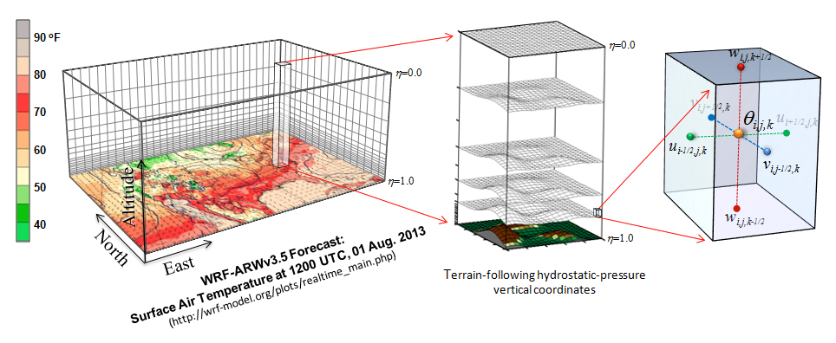

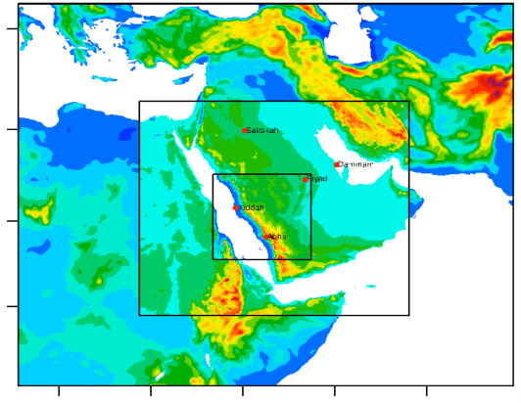
Model evaluation
João A. Hackerott and Morgan Yarker
Seychelles, 24th February, 2016

Slide 2

Why verify?
Disagree with a fact.
Elaborate hypothesis.
Proof the hypothesis.
Develop improvement.
Hypothesis
Example:
I ran WRF for 3 month on my hometown and it was under estimating the rainfall.
Fact: Model simulates rain within an accepted error.
I decided to change the cumulus parameterizations since I verified that the problems were occurring during convective days.
Hypothesis: Problems in Cumulus Parameterization.
Proof: Compare to others.
I changed from Tiedtke to KF and after 3 more months, the verification improved.
Develop: Apply the change on operation.

Slide 3
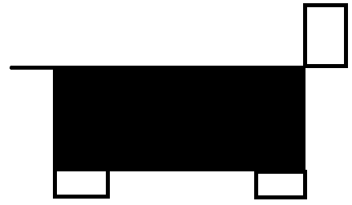
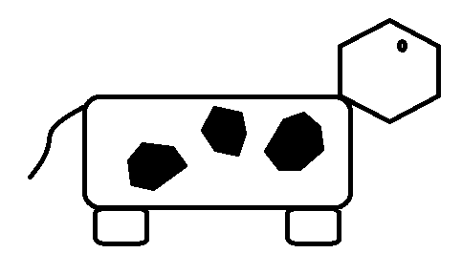
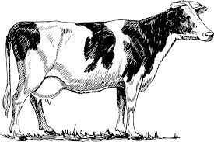

Accepted error…
But, what is an error?
Which parameterization?

Slide 4

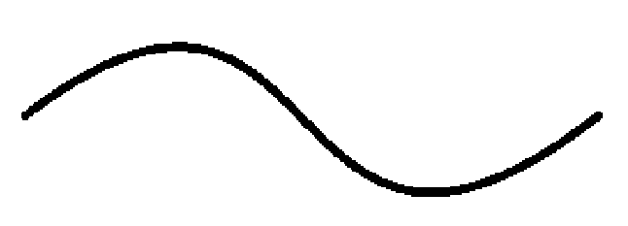
Resolution
Which grid space?
Gs = L
Gs = L/3
Gs = L/2
Gs = L/4
Gs = L/8
Sea breeze: ~80km -> need around 10km grid space.

Slide 5
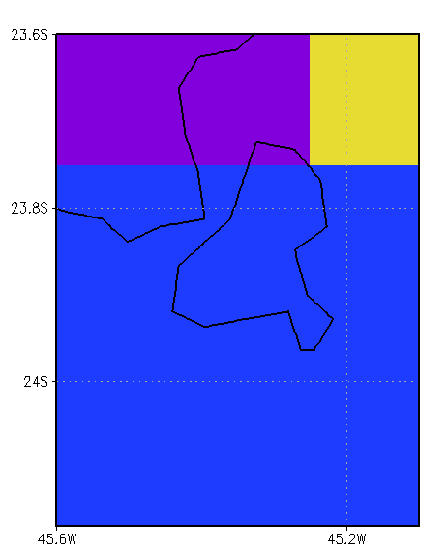
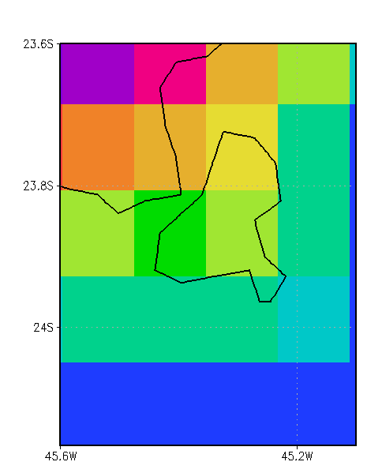
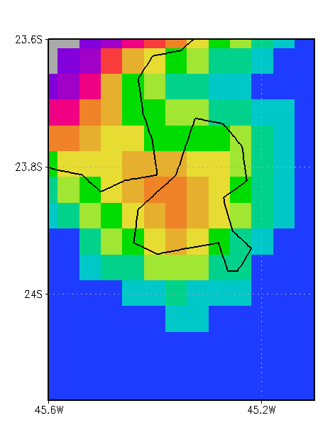
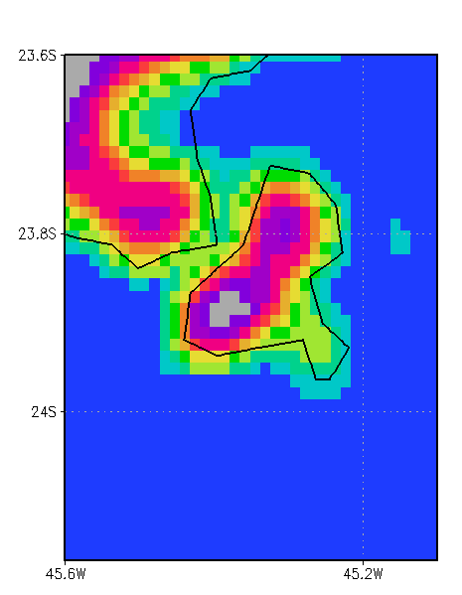

Resolution
0,5°
Which model should I use?
Pay attention to the vertical resolution as well!
27 km
9 km
3 km
Altitude (m)

Slide 6
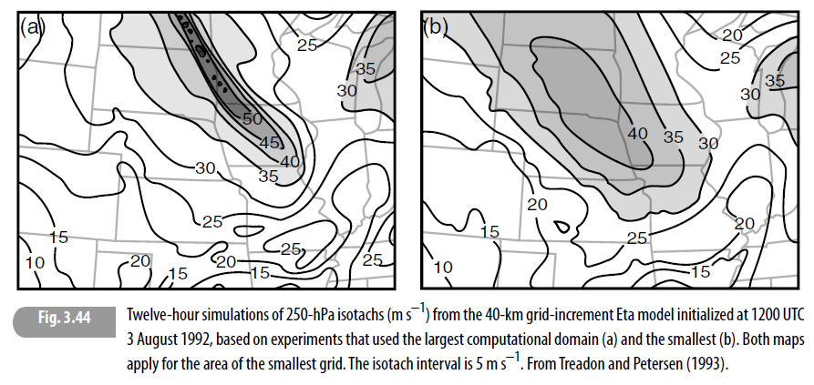
Domain’s size
Same resolution
Large domain
Small domain
1st domain has to resolve the synoptic conditions.
The domains must be large!
Attention where is your interest!

Slide 7
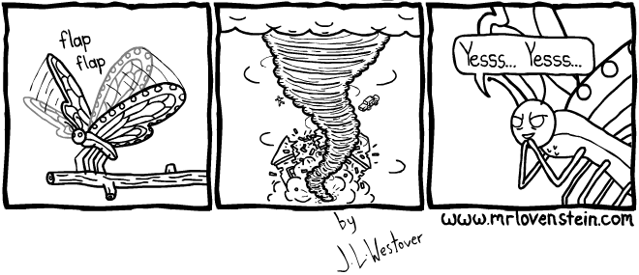
Computational error
Chaos theory
(Lorenz, 1963)
Suppose a perfect model
(physics and initial conditions)
The forecast will not be perfect due to truncations
Because of nonlinearity of meteorological equations, small deviation may increase significantly with time.

Slide 8
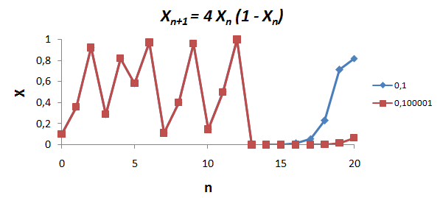
Example of chaotic equation

Slide 9
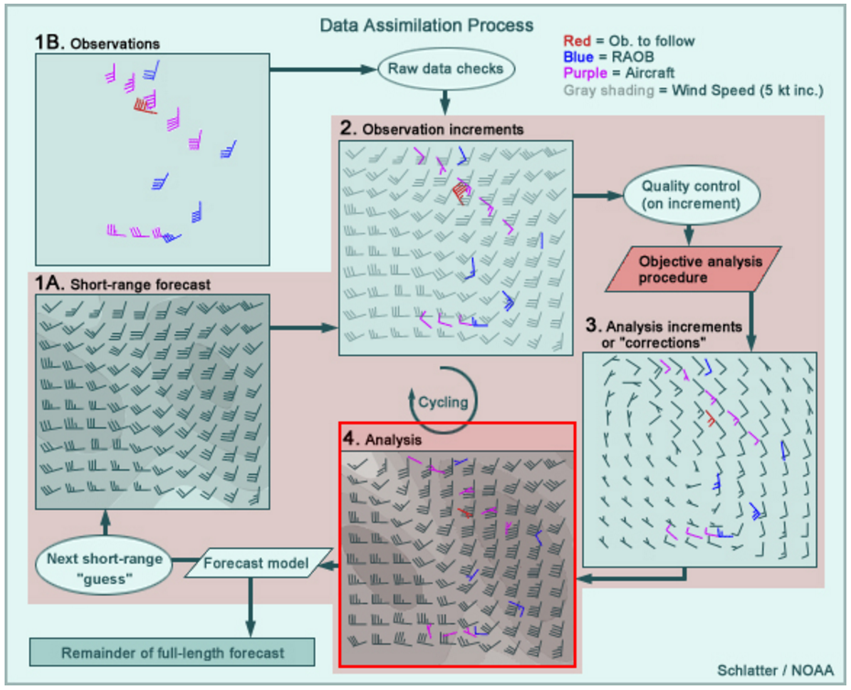
Initial condition error
Analysis is not perfect!
Grid interpolation.
Observational problems.
Lack of data.
It is a model simulation.
www.meted.ucar.edu /bom/mdata_assim/

Slide 10
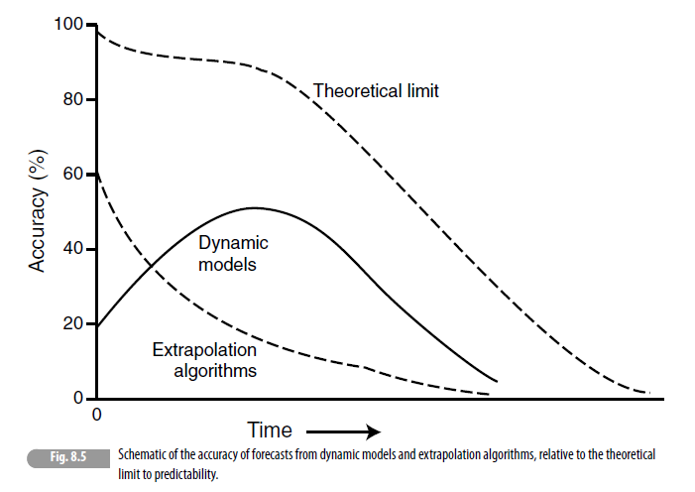
Summary of model error
Unsolved physics
Observation
Chaos / truncation
Analysis
(Warner, 2011)

Slide 11
Observed data for model verification
Observed data are not the absolute truth!
We can’t know the complete reality…
Observations generally are more “true” than a model analysis and re-analysis (at least they are relatively more independent).
Observational uncertainty should be somehow taken into account.
You must be tuff (exigent) about your comparison!!!

Slide 12
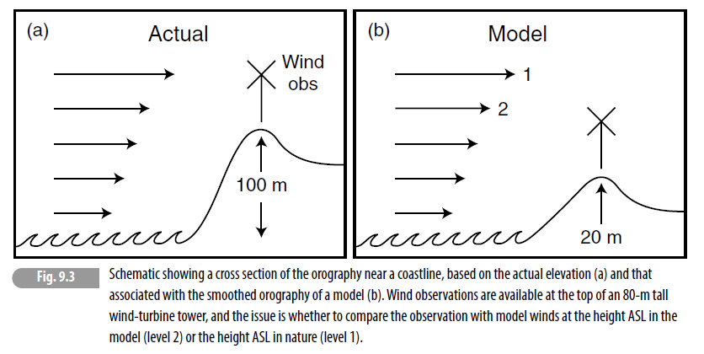
Compare to observations…
(Warner, 2011)

Slide 13
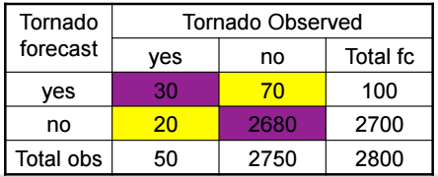
Dichothomus evaluation
Probability of right tornado forecasted = 30/50 = 60%
Percentage of correct forecast = (30+2680)/2800 = 97%
These tables are easy to produce and give you valuable information
Can be used also for thresholds.
Example: Temperature less than 20°C.

Slide 14
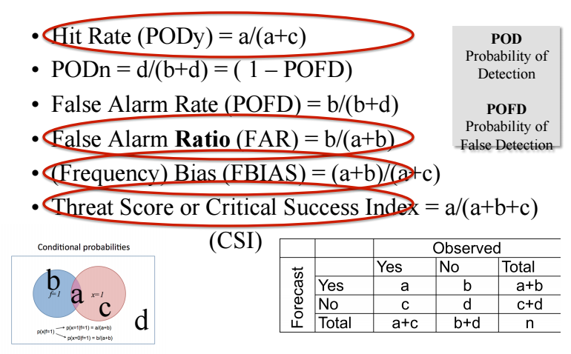
Indices based on conditioning
Hit Rate (Prob. Of Detction) =a/(a+c)
False Alarme Tate = b/(b+d)
Probability of detaction= 1-b/(b+d)
False alarme ratio = b/(a+b)
Frequency bias (a+b)/(a+c)
Critical success index = a/(a+b+c)

Slide 15
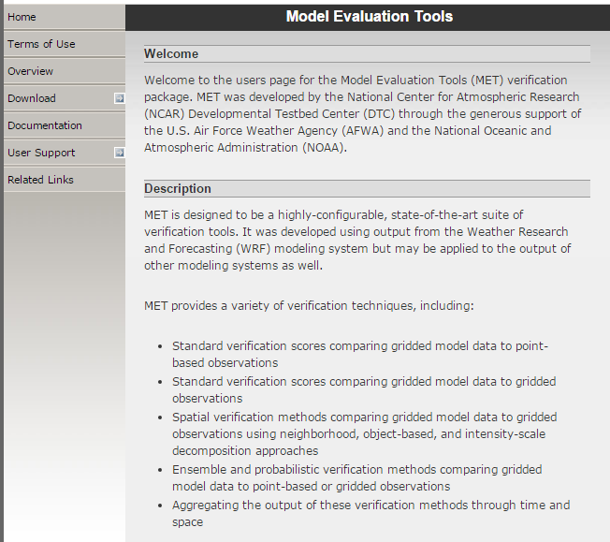
MET software

Slide 16
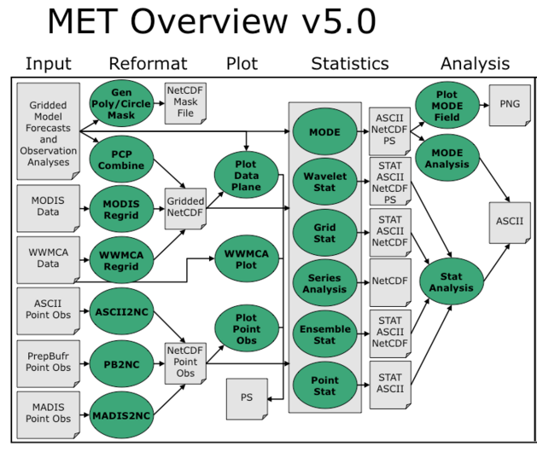

Slide 17
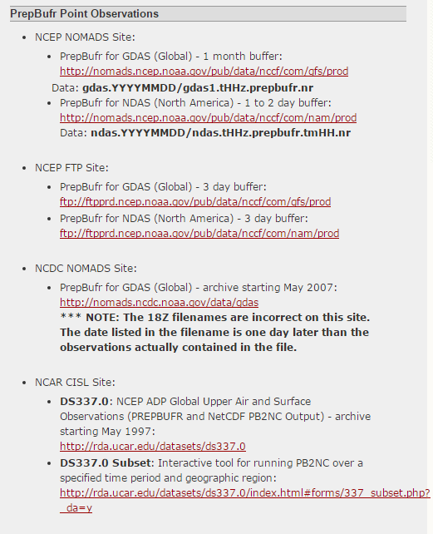
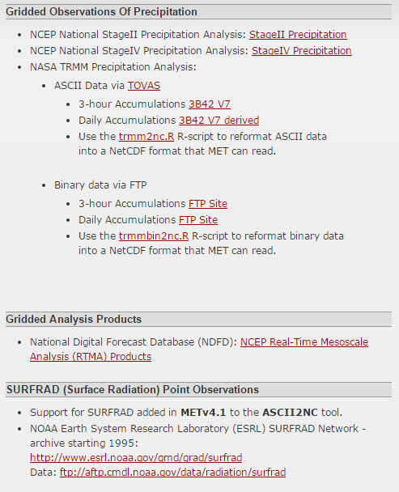
Download observational data

