Slide 1




Products based on WRF
João A. Hackerott and Morgan Yarker
Seychelles, 25th February, 2016

Slide 2
Products classification
1) Climate products
2) Short term forecast products (weather)
3) Nowcasting products

Slide 3
Short term forecast
Sports
  Car races
  Sailing races
Ocean applications
  Fishing business
  Offshore voyages
Airplane route
Energy trading
  Solar energy, wind mills production on the week…
Civil defense
  Extreme events alert

Slide 4
Short term forecast
Set up the WRF depending on the client interest
  Domain;
  Parameterizations (rain, wind, hail?);
  How often to run? (every 6h or once a day?)
  How long each simulation? (1, 2,…,15 days?)
  How often to generate the output? (10mins, 1h?)
Post processing
  Which figures will my client be able to understand?
  How to present the product? (webpage, report…)

Slide 5
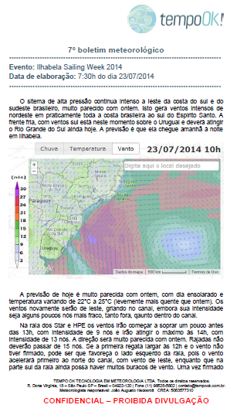

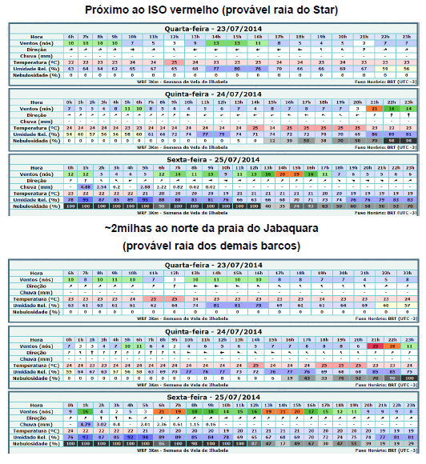
Sailing race

Slide 6
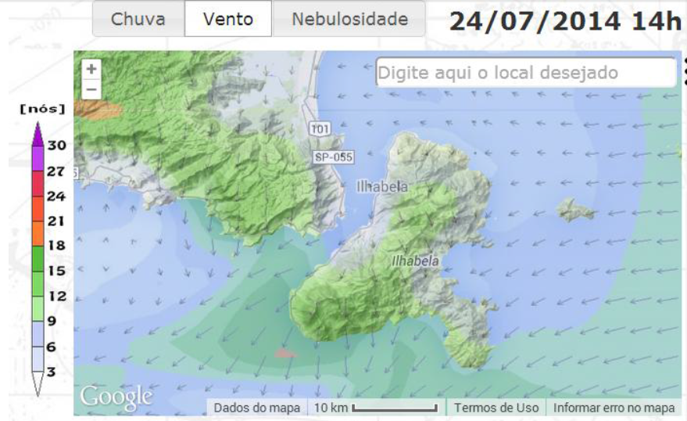
Make good and understandable maps

Slide 7
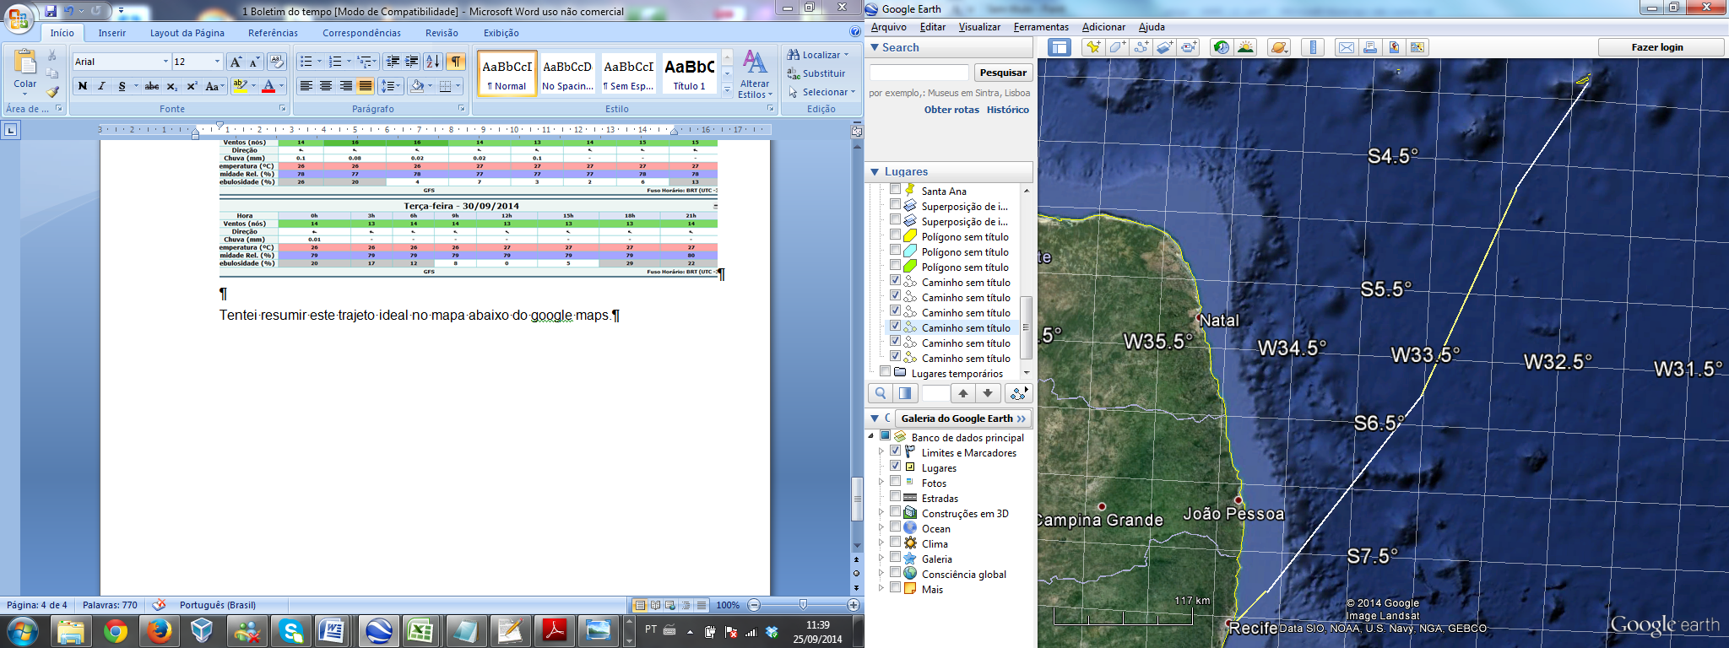
For cruising
60nm rumando a 30°
100nm rumando a 22°
111nm rumando a 35°
33nm rumando a 40°

Slide 8
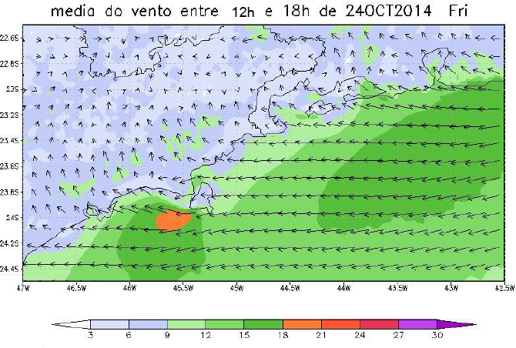
Average maps for cruising

Slide 9
E-mail reports…
Build a summarized e-mail that contains all high technology information in a understandable language.

Slide 10
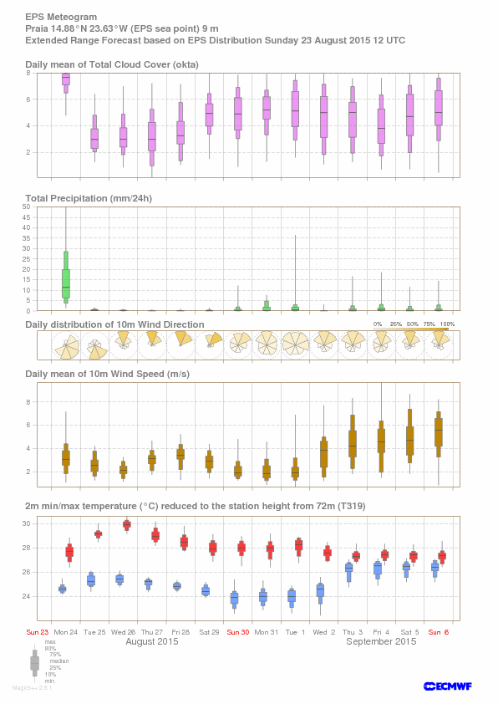
“Probabilistic” meteograms
Meteograms are often used to summarise NWP forecasts.
With ensemble forecasting a new type of meteogram, summarising all model results is possible.
  If you belief that the probability space is properly sampled by the EPS runs then this reflects a probabilistic forecast.
  Then you can also make a map of probabilities of occurance

Slide 11
Climate products
Climate forecast
  Agricultural farms
  Energy business
  Governmental decisions
  CO₂ emission credits
Climatology
  Plan the best place to build energy farms

Slide 12
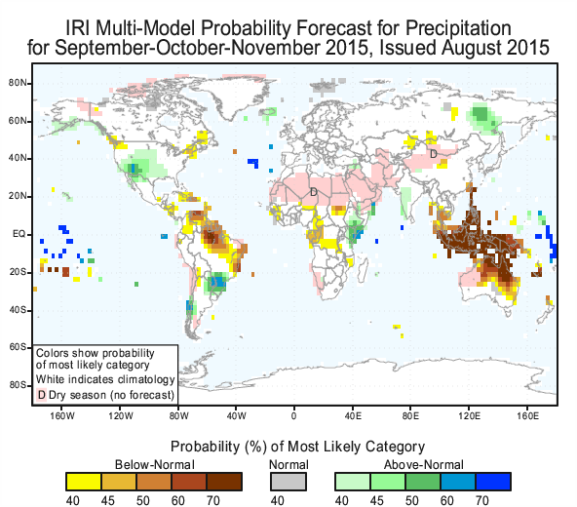
Climate
Seasonal forecast
Madden Julian Oscilation (MJO)
El- Niño
Monsoon
SST related patterns
Why not to run WRF?

Slide 13
Climate
Climatological forecast (long term)
Warming of the climate system is unequivocal, and since the 1950s, many of the observed changes are unprecedented over decades to millennia. The atmosphere and ocean have warmed, the amounts of snow and ice have diminished, sea level has risen, and the concentrations of greenhouse gases have increased
(IPCC, 2013, SPM)

Slide 14
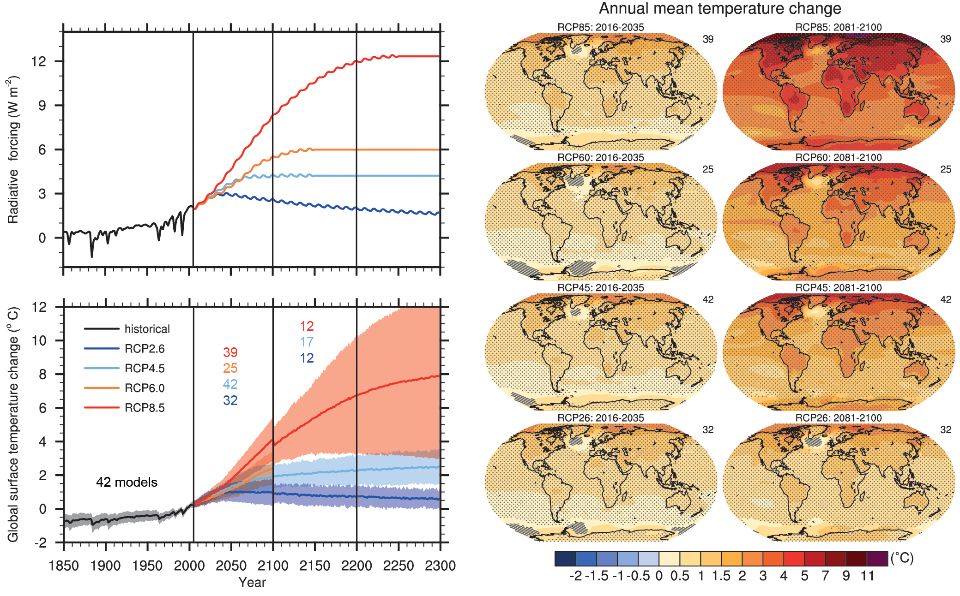
(source IPCC 2013 WG1 report )‏

Slide 15
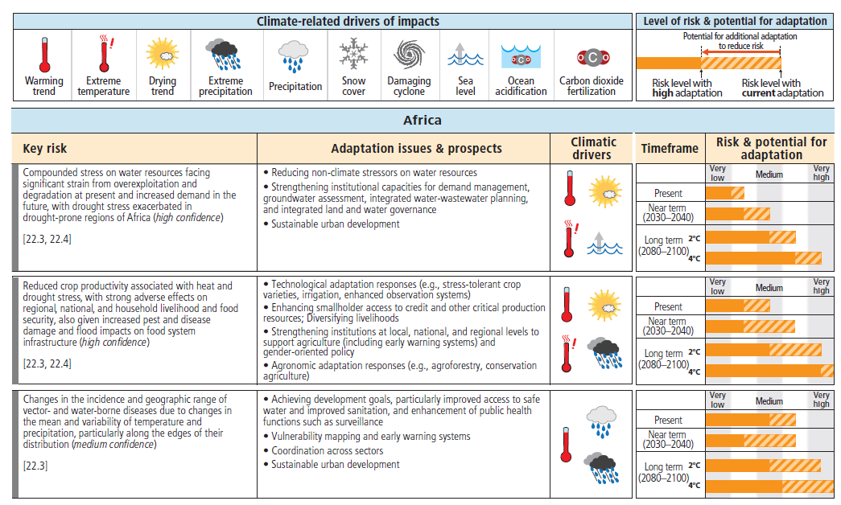

Slide 16
So, what to do with the information?
Matter of belief?
Science does not really work that way.
Little wiggle room for differences in opinion given the enormity of the evidence
Is it a scientific issue?
Not really either. This is an ethical issue
Many solutions are technical issues.
  But which ones to implement?
    Many Economists feel strongly that cost benefit analysis is all that is needed
    But their analysis has gaps
        Discounting arguments never seem to cover all of the areas affected

Slide 17
So, what to do with the information?
Climate change touches on several different ethical questions:
Rich nations vs poor people
  Is it ethically acceptable that western lifestyles hurt the poorest in far away places?
    WHO estimates that Climate Change already causes over 150.000 deaths a year
Present generation vs future generations
  Is it ethically defensible that our use of resources endangers future generations?
Humans vs. other natural systems
  Climate change is accelerating species extinction, habitat loss etc.
    Can we do as we please?
      (Aside from the issue that nature can “correct” our mistreatment of ecosystems)

Slide 18
What do you think about it?
Let’s share experiences

