Slide 1


WOD
Operational and On Demand
Weather Forecasts
Logi Ragnarsson and Ólafur Rögnvaldsson*
ISOR/Belgingur
*or@belgingur.eu
Notes:
Introduction to the Forecast On Demand solution, of which SARWeather is but one branch

Slide 2
Outline of this talk
Design philosophy
Hardware configuration
WOD overview
Individual components
Job life cycle
API

Slide 3
Design philosophy
Based on Open Source components
  WRF/WPS weather model and accompanying software
  Python language and libraries
  Linux, PostgreSQL, and nginx webservices
Event Driven
  Processing starts as soon as possible
  Computing resources don’t stand idle out of fear
Scalable and Resilient
  Just add computing nodes for increased throughput
  Other nodes step in if one is removed
Notes:
The design philosophy of the WOD system can not be described in full in one slide, but it embraces the open source philosophy. This makes it possible to update, scale out and deploy without having to worry about licensing fees.
Scientific libraries from the NumPy family. It is run on clusters of linux machines, uses PostgreSQL and Ngnx webservices. The system code is event driven; processes wait until they get an event from an external source before they do any kind of processing at all. Don’t have to wait until we are certain of a certain process can take place because we know exactly when the conditions for said process to take place are fulfilled. This also means that throughput can be added as needed to handle increased workload.

Slide 4
Current Hardware Configuration

Slide 5
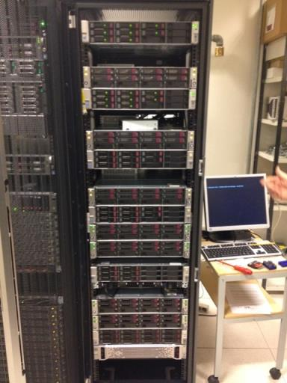
Current Hardware Configuration

Slide 6
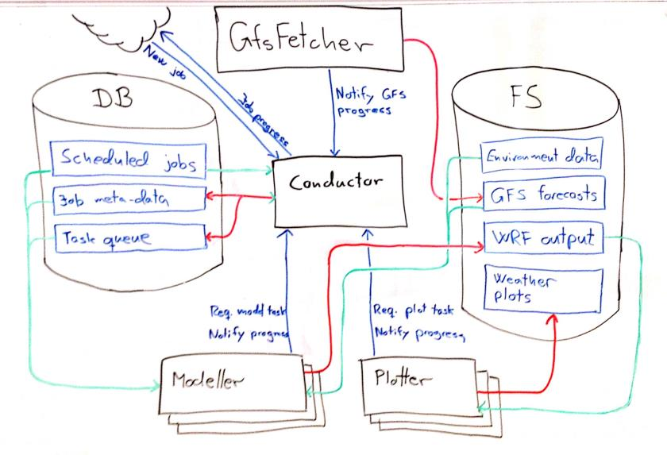
WOD Overview

Slide 7
GFS Fetcher
Retrieves GFS global forecast 4x per day
  Analysis at 00, 06, 12, and 18 UTC
  Data starts arriving 3½ – 4 hours later
Launch externally via cron
Sends a message to Conductor on incremental progress
  Start Jobs before global forecast completes
  Shorter Jobs can start earlier

Slide 8
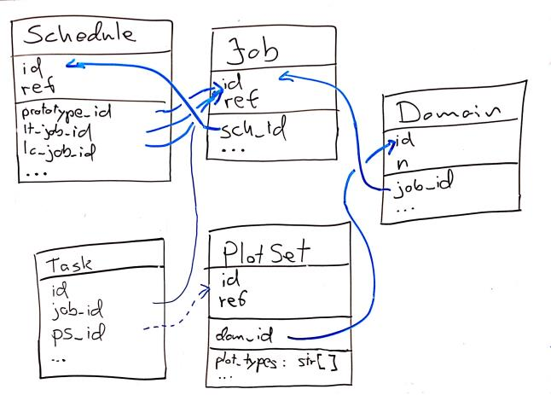
Job Meta Data
Lives in an SQL Database
Small and searchable
Job Hierarchy: Schedule, Job, Domain, PlotSet
Queue of Tasks
Internal ID and external ref values

Slide 9
Schedule Records
Indicates that a forecast should be launched when new data arrives
Optional rule to decide on which global GFS forecast to run
Links to prototype Job used to create new jobs
Links to last completed Job
Links to last triggered Job

Slide 10
Job Records
Meta-data about a single forecast run
Priority value to help with scheduling
A Job is of a JobType specifying model settings and dimensions
Jobs contain one or more Domains which mark nested rectangular forecast regions
Domains usually contain one or more PlotSets
  Geographic region
  Plot types to create
  Plot size to create

Slide 11
Conductor
Central component of the system
Only reacts to messages from other components
  No heavy processing
  Never initiates processing
  Does not “know” about other components
Creates new Jobs from Schedule on message from the GFS Fetcher
Updates Job state in DB on messages from Workers
Assigns Tasks to Workers who request it
  Using Task priority inherited from Job priority inherited from Schedule priority
Recovers Jobs and Tasks which fail or time out

Slide 12
Model Data
Lives in networked file-system
Config files for each model run
Large data files
  Static input for weather model
  Global weather data
  Weather model output
  Weather images
Can be located from Job meta-data, but not (easily) searchable
  Data-based directory structure
  Directory for each Job

Slide 13
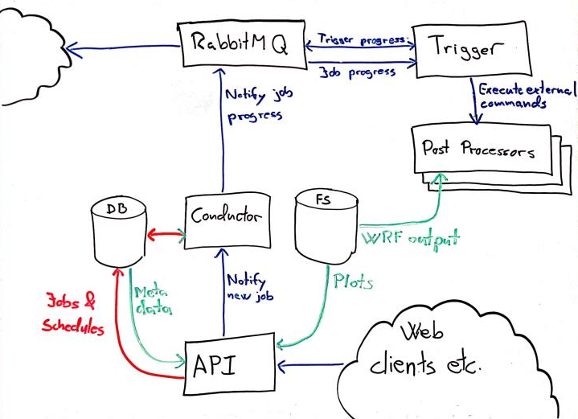
System Overview

Slide 14
Triggers
Connected by RabbitMQ message bus
  Can be run remotely
  Unable to interfere with core system processing
  Requests queue up if Trigger goes down
Runs custom post-processors when Jobs complete
  Create specialized plots
  Generate point forecasts
  Generate custom reports for industry
Triggers jobs when another triggered job completes
  Intermediate data format used for multiple final products
  Data processing detached from delivery
Gives post-processors access to model output

Slide 15
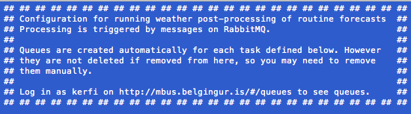
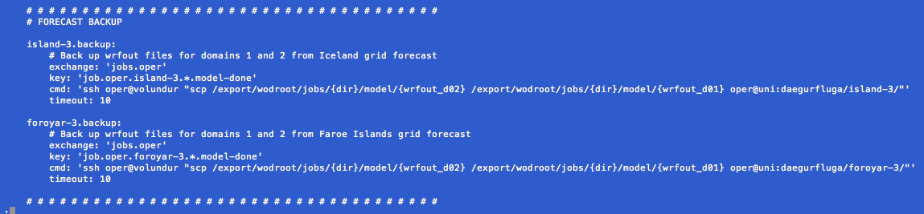
Triggers

Slide 16
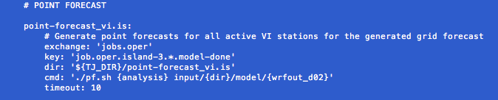
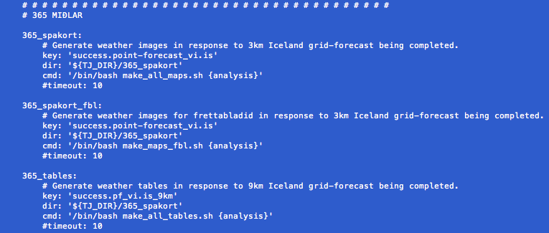
Triggers

Slide 17
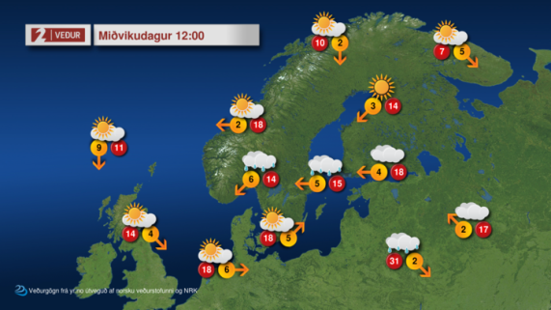
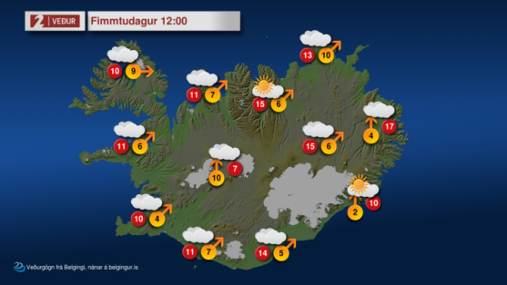
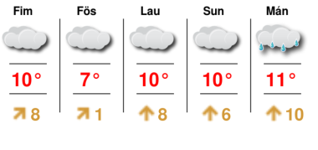
Triggers

Slide 18
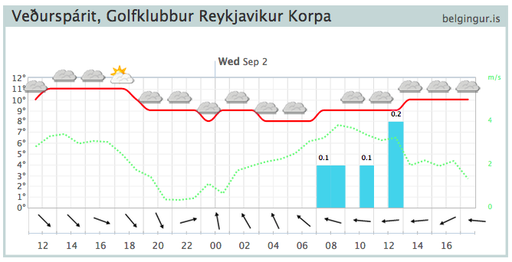
Triggers

Slide 19
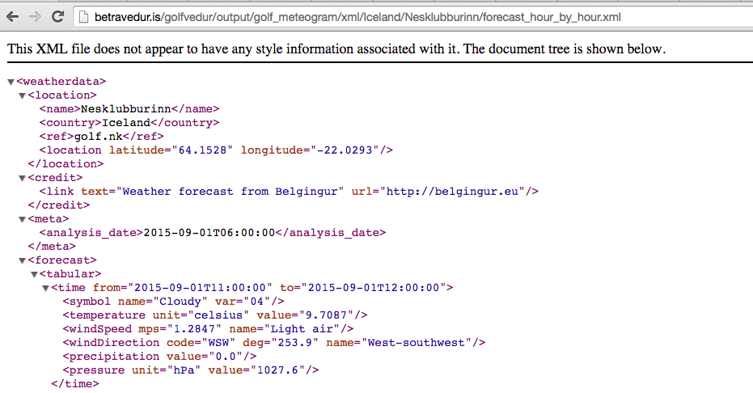
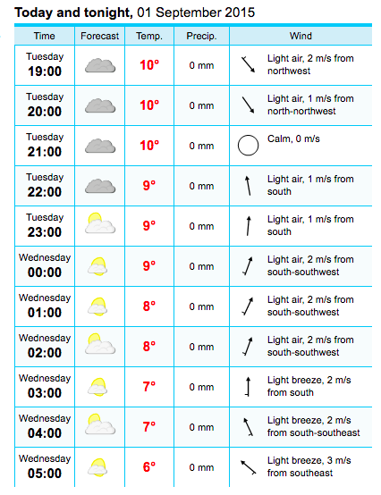
Triggers

Slide 20
Job Life Cycle I
GFS Fetcher has fetched 48 hours of data and send a message to Conductor
Conductor sees that a Schedule record needs 48 hours of global weather data, clones the prototype Job with updated date fields
Conductor creates Model Task for the Job and puts in the queue
Model Task waits in queue until it reaches the front of the queue and …
an idle Modeller requests a Model Task from the Conductor and is assigned the one for our Job

Slide 21
Job Life Cycle II
Modeller works on the Model Task, writes a frame of model output and sends a message notifying the Conductor
Conductor creates a Plot Task for each PlotSet for which there is new data and places them in the queue
Each Plot Task waits in the queue until it reaches the front of the queue and …
an idle Plotter requests a Plot Task from the Conductor and is assigned the one for our Job
The above steps are repeated until the Plot Task is completed
The Job is marked as completed
The Schedule is update with the new last-completed Job

Slide 22
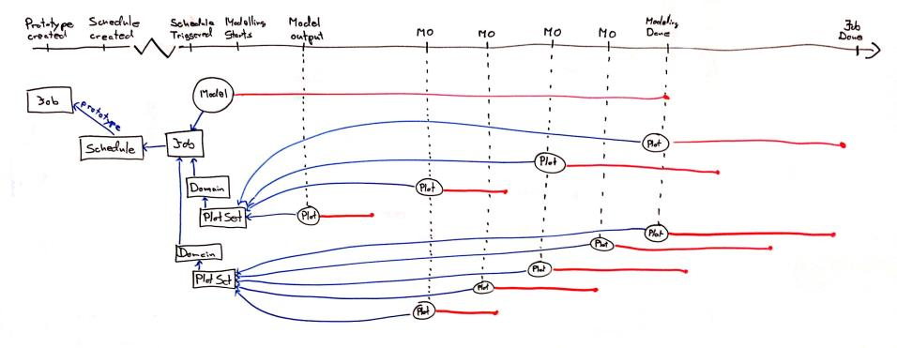
Job Life Cycle III

Slide 23
API
A RESTful API with discoverable web interface https://wod.belgingur.is/wod/api/1.0
Can be used to create Jobs and Schedules
Can be used to Trigger Schedules
Reads Job/Schedule meta-data given the reference value for the object https://wod.belgingur.is/wod/api/1.0/jobs/20150901-160225-6829ceb37474 https://wod.belgingur.is/wod/api/1.0/schedules/capoverde-9
Reads weather images
https://wod.belgingur.is/wod/api/1.0/jobs/20150901-160225-6829ceb37474/plot/1/full/composite/0-6.png

