Slide 1
WOD
Demonstration part
Ólafur Rögnvaldsson
ISOR/Belgingur
or@belgingur.eu
Notes:
Introduction to the Forecast On Demand solution, of which SARWeather is but one branch

Slide 2
Outline of this talk
Step by step demonstration of how to set up a routine forecast in the WOD system

Slide 3
Setting up forecasts
Notes:
The simplest way to set up a routine forecast in the WOD system is go through the API, i.e. the web interface

Slide 4
Setting up forecasts
Notes:
First of all we must submit a Job

Slide 5
Setting up forecasts
Notes:
We suggest that you leave the “ref” box empty but put something descriptive in the “title” box. Then fill in the lat/lon boxes

Slide 6
Setting up forecasts
Notes:
The forecast type is an important one, here the user is defining

Slide 7
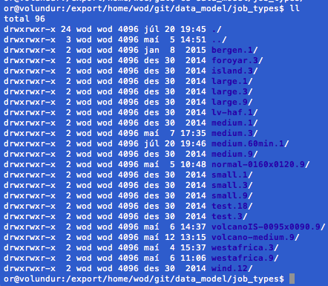
Setting up forecasts
Notes:
The simplest way to set up a routine forecast in the WOD system is go through the API, i.e. the web interface

Slide 8
Setting up forecasts
Notes:
The simplest way to set up a routine forecast in the WOD system is go through the API, i.e. the web interface

Slide 9
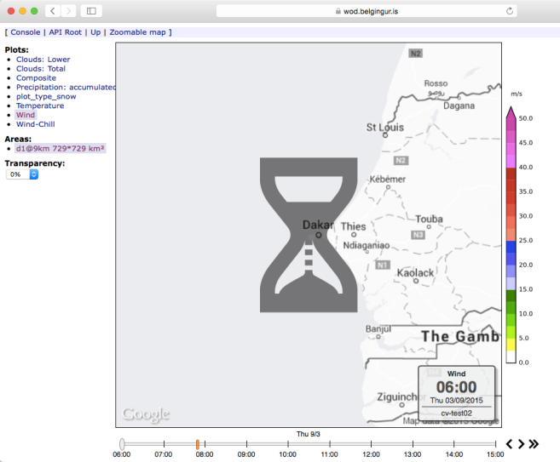
Setting up forecasts
Notes:
The simplest way to set up a routine forecast in the WOD system is go through the API, i.e. the web interface

Slide 10
Setting up forecasts
Notes:
The simplest way to set up a routine forecast in the WOD system is go through the API, i.e. the web interface

Slide 11
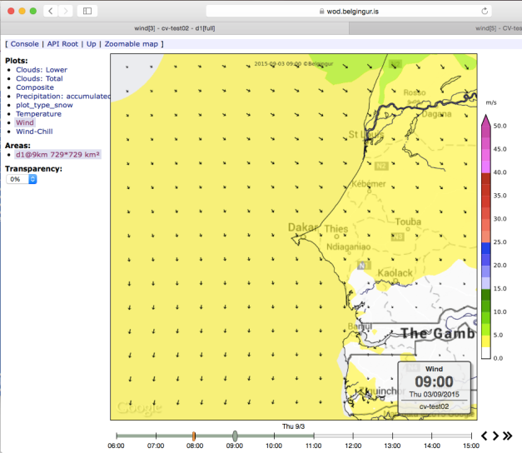
Setting up forecasts
Notes:
The simplest way to set up a routine forecast in the WOD system is go through the API, i.e. the web interface

Slide 12
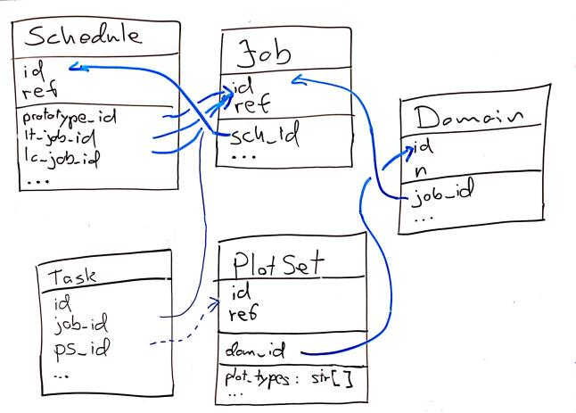
Job Meta Data
Lives in an SQL Database
Small and searchable
Job Hierarchy: Schedule, Job, Domain, PlotSet
Queue of Tasks
Internal ID and external ref values

Slide 13
Changes can be done
Entries in the meta-data base can be modified using standard SQL commands
wod=> update schedule set period_length='{2 days, 2 days}' where prototype_id=4724;

Slide 14
Changes can be done
Entries in the meta-data base can be modified using standard SQL commands
wod=> update schedule set expires=lt_analysis where prototype_id=4724;
Notes:
Proceed with caution !!!

