Slide 1
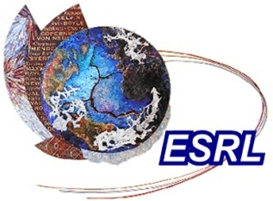

Physics Representations in Numerical Weather Prediction Models:
An Overview
Jian-Wen Bao
NOAA/Earth System Research Laboratory, Boulder, CO, USA
Workshop on
Numerical Weather Prediction Systems
and Seasonal Forecast for SIDS
Espargos, Sal Island, Cabo Verde
2nd – 5th September, 2015

Slide 2
Outline
Introduction
  Representing diabatic forcing through physics parameterizations
Parameterization of clouds
  Grid resolved processes: microphysics of clouds and precipitation
  Sub-grid processes: clouds and precipitation associated with unresolved moist convection
Parameterization of radiation transfer
  Basic concepts and approximations
Parameterization of sub-grid mixing
  Mixing by turbulence and surface fluxes
Parameterization of surface property transfer
  Basic components: air-sea/land interface fluxes, oceanic PBL mixing and oceanic surface waves

Slide 3
Introduction: representations of physics in numerical weather prediction (NWP) models
In all the operational NWP models, the following physics processes are required to be represented through parameterizations:
  Microphysics of resolved clouds and precipitation
  Radiation (short-wave and long-wave)
  Subgrid turbulence mixing and diffusion
  (including planetary boundary layer and surface layer)
  Subgrid convection
  Interaction with Earth’s surface

Slide 4
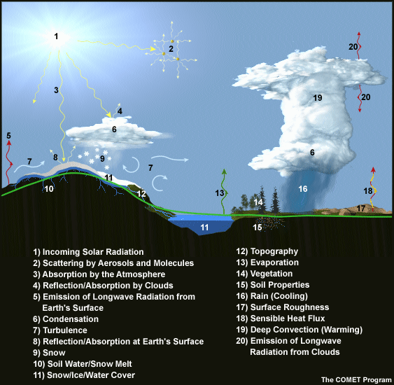
Introduction:
What is parameterization and why is it needed
This diagram depicts some of the physical processes and parameters that are typically parameterized, both because they cannot be explicitly predicted in full detail in model forecast equations regardless of the grid point or wave number resolution and because their effects on the forecast variables resolvable by a model are crucial to forecast realism.

Slide 5
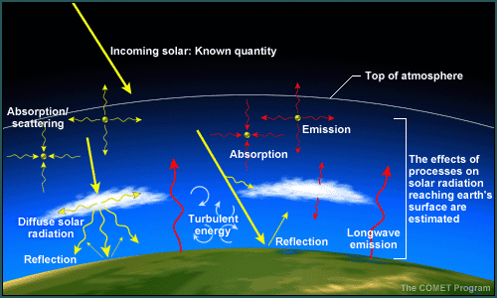
Introduction: Why parameterize (cont’d)
The effects that model physics parameterizations attempt to simulate are generally unresolvable at grid scales and can be categorized as follows:
Shortwave (solar) and longwave (terrestrial) radiation in the atmosphere; this includes the effects of clouds, water vapor, trace gases, and aerosols.
Land and sea surface characteristics and their impact on how incoming radiation affects surface energy and water balances; this includes the effects of vegetation type, soil type, soil moisture quantities, snow, water bodies, and land and sea ice.

Slide 6
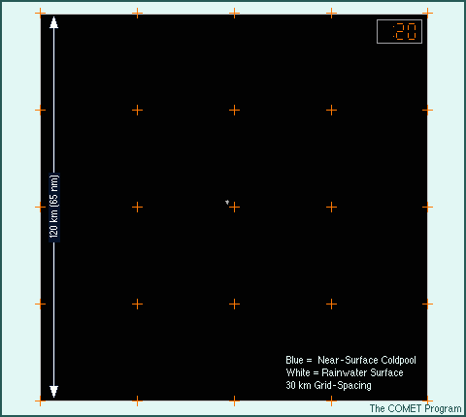
Introduction: Why parameterize (cont’d)
Convective processes: Important vertical redistribution of heat and moisture by convection can easily occur between mesoscale grid boxes. The animation shows the development of the rain shaft (white and gray) and the accompanying cold pool (blue shading). Notice that sub grid-scale variations in the convection will have an effect on the moisture and heating in some of the model grid boxes.

Slide 7
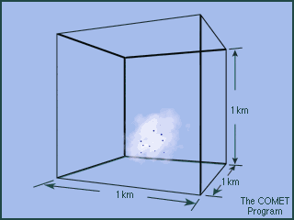
Introduction: Why parameterize (cont’d)
Microphysical processes: Even in very high-resolution models, microphysical processes occur on a scale too small to be modeled explicitly. There are important variations in both the horizontal and vertical. In this example, the cloud microphysical processes of condensation and droplet growth are occurring inside a 1-km model grid box.

Slide 8
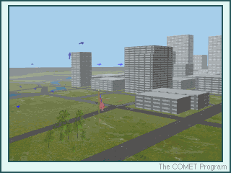
Introduction: Why parameterize (cont’d)
A model cannot resolve any of these local flows, swirls, or obstacles if they exist within a grid box. However, the model must account for the aggregate effect of these surfaces on the low-level flow with a single number that goes into the friction (F) term in the forecast wind equation. The method of accounting for such effects without directly forecasting them is called parameterization.
This is just a simple example. In the real atmosphere, there are many complex processes that need to be parameterized.
NWP models cannot resolve weather features and/or processes that occur within a single model grid box.
This example shows complex flow around a variety of surface features:
Friction that is large over tall trees
Turbulent eddies created around buildings or other obstacles
Much less surface friction over open areas

Slide 9
Introduction:
Why parameterize (summary)
The standard Reynolds decomposition and averaging lead
to co-variances that need “closure” or “parameterization”.
Radiation absorbed, scattered and emitted by molecules,
aerosols and cloud droplets play an important role in the
atmosphere and need “parameterization”.
Cloud microphysical processes need “parameterization”.
Parameterization schemes express the effect of sub-grid
processes in resolved variables such as U, V, T, and q(v, l, ...)

Slide 10
Reynolds decomposition
Take the equation for potential temperature as an example:
advection
source
molecular diffusion
Reynolds decomposition:
Averaged over a grid box (and a time step):
: source term (e.g. radiation absorpt./emiss. or condens.)
: subgrid (Reynolds) transport term (e.g. due to
turbulence, convection)

Slide 11
Importance of and requirements for physics parameterizations in NWP models (summary)
Importance:
  Tendencies from diabatic processes are substantial and contribute to the
  evolution of the atmosphere even in the short range.
  Diabatic processes drive the general circulation and synoptic development.
  The parameterized physics provide important daily weather parameters:
  diurnal cycle, clouds, precipitation, fog, surface wind and gusts, T and q at
  2m level.
Requirements:
  Accommodate different applications.
  Parameterization needs to work over a wide range of spatial resolutions.
  Time steps are long (from a few seconds to a few minutes); Numerics needs
  to be efficient and robust.
  Interactions between processes are important and should be considered in
  the design of the schemes.

Slide 12
Parameterization of clouds

Slide 13
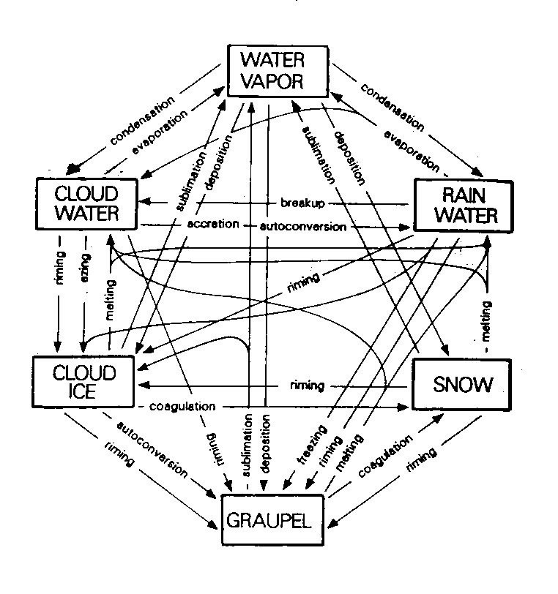
Parameterization of resolved clouds:
Which quantities to represent ?
Water vapor
Cloud water droplets
Rain drops
Pristine ice crystals
Aggregate snow flakes
Graupel pellets
Hailstones
Note for ice phase particles:
  Additional latent heat.
  Terminal fall speed of ice hydrometeors significantly less.
  Optical properties are different (important for radiation).

Slide 14
Cloud microphysical processes
We would like to include in NWP models:
  Formation of clouds
  Release of precipitation
  Evaporation of both clouds and precipitation
Therefore we need to describe
  Nucleation of water droplets and ice crystals from water vapor
  Diffusional growth of cloud droplets (condensation) and ice crystals (deposition)
  Collection processes for cloud drops (collision-coalescence), ice crystals (aggregation) and ice and liquid (riming) leading to precipitation sized particles
  The advection and sedimentation (falling) of particles
  the evaporation/sublimation/melting of cloud and precipitation size particles

Slide 15
Cloud parameterization Issues:
Degree of complexity ?
Complexity
Small ice
Ice Mass
Ice mass
Cloud
Mass
Medium ice
Liquid Mass
Ice number
Large ice
“Single Moment”
Schemes
“Double Moment”
Schemes
“Spectral/Bin”
Microphysics
Most NWP models only have simple single-moment schemes

Slide 16
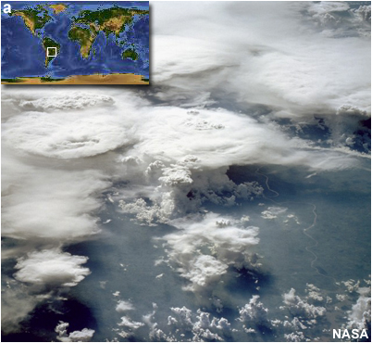
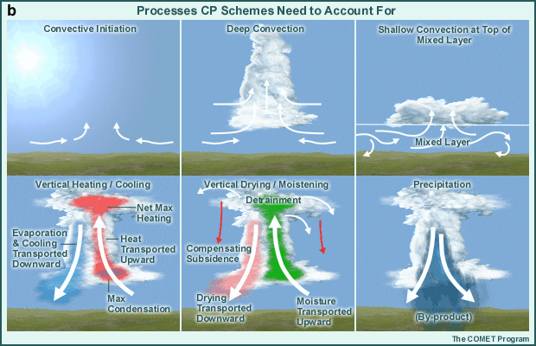
Cumulus convection is ubiquitous in the tropics and latent heat transport in cumulus convection is the primary method of transferring energy from the surface to the atmosphere. Therefore, cumulus convection needs to be represented in numerical models of tropical weather. Cumulus convection occurs at several scales, which means that it is impossible for the model to resolved and predict all individual clouds. Therefore, numerical models create parameters to account for the effect of cumulus convection within individual grid boxes.
(Above) Photograph of tropical cumulus, (Right) processes to be accounted for in subgrid parameterization schemes.
Tropical Convective Processes:
How NWP models emulate?

Slide 17
Elements of convection parameterization
Determine occurrence/location of convection
Trigger
Determine vertical distribution of heating, moistening and momentum changes
Cloud model
Determine the overall amount of the energy conversion, convective precipitation = heat release
Closure

Slide 18
Radiation Transfer in the NWP models

Slide 19
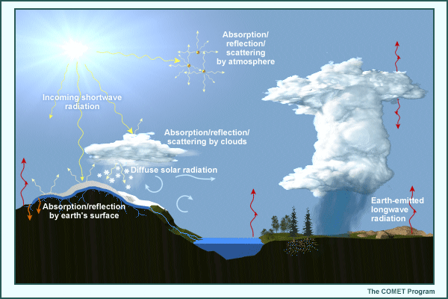
Shortwave and Longwave Radiation Processes
We know the amount of incoming solar energy at the top of the atmosphere at diurnal, synoptic, and short-range climate timescales. But uncertainties arise in emulating the effects of the atmosphere and earth's surface on incoming solar and outgoing terrestrial radiation.

Slide 20
Uncertainties in shortwave and longwave radiation processes includes
In the atmosphere
  Transmission/Absorption
  Reemission (for atmospheric longwave radiation)
  Reflection
  Scattering
At the earth's surface
  Transformation from shortwave into other forms of energy at the earth's surface, based on the state of that surface over the area covered by the model grid box
  Net emission of longwave radiation from the earth's surface toward space

Slide 21
Uncertainties in shortwave and longwave radiation processes (cont’d)
These uncertainties exist because:
We can only crudely emulate the effects of the atmosphere and its constituents (for example, clouds, aerosols, and absorbing gases) on the incoming solar beam and outgoing terrestrial/longwave radiation;
We can only estimate the state of the land and sea surface in models and its effects on the absorption and subsequent conversion of incoming shortwave radiation into other forms of energy.
The real world data needed to fine-tune the emulation of land and sea surface physics (for example, soil moisture and surface fluxes) are incomplete.

Slide 22
The basics of radation transfer parameterization
The Radiative Transfer Equation (RTE)
For NWP model applications,
  no polarization effect
  stationarity (no explicit dependence on time)
  plane-parallel (no sphericity effect)
Sources and sinks:
  Extinction
  Emission
  Scattering

Slide 23
Parameterization of sub-grid turbulent mixing

Slide 24
Parameterization of the PBL Mixing (Overview)
Parameterization | Application | Order and Type of Closure
Bulk models | Models that treat PBL top as surface | 0th order non-local
K-profile | Models with fair resolution | 1st order local or non-local
TKE-closure | Models with high resolution | 1.5th order local
Higher order closure | Models with high resolution | 2nd or 3rd order local

Slide 25
Property Summary of the K-Profile
and TKE Schemes
The K-profile scheme assumes that there is a well defined layer h in which the vertical distribution of diffusivities follows a special cubic polynomial function x(1-x)², where x = z/h.
The TKE scheme naturally links the PBL depth to the sub-grid TKE distribution, though it does require a specification of the mixing length.
3. The magnitude of the diffusivities from the K-profile scheme is determined by the PBL depth, while in the TKE scheme it is determined by the mixing length.

Slide 26
Parameterization of surface fluxes
Surface layer (Monin Obukhov) similarity
Ocean surface fluxes
  Roughness lengths and transfer coefficients
  Air-sea coupling at high wind speeds

Slide 27
Parameterization of surface property transfer

Slide 28
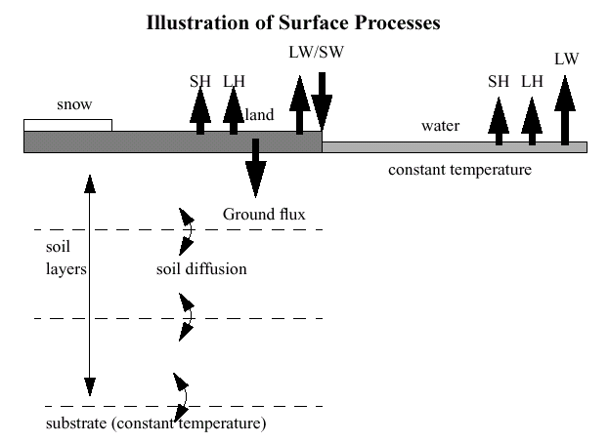
Courtesy of Jimy Dudhia

Slide 29
What is in the land surface physics?
Vegetation effects included
Predicts soil temperature and soil moisture in four layers and diagnoses skin temperature
Predicts snow cover and canopy moisture
Handles fractional snow cover and frozen soil
Time-varying snow albedo
Provides heat and moisture fluxes for PBL
Urban Canopy Model options

Slide 30
Atmospheric BL-Wave-Current
Interaction Processes
Atmospheric Boundary Layer
Sea state,
Sea spray
Atmosphere
Current
Surface waves
Ocean
Current
Ocean currents
Courtesy of Isaac Ginis

Slide 31
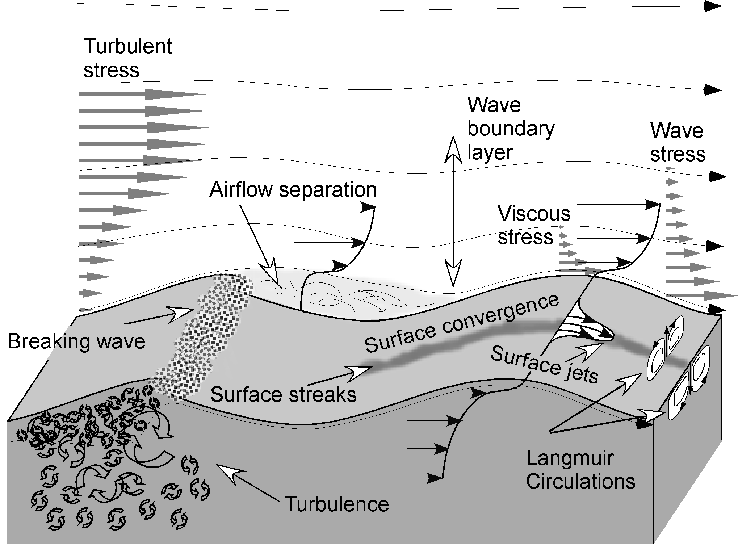
Wind-Wave-Current Interaction
Courtesy of Fabrice Veron

Slide 32
Questions???

