Slide 1

Introduction to the
WRF Weather Model
and the ISOR/Belgingur Operational and on Demand Forecast Solution
Ólafur Rögnvaldsson
ISOR/Belgingur
or@belgingur.eu
Notes:
Introduction to the Forecast On Demand solution, of which SARWeather is but one branch

Slide 2
Outline of this talk
Introduction
  What is ISOR/Belgingur
  Atmospheric modeling
The WRF modeling system
  Pre-processing
  Model physics
  Running the model and data visualization
The ISOR/Belgingur forecasting suite
  Introduction
  Demonstration

Slide 3
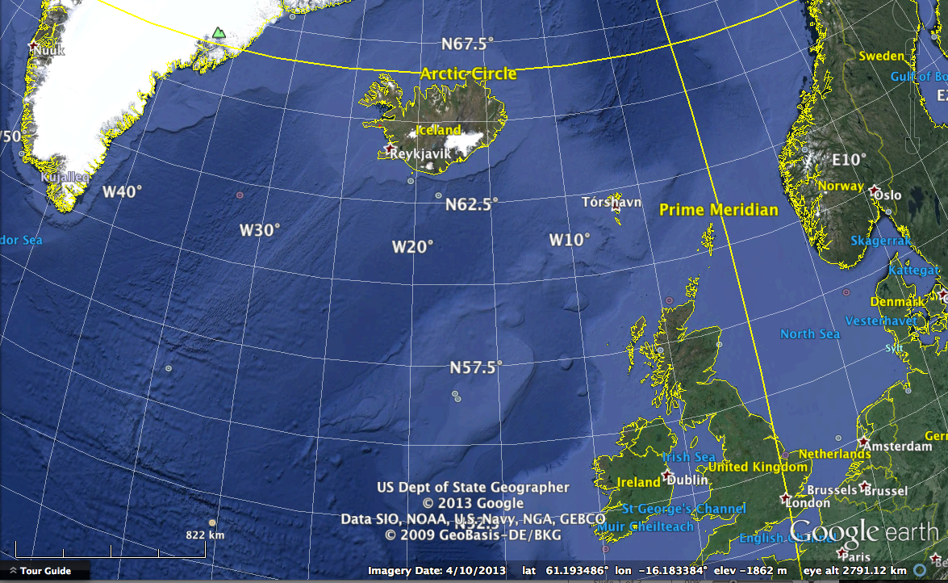
Where we came from
Reykjavík,
Iceland

Slide 4
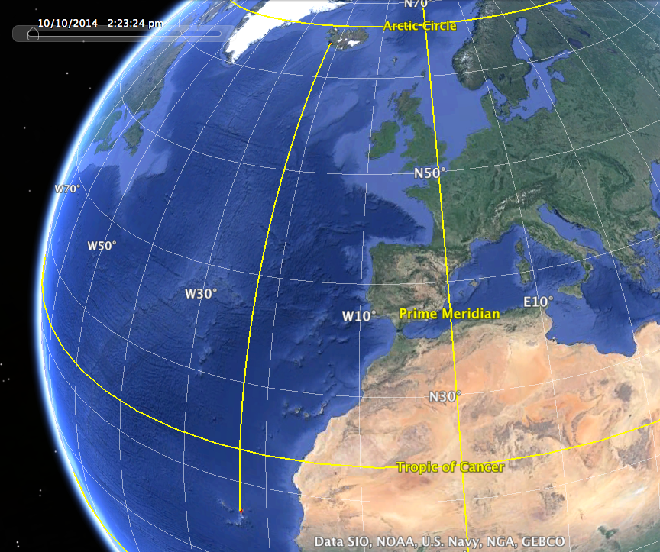
Where we went ☺
Notes:
Some 8700 km from Nairobi

Slide 5
About ISOR (aka Iceland Geosurvey)
Established in 2003 when the GeoScience Division of the National Energy Authority of Iceland was spun off as a separate entity
A self-financing, state-owned, non-profit institution
More then six decades of continuous experience in the field of geothermal and hydropower research and development
Provides over half of the teaching staff of the UNU Geothermal Training Programme, operated since 1979

Slide 6
About Belgingur
Founded in 2001 – www.belgingur.eu
Mixed private and governmental ownership
  90% private
  10% owned by ISOR (aka Iceland Geosurvey)
Strong tradition in atmospheric research
  Atmospheric flow in complex terrain
  Dynamical downscaling of global climate data
Operational forecasts since 2004
  www.belgingur.is
On-Demand forecasts since 2012
  SARWeather – www.sarweather.com

Slide 7
Our network
Long time collaborators with
  NOAA/ESRL in Boulder, USA
  ISOR, Iceland
  The Icelandic Meteorological Office
  University of Bergen, Norway
  University of Iceland and Reykjavík University, Iceland
Service provider for
  GDACS – Global Disaster and Alerts Coordination System
    SARWeather On-Demand forecasts
  Landsvirkjun – The Icelandic Power Company
  Vegagerðin – The Icelandic Road Authorities
  The Icelandic Meteorological Office (2004-2012)
  Eneco Ltd., the Netherlands
  365 Media, Iceland
Notes:
First long-term scientific visit to NOAA was in 2002, on average we go there every two years for short to medium research visits ranging from few weeks to a month or two. Geothermal exploration and modelling of the Olkaria region was the first collaborative project, we provided the necessary hardware and assisted with geothermal model installation. Service providers for IMO and collaborators on a number of research projects (observations and modelling). UiB: Observations using UAV and use of these data to improve model simulations (and hopefully short range forecasts). UI and RU: Mainly research on observations of Volcanic Ash, data assimilation and improved modelling of volcanic ash dispersion and re-suspension.

Slide 8
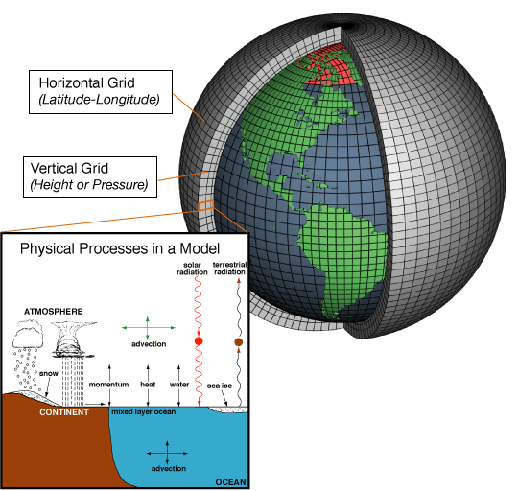
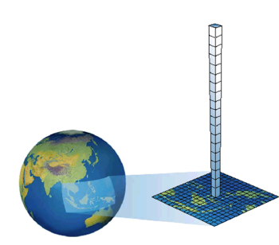
Atmospheric models
Set of equations that describe the atmospheric flow and need to be integrated forward in time to produce a weather forecast

Slide 9
Atmospheric models
Set of equations that describe the atmospheric flow and need to be integrated forward in time to produce a weather forecast
Initial and boundary data come from global models
Regional

Slide 10
The WRF atmospheric model
Open source model developed in collaboration of
  NCAR, NOAA, AFWA, NRL, Univ. of Oklahoma & FAA
Five development teams with sixteen workgroups
  More than 160 official developer
  Additional development by academic and governmental institutions in the US and abroad
  Very large user community (>20.000), excellent support
Non-hydrostatic
Regional and global applications
Wide range of scales for both real time and idealized applications
  Optional data assimilation (3D-VAR, 4D-VAR, and FDDA)
  Has been modified for volcanic applications
  Includes a dust module (re-suspension of dust/ash)

Slide 11
WRF modeling system flow chart

Slide 12
WPS - the WRF Pre-processing System
The purpose of WPS is to prepare input to WRF for real-data simulations:
  Defines simulation coarse domain and ARW nested domains
  Computes latitude, longitude, map scale factors, and Coriolis parameters at every grid point
  Interpolates time-invariant terrestrial data to simulation grids (e.g., terrain height and soil type)
  Interpolates time-varying meteorological fields from another model onto simulation domains
Courtesy of Michael Duda @ NCAR

Slide 13
WPS flow chart
Courtesy of Michael Duda @ NCAR

Slide 14
WPS - overview
geogrid (think geographical)
  Define size/location of model domains and interpolate static terrestrial fields to simulation grids
ungrib (think un+grib)
  Extract meteorological fields from GRIB files
metgrid (think meteorological)
  Horizontally interpolate meteorological fields (from ungrib) to simulation grids (defined by geogrid)
Courtesy of Michael Duda @ NCAR

Slide 15
The geogrid program
Courtesy of Michael Duda @ NCAR

Slide 16
The geogrid program
For WRF model domains, geogrid defines:
  Map projection (all domains must use the same projection)
  Geographic location of domains - Dimensions of domains
Geogrid provides values for static (time-invariant) fields at each model grid point
  Compute latitude, longitude, map scale factor, and Coriolis parameters at each grid point
  Horizontally interpolate static terrestrial data (e.g., topography height, land use category, soil type, vegetation fraction, monthly surface albedo)
Courtesy of Michael Duda @ NCAR

Slide 17
Geogrid: Nesting basics
A nested domain is a domain that is wholly contained within its parent domain and that receives information from its parent, and that may also feed information back to its parent
  A nested domain has exactly one parent
  A domain may have one or more children
2-way nests on the same nesting level must not overlap in coverage!
Courtesy of Michael Duda @ NCAR

Slide 18
Geogrid: Nesting example
Example configuration using four domains
Each domain is assign a domain ID #
Relative location of inner domains is set in namelist.wps
Courtesy of Michael Duda @ NCAR

Slide 19
Geogrid: Interpolating static fields
Given definitions of all computational grids, geogrid interpolates terrestrial, time-invariant fields
  Topography height
  Land use categories
  Soil type (top layer & bottom layer)
  Annual mean soil temperature
  Monthly vegetation fraction
  Monthly surface albedo
Courtesy of Michael Duda @ NCAR

Slide 20
Geogrid: Interpolating static fields
In general, source data are given on a different projection from the model grid
Courtesy of Michael Duda @ NCAR

Slide 21
Geogrid: Output
The parameters defining each domain, plus interpolated static fields, are written using the WRF I/O
  One file per domain for ARW
Filenames: geo_em.d0n.nc
  (where n is the domain ID number)
Example:
  geo_em.d01.nc
  geo_em.d02.nc (nest)
  geo_em.d03.nc (nest)
Courtesy of Michael Duda @ NCAR

Slide 22
Geogrid: Example output fields
Courtesy of Michael Duda @ NCAR

Slide 23
The ungrib program
Courtesy of Michael Duda @ NCAR

Slide 24
The ungrib program
Read GRIB Edition 1 and GRIB Edition 2 files
Extract meteorological fields
If necessary, derive required fields from related ones
  E.g., compute RH from T, P, and Q
Write requested fields to an intermediate file format
Uses Vtables (Vartibal tables) to identify which fields to extract
Vtables are files that give the GRIB codes for fields to be extracted from GRIB input files
One Vtable for each source of data
Vtables are provided for: NAM 104, NAM 212, GFS, AGRMET, and others
Courtesy of Michael Duda @ NCAR

Slide 25
Ungrib: Intermediate file format
After extracting fields listed in Vtable, ungrib writes those fields to intermediate format
For meteorological data sets not in GRIB format, the user may write to intermediate format directly
  Allows WPS to ingest new data sources (basic programming required of user)
  Simple intermediate file format is easily read/written using routines from WPS (read_met_module.F and write_met_module.F)
Output files named FILE:YYYY-MM-DD_HH
  YYYY is year of data in the file; MM is month; DD is day; HH is hour
  All times are UTC
Courtesy of Michael Duda @ NCAR

Slide 26
The metgrid program
Courtesy of Michael Duda @ NCAR

Slide 27
The metgrid program
Horizontally interpolate meteorological
data (extracted by ungrib) to simulation domains (defined by geogrid)
  Masked interpolation for masked fields
  Can process both isobaric and native vertical coordinate data sets
Rotate winds to WRF grid
  i.e., rotate so that U-component is parallel to x- axis, V-component is parallel to y-axis
Courtesy of Michael Duda @ NCAR

Slide 28
Metgrid: Masked interpolation
Masked fields may only have valid data at a subset of grid points
  E.g., SST field only valid on water points
When metgrid interpolates masked fields, it must know which points are invalid (masked)
  Can use separate mask field (e.g., LANDSEA)
  Can rely on special values (e.g., 1×10³⁰) in field itself to identify masked grid points
Courtesy of Michael Duda @ NCAR

Slide 29
Example: Masked interpolation
Skin temperature field inter-polated from GFS 0.5-deg field with no mask using a sixteen-point interpolator
Skin temperature field interpolated using masks: GFS water points interpolated to model water points, GFS land points interpolated to model land points
Courtesy of Michael Duda @ NCAR

Slide 30
Metgrid: Model output
For all domains; one file per time period
Files contain static fields from geogrid plus interpolated meteorological fields
Filenames: ARW: met_em.d0n.YYYY-MM-DD_HH:mm:ss.nc
(where n is the domain ID number)
Courtesy of Michael Duda @ NCAR

Slide 31
WPS summary
Vertical interpolation to WRF sigma levels is
performed in the real program
Courtesy of Michael Duda @ NCAR

Slide 32
WRF physics
Radiation
  Longwave (ra_lw_physics)
  Shortwave (ra_sw_physics)
Surface
  Surface layer (sf_sfclay_physics)
  Land/water surface (sf_surface_physics)
PBL (bl_pbl_physics)
Turbulence/Diffusion (diff_opt, km_opt)
Cumulus parameterizatio (cu_physics)
Microphysics (mp_physics)
Courtesy of Jimy Dudhia @ NCAR

Slide 33
WRF physics – direct interaction of parameterizations
Courtesy of Jimy Dudhia @ NCAR

Slide 34
Radiation
Provides atmospheric temperature tendency profiles and surface radiative fluxes
Courtesy of Jimy Dudhia @ NCAR

Slide 35
Long wave radiation
Compute clear-sky and cloud upward and downward radiation fluxes
  Consider IR emissions from model layers
  Surface emissivity based on land-type
  Flux divergence leads to cooling in a model layer
  Downward flux at surface is important in land energy budget
  IR radiation generally leads to cooling in clear air (~2 K/day), stronger cooling at cloud tops and warming at cloud base
Courtesy of Jimy Dudhia @ NCAR

Slide 36
Short wave radiation
Computes clear-sky and cloudy solar fluxes
Includes annual and diurnal solar cycles
Most schemes consider downward and upward (reflected) fluxes
  Note that the Dudhia scheme has only downward fluxes
Primarily a warming effect in clear sky
Important component of the surface energy balance
Courtesy of Jimy Dudhia @ NCAR

Slide 37
Surface physics components
Courtesy of Jimy Dudhia @ NCAR

Slide 38
WRF surface layer options
Use similarity theory to determine the exchange coefficients and diagnostics of 2m T and Q and 10m winds
Provide exchange coefficients to land-surface models
Provide friction velocity to PBL schemes
Proved surface fluxes over water points
Schemes have variations in stability functions and roughness lenghts
Courtesy of Jimy Dudhia @ NCAR

Slide 39
WRF land-surface models
Courtesy of Jimy Dudhia @ NCAR

Slide 40
WRF land-surface models
Driven by surface energy and water fluxes
Predicts soil temperature and soil moisture in layers (4 for Noah and NoahMP, 6 for RUC, 2 for PX and 3 for SSiB)
Predicts snow water equivalent on ground. May be in layers (NoahMP, RUC, and SSiB)
May predict canopy moisture only (Noah, RUC) or temperature only (SSiB) or both (NoahMP)
Courtesy of Jimy Dudhia @ NCAR

Slide 41
Planetary boundary layer
Courtesy of Jimy Dudhia @ NCAR

Slide 42
WRF PBL options
Purpose is to distribute surface fluxes with boundary layer eddy fluxes and to allow for PBL growth by entrainment
Classes of PBL schemes are:
  Turbulent kinetic energy prediction (Mellor-Yamada Janjic, MYNN, Bougeault-Lacarre, TEMF, QNSE, CAM UW)
  Diagnostic non-local (YSU, GFS, MRF, ACM2)
Above the PBL all these schemes also do vertical diffusion due to turbulence
Courtesy of Jimy Dudhia @ NCAR

Slide 43
WRF PBL options
PBL schemes can be used for most grid sizes when surface fluxes are present
Lowest level should be in the surface layer
  Important for surface (2m, 10m) diagnostic interpolation
With ACM2, GFS and MRF schemes, lowest full level should be 0.99 or 0.995, not too close to 1
TKE schemes can use thinner surface layers
Assumes that PBL eddies are not resolved
At grid size dx << 1km this assumption breaks down
  Can use 3d diffusion instead of a PBL scheme in WRF Version 3 (coupled to surface physics)
  Works best when dx and dz are comparable
Courtesy of Jimy Dudhia @ NCAR

Slide 44
Cumulus parameterization
Courtesy of Jimy Dudhia @ NCAR

Slide 45
Cumulus schemes
Used for grid columns that completely contain convective clouds
Re-distribute air in column to account for vertical convective fluxes
  Updrafts take boundary layer air upwards
  Downdrafts take mid-level air downwards
Schemes have to determine
  When to trigger a convective column
  How fast to make the convection act
Clouds only activate in columns that meet certain criteria
  Presence of some CAPE in sounding
  Not too much convective inhibition (CIN) in sounding
  Minimum cloud depth from parcel ascent
Courtesy of Jimy Dudhia @ NCAR

Slide 46
Microphysics schemes
Range of levels of sophistication
  Warm rain (i.e. no ice) – idealized
  Simple ice (3 arrays)
  Mesoscale (5 arrays, no graupel)
  Cloud scale single-moment (6 arrays, with graupel)
  Double moment (8-13 arrays)
  Spectral Bin (120-240 arrays)
Latent heat release from
  Condensation, evaporation, deposition, sublimation, freesing, and melting
Particle types
  Cloud water, raind drops, ice crystals, snow, graupel, hail
Processes
  Aggregation, accretion, growth, and fall-out
Courtesy of Jimy Dudhia @ NCAR
Notes:
Microphysical schemes are typically grouped into “bulk” and “bin” models. Bulk models use a distribution function (e.g. that of Marshall and Palmer (1948)) to describe the distribution of hydrometeors in the atmosphere. These models predict the particle mixing ratio (total mass per unit volume of air), and sometimes the total particle concentration as well. The former are named single-moment schemes, and the latter double moment schemes. The benefit of using double-moment compared to single-moment methods is that they predict both number concentration and mixing ratio and are therefore able to derive the broad features of the drop size distribution. In doing so, the double-moment scheme improves the representation of growth processes and precipitation formation and as such can be used over a wider range of environments. In contrast, bin models do not use distribution functions but instead divide the particle distribution into a finite number of categories (or “bins”). The particle distribution into bins requires considerable more computing power than the bulk approach and a poor knowledge on ice phase physics results in potentially inaccurate representation of the evolution of ice particle concentrations. Due to this, bin models are currently not part of any operational models, unlike bulk schemes, and are used only in a few research models.

Slide 47
Microphysics: Single vs. double moment schemes
Single-moment schemes have one prediction equation for mass (kg/kg) per species (Qr, Qs, etc.) with particle size distribution being derived from fixed parameters
Double-moment (DM) schemes add a prediction equation for number concentration (#/kg) per DM species (Nr, Ns, etc.)
  DM schemes may only be double-moment for a few species
  DM schemes allow for additional processes such as size-sorting during fall-out and sometimes aerosol (CCN) effects
Courtesy of Jimy Dudhia @ NCAR

Slide 48
Running the WRF model
WRF system flowchart
Courtesy of Wei Wang @ NCAR

Slide 49
Running the WRF model
cd to run/ or one of the test case directories
Move or link WPS output files to the directory for real-data cases
Edit namelist.input file for the appropriate grid and times of the case
Run a initialization program (real.exe)
Run model executable, wrf.exe
Courtesy of Wei Wang @ NCAR

Slide 50
What is a namelist?
A Fortran namelist contains a list of runtime options for the code to read in during its execution. Use of a namelist allows one to change runtime configuration without the need to recompile the source code.
Fortran90 namelist has very specific format, so edit with care:
&namelist-record - start
/ - end
As a general rule:
  Multiple columns: domain dependent
  Single column: value valid for all domains
A namelist file may contain a number of records
Courtesy of Wei Wang @ NCAR

Slide 51
What is a namelist?
Courtesy of Wei Wang @ NCAR

Slide 52
How to check model output?
Use ncdump:
  ncdump –h wrfout_d0?_<date>
  to get the header information
  ncdump –v Times wrfout_d0?_<date>
  to check output time
  ncdump –v Uwrfout_d0?_<date>
  to chech a particular variable (U, in this case)
Use ncview to quickly plot variables
Plethora of other software tools
  NCL
  RIP4
  Grads
  Python
Courtesy of Wei Wang @ NCAR

Slide 53
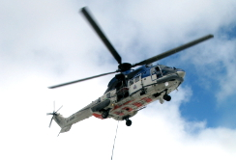

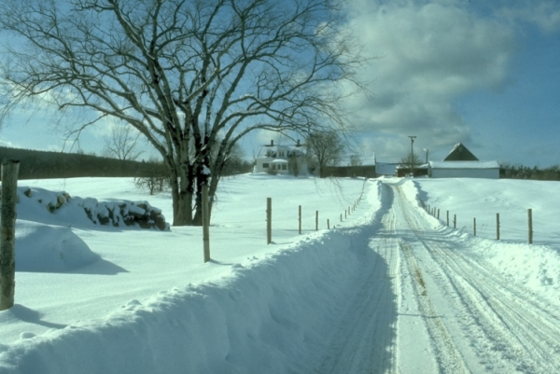
Forecast On Demand
Three layer cake
Open source atmospheric model and input data
Customized Output, e.g.
Search And Rescue
(SARWeather)
Wind Energy
Road Authorities
Forecast On Demand software stack
Notes:
The SARWeather solution is but one of many end-products that use the FOD software stack.

Slide 54
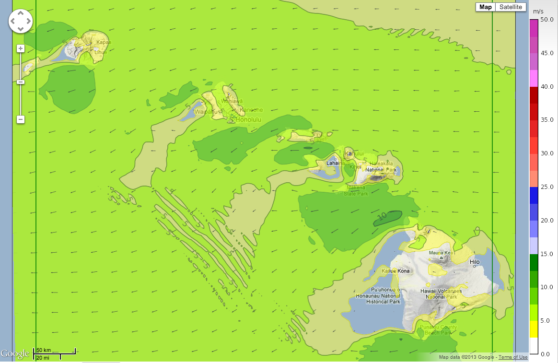


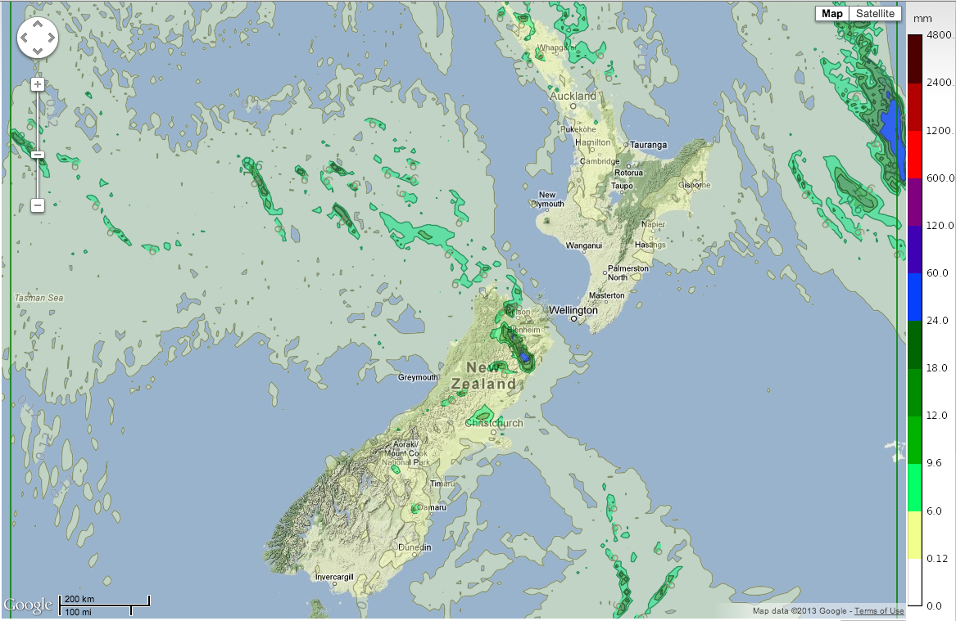

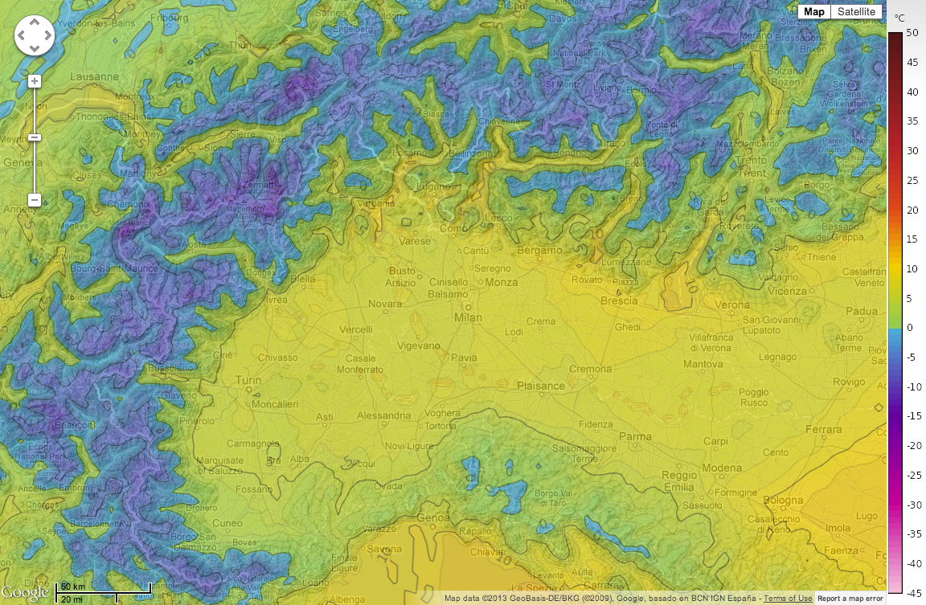
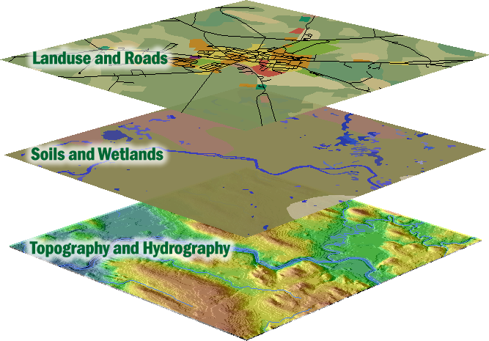
Dataflow static and dynamic data
Forecast On Demand
New global forecast every 6 hours
Forecast On Demand
Forecast On Demand
Static geographic data

Slide 55
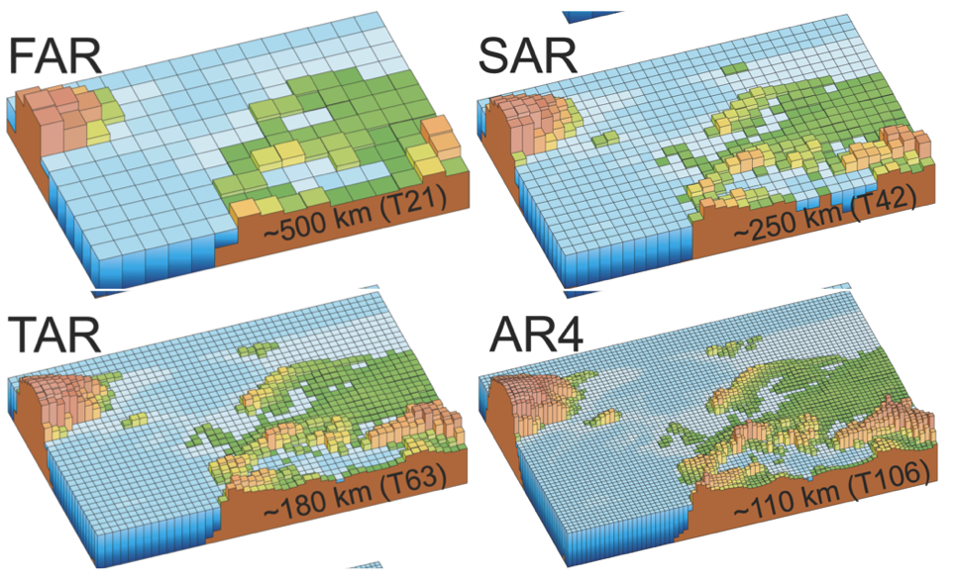
Importance of high resolution
Global forecasts
15-50 km grid
Current climate models, ~100 km grids
Belgingur forecasts
9 – 3 – 1 km grids
From IPCC 2007

Slide 56
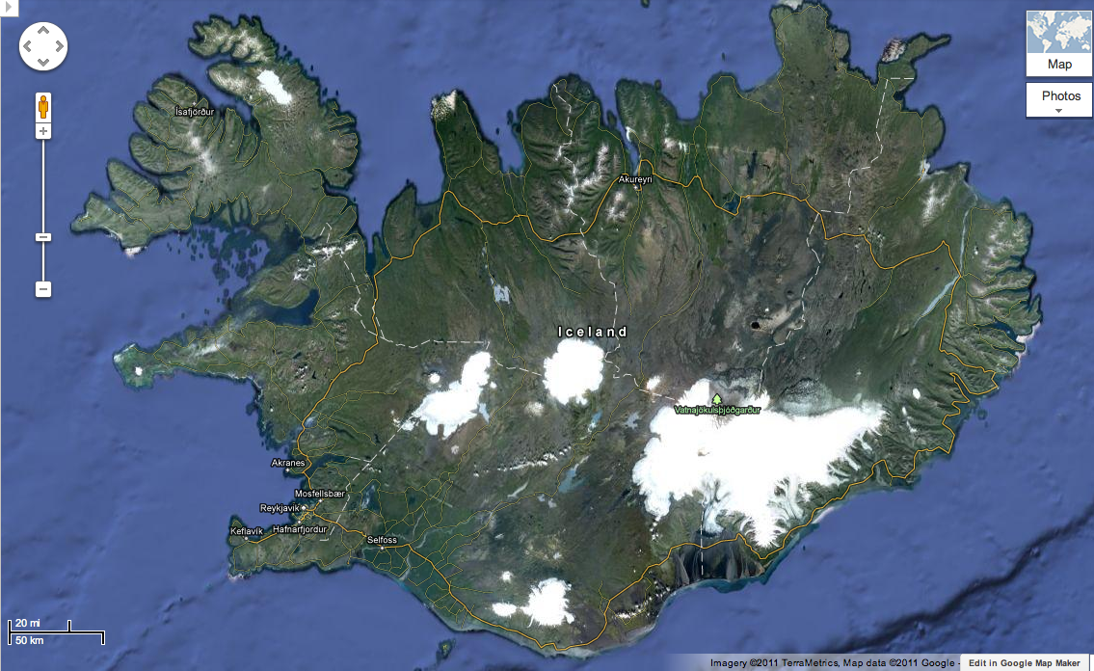
Importance of high resolution
How does the weather model “see” this mountain?

Slide 57
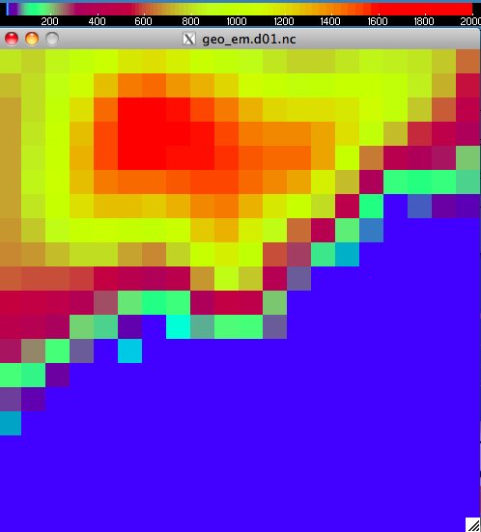
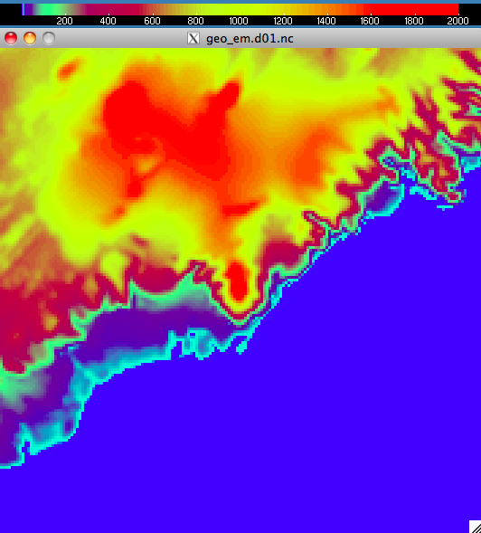
Importance of high resolution
Vatnajökull icecap, max height is 1675m. Top height of Mt. Öræfajökull is only 880m
At 1km resolution the max height is 2020m. Top height of Mt. Öræfajökull is now 1945m

Slide 58
Importance of high resolution
9 km resolution

Slide 59
Importance of high resolution
3 km resolution

Slide 60
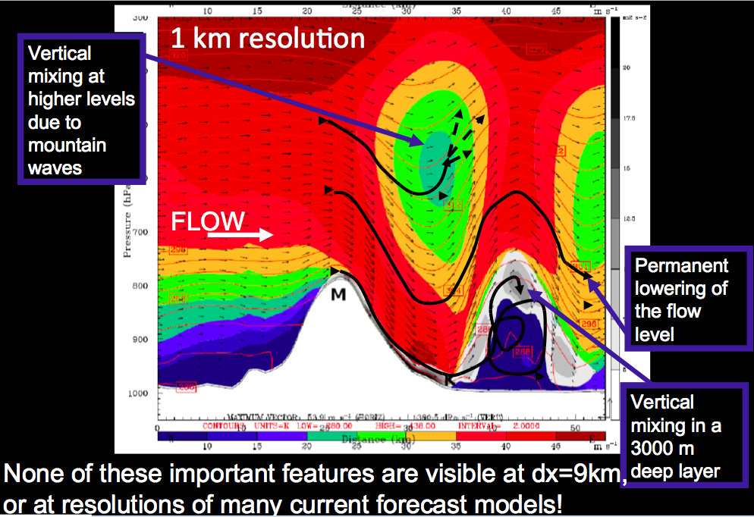
Importance of high resolution
1 km resolution

Slide 61
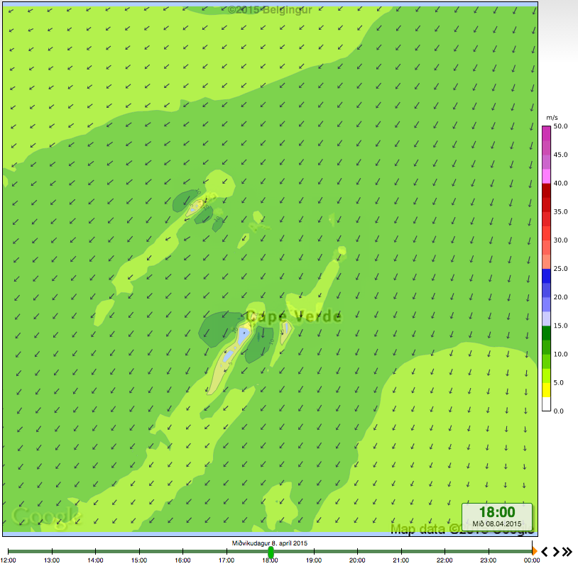
Cape Verde at 9 km resolution
Notes:
Some 8700 km from Nairobi

Slide 62
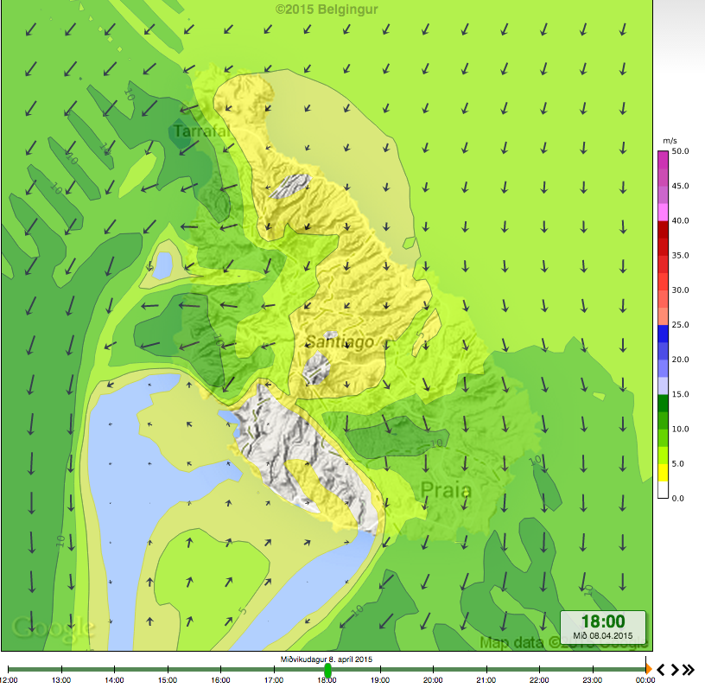
Cape Verde at 1 km resolution
Notes:
Some 8700 km from Nairobi

Slide 63
Why not always use 1km resolution?
Need 1000-times more CPU power to simulate a 1 km resolution forecast than a 10 km one for the same region!

Slide 64
The WRF-Chem model
Open source addition to the WRF model
  Development is led by NOAA
Potential to to simulate the coupling between dynamics, radiation and chemistry
  Capable of both on-line and off-line modeling
Simulate and forecast the dispersion of chemical constituents and/or other airborne pollutants
  e.g. SO₂ and volcanic ash
Notes:
Dreifing mengunarefna er reiknuð jöfnum höndum við framvindu veðurspárinnar og tekur fullt tillit til breytileika andrúmsloftsins. Dreifingarlíkön sem eru "off-line" (svo sem Flexpart og NAME líkan bresku veðurstofunnar) eru á hinn bóginn þvinguð af veðurreikningum þar sem langur tími (oft klukkustund eða meira) getur liðið á milli nýrra reiknigilda. Fyrir "on-line" líkön er þessi tími milli nýrra reiknigilda hins vegar mældur í mínútum, eða jafnvel sekúndum.
Hin aukna reikninákvæmni sem fæst með því að nota "on-line" dreifingarlíkön er m.a. útlistuð í eftirfarandi ritrýndum vísindagreinum: Grell og Baklanov, 2011 og Grell o.fl., 2011. Grell, G. A. and Baklanov, A.: Integrated Modeling for Forecasting Weather and Air Quality: A Call for Fully Coupled Approaches, Atmos. Environ., 45, 6845–6851, doi:10.1016/j.atmosenv.2011.01.017, 2011.
Grell, G., Freitas, S. R., Stuefer, M., and Fast, J.: Inclusion of biomass burning in WRF-Chem: Impact of wildfires on weather forecasts, Atmos. Chem. Phys., 11, 5289–5303, doi:10.5194/acp- 11-5289-2011, 2011.

Slide 65
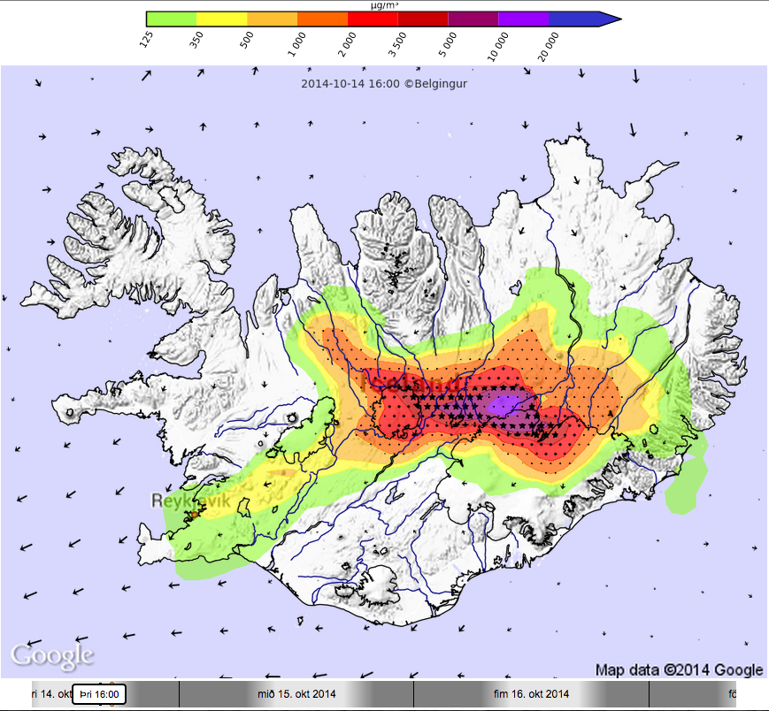
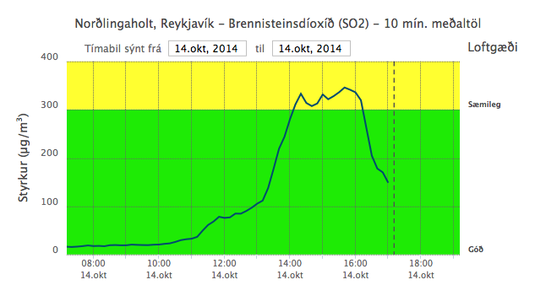
SO₂ forecasts
SO₂ forecast for 16 UTC 2014-10-14
Strength of SO₂ in Reykjavík is ~350 μg/m³

Slide 66
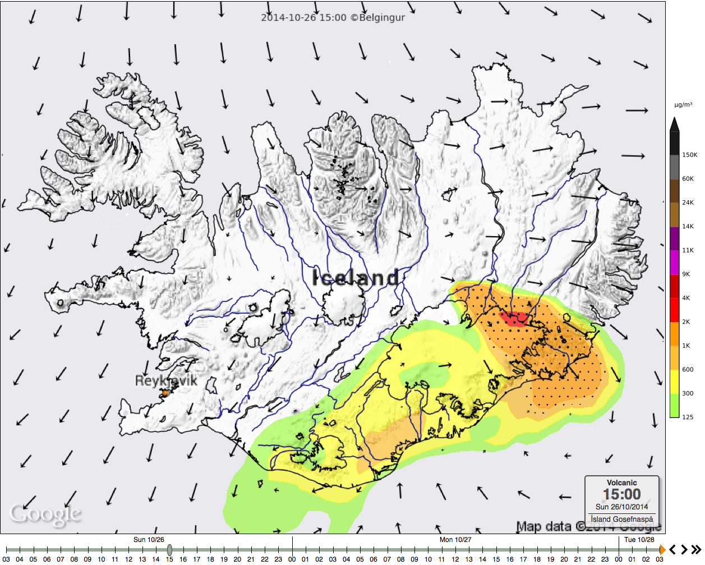
SO₂ forecasts
SO₂ forecast for 15 UTC 2014-10-26
Strength of SO₂ around Höfn í Hornafirði between 3000-7000 μg/m³

Slide 67
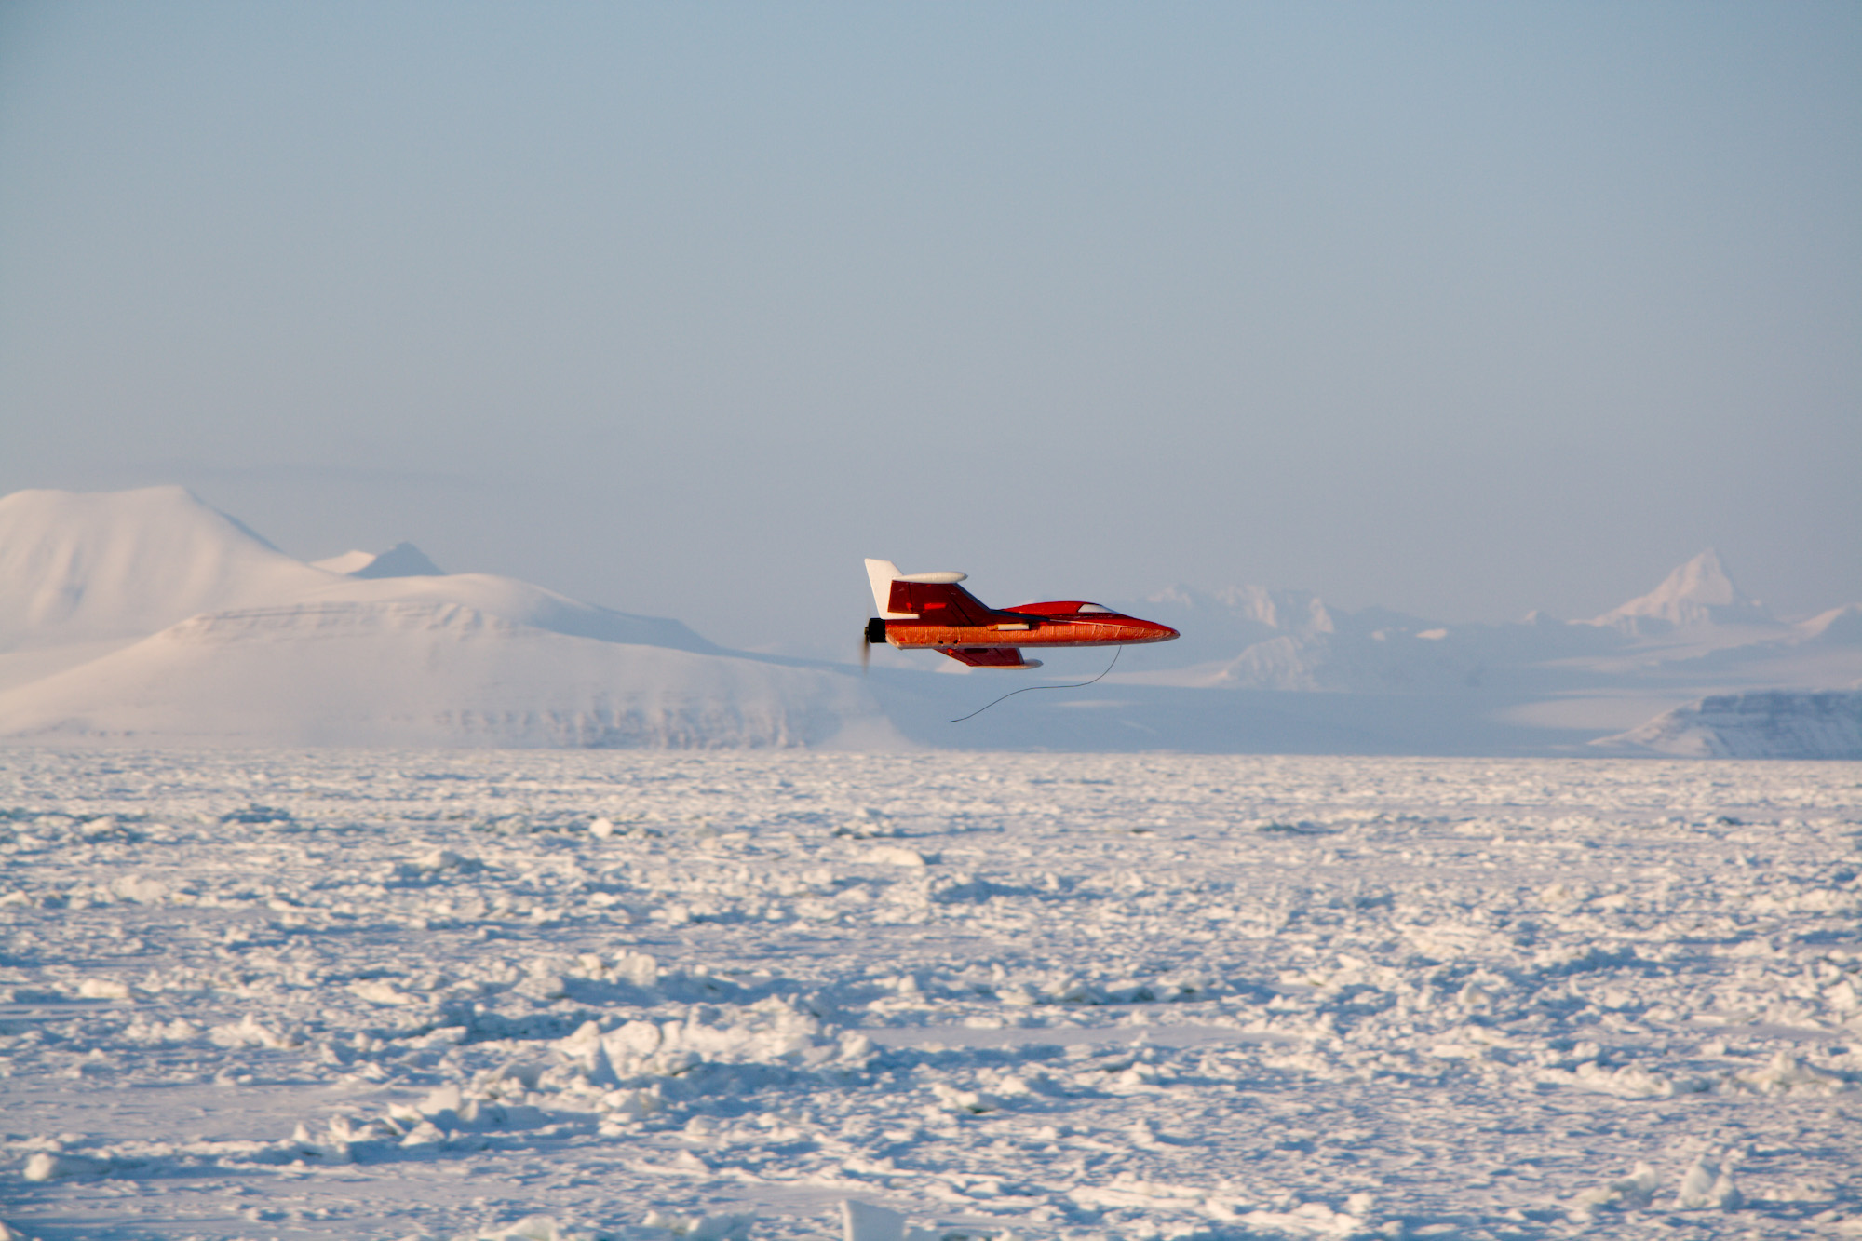
SUMO and WRF
The SUMO (Small Unmanned Meteorological Observer) can measure winds, humidity, pressure, and temperature in a vertical profile up 4km height

Slide 68
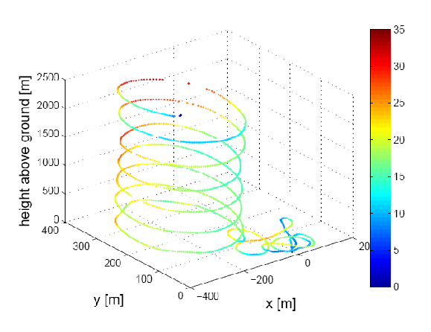
SUMO and WRF
This data can be assimilated with the WRF weather forecast

Slide 69
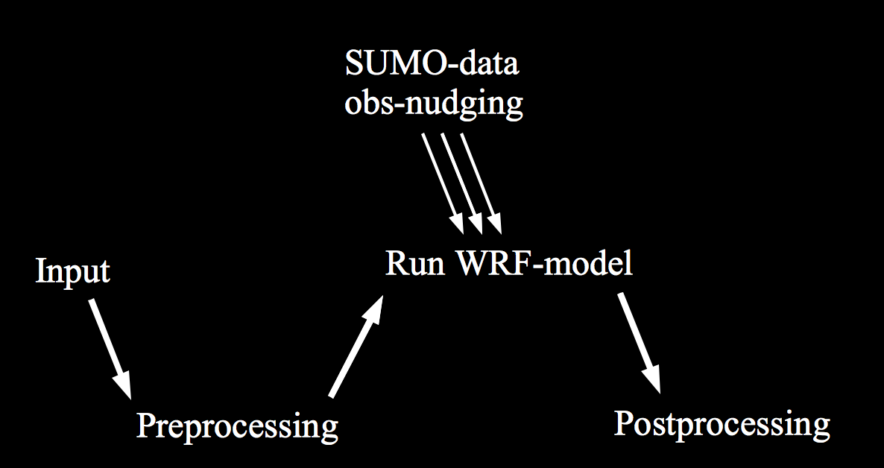
SUMO and WRF
The SUMO-data is incorporated into the WRF-simulation, via obs-nudging

Slide 70
Additional sensors
The SUMO has been equipped with an optical dust sensor
GP2Y1010AU0F is a dust sensor by optical sensing system:
An infrared emitting diode (IRED) and an phototransistor are diagonally arranged into the device
It detects the reflected light of dust in air
Especially effective to detect very fine particle
In addition it can distinguish smoke from house dust by pulse pattern of output voltage
Saturation at about 500μg/m³

Slide 71
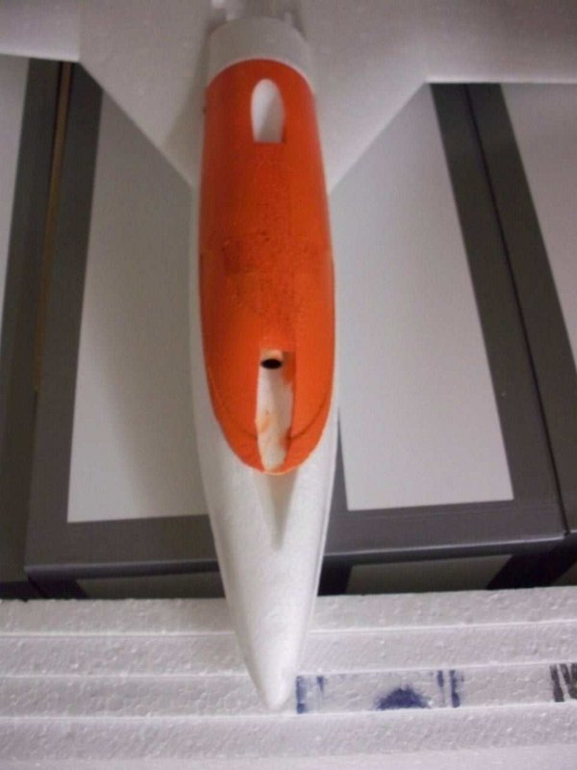
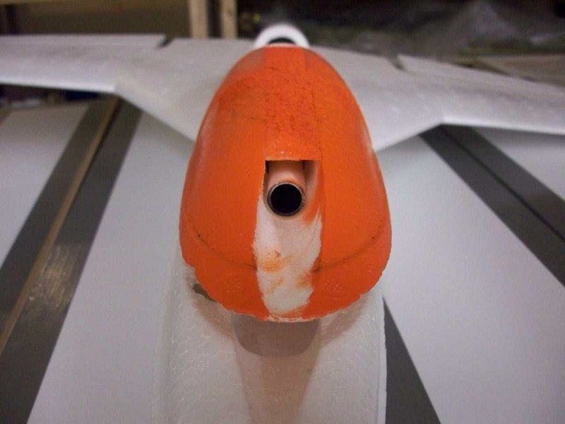
Preliminary results
The SUMO dust sensor has been tested in France and Iceland

