Slide 1

Measurements and simulations of volcanic ash for civil aviation
Small unmanned airplanes
In-situ observations of airborne dust/ash and improved local weather forecasts
Ólafur Rögnvaldsson – IMR/UiB
Hálfdán Ágústsson – IMR/UI/IMO
Haraldur Ólafsson – UI/UiB/IMO
Marius O. Jonassen – UiB/IMR

Slide 2
Overview
Measurements and simulations of volcanic ash for civil aviation
Atmospheric models
  Global vs. regional
  The WRF model
Importance of resolution
Use of observations from UAS’s
  The SUMO system
On-going research
  SARWeather and SUMO
Conclusions

Slide 3
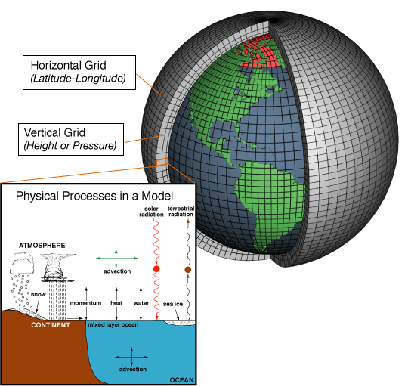
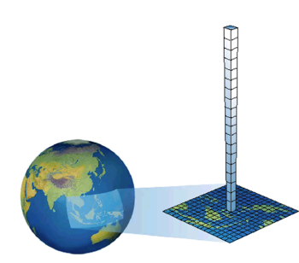
Atmospheric models
Measurements and simulations of volcanic ash for civil aviation
Set of equations that describe the atmospheric flow and need to be integrated forward in time to produce a weather forecast

Slide 4
The WRF atmospheric model
Measurements and simulations of volcanic ash for civil aviation
Open source model developed in collaboration of
  NCAR, NOAA, FSL, AFWA, NRL, Univ. of Oklahoma & FAA
Five development teams with sixteen workgroups
  More than 160 official developer
  Additional development by academic and governmental institutions in the US and abroad
  Very large user community, excellent support
Non-hydrostatic
Regional and global applications
Wide range of scales for both real time and idealized applications
  Optional data assimilation (3D-VAR, 4D-VAR, and FDDA)
  Has been modified for volcanic applications
  Includes a dust module (re-suspension of dust/ash)

Slide 5
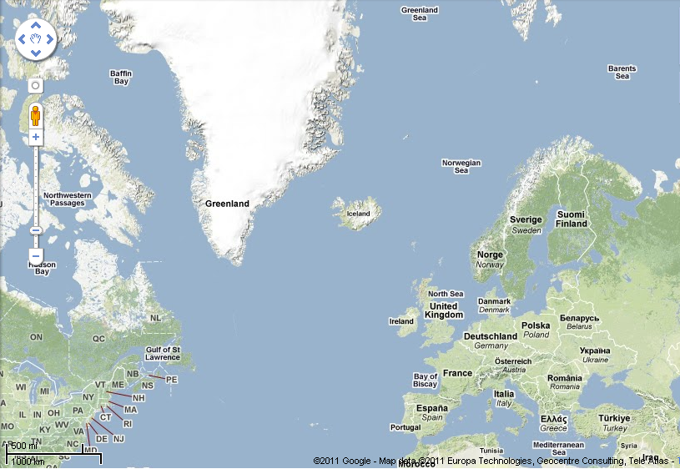
Importance of high resolution
Measurements and simulations of volcanic ash for civil aviation
Global forecasts
15-50 km grid
SARWeather forecasts
9 – 3 – 1 km grids

Slide 6
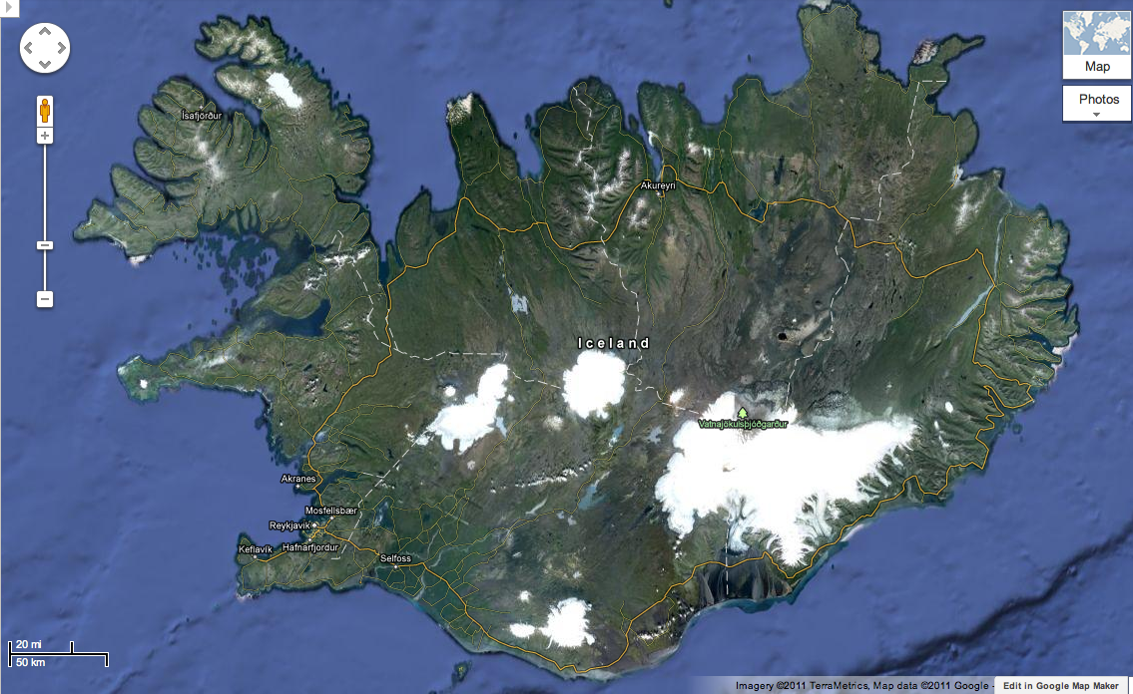
Importance of high resolution
Measurements and simulations of volcanic ash for civil aviation
How does the weather model “see” this mountain?

Slide 7
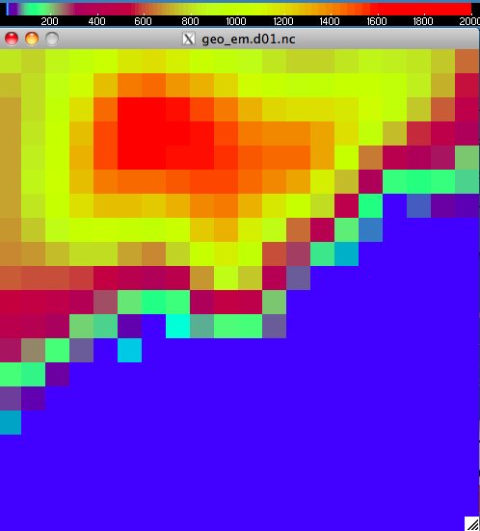
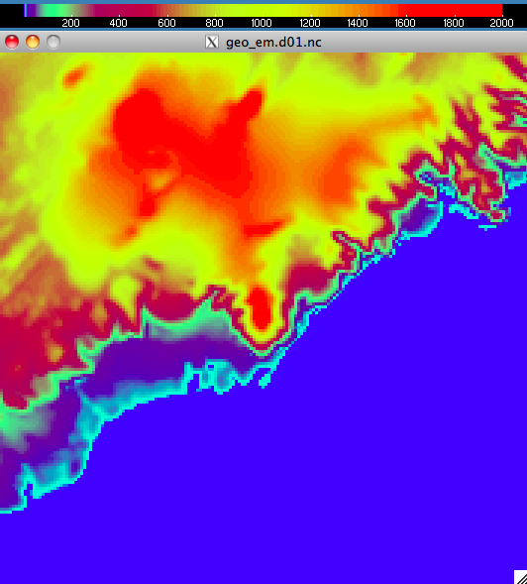
Importance of high resolution
Measurements and simulations of volcanic ash for civil aviation
Vatnajökull icecap, max height is 1675m. Top height of Mt. Öræfajökull is only 880m
At 1km resolution the max height is 2020m. Top height of Mt. Öræfajökull is now 1945m

Slide 8
Importance of high resolution
Measurements and simulations of volcanic ash for civil aviation
9 km resolution

Slide 9
Importance of high resolution
Measurements and simulations of volcanic ash for civil aviation
3 km resolution

Slide 10
Importance of high resolution
Measurements and simulations of volcanic ash for civil aviation
1 km resolution

Slide 11
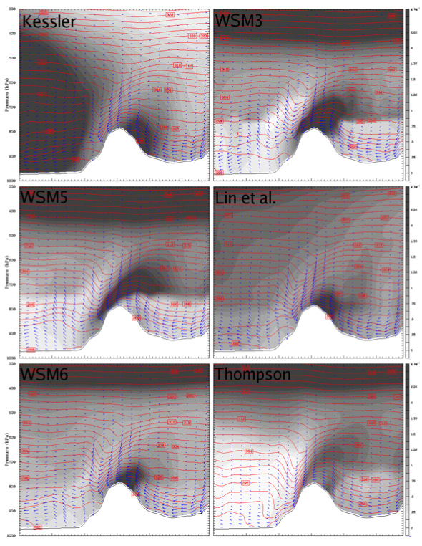
Measurements and simulations of volcanic ash for civil aviation
Simulation results are also affected by the choice of parameterization schemes
Rögnvaldsson, Ó., Bao, J.-W., Ágústsson, H., and Ólafsson, H.: Downslope windstorm in Iceland – WRF/MM5 model comparison, Atmos. Chem. Phys., 11, 103-120, doi:10.5194/acp-11-103-2011, 2011.

Slide 12
Why not always use 1km resolution?
Measurements and simulations of volcanic ash for civil aviation
Need 1000-times more CPU power to simulate a 1 km resolution forecast than a 10 km one for the same region!

Slide 13
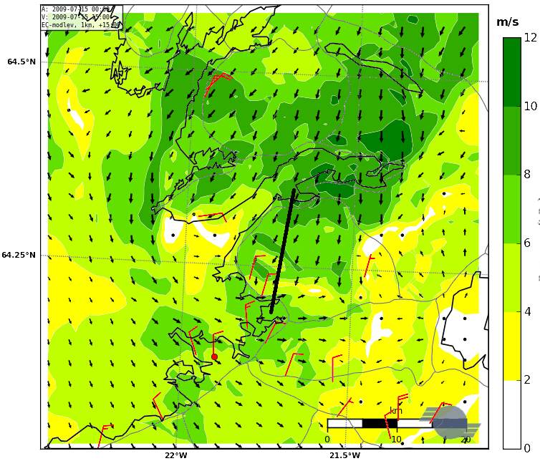
High resolution not always sufficient
Measurements and simulations of volcanic ash for civil aviation
Simulated and observed surface winds
on 15 July 2009 at 13 UTC
Model simulates a see-breeze that is not seen in observations
WRF at a resolution of 500 m forced with ECMWF-data on model levels.
Observed surface winds in red
Mt. Esja

Slide 14
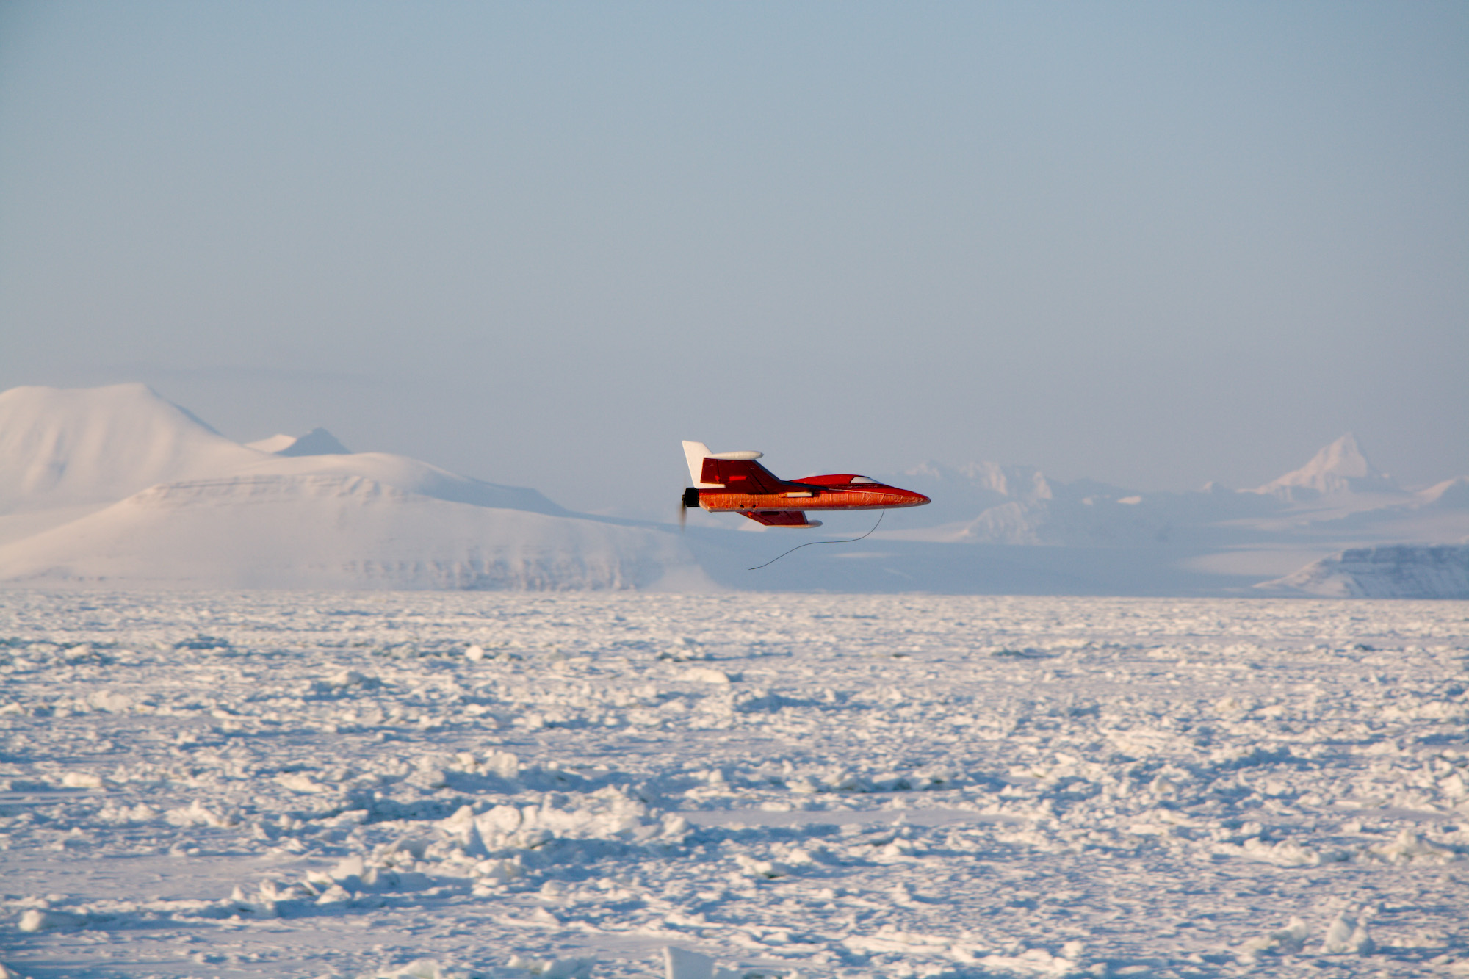
SUMO and WRF
Measurements and simulations of volcanic ash for civil aviation
The SUMO (Small Unmanned Meteorological Observer) can measure winds, humidity, pressure, and temperature in a vertical profile up 4km height

Slide 15
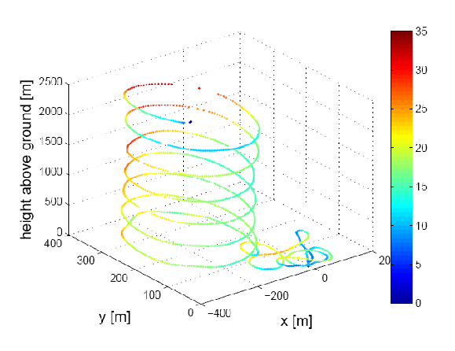
SUMO and WRF
Measurements and simulations of volcanic ash for civil aviation
This data can be assimilated with the WRF weather forecast

Slide 16
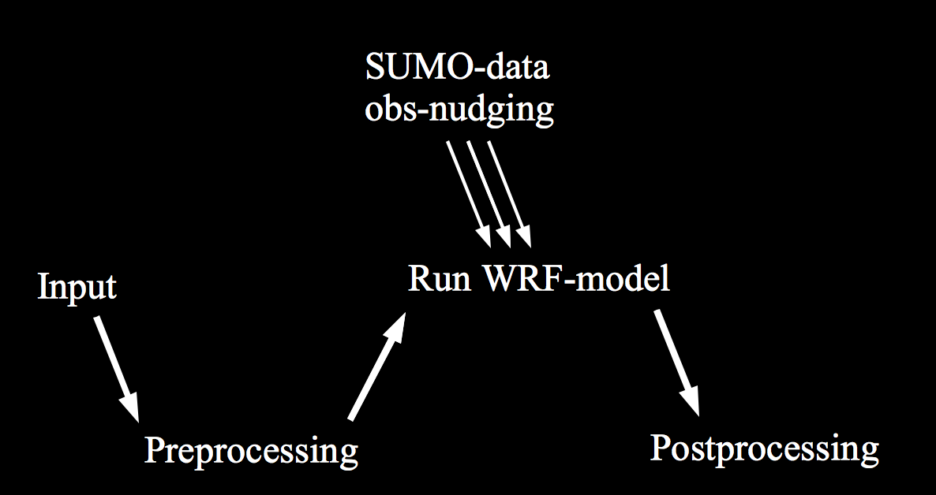
SUMO and WRF
Measurements and simulations of volcanic ash for civil aviation
The SUMO-data is incorporated into the WRF-simulation, via obs-nudging

Slide 17
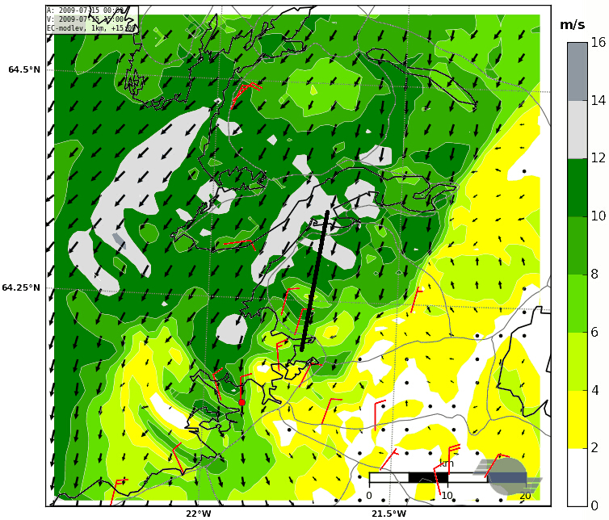
Effects of additional observations
Measurements and simulations of volcanic ash for civil aviation
Simulated and observed surface winds
on 15 July 2009 at 13 UTC
The flow structure is now in much better agreement with available observations
WRF at a resolution of 500 m forced with ECMWF-data on model levels and SUMO data
Observed surface winds in red
Mt. Esja

Slide 18
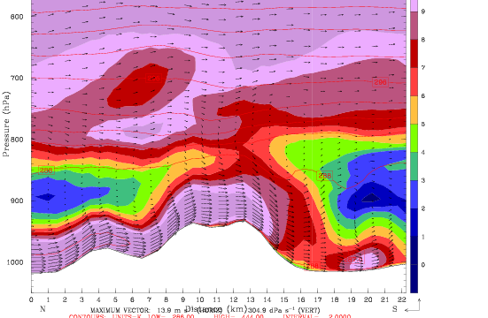
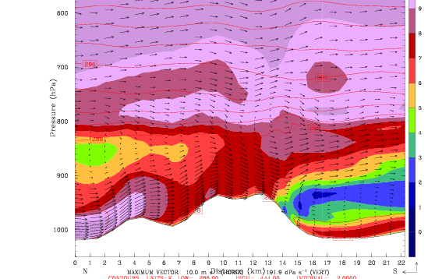
Effects not just at the surface
Measurements and simulations of volcanic ash for civil aviation
Simulated flow in N-S section across Mt. Esja
No extra observations
Wrong!
A major difference in flow pattern extending far above mountain top leve
Wind speed, ranging from 0 to 12 m/s
23 km

Slide 19
Effects can be far reaching
Measurements and simulations of volcanic ash for civil aviation
“Substantial improvements of winds, temperatures and humidity in the region are achieved”
CTRL - ObsNudge
50 km
Marius O. Jonassen, Haraldur Ólafsson,
Hálfdán Ágústsson, Ólafur Rögnvaldsson, and Joachim Reuder (2012). Improving a high resolution numerical weather simulation by assimilating data from an unmanned aerial system.
Monthly Weather Review, in revision

Slide 20
Additional sensors
Measurements and simulations of volcanic ash for civil aviation
The SUMO has been equipped with an optical dust sensor
GP2Y1010AU0F is a dust sensor by optical sensing system:
An infrared emitting diode (IRED) and an phototransistor are diagonally arranged into the device
It detects the reflected light of dust in air
Especially effective to detect very fine particle
In addition it can distinguish smoke from house dust by pulse pattern of output voltage
Saturation at about 500μg/m³

Slide 21
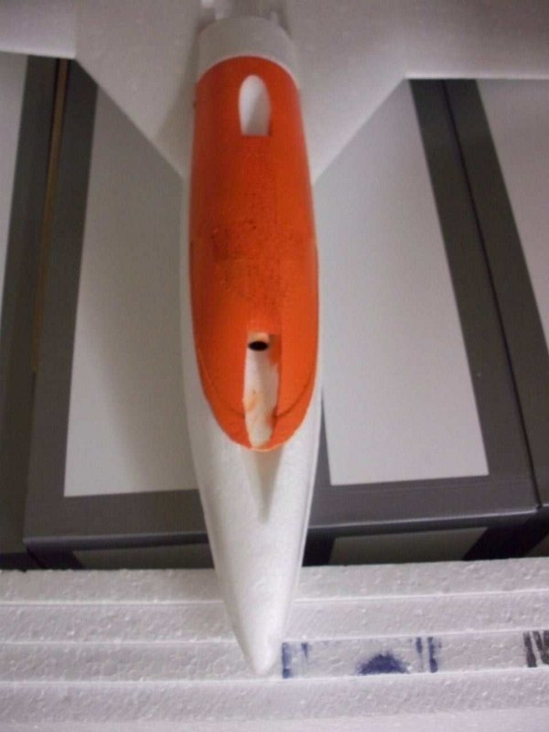
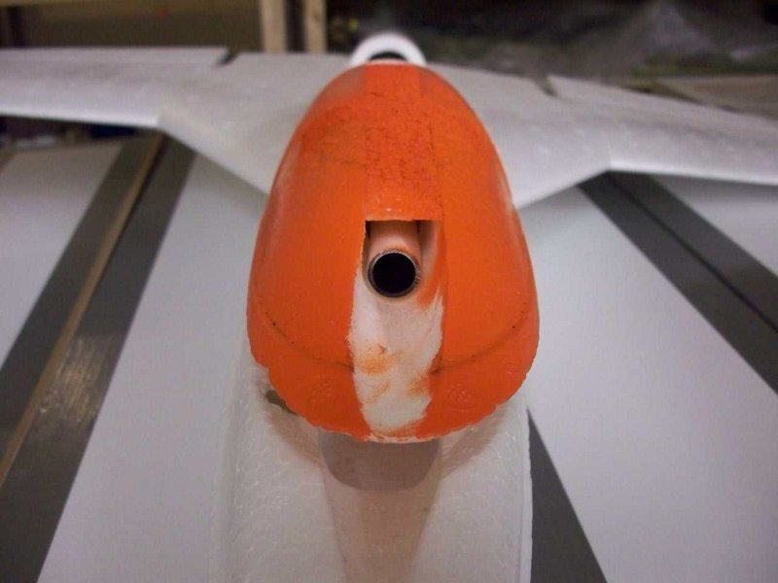
Preliminary results
Measurements and simulations of volcanic ash for civil aviation
The SUMO dust sensor has been tested in France and Iceland

Slide 22
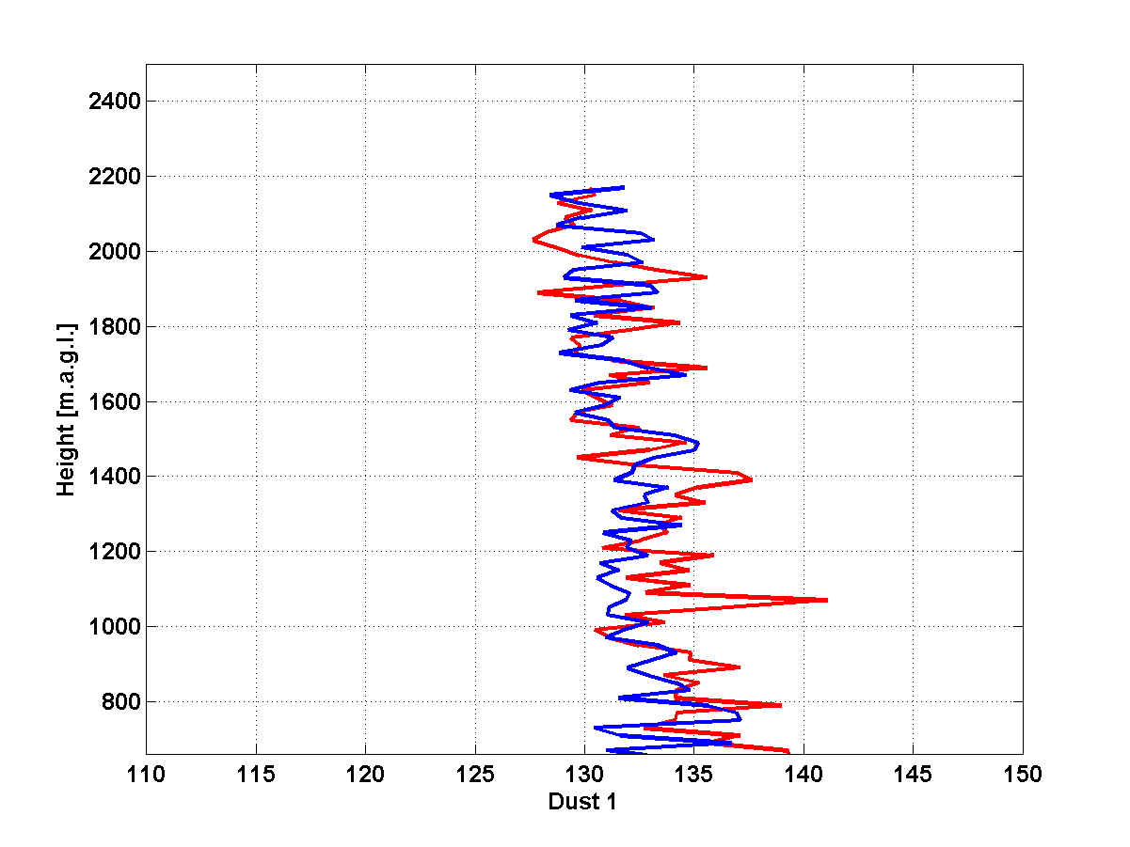
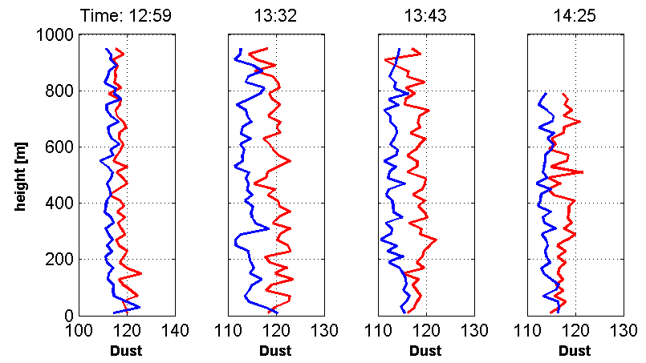


Preliminary results
Measurements and simulations of volcanic ash for civil aviation
The SUMO dust sensor has been tested in France and Iceland
Ascending
Descending
Sensor is now being calibrated and tested
with ash from Mt. Eyjafjallajökull

Slide 23
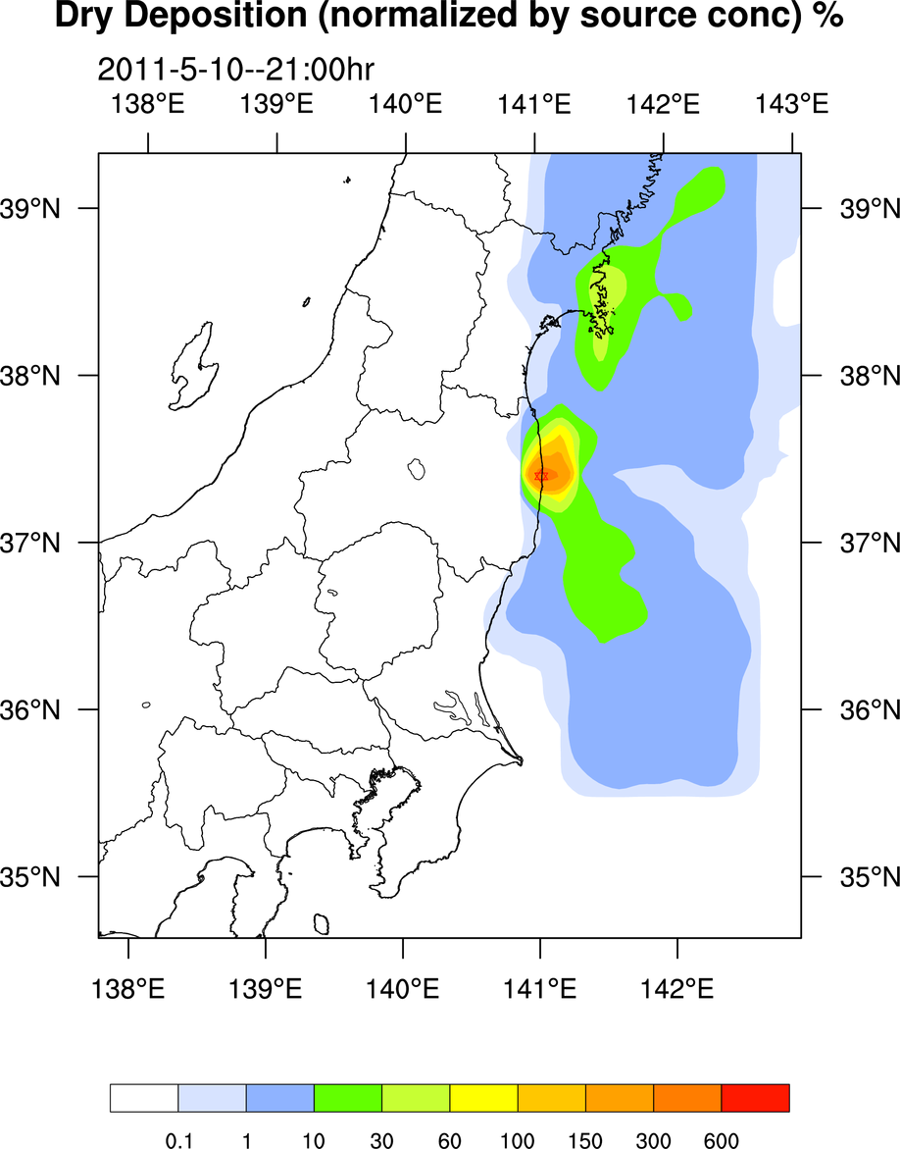
Various uses of model output
Measurements and simulations of volcanic ash for civil aviation
To correctly simulate distribution of pollutants, it is very important to correctly simulate the atmospheric conditions close to the source.
Data courtesy of Prof. Saji Hameed at the University of Aizu, Fukushima.

Slide 24
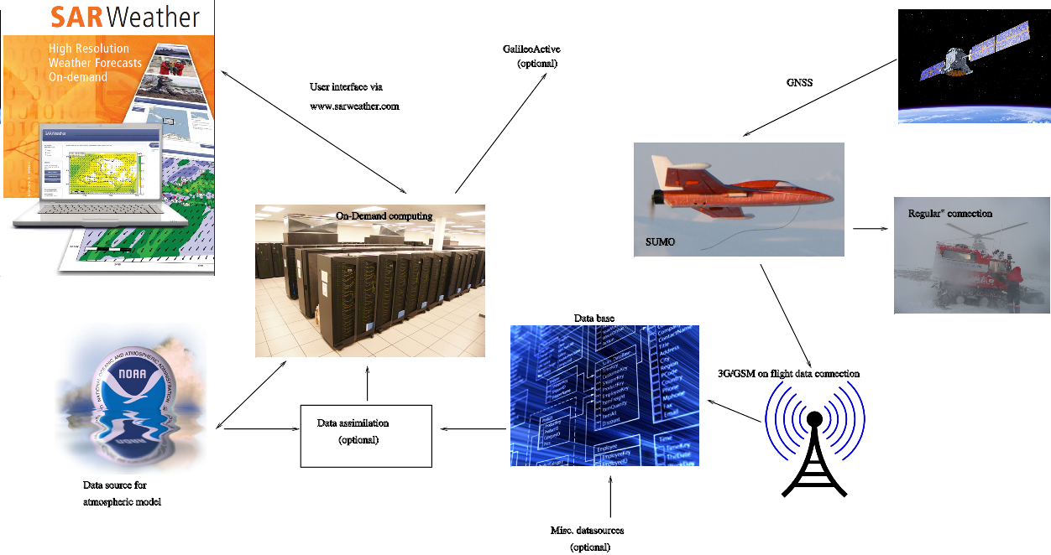
Current research and development
Measurements and simulations of volcanic ash for civil aviation
System schematics
Integration with other systems
D4H
GDACS
MapAction
User interface
Data assimilation
(optional)
Data source for atmospheric model
Misc. datasources (optional)

Slide 25

Current research and development
Measurements and simulations of volcanic ash for civil aviation
System schematics
Integration with other systems
D4H
GDACS
MapAction
Optional module
Still under development
User interface
Data assimilation
(optional)
Data source for atmospheric model
Misc. datasources (optional)
SARWeather

Slide 26
Conclusions
Measurements and simulations of volcanic ash for civil aviation
The WRF model has a wide variety of applications
Model resolution is important
  Especially in the vicinity of complex terrain
Additional observations can improve the simulation
  Vertical profiles made by the SUMO
The SUMO is a low-cost system with many advantages
  Proof of concept before investing in a more durable and expensive UAS
  Additional sensors are being added to the system
  Dust sensor could detect low concentrations of ash above airports (fly vs. no fly)
The SUMO is currently being integrated to the SARWeather, on-demand, forecasting system

