Slide 1

WOD
Operational and On Demand
Weather Forecasts
Ólafur Rögnvaldsson
Belgingur
or@belgingur.eu
Karolina Stanislawska & Logi Ragnarsson
Notes:
Introduction to the Forecast On Demand solution, of which SARWeather is but one branch

Slide 2
Outline of this talk
Why?
Design philosophy
WOD overview – deployment and updates
Examples of applications
Summary

Slide 3

Why?
There is a need for the potential of running high resolution operational forecasts in many developing countries
Lack of necessary infrastructure is delaying progress
The WOD system solves some of these problems
  “Infrastructure in a box”
  Shares many features with the SARWeather system
Was initially partially funded by DfID and the EU via the ClimDev work programme
On-going development is funded by the Icelandic Technology Development Fund - Tækniþróunarsjóður

Slide 4
Design philosophy
Based on Open Source components
  WRF/WPS weather model and accompanying software
  Python language and libraries
  Linux, PostgreSQL, and nginx webservices
Event Driven
  Processing starts as soon as possible
  Computing resources don’t stand idle out of fear
Scalable and Resilient
  Just add computing nodes for increased throughput
  Other nodes step in if one is removed
Notes:
The design philosophy of the WOD system can not be described in full in one slide, but it embraces the open source philosophy. This makes it possible to update, scale out and deploy without having to worry about licensing fees.
Scientific libraries from the NumPy family. It is run on clusters of linux machines, uses PostgreSQL and Ngnx webservices. The system code is event driven; processes wait until they get an event from an external source before they do any kind of processing at all. Don’t have to wait until we are certain of a certain process can take place because we know exactly when the conditions for said process to take place are fulfilled. This also means that throughput can be added as needed to handle increased workload.

Slide 5
System description
Built around the WRF-Chem modelling system
Initial and boundary data taken from the global GFS model as well as the GEFS and CFS systems
System installation is fast and highly automated
Can be used to create conventional short- to medium-range weather forecasts for any location on the globe as well as ensemble and S2S forecasts
  Input can be GFS, GEFS, and/or CFS
Can be used as a tool to provide input to other modelling systems, such as hydrological models
Access to global and WOD forecasts alike via fast API’s
A wide variety of post-processing options are also available

Slide 6
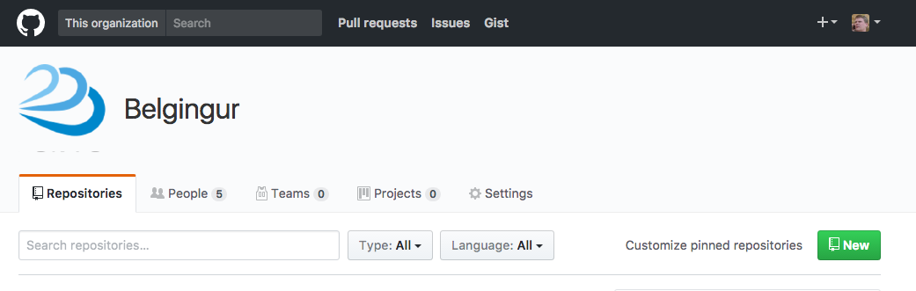
Deployment and updates
Code is retrieved from GitHub, while WRF, WPS and associated binaries are retrieved from Belgingur's servers.

Slide 7
Deployment and updates
The deployment scripts are under source control along with WOD source code and is exercised and tested on Belgingur's Continuous Integration Servers with each change to the code
This ensures that deployments and updates will run smoothly

Slide 8
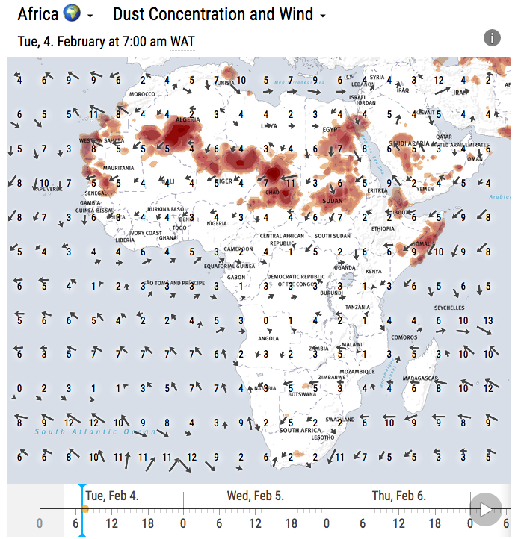
Deployment and updates
Dust forecasts are among the latest addition to the WOD system

Slide 9
Documentation and API’s
New API’s have been added giving users direct access to global forecasts (GFS, GEFS, CFS, and GWES)
Improved documentation with detailed change-log for new system releases and e-mail list for registered end-users and developers
  https://github.com/Belgingur/WOD-Documentation/wiki
  https://github.com/Belgingur/WOD-Documentation/wiki/Getting-Started-With-WOD-APIs
  https://github.com/Belgingur/WOD-Documentation/wiki/WOD-API-Change-Logs

Slide 10
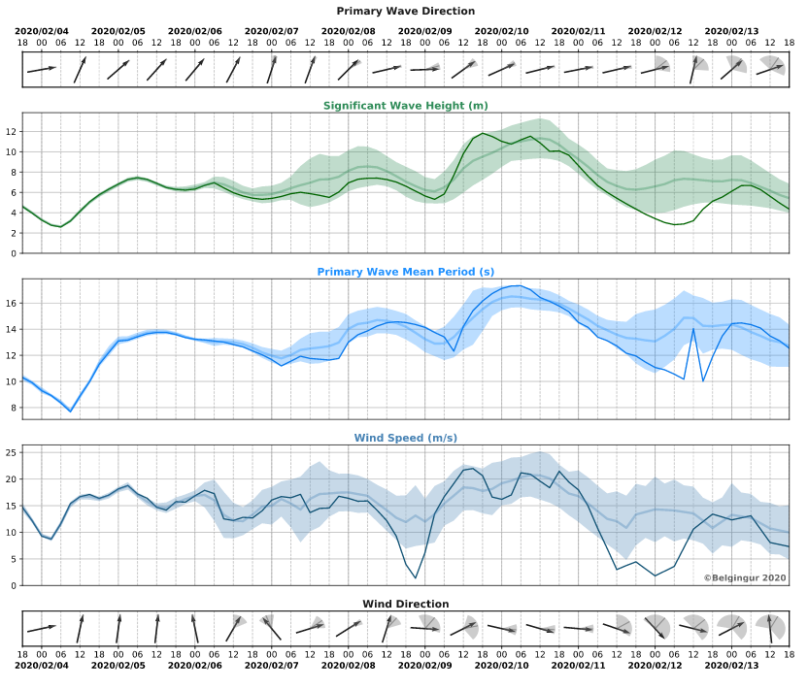
Examples of API’s
https://wod.belgingur.is/api/v2/plot/point/upstream/global-gwes/latlon/60,-25/spread_wavegram.svg
Ten day wave forecast from the GWES system for 60°N and 25°W

Slide 11
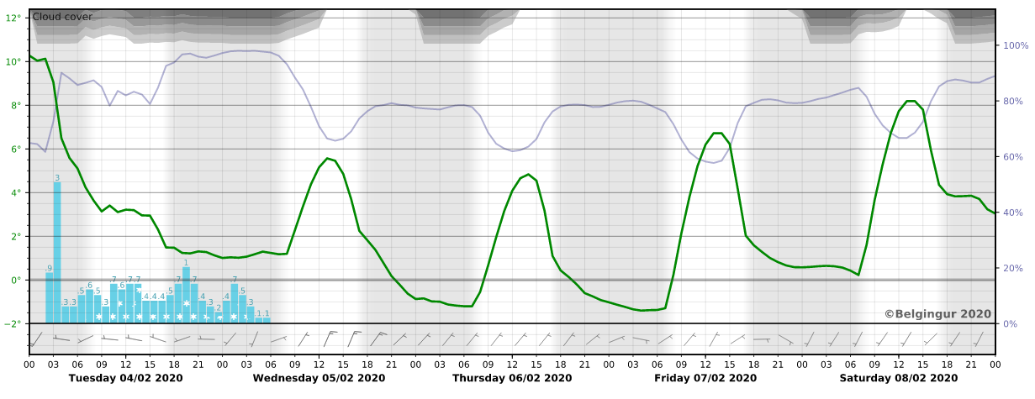
Examples of API’s
https://wod.belgingur.is/api/v2/plot/point/upstream/global-gfs-1/latlon/46.220,6.138/meteogram.svg
Five day forecast from the GFS system for Geneva

Slide 12
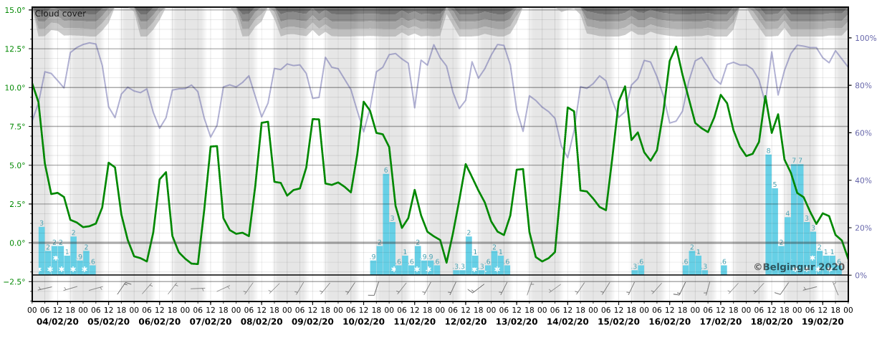
Examples of API’s
https://wod.belgingur.is/api/v2/plot/point/upstream/global-gfs/latlon/46.220,6.138/meteogram.svg
Sixteen day forecast from the GFS system for Geneva

Slide 13
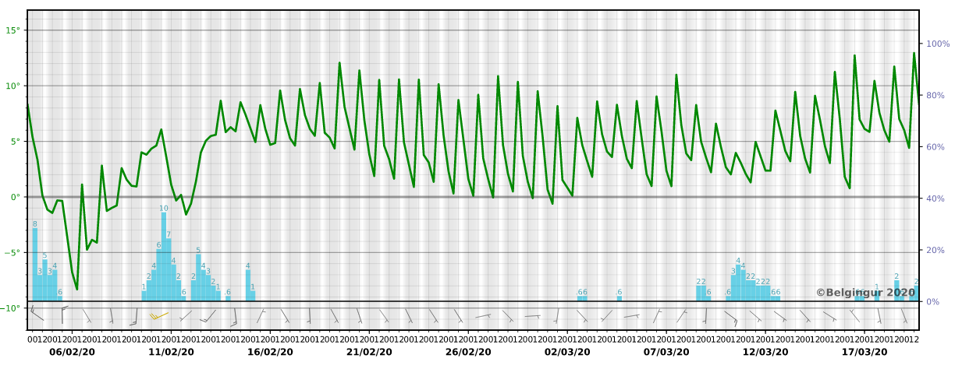
Examples of API’s
https://wod.belgingur.is/api/v2/plot/point/upstream/global-cfs/latlon/46.220,6.138/meteogram.svg
Forty five day forecast from the CFS system for Geneva

Slide 14
Examples of API’s
This data can also be accessed as .json or .csv files
https://wod.belgingur.is/api/v2/data/point/upstream/global-gfs-1/latlon/46.220,6.138/vars/@meteogram.json
https://wod.belgingur.is/api/v2/data/point/upstream/global-gfs/latlon/46.220,6.138/vars/@meteogram.json
https://wod.belgingur.is/api/v2/data/point/upstream/global-cfs/latlon/46.220,6.138/vars/@meteogram.json

Slide 15
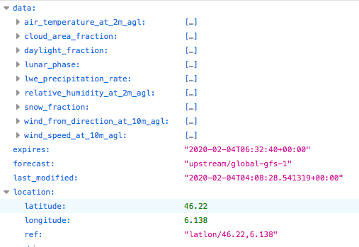
Examples of API’s
This data can also be accessed as .json or .csv files

Slide 16
System applications
The WOD post-processing provides charts and meteograms and is split into modules
  By default, observations are taken from the MADIS website - https://madis.ncep.noaa.gov
  Possible to integrate other data sources
Each module has a dedicated web interface and API
Possible to control the dissemination of results
The WOD system comes with a simple website that combines both widgets

Slide 17
Development
Continue to increase API’s flexibility and speed
Continue to add new upstream data sources to the API’s
Work on adding 4D-VAR data assimilation capabilities to the WOD system has just started
  Funded by the Icelandic Technology Development Fund

Slide 18
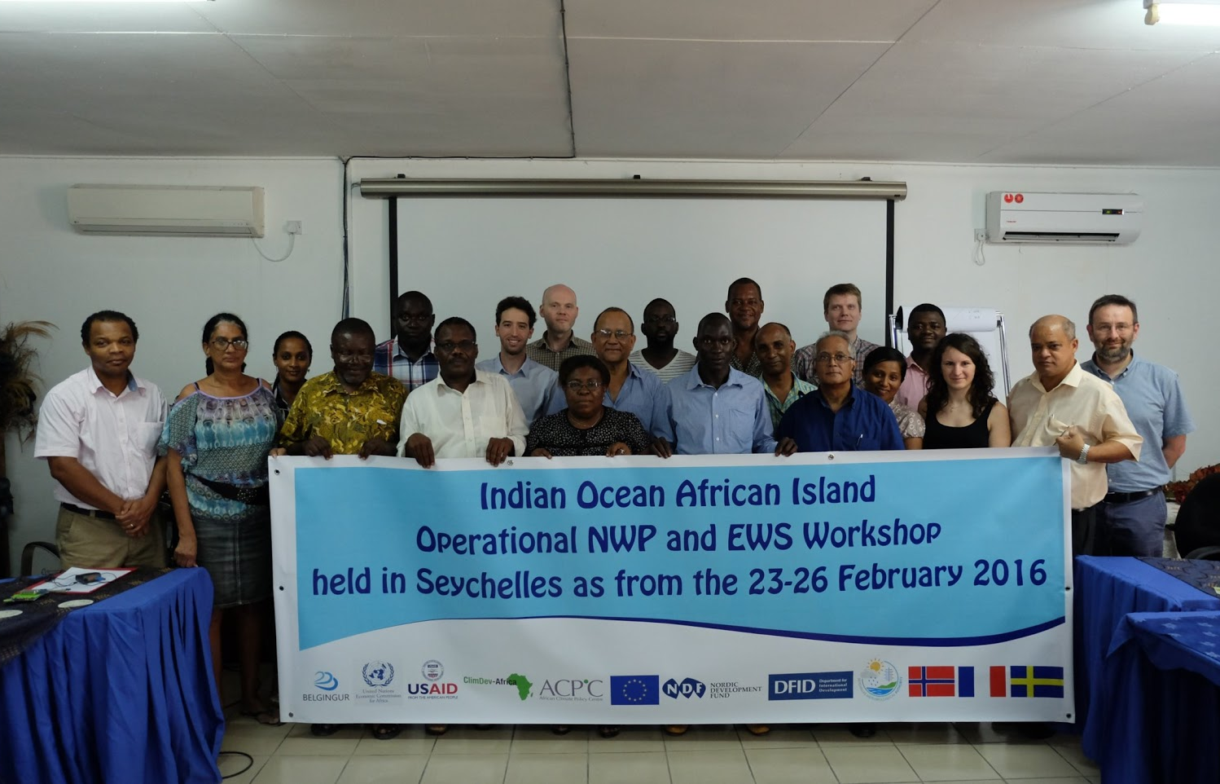
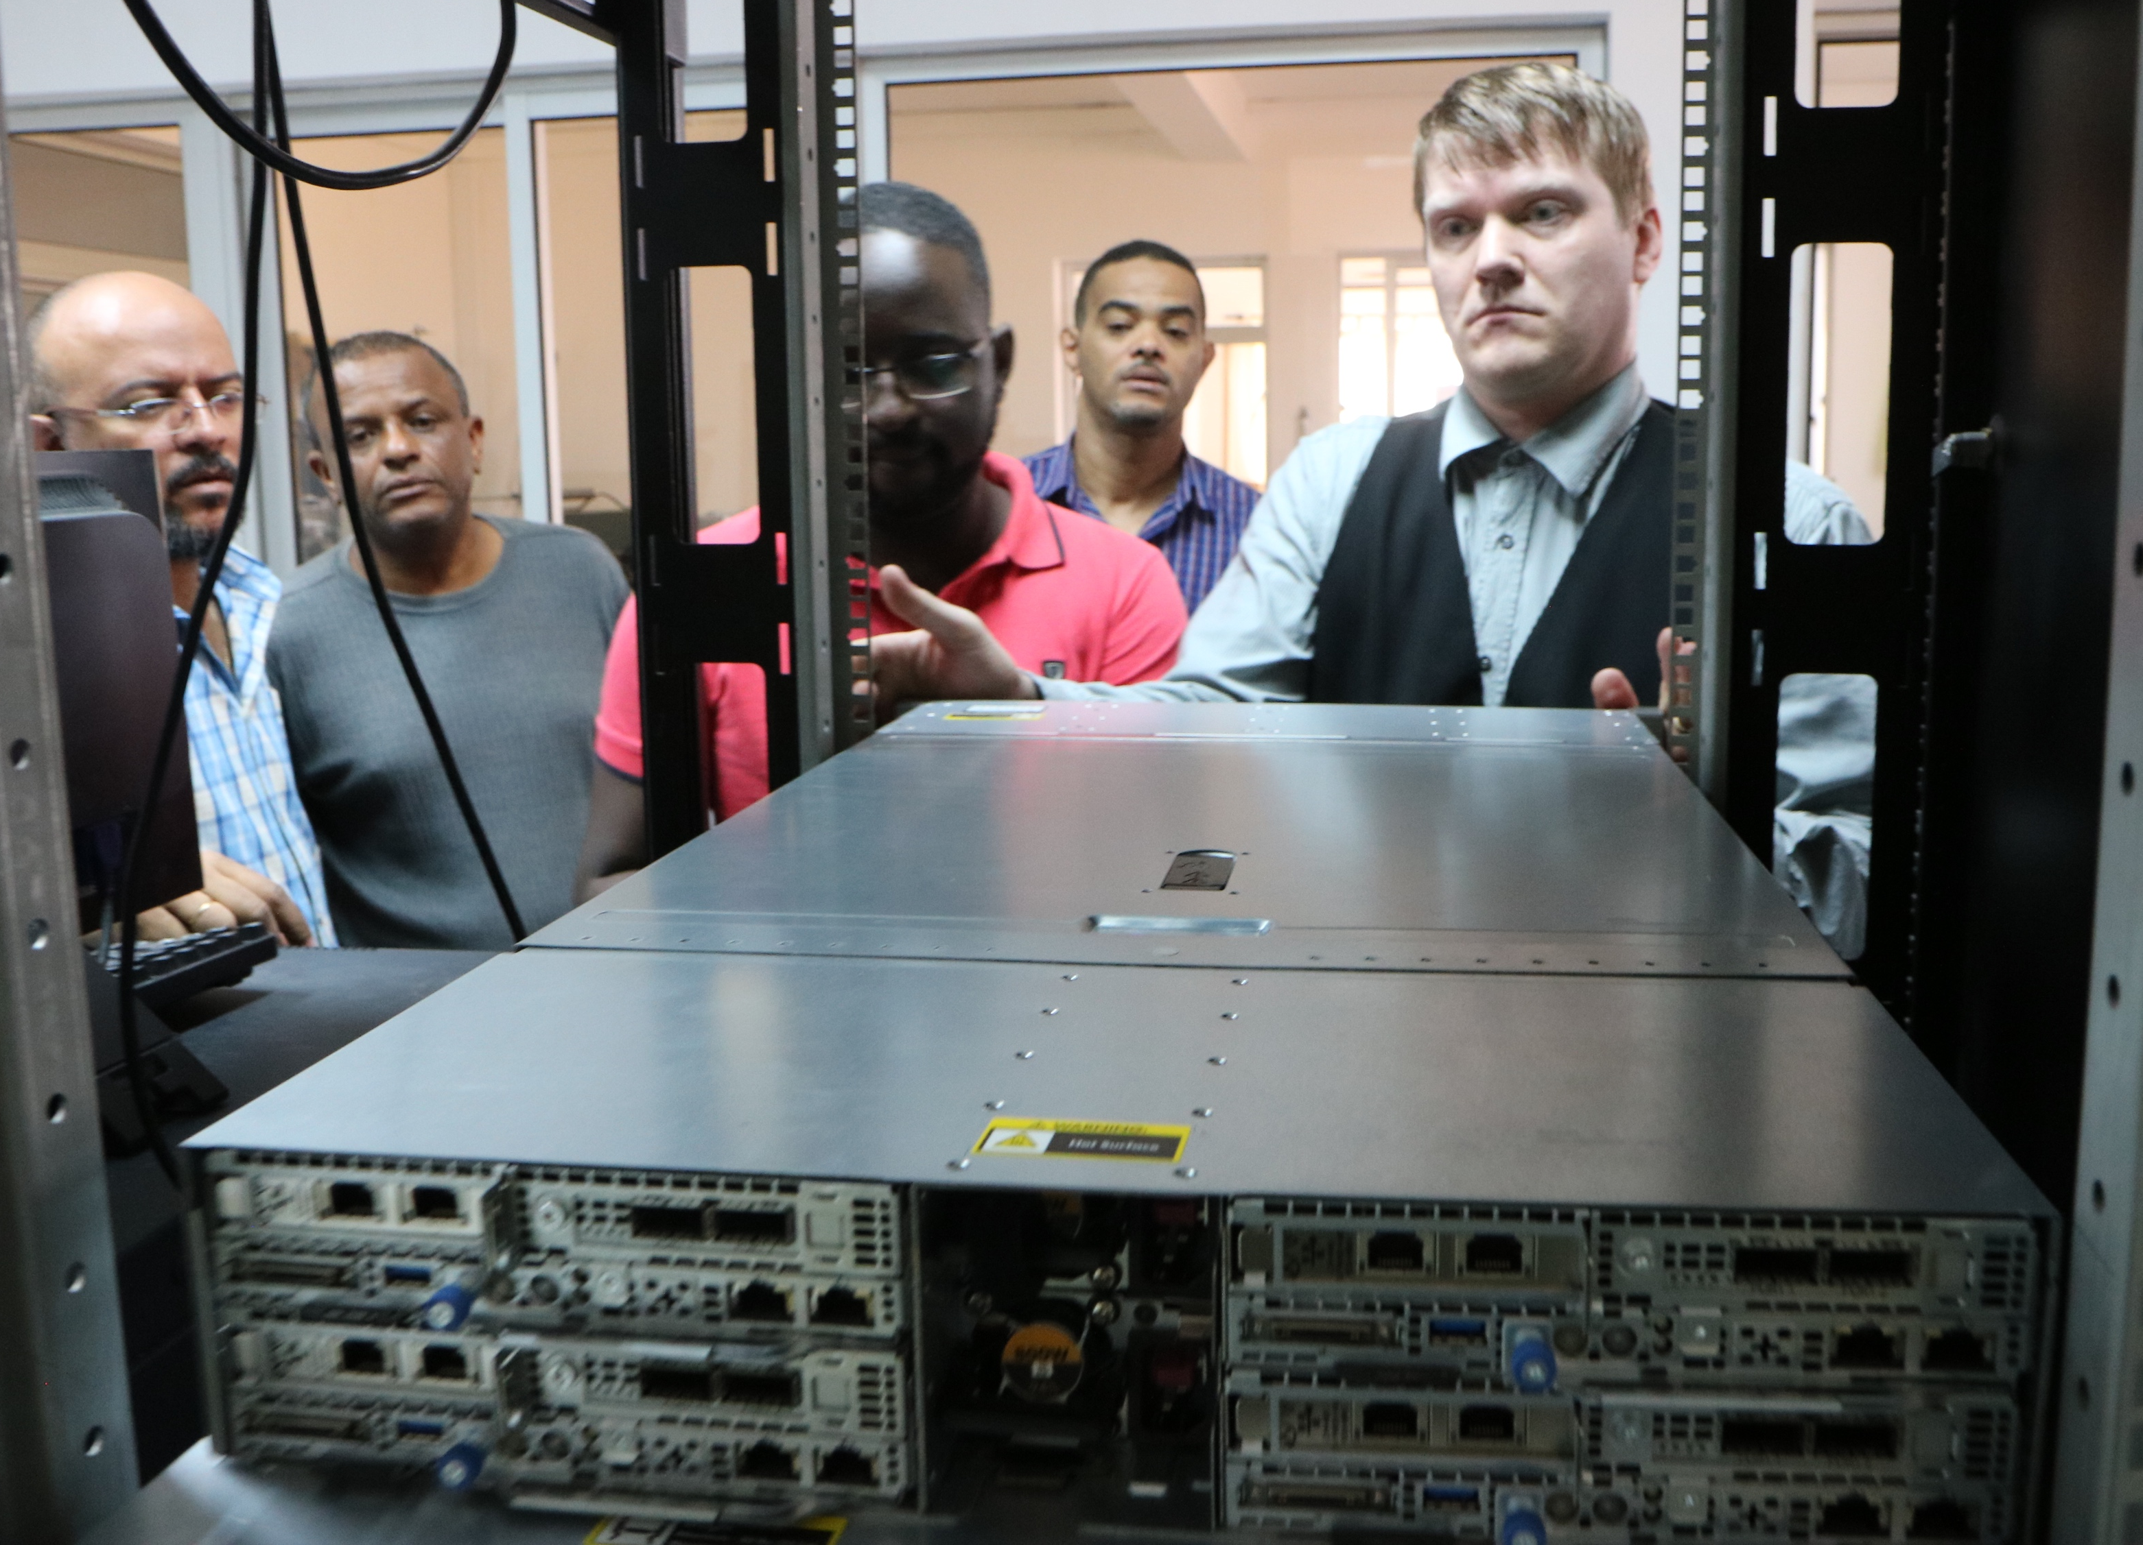
System applications
WOD is run operationally in Cabo Verde and Seychelles
  http://syn.meteo.gov.sc
  http://www.inmg-wod.org

Slide 19
Summary
The WOD system can be used to create conventional short- to medium-range weather forecasts for any location on the globe as well as ensemble and S2S forecasts
Designed to meet the needs of NMHs that have limited resources and little experience in running operational forecast systems
It is based on Open Source components, is Event Driven and very Scalable and Resilient
Output can be used as input into other decision support software
Forecasts can be accessed via fast and flexible API’s

Slide 20
Thank you
https://wod.belgingur.is
https://wod.belgingur.is/api/v2/ui/
https://github.com/Belgingur/WOD-Documentation/wiki/Getting-Started-With-WOD-APIs

