Slide 1

Geofysisk Institutt, 2013-02-08
Numerical simulations of surface winds and precipitation in Iceland
Ólafur Rögnvaldsson
Belgingur and UiB
or@belgingur.is

Slide 2
Overview
Geofysisk Institutt, 2013-02-08
Observations of weather in Iceland
Atmospheric models
Simulations of precipitation
Simulations of surface winds
Ongoing research
Summary

Slide 3
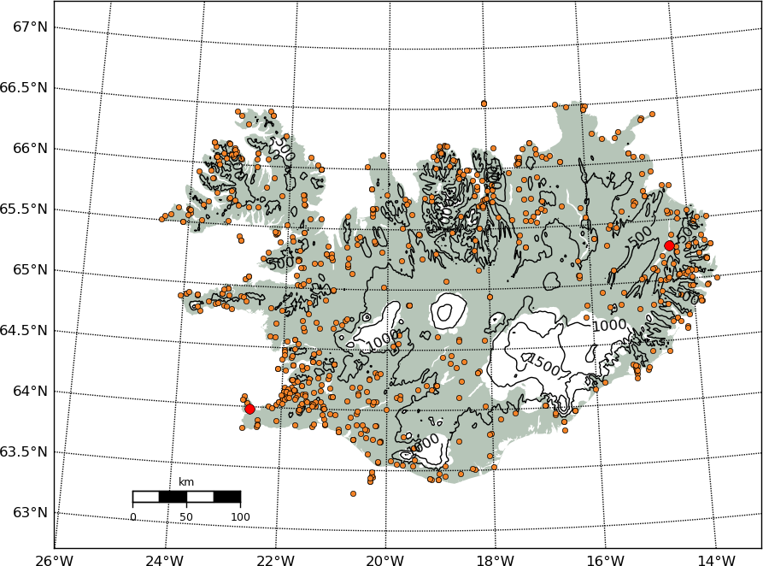
Observations of weather in Iceland
Geofysisk Institutt, 2013-02-08
Current observational network in Iceland. Most stations are automatic, or becoming automatic
Hveravellir
Reykjavík
Egilstaðir airport
Kefalvík airport
Notes:
Most of the surface stations in Iceland are located close to the coast or at a low elevation. This leads to problems when trying to get a picture of precipitation and winds in the highlands and on the ice caps, which constitute more than 10% of the area of Iceland.

Slide 4
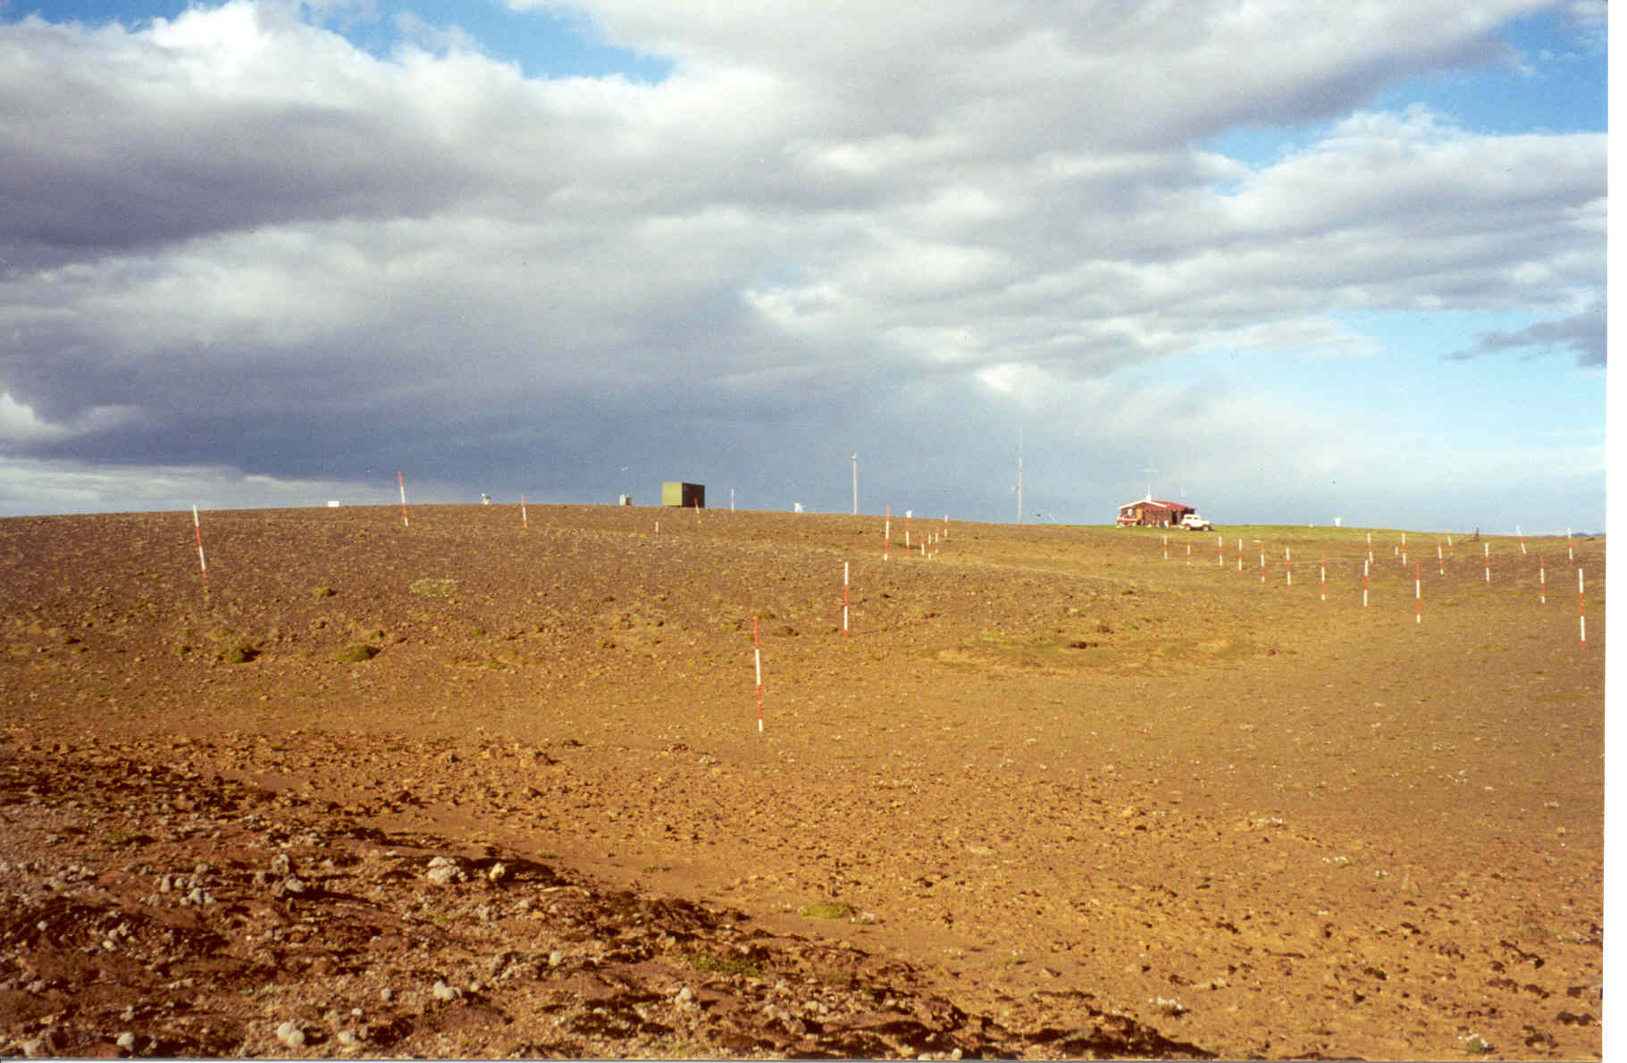
Observations of weather in Iceland
Geofysisk Institutt, 2013-02-08
Snow stakes at Hveravellir, central Iceland. Height above sea level is 640 meters.
Notes:
There is a further problem when trying to observe rain in strong wind situations. This is in particular difficult when the precipitation falls as snow. At Hveravellir, central Iceland, accumulated snow was observed daily over a period of 40 years (1966-2006).

Slide 5
Observations of weather in Iceland
Geofysisk Institutt, 2013-02-08
“True ground”/Observed precipitation
At 6-12 m/s winds and T<0°C, true ground precipitation is about 300% of observed precipitation
Notes:
When comparing the observed snow accumulation to observed precipitation from a conventional rain gauge at Hveravellir this picture emerges.

Slide 6
Observations of weather in Iceland
Geofysisk Institutt, 2013-02-08
“True ground”/Observed precipitation
At 6-12 m/s winds and T<0°C, true ground precipitation is about 300% of observed precipitation
Notes:
This reduction in underestimation of solid precipitation in very strong winds is believed to caused by continious resuspencion of individual snow flakes.

Slide 7
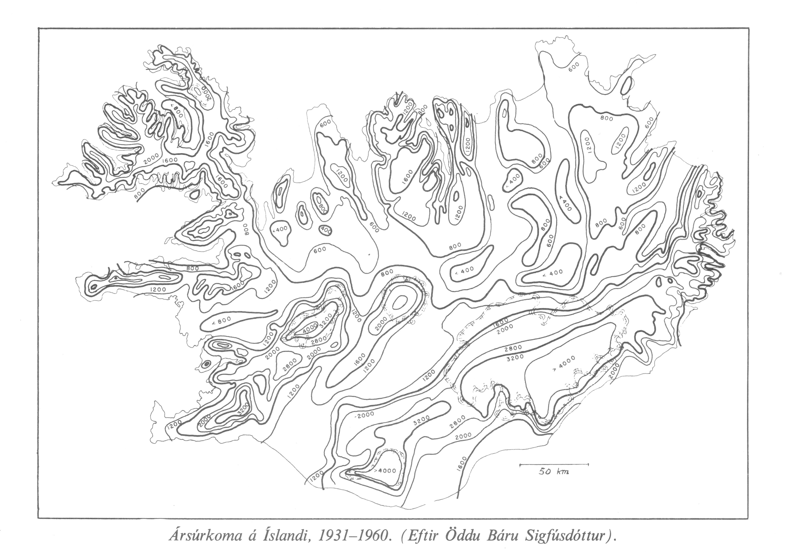
Observations of weather in Iceland
Geofysisk Institutt, 2013-02-08
Mean annual precipitation for Iceland, 1931-1960, by Adda Bára Sigfúsdóttir, at the Icelandic Meteorological Office
Notes:
In spite of these shortcomings, observed precipitation had been used to create a precipitation map back in the early 1970s. Observations in the highlands and mountains/ice caps where close to non-existing for this period.

Slide 8
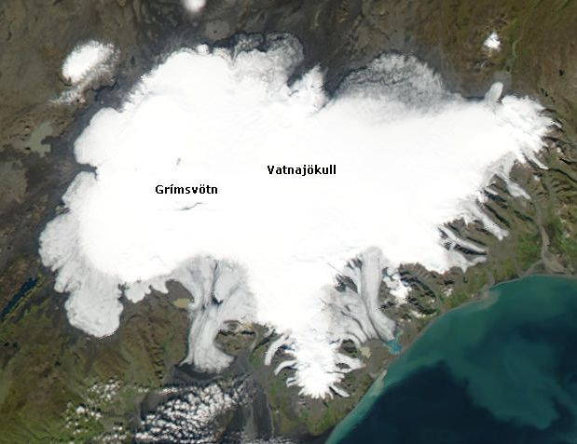
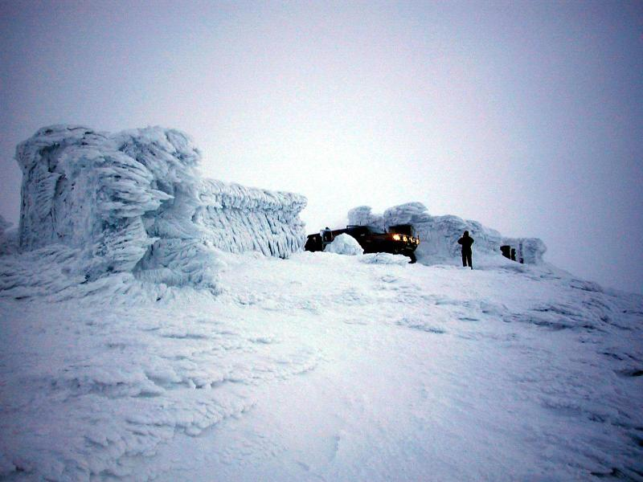
Observations of weather in Iceland
Geofysisk Institutt, 2013-02-08
Not just a problem observing precipitation
Photo: Einar Kjartansson
Notes:
Icing can cause major problems for observations, in particular at high elevations. Here is an example from Mt. Grímsfjall on the Vatnajökull ice cap in SE-Iceland. The structures seen are actually cosy cabins...

Slide 9
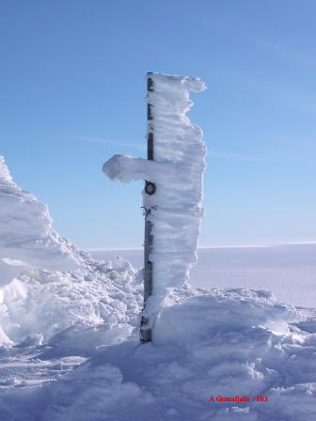
Observations of weather in Iceland
Geofysisk Institutt, 2013-02-08
Winds can be tricky to observe as well
Notes:
Precipitation as well as winds ...

Slide 10
Observations of weather in Iceland
Geofysisk Institutt, 2013-02-08
Dropsonde data from the GDDEx project in 2008
Notes:
And than observations done at the surface may not always be representative for what is going on further aloft. This can be also be difficult to simulate using numerical models. Here is an example of a wake in the lee of Mt. Snæfellsjökull in W-Iceland.

Slide 11
Observations of weather in Iceland
Geofysisk Institutt, 2013-02-08
There are however other sources of observations of precipitation available
Notes:
Accumulated winter precipitation can be observed and used to give a good estimate of the accumulated area precipitation for the individual ice caps and glaciers

Slide 12
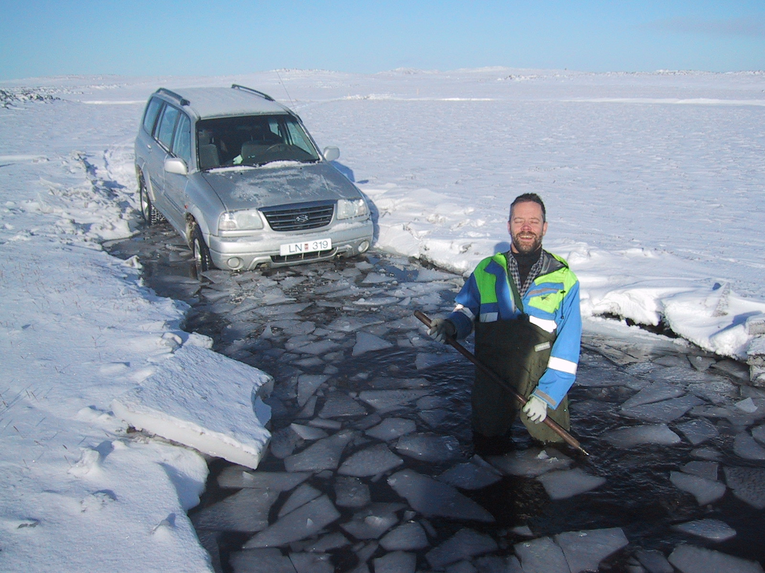
Observations of weather in Iceland
Geofysisk Institutt, 2013-02-08
Location, location, location
Notes:
It is however not always trivial to collect this data

Slide 13
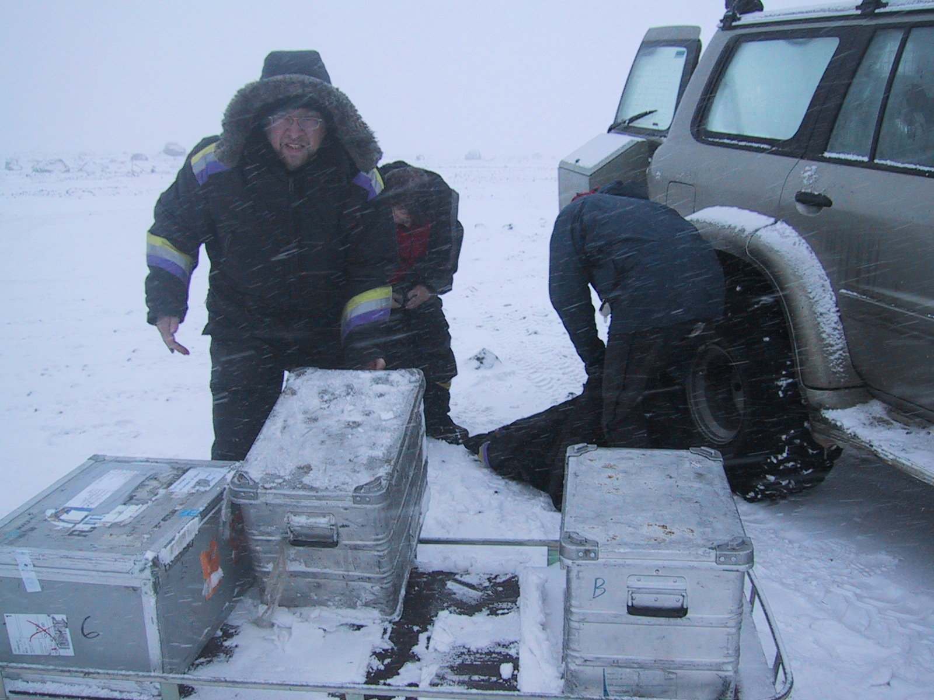
Observations of weather in Iceland
Geofysisk Institutt, 2013-02-08
Somewhat rough working conditions
Notes:
This data is however not always trifial to collect

Slide 14
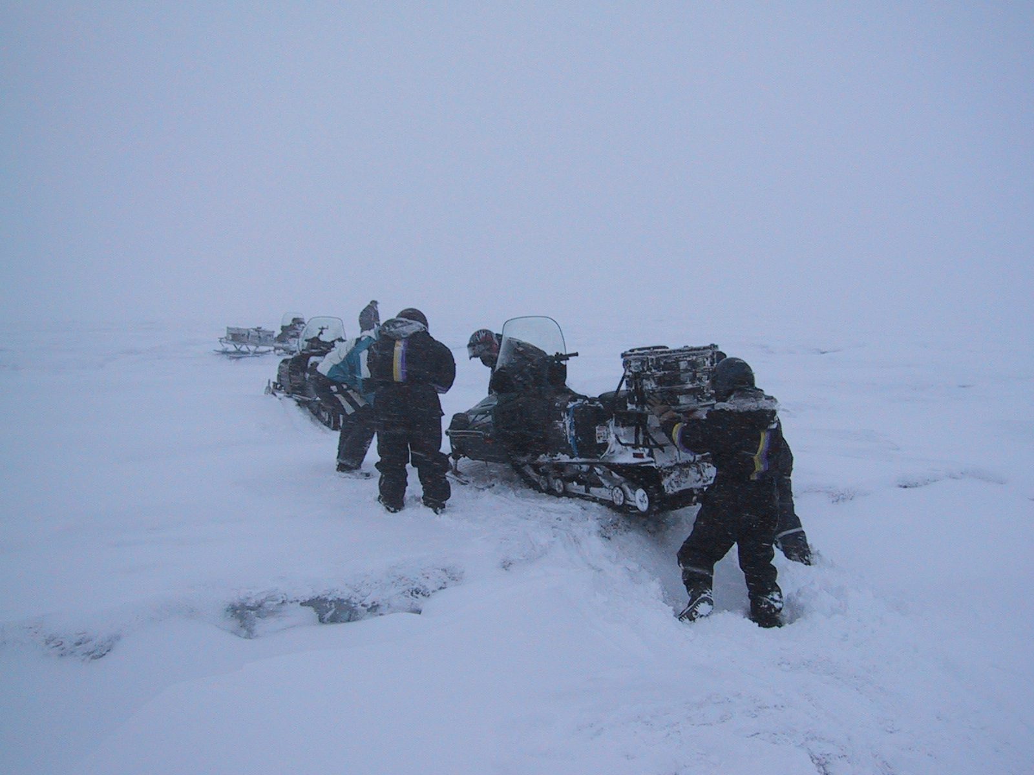
Observations of weather in Iceland
Geofysisk Institutt, 2013-02-08
There are openings in the ice to pass
Notes:
This data is however not always trifial to collect

Slide 15
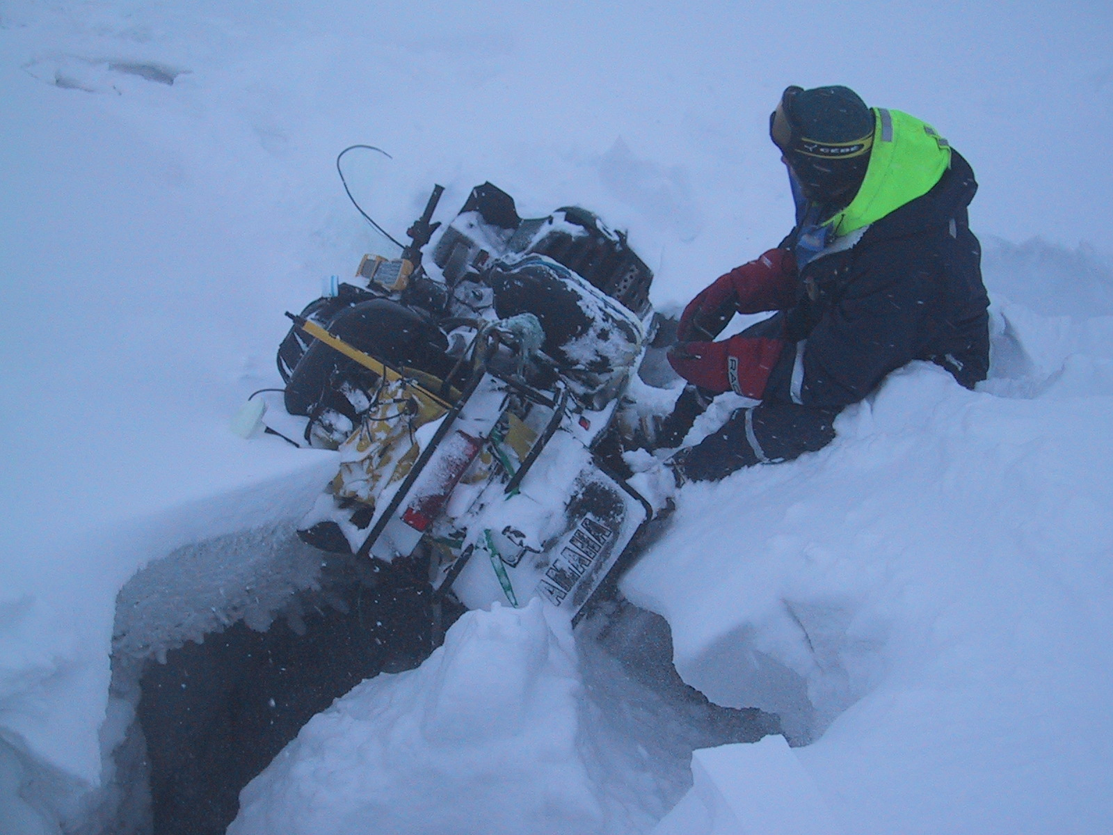
Observations of weather in Iceland
Geofysisk Institutt, 2013-02-08
or to fall into
Notes:
This data is however not always trifial to collect

Slide 16
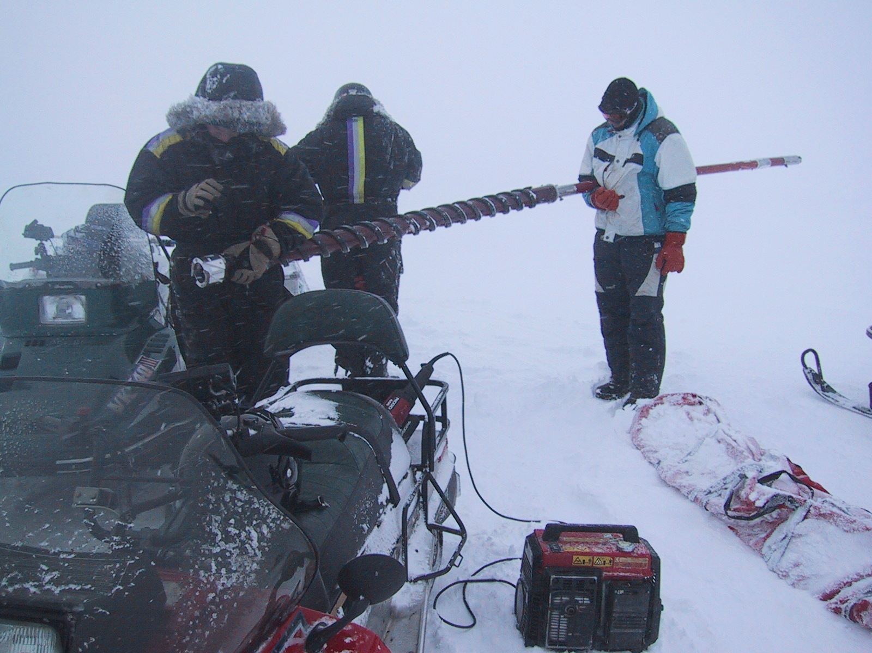
Observations of weather in Iceland
Geofysisk Institutt, 2013-02-08
The accumulation of the winter is measured by
drilling down to the surface of last summer
Notes:
The density of the core is measured to calculate the water equivalent of the winter layer. Measurements of the core temperature and visual observations of melt-layer incidence and thickness, as well as grain size are carried out on each snow core. Visual inspection of dust content is used together with observations of grain coarseness to identify the previous year’s summer surface and thereby, the thickness of the winter layer.

Slide 17
Observations of weather in Iceland
Geofysisk Institutt, 2013-02-08
In addition, observations of runoff from individual gauging stations can be used to give information on accumulated precipitation for the corresponding watersheds
Notes:
Here is an example of six watersheds that have been used for comparison with simulated precipitation.

Slide 18
Observations of weather in Iceland
Geofysisk Institutt, 2013-02-08
To summarise
Bulk of the observational network is located close to the coast or at low elevation
Rain gauge undercatchment due to wind is a serious problem, especially for solid precipitation events
At high elevation icing can cause equipment failure
Observations of accumulated winter precipitation is available
Runoff data can give valuable information on precipitation
Notes:
The sparsness of observations in the highlands and on the ice caps poses a serious problem for the energy sector as large amounts of precipitation fall in this regions. The winter precipitation is to a large degree stored on the ice caps until spring, when it melts and flows to the ocean, and in some cases stopping at a number of reservoirs. Reliable information on the precipitation is therefore of great importance for the hydropower sector. Temperature, winds and radiation are also of relevance as these parameters play an important role in energy balance models used to estimate day-to-day and week-to-week runoff for individual watersheds.

Slide 19
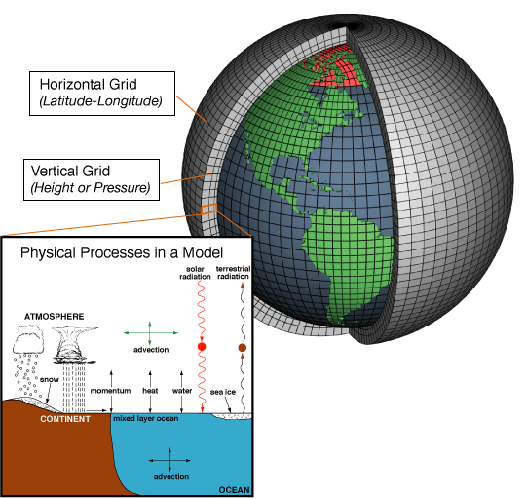
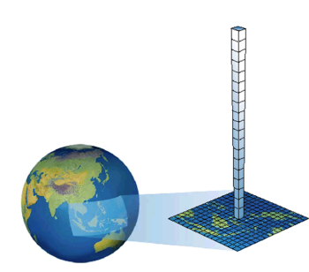
Atmospheric models
Geofysisk Institutt, 2013-02-08
Set of equations that describe the atmospheric flow and need to be integrated forward in time to produce a weather forecast or a climate scenario prediction
Global
Regional

Slide 20
Atmospheric models
Geofysisk Institutt, 2013-02-08
Set of equations that describe the atmospheric flow and need to be integrated forward in time to produce a weather forecast or a climate scenario prediction
Initial and boundary data come from global models
Regional

Slide 21
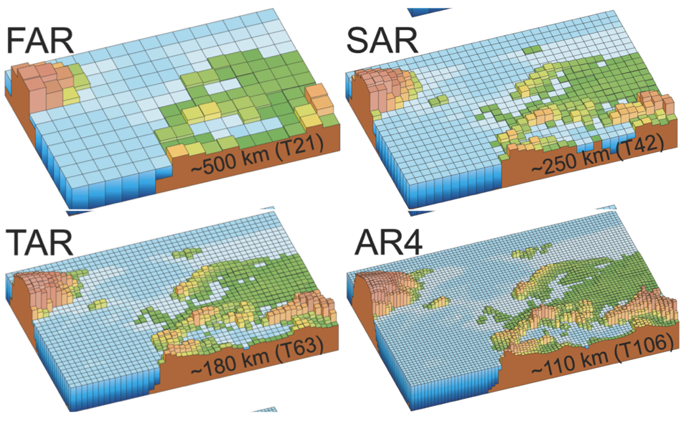
Importance of high resolution
Geofysisk Institutt, 2013-02-08
Global forecasts
15-50 km grid
Regional forecasts
1-10 km grid
Current climate models, ~100 km grids
From IPCC 2007

Slide 22
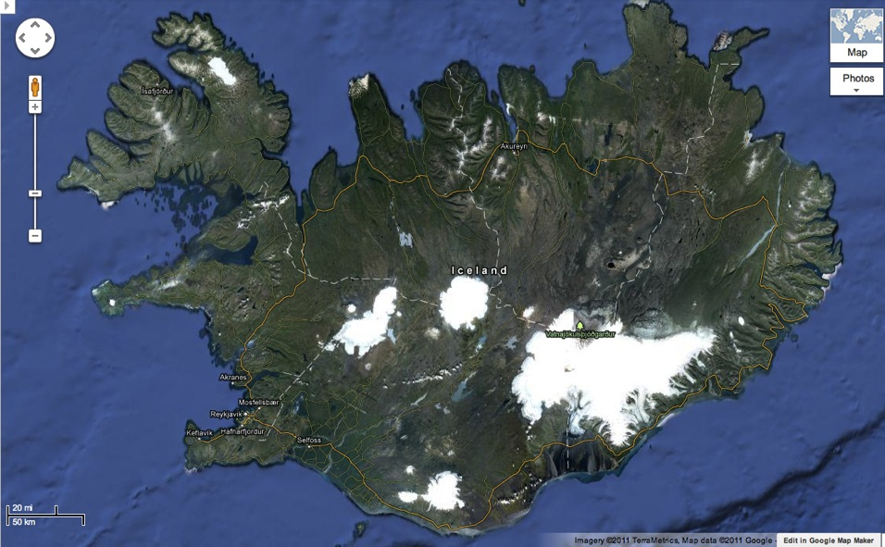
Importance of high resolution
Geofysisk Institutt, 2013-02-08
60km
20km
400 < Z < 1400 m
How is the wind flow over this mountainous peninsula simulated at 9 and 1 km resolution?

Slide 23
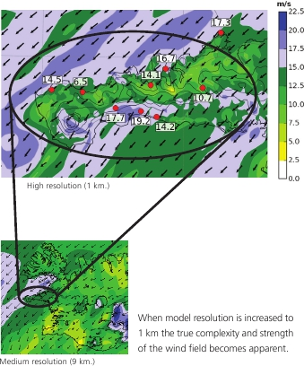
Importance of high resolution
Geofysisk Institutt, 2013-02-08
Very high resolution – 1 km
When model resolution is increased to 1 km the true complexity and strength of the wind field becomes apparent
Medium resolution – 9 km
Notes:
At 1 km resolution there is a great variability in the simulated wind field. The simulation captures a downsloap windstorm that is confirmed by observations, which is not seen on the coarser grid.

Slide 24
Why not always use 1km resolution?
Geofysisk Institutt, 2013-02-08
Need 1000-times more CPU power to simulate a 1 km resolution forecast than a 10 km one for the same region!

Slide 25
Simulations of precipitation
Geofysisk Institutt, 2013-02-08
Mean annual precipitation from March 1988 through February 2003 as simulated by the MM5 model at a 8 km horizontal resolution
Notes:
As available computer hardware was limited we had to choose between a short simulation period at a high resolution and a longer period at a coarser resolution. A 15 year period simulated at 8 km horizontal resolution was the result.

Slide 26
Simulations of precipitation
Geofysisk Institutt, 2013-02-08
Simulation period is September 2001 through August 2002
Unmodified terrain Terrain height set to 1 meter
The effects of terrain on the precipitation pattern, and amount, are very large with the mountains constituting to about 40% increase in precipitation
Notes:
To get an idea of the importance of terrain in shaping the precipitation in Iceland, we ran a sensitivity tests where we reduced the terrain of Iceland down to one meter and compared to a simulation with unmodified terrain.
The mountains cause a drying in the highlands north of the Vatnajökull ice cap and north of the two large ice caps in central Iceland. The valley areas in the central and southeast part of the NW quadrant and the two largest fjords in the northwestern-most part of Iceland are also drier when the mountains are present. The mountains cause an increase in precipitation that reaches far south of Iceland, while a decrease in precipitation is evident far to the north and northeast of Iceland.

Slide 27
Simulations of precipitation
Geofysisk Institutt, 2013-02-08
Some similarities with the early work of Adda Bára, and some differences
Notes:
The precipitation gradient from Mt. Bláfjöll in the SW of Iceland to Mt. Langjökull ice cap is similar in both maps. However, maximum values on the ice caps are considerably higher in the MM5 map. The overall smoothness is also more pronounced in the early map as the impacts of the terrain on the precipitation field are more remarked in the MM5 simulation

Slide 28
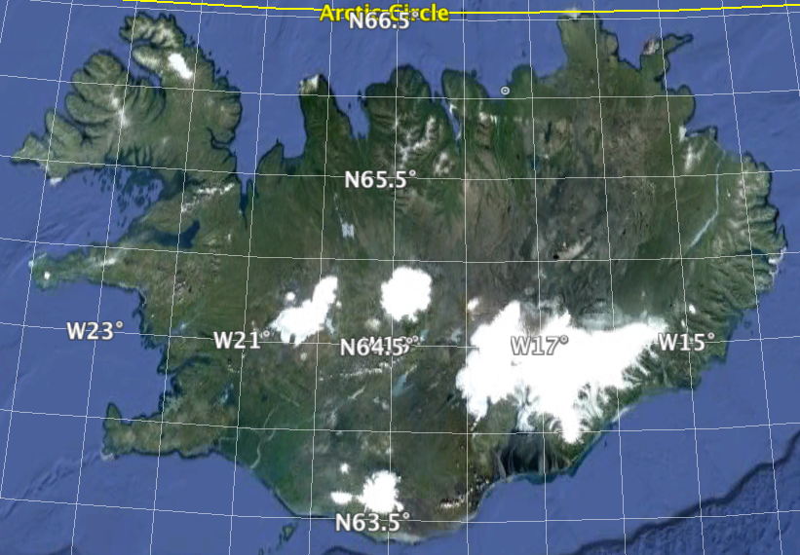
Simulations of precipitation
Geofysisk Institutt, 2013-02-08
Notes:
We have compared observed precipitation from these three large ice caps, as well as two sub-glaciers of Vatnajökull ice cap, to simulated precipitation. The time periods varies as observational data is not available for the whole simulation period.

Slide 29
Simulations of precipitation
Geofysisk Institutt, 2013-02-08
Hofsjökull ice cap
Observed (solid lines) and simulated (dashed lines) accumulated winter precipitation for five large ice caps in central and SE Iceland
Notes:
We now compare the simulated precipitation with observed glaciological data. In general there is very good agreement between observed accumulated winter precipitation and simulated one, although there are discrepancies at times.

Slide 30
Simulations of precipitation
Geofysisk Institutt, 2013-02-08
As the southern margin of Vatnajökull ice cap reaches near sea level, it’s mass balance is sensitive to liquid precipitation and/or winter ablation. This may explain why observed precipitation is about 500mm less than simulated
Notes:
In general there is very good agreement between observed accumulated winter precipitation and simulated one, although there are discrepancies at times. The mass balance model for Vatnajökull ice cap does not take this processes into account, these processes are not at play for the higher elevation subglaciers Dyngjujökull and Brúarjökull.

Slide 31
Simulations of precipitation
Geofysisk Institutt, 2013-02-08
Simulated discharge, using modelled precipitation as input, agrees well with observed discharge from 69 watershed gauges
Notes:
Output from the MM5 model was used to force the WaSiM hydrological model to create a run-off map for Iceland. The difference between measured and modeled discharge was in general found to be less than 5%. As the WaSiM model was not run with a groundwater module the precipitation from MM5 was scaled in order to make the simulated water balance fit the observed water balance for individual watersheds. The difference between non-scaled annual precipitation and scaled annual precipitation was found the be 2% (1.790 mm/yr compared 1.750 mm/yr).

Slide 32
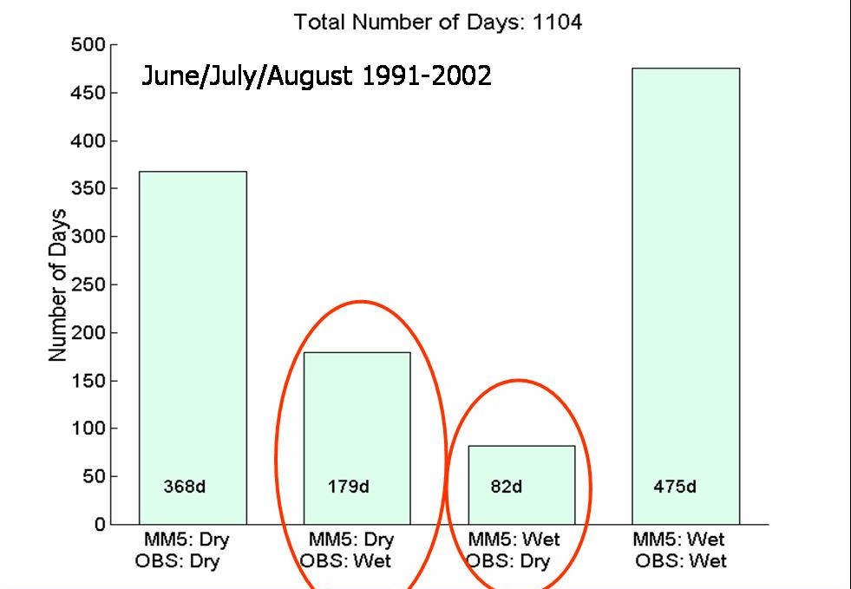
Simulations of precipitation
Geofysisk Institutt, 2013-02-08
There is however the issue of false alarms, both “dry” (16%) and “wet” (7%). In the “wet” cases, the model tends to produce small amounts (<0.5mm/day) quite frequently
MM5: Dry MM5: Dry MM5: Wet MM5: Wet
Obs: Dry Obs: Wet Obs: Dry Obs: Wet
Notes:
This does however not mean that the day-to-day simulated precipitation is always correct, even though the mean annual precipitation is in good agreement with observations.

Slide 33
Simulations of precipitation
Geofysisk Institutt, 2013-02-08
Notes:
We have seen how the orography of Iceland shapes the precipitation pattern and precipitation amounts, and that the large scale precipitation pattern agrees well with observed glaciological precipitation as well as modelled discharge. We have however yet to show if we can get a more detailed picture by increasing the model resolution. This was the main purpose of the REX experiment, in the fall of 2002, where fifteen rain gauges where installed over the Mt. Bláfjöll mountain ridge in SW-Iceland. In total, six intensive operational periods were observed, providing precipitation data that could be used to validate the model simulations.

Slide 34
Simulations of precipitation
Geofysisk Institutt, 2013-02-08
B
A
Accumulated precipitation during IOP5, 3 – 7 October 2002.
Notes:
What we found out was that not only was resolution important but also certain assumptions made in the microphysical scheme. In particular, a parameter describing the size of individual cloud droplets, was found to be of significant importance.

Slide 35
Simulations of precipitation
Geofysisk Institutt, 2013-02-08
Maritime CNP
Continental CNP
Accumulated precipitation [mm]
Height above sea level [m]
Too little precipitation on the lee side!!!
A
B
Sensitivity to various CNP values at 2 km horizontal resolution
Notes:
When this parameter, called CNP, was representative for continental conditions there was considerably less simulated precipitation, But when the parameter become more representative of a maritime climate, simulated precipitation increased.

Slide 36
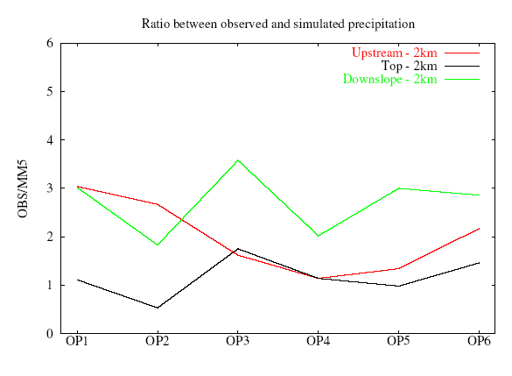
Simulations of precipitation
Geofysisk Institutt, 2013-02-08
Ratio between observed and simulated precipitation
Notes:
This downslope deficiency in simulated precipitation is present in all of the IOPs.

Slide 37
Simulations of precipitation
Geofysisk Institutt, 2013-02-08
To summarise
We can use atmospheric models to simulate precipitation in Iceland
Simulated precipitation over longer periods agrees well with glaciological and hydrological data. Important for the hydropower sector
On short timescales the false alarm rate is 16% for “dry” and 7% for “wet” summer events
Precipitation in complex terrain is better represented as model resolution is increased
Model underestimates precipitation in the lee of a narrow mountain range, independent of resolution
Notes:
To some extent the agreement between observed and simulated precipitation over longer time periods is due to compensation of errors on shorter time scales.

Slide 38
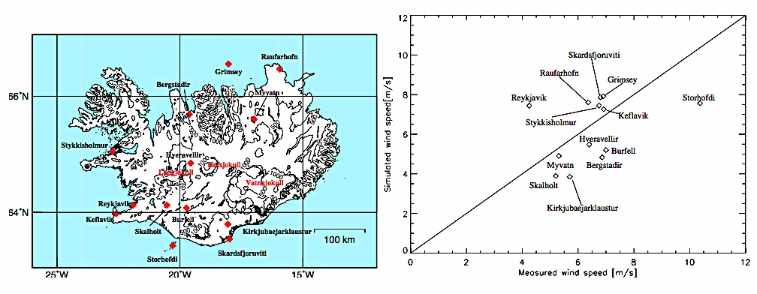
Simulations of winds
Geofysisk Institutt, 2013-02-08
Simulated (@8km resolution) and observed 10 meter winds for a fifteen year period 1987-2002 for thirteen different locations away from significant unresolved orography.
Notes:
Two stations show the greatest discrepancies, Reykjavík and Stórhöfði. Both of these are close to the coast. The anemometer at Stórhöfði is located on a 120m high cliff whilst the corresponding grid cell in the model is at sea level. The Reykjavík weather station is at 50 m height but the nearest grid cell in the MM5 model is at 150 m height. There is also considerable coastal gradient in the MM5 model, with value for the neighboring grid cell being 5.7 m/s. Differences in modeled and observed values can to a large extent be explained by the model coarse resolution and corresponding errors in land use parameters and orography.

Slide 39
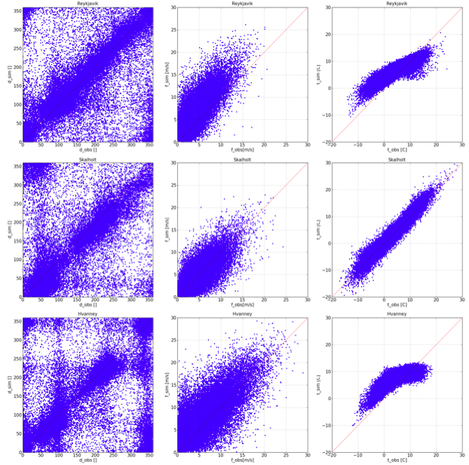
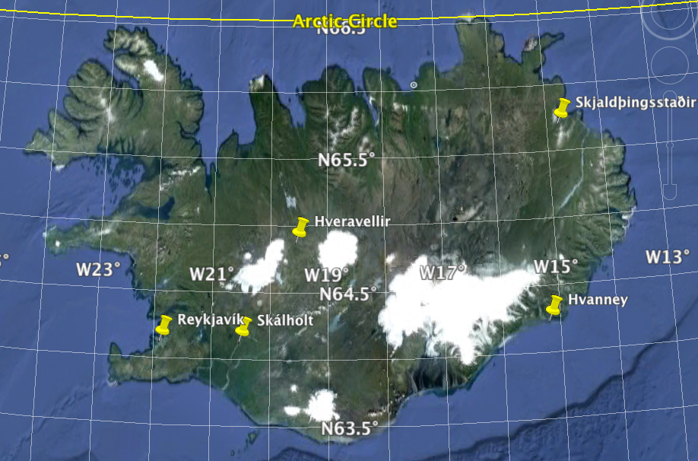
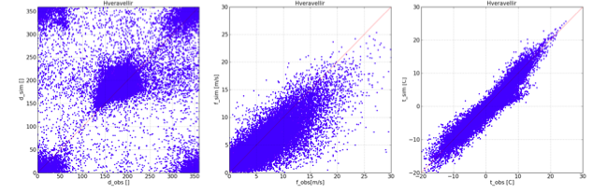
Geofysisk Institutt, 2013-02-08
Direction Speed Temperature
Simulated
A more recent downscaling experiment has been done with the WRF model at a 3km horizontal resolution for the period 1994 to 2012
Observed
Notes:
Scatterograms showing observed and simulated wind direction, speed and temperature for four different locations. The top graph is from Reykjavík. It is clear that the model data is characteristic of a coastal data point. Wind speed is overestimated and the 2 meter temperature is damped by the presence of the ocean. The model does not simulate the high values nor the lowest values of temperature corectly.
Following is a inland station that is far from unresolved orography, there is no bias in wind direction, speed or temperature.
The third station is a coastal one, showing similar charagterstics as Reykjavík, however at Hvanney there is no urbanization and there is less overestimation of winds.
The last station is in the interior of Iceland and the model is underestimating the wind speed. There is also cold bias in the temperature.

Slide 40
Simulated mean winds
Geofysisk Institutt, 2013-02-08
m/s
JJA
SE-direction
DJF
SW-direction
Notes:
The simulations reveal considerable seasonal variability in wind speed as well as dependency to wind direction. Note that wind speed off the south coast is in general greater than off the north coast.
For summer months there is also a very nice sea-breeze signal in a fjord in NW-Iceland (benda með priki)
In SE-winds there is a clear sign of gravity wave in the lee of the large ice caps and a very nice corner wind south of the mountains in S-Iceland.

Slide 41
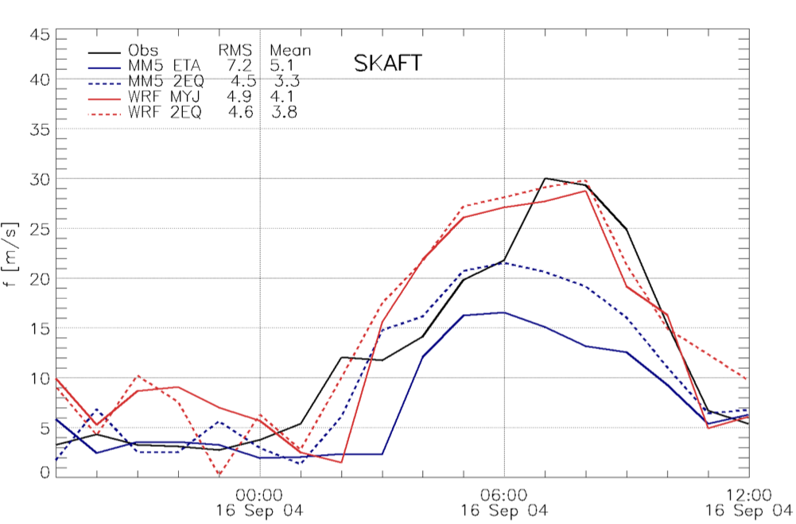
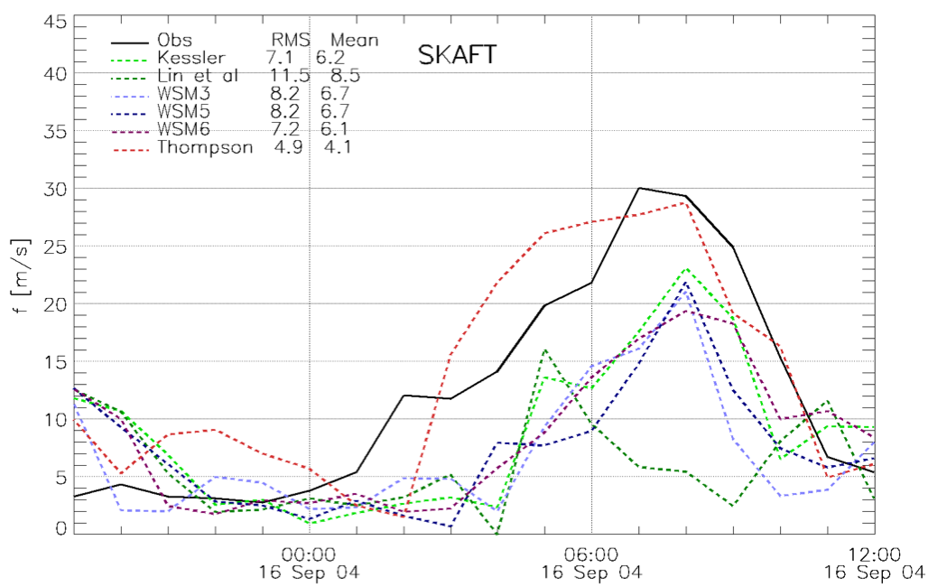
Geofysisk Institutt, 2013-02-08
Downslope windstorm- Case study
Downslope windstorm in SE-Iceland in Sep 2004.
Testing sensitivity to PBL schemes and different microphysics schemes
Wind direction
40
40
Obs
Obs
Different models
Different microphysics
WRF
Wind speed [m/s]
WRF/Thompson
OK
20
20
WRF/other
Too low winds
MM5
00:00 06:00 12:00
16 Sep 04
00:00 06:00 12:00
16 Sep 04
Notes:
A downslope windstorm in SE-Iceland in September 2004 is simulated using both the WRF as well as the MM5 model. Both models are run with a modified MYJ PBL scheme, containing a prognostic equation for the mixing length. Improvements in simulated surface winds are more pronounced in the MM5 model than in the new WRF model. Sensitivity tests using different microphysics scheme reveal a substantial sensitivity of the simulated surface winds to different representations of the microphysical processes upstream of the mountain.
The phase changes of water influence the temperature and consequently the static stability upstream of the mountain. And downslope windstorms are sensitive to the static stability.
This is of importance for operational weather forecasting, in particular in Iceland where downslope windstorms are relatively frequent.

Slide 42
Simulations of winds
Geofysisk Institutt, 2013-02-08
To summarise
We can use atmospheric models to simulate winds in Iceland
Iceland as a whole shapes the wind field both upstream and downstream
Effects of terrain can be seen clearly
To some extent observed errors at various stations may be explained by:
Sub-grid orography
Proximity to water bodies
Inaccurate landuse characteristics, e.g. incorrect surface roughness
Downslope winds can be sensitive to microphysical processes upstream of the mountain
Notes:
Geisp...

Slide 43
Ongoing research
Geofysisk Institutt, 2013-02-08
On-demand weather forecasting system
www.sarweather.com
Use of vertical profiles from UAVs and Sodar/RASS to improve short range forecasts
New data series for Iceland in preparation
1957 to present
2km horizontal resolution
65 vertical levels with emphasis on the lowest part of the PBL
Updated landuse database (Corine vs. USGS)
Correct outlines of ice caps
Modifications of albedo over the ice caps

Slide 44
Summary
Geofysisk Institutt, 2013-02-08
Our initial research questions were twofold:
Can one use a regional model to dynamically scale down a coarse resolution global atmospheric analysis to gain better understanding of temporal and spatial distribution of winds and precipitation in Iceland?
What, if anything, is gained by increasing the horizontal resolution of the regional model?
Notes:
As we have hopefully shown, than the answer to the first question is a definite “yes”. The climate of Iceland is to a large extent governed by synoptic scale flow that impinges the topography. Both the flow and the topographical influence are relatively predictable. Therefore, this downscaling approach may work better for Iceland and surrounding waters, than for places with less predictable weather.
As for the second question, much additional information can be gained on both temporal and spatial variability of winds and precipitation by increasing the model resolution. The validity of model results is however strongly dependent on the quality of the initial atmospheric analysis and the ability of the model to correctly resolve the relevant physical processes, as well as parameterize the relevant sub-grid processes.

Slide 45
Conclusions
Geofysisk Institutt, 2013-02-08
Improvements in representation of topography in the numerical system lead to large and clear improvements in the accuracy of the simulated precipitation.
Notes:
Improvements in representation of topography in the numerical system lead to large and clear improvements in the accuracy of the simulated precipitation. This is both important for short range weather forecasts as well as for dynamical downscaling of past, present, and model scenarios of future climate.

Slide 46
Conclusions, cont.
Geofysisk Institutt, 2013-02-08
We have validated our simulations with unconventional observational data:
Hydrological data from many watersheds
Snow data from many ice caps
Notes:
High resolution simulations are a useful and valuable tool to describe the temporal and spatial pattern of precipitation in the complex terrain of Iceland. A new methodology has been successfully applied:
Validation of simulated annual precipitation with independent hydrological data from many watersheds
Validation of simulated winter precipitation by comparison with observed accumulated snow on a number of large ice caps

Slide 47
Conclusions, cont.
Geofysisk Institutt, 2013-02-08
Simulations of mean annual precipitation are very good
The quality of day-to-day simulated values is less
The MM5 numerical simulations underestimate systematically precipitation immediately downstream of a narrow mountain ridge, independent of model resolution.
Notes:
On a timescale of a day, or less, there are still substantial errors in simulated precipitation. Results on larger timescales (30 days and beyond) are better, but this is due to compensating errors on shorter timescales
The MM5 numerical simulations underestimate systematically precipitation immediately downstream of narrow (10 km) mountain ridges, independent of model resolution (8, 4, or 2 km). This underlines the need for high resolution observations of the atmospheric flow in the vicinity of the mountain ridge, as well as of the microphysical parameters

Slide 48
Conclusions, cont.
Geofysisk Institutt, 2013-02-08
High resolution numerical simulations produce realistic orographic wind patterns.
A new two-equation planetary boundary layer scheme, with a prognostic mixing length, captures well the magnitude of an extreme downslope windstorm
Notes:
High resolution numerical simulations produce realistic orographic wind patterns. However, an in-depth investigation of a downslope windstorm reveals substantial sensitivity of the simulated surface winds to microphysical processes upstream of the mountain, through their influences on static stability
A new two-equation planetary boundary layer scheme, with a prognostic mixing length, captures well the magnitude of an extreme downslope windstorm

Slide 49

Thank you
Geofysisk Institutt, 2013-02-08
Halló amma ☺

Slide 50
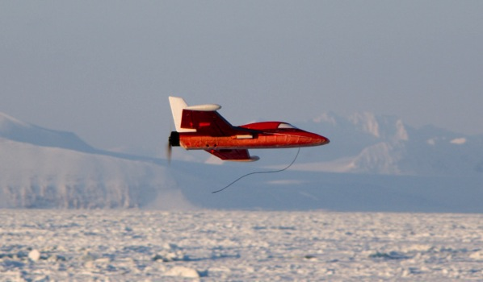
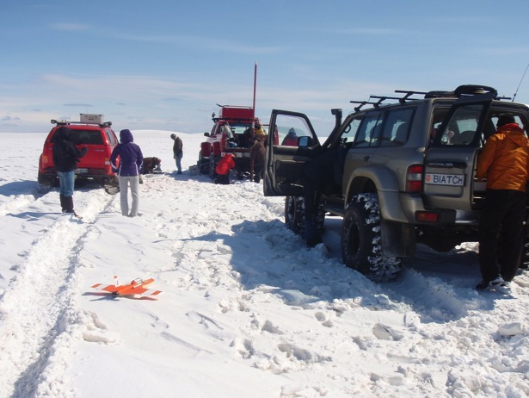

SUMO and WRF
AOGS Singapore
Can be operated in cold climates
The SUMO (Small Unmanned Meteorological Observer) can measure winds, humidity, pressure, and temperature in a vertical profile up to a 4km height
SARWeather – www.sarweather.com

Slide 51
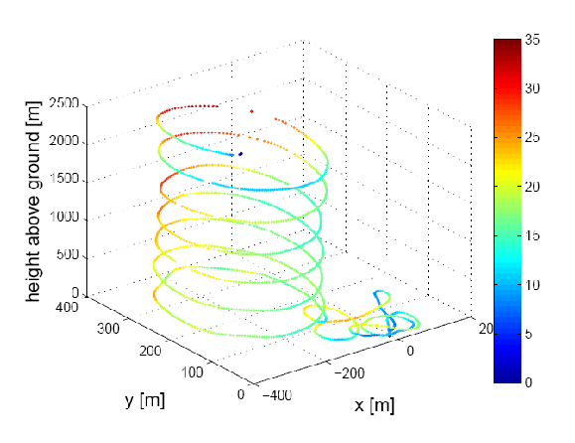
SUMO and WRF
AOGS Singapore
This data can be assimilated with the WRF weather forecast
SARWeather – www.sarweather.com

Slide 52
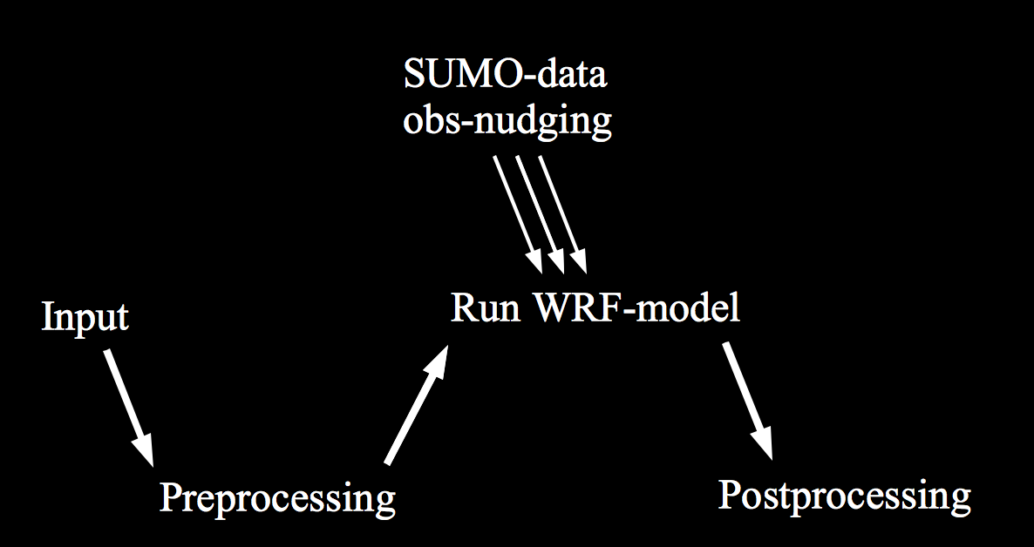
SUMO and WRF
AOGS Singapore
The SUMO-data is incorporated into the WRF-simulation, via obs-nudging
SARWeather – www.sarweather.com

Slide 53
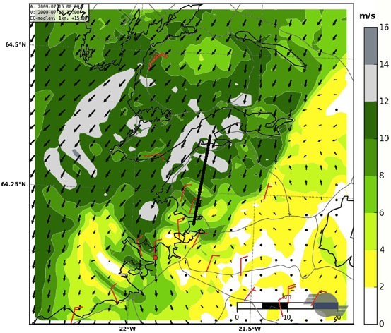
Effects of additional observations
AOGS Singapore
Simulated and observed surface winds
on 15 July 2009 at 15 UTC
The flow structure is now in much better agreement with available observations
WRF at a resolution of 500 m forced with ECMWF-data on model levels and SUMO data
Observed surface winds in red
Mt. Esja
SARWeather – www.sarweather.com

Slide 54
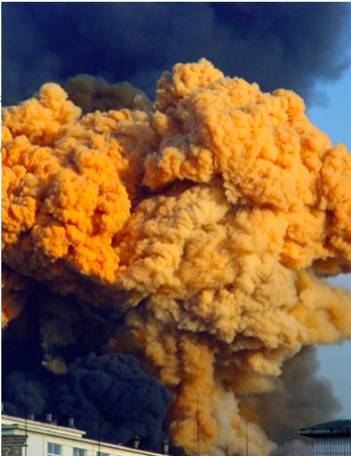
Effects of additional observations
AOGS Singapore
What if there would be a chemical explosion?
Where does the wind driven pollution go? Where do we need to evacuate?
WRF at a resolution of 500 m forced with ECMWF-data on model levels and SUMO data
Observed surface winds in red
Mt. Esja
SARWeather – www.sarweather.com

Slide 55
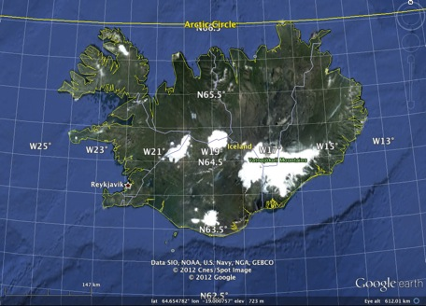
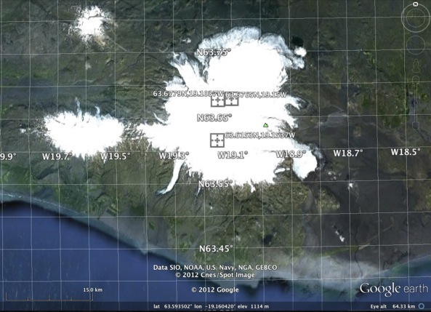
Transmitting data from the field
AOGS Singapore
Observations made over Myrdalsjokull ice cap in South Iceland on 17 May 2012
Data can be transmitted via 3G mobile connection
One profile used for comparison at 16:30 UTC
Three profiles used to nudge the forecast at times 11:55, 12:58 and 14:38 UTC
Site altitudes ~ 1300 m.a.s.l.
Profile heights ~ 2000 m.a.g.l.
From 860hPa to 650/680hPa
SARWeather – www.sarweather.com

Slide 56
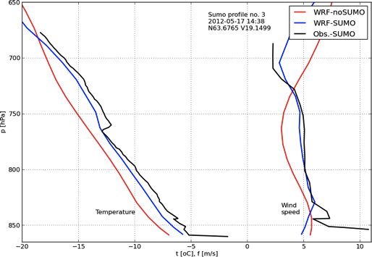
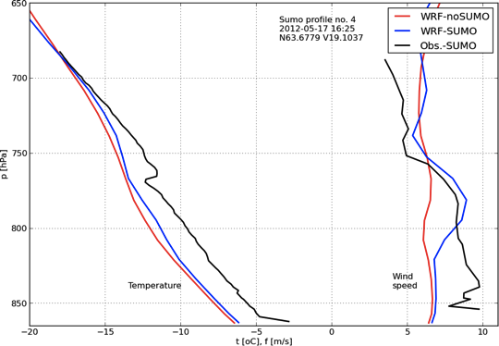
Transmitting data from the field
AOGS Singapore
Profile used for nudging @ 14:38 UTC
Observations made over Myrdalsjokull ice cap in South Iceland on 17 May 2012
Obs in black
WRF - noSUMO in red
WRF - withSUMO in blue
750 hPa
Wind-speed
Temperature
Profile used for comparison @ 16:30 UTC
850 hPa
-20°C -10°C 0°C 5m/s 10m/s
750 hPa
Wind-speed
Problems with low-level windspeed and a cold bias 2hrs after last profile
Temperature
850 hPa
SARWeather – www.sarweather.com
-20°C -10°C 0°C 5m/s 10m/s

Slide 57
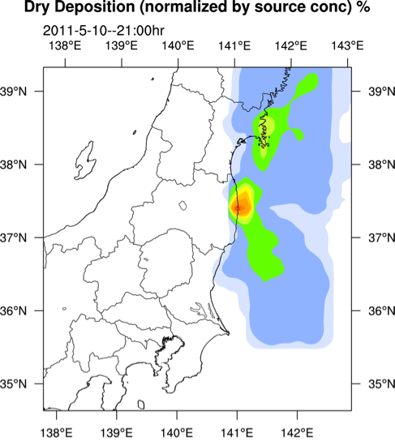
Various uses of model output
AOGS Singapore
To correctly simulate distribution of pollutants, it is very important to correctly simulate the atmospheric conditions close to the source.
Data courtesy of Prof. Saji Hameed at the University of Aizu, Fukushima.
SARWeather – www.sarweather.com

Slide 58
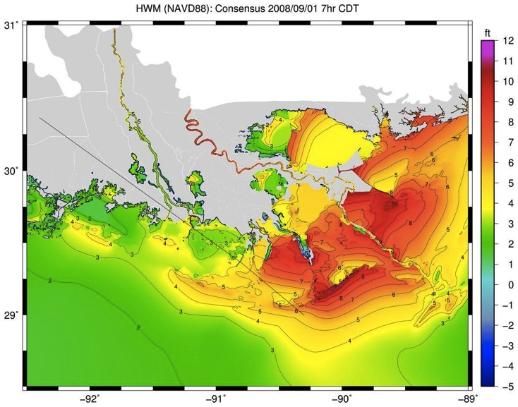
Various uses of model output
AOGS Singapore
Output from SARWeather could also be used as input to coastal waves and circulation and storm surge models such as the coupled SWAN+ADCIRC system
Simulated maximum water level for hurricane Gustav, September 2008. Taken from www.adcirc.org
SARWeather – www.sarweather.com

Slide 59
Conclusions
AOGS Singapore
Model resolution is important
Especially in the vicinity of complex terrain
On-Demand CR system has been developed
Called SARWeather – www.sarweather.com
Data from SARWeather can be used as a driver for a number of other modeling systems
Additional observations can improve the simulation
Vertical profiles made by the SUMO, radiosondes, Sodar/RASS, or other means
The SUMO is a low-cost system with many advantages
Proof of concept before investing in a more durable and expensive UAS
Is currently being integrated to the SARWeather CR system
Work just started to integrate Sodar/RASS data as well
SARWeather – www.sarweather.com

Slide 60
Future work
AOGS Singapore
Continue improving usability
Re-occurring forecasts
Add output at different vertical levels
Add weather parameters for aviation
Visibility, icing potential, turbulence severity
Better support for mobile devices
Location based services
Add support for different modeling systems, e.g.
Dispersion models
Wave and storm surge models
Flash-flood modeling
Add support for different data sources for nudging
Radiosondes
Sodar/RASS
SARWeather – www.sarweather.com

Slide 61
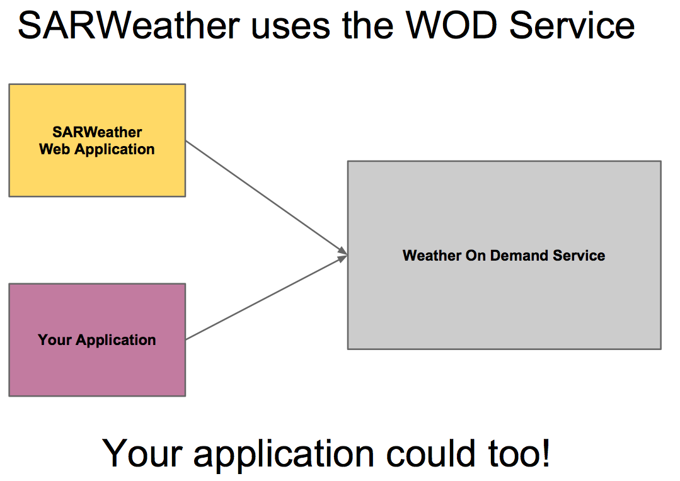
More on the service
AOGS Singapore
SARWeather – www.sarweather.com

Slide 62
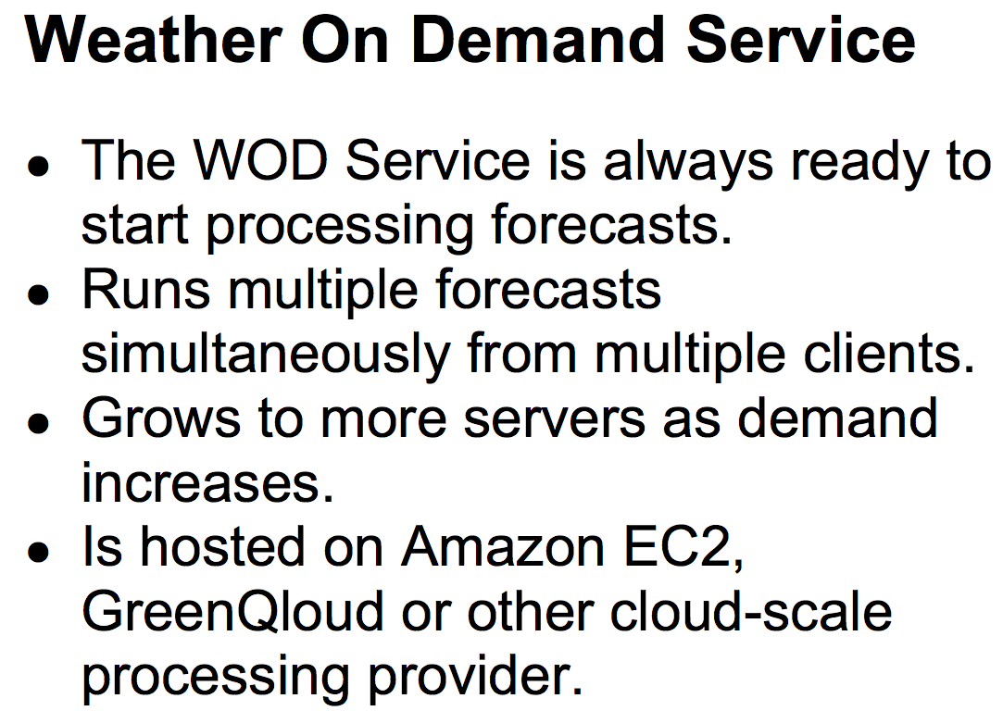
More on the service
AOGS Singapore
SARWeather – www.sarweather.com

Slide 63
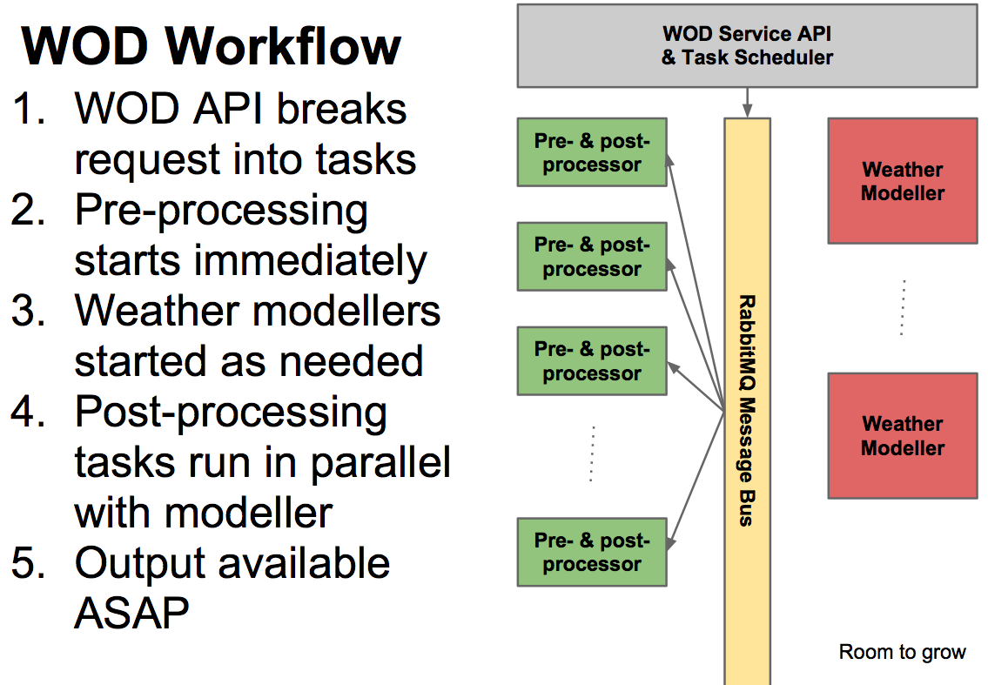
More on the service
AOGS Singapore
SARWeather – www.sarweather.com

Slide 64
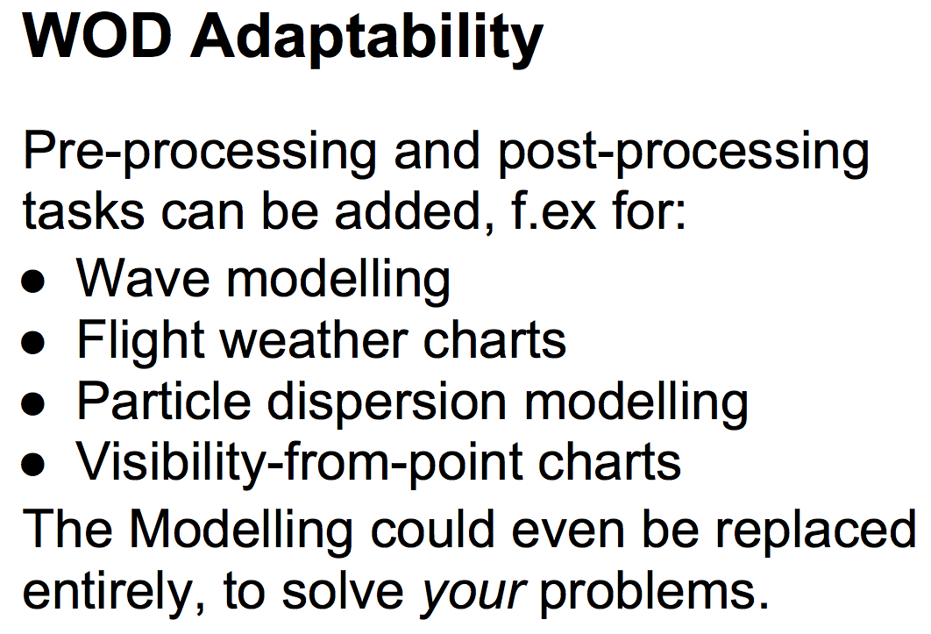
More on the service
AOGS Singapore
SARWeather – www.sarweather.com

