Slide 1

Greening of the Amazon
Rise of renewable energy in Brazil
Ólafur Rögnvaldsson
&
João Hackerott
Belgingur
or@belgingur.eu

Slide 2
Outline of this talk
Why?
Where?
How?
  WOD overview
Examples of applications

Slide 3
Why?
Brazil is the 5th largest country in the world by area and population
  8.5 million km²
  211 million in 2017
Ranked as the 8th largest economic area at the end of 2017
  2.055 billion US$ – 2.55% of the global GDP
Total installed capacity is 168,3 GW (owned by 47 companies)
  Hydro-power – 64% (1.319 power plants)
  Wind-power – 7,9% (511 wind parks)
  Solar-power – 0,6% (expected to increase by orders of magnitude in coming years)
  227 registered trading companies

Slide 4
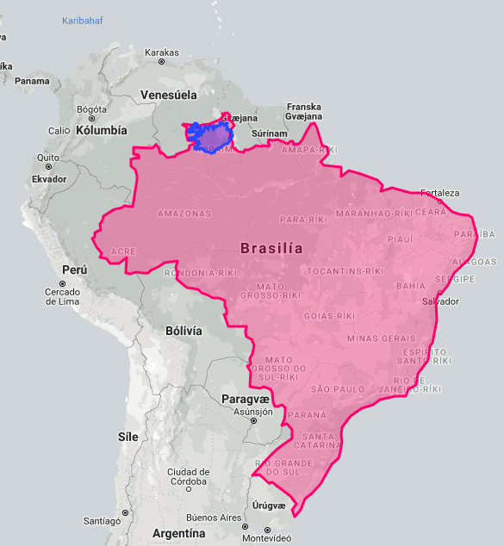
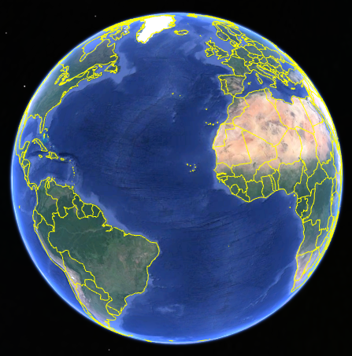
Where?

Slide 5
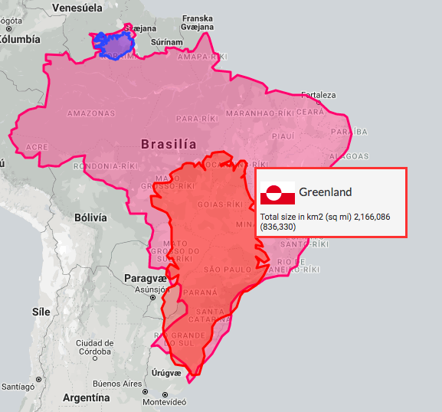
Where?

Slide 6
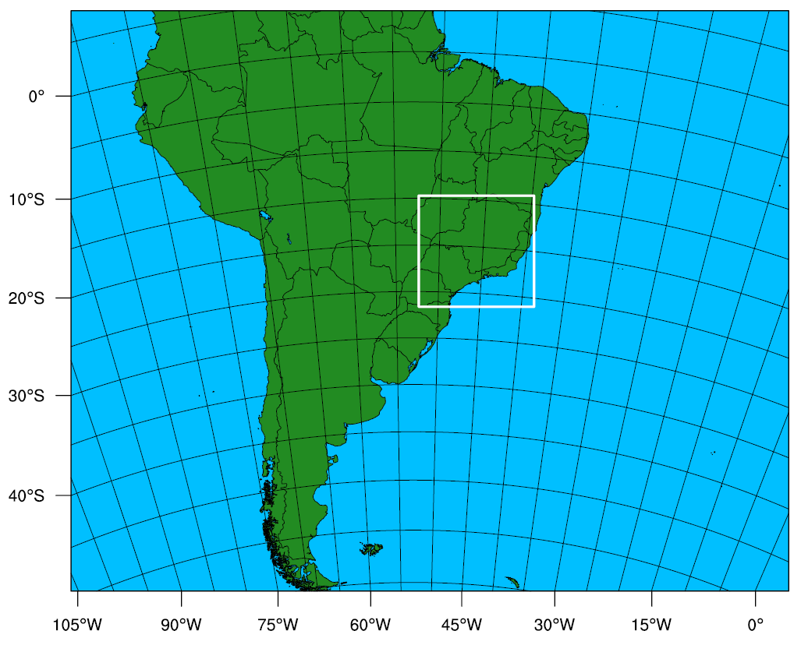
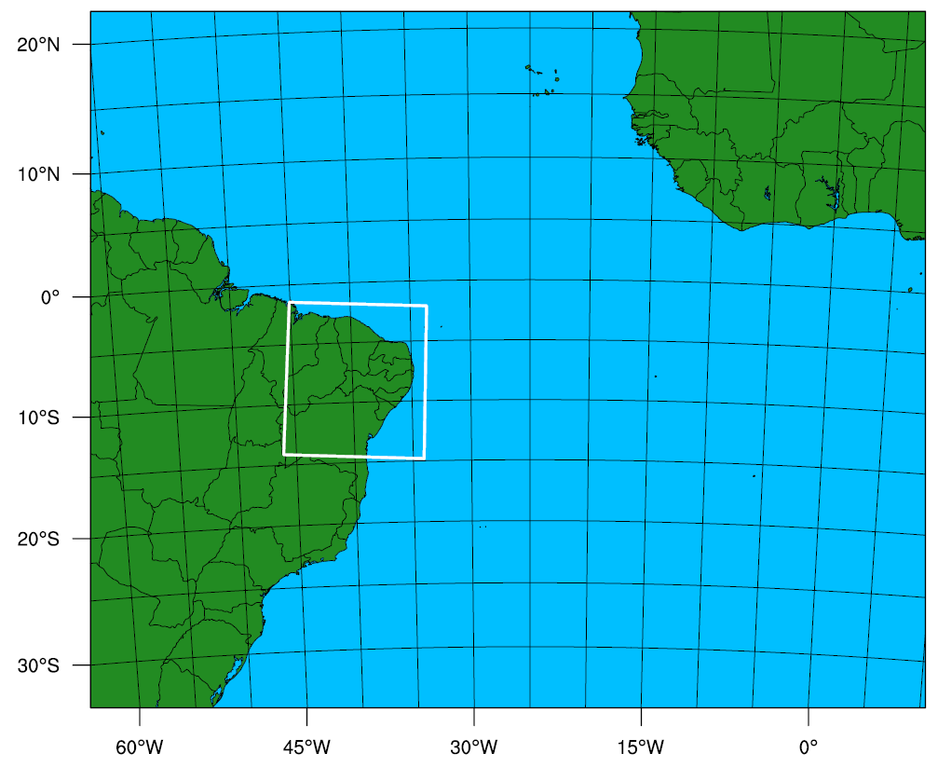
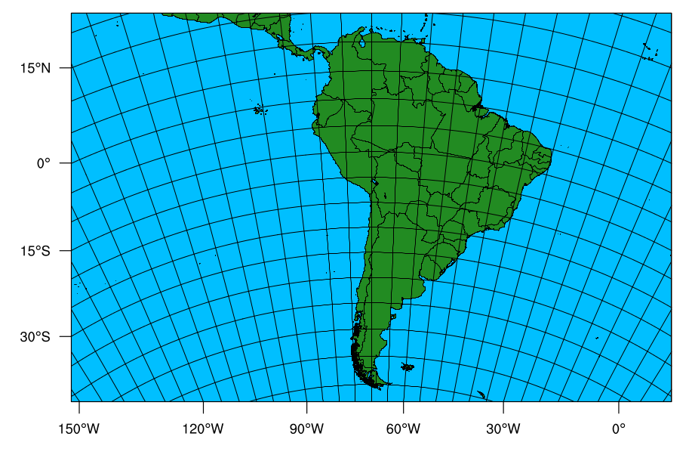
Where?
∆X=12,5km – 10 days
58 Mkm²
∆X= 12,5km – 10 days
50 Mkm²
∆X=2,5km – 5 days
1,8Mkm²
∆X=2,5km – 5 days
1,8Mkm²
∆X=20km – 30 days
109 Mkm²
We operate three individual forecast regions, of which two have a nested inner domain. Forecast range is 5, 10, and 30 days

Slide 7
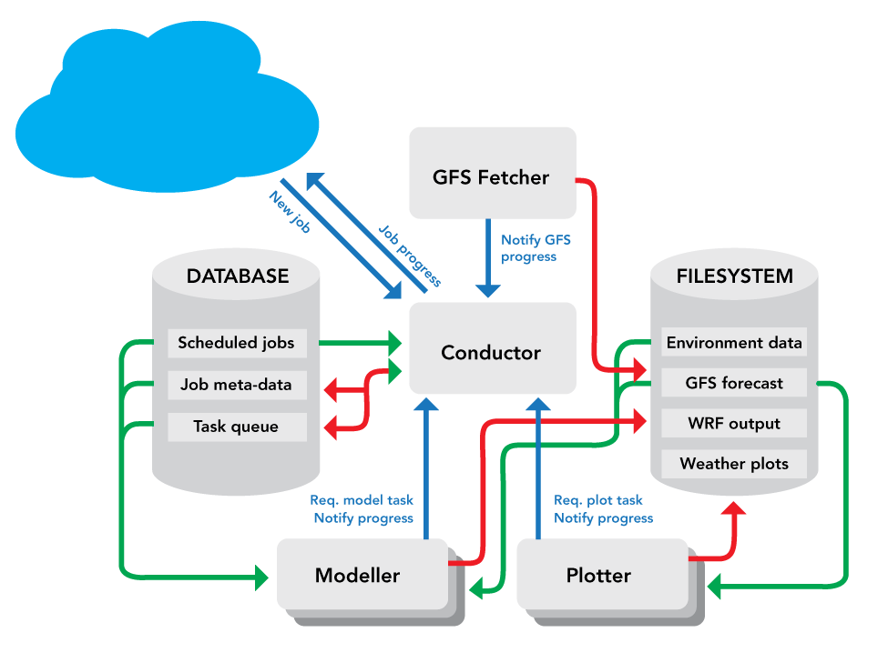
How?
The WOD forecasting system is run on an in-house cluster
Scalable
Reliable
Flexible
Notes:
Schematic of the main components of the WOD system. Red lines indicate data being written whilst green lines show data being read. Blue lines represent messages being sent and blue boxes show individual tasks within the WOD system. The cylinders are databases, to the left is the meta-database and to the right is the shared file-system database. The black boxes represent components of the WOD system that perform specific tasks, such are running the weather model (i.e. Modeller) or create weather charts (i.e. Plotter). See text for more detailed description of each component.

Slide 8
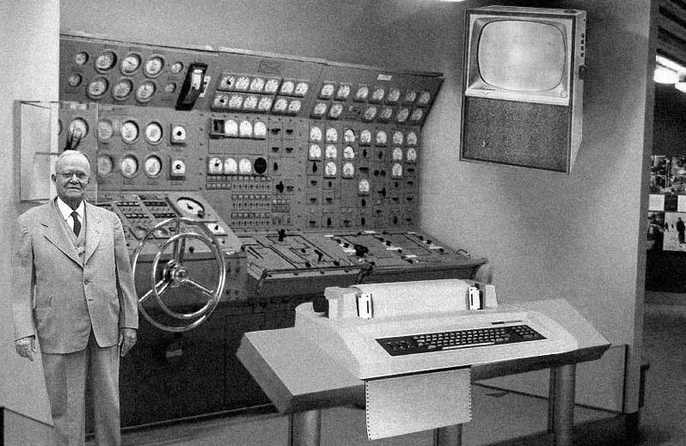
How?
The WOD forecasting system is run on an in-house cluster
Scalable
Reliable
Flexible
Notes:
Schematic of the main components of the WOD system. Red lines indicate data being written whilst green lines show data being read. Blue lines represent messages being sent and blue boxes show individual tasks within the WOD system. The cylinders are databases, to the left is the meta-database and to the right is the shared file-system database. The black boxes represent components of the WOD system that perform specific tasks, such are running the weather model (i.e. Modeller) or create weather charts (i.e. Plotter). See text for more detailed description of each component.

Slide 9
WOD description
Built around the WRF-Chem modelling system
Initial and boundary data taken from the global GFS model as well as the GEFS and CFS systems
System installation is fast and highly automated
Can be used to create conventional short- to medium-range weather forecasts for any location on the globe as well as ensemble and S2S forecasts
  Input can be GFS, GEFS, and/or CFS
Can be used as a tool to provide input to other modelling systems, such as hydrological and agro-models
A wide variety of post-processing options are also available

Slide 10
Trade energy applications
64% of the Brazilian energy production comes from hydro-power
Monitoring the precipitation over the main hydrological basins is crucial in order to be able to estimate the energy pricing fluctuations
About 30% of the energy produced in Brazil is traded on the Free Market, where large companies can buy energy from traders who operate on the energy stock market
The energy prices in the Free Market fluctuates daily according to the energy available in the national system
The price, therefore, highly depends on weather conditions, since wind-, solar- and hydro-power sums over 72% of the Brazilian energy matrix

Slide 11
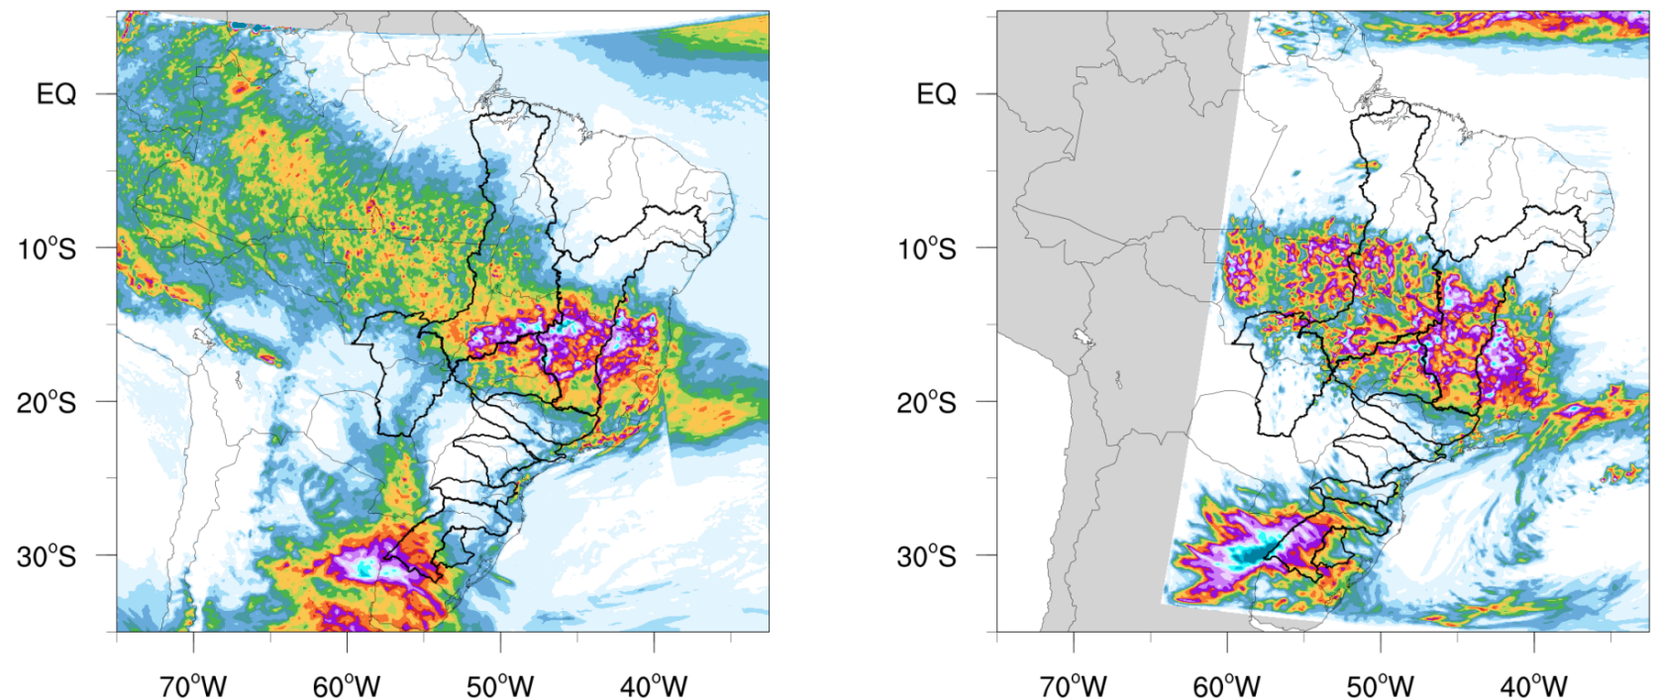
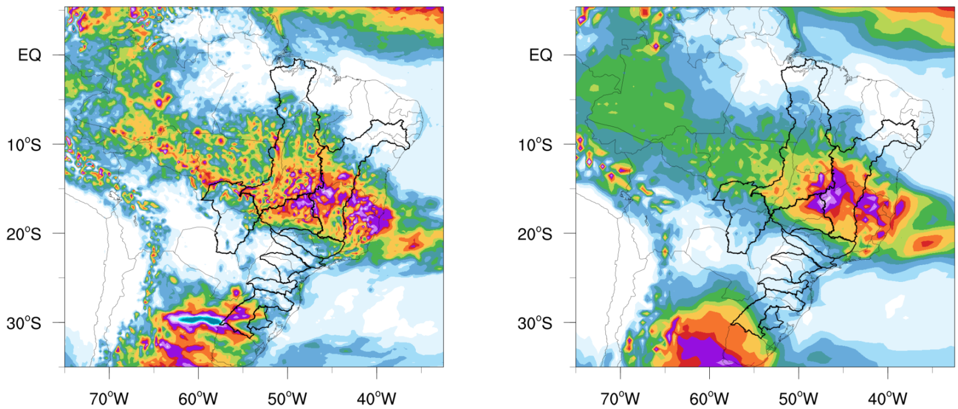
Operational model comparison
brazil-a
brazil-b
GFS
GEFS
5-days accumulated precipitation in different basins
(both for days 1-5 and 6-10)
[mm]

Slide 12
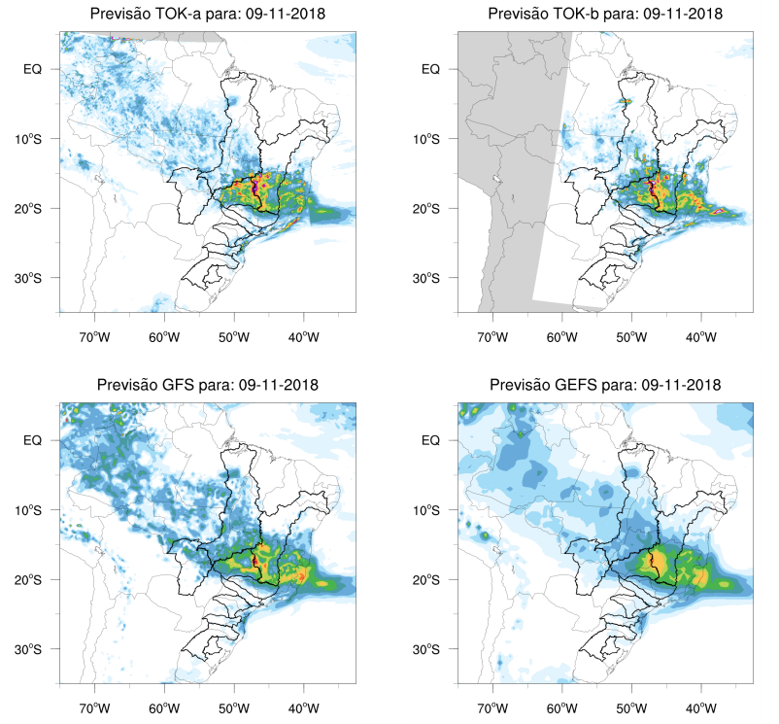
Also for daily precipitation up to 10 days

Slide 13
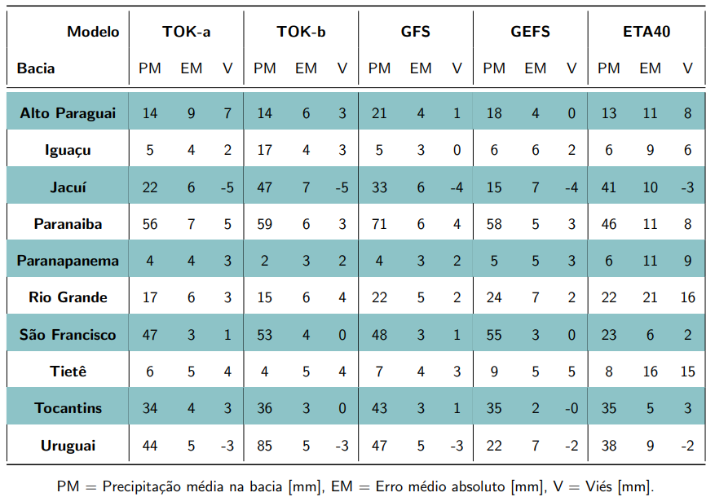
Objective values for model comparison per forecasted day or 5-days

Slide 14
Wind power production
The wind mill cannot be erected if the wind speed exceeds 8 m/s, so precise wind forecast at different levels above the ground is important during the farm’s installation and maintenance
Wind velocity, specially in tropical regions has strong diurnal and local variability (due to turbulence), so models with both high temporal and spatial resolutions are very important for wind power production forecast
In Brazil it is mandatory for wind power companies to report to the government the expected power production for the next 10 days
It is important for wind power companies short term strategic planning to estimate its power production, even though the energy pricing is fixed by long term contracts. Exceeding contracted energy production can be sold at the Free Market
Wind production is usually derived from wind speed, wind direction and air density estimated at the wind mill’s hub level

Slide 15
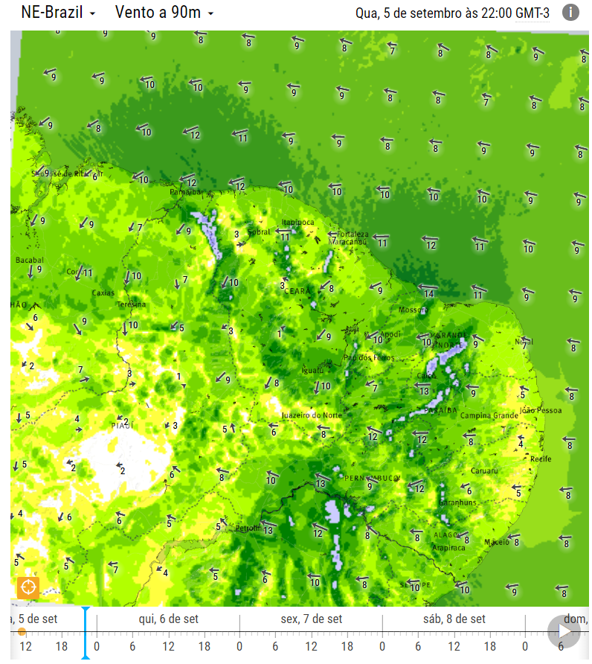
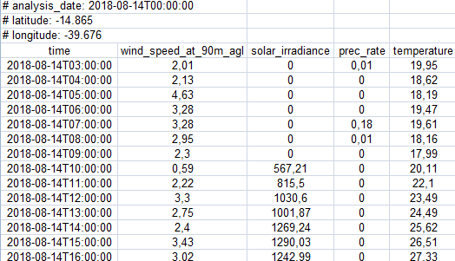
Wind speed at hub height

Slide 16
Solar power production
Solar farms are usually built in semi-desert regions where dust often covers instruments for irradiance data collection. A good 1-day weather forecast is an independent dataset to use for daily monitoring of irradiance
High temporal resolution of regional models output is very important for a precise production forecast
The solar power efficiency is a function of short wave downward irradiance, 2-m temperature and 10-m wind speed

Slide 17
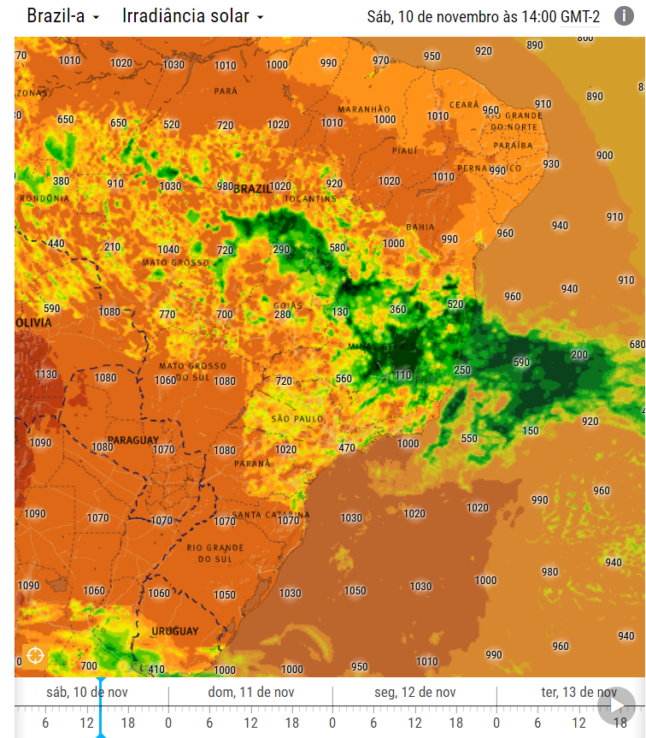
Incoming solar irradiance

Slide 18









Brazilian energy companies currently using our forecast solutions
Heimsyfirráð, eða kvef !!

Slide 19

Thank you

