Slide 1



Energy applications and tools
Ólafur Rögnvaldsson
&
João Hackerott
Addis Ababa, 10th February, 2017

Slide 2
Energy applications:
Implementation plan
Simulation for the past years
Maintenance schedule
Short range and S2S forecast
Production forecast
Short range and S2S forecast

Slide 3
Tool: WRF regional model
Non-hydrostatic core;
More than 100 million possible combinations of parameterizations;
Optimized for nesting and downscaling configurations;
Optimized for super-computer architecture;
Fits well for both short and long range forecast.

Slide 4
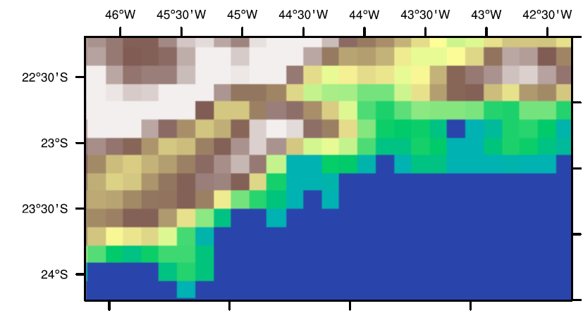
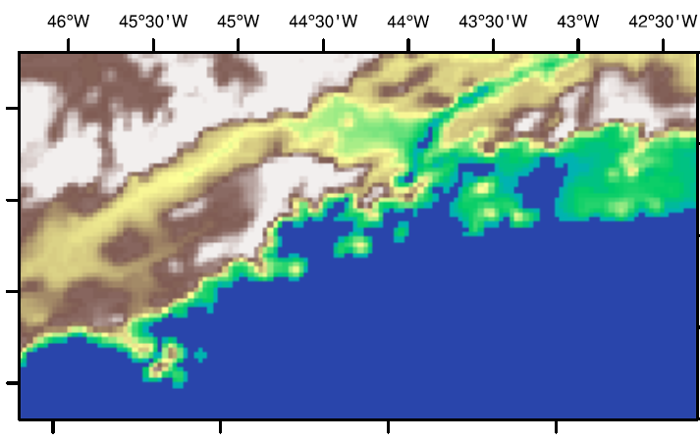
High resolution important
10Km Vs 3km
Altitude (m)

Slide 5
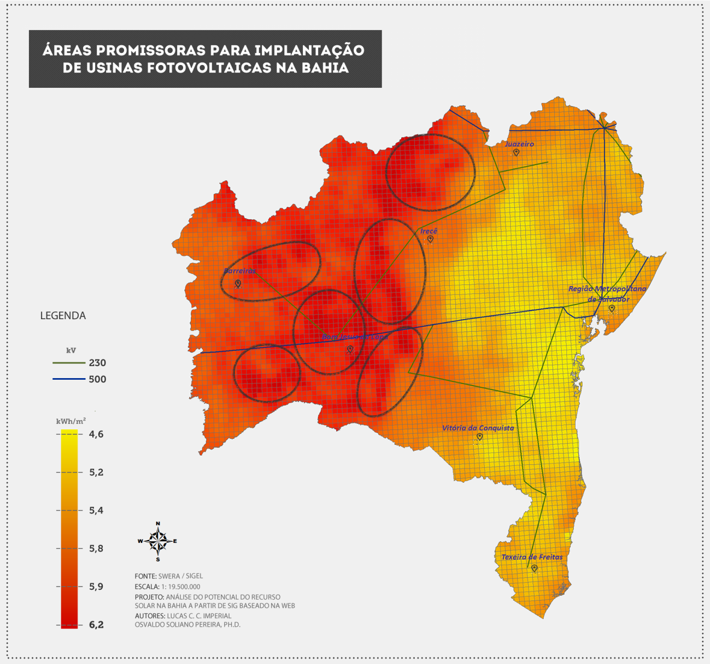
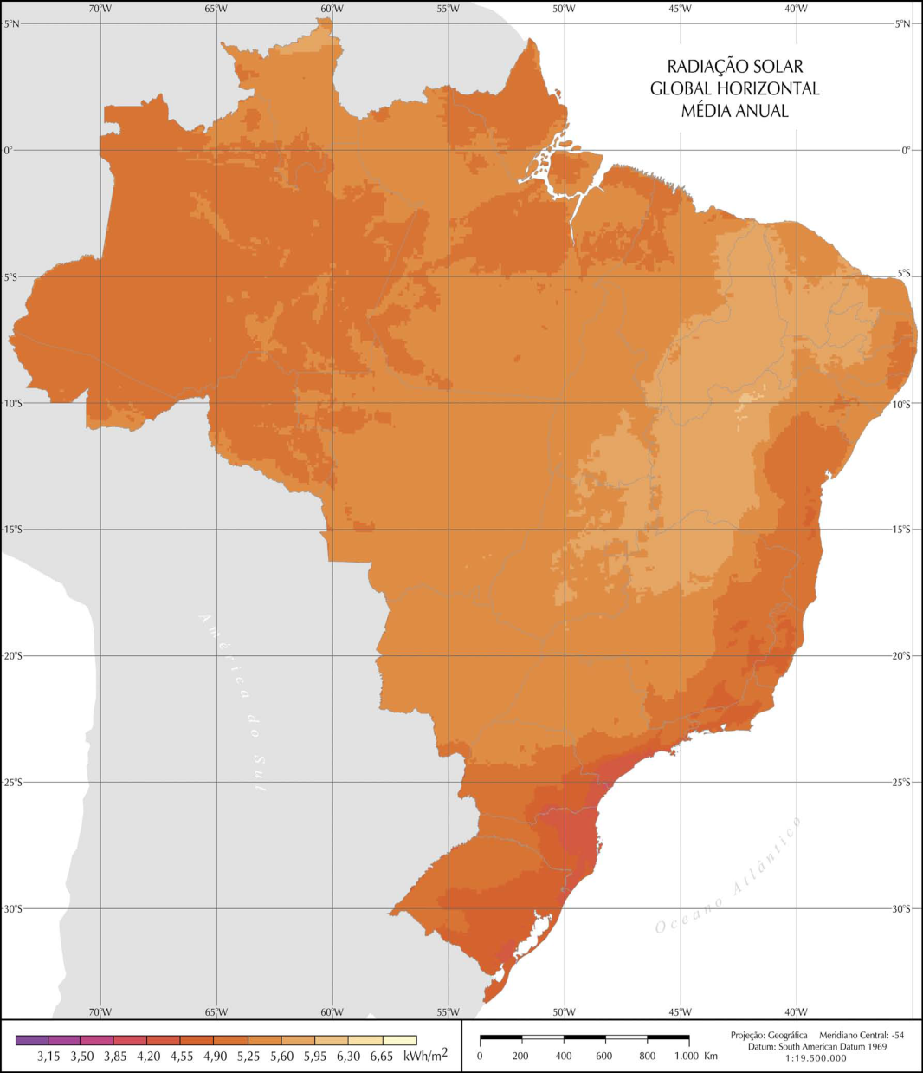
Energy implementation plan
Use the available dataset from the and run high resolution climate simulations
High resolution climatology
Low resolution climatology

Slide 6
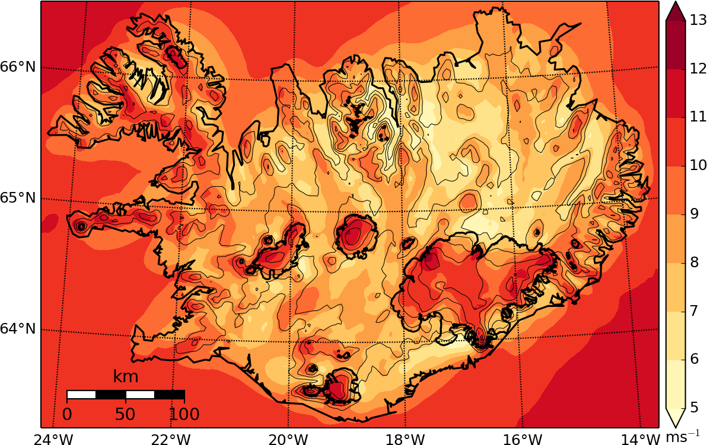
Energy implementation plan
Can be used as a first guess for estimating potential wind energy
Simulated mean annual wind speed in Iceland at 100 meters above ground

Slide 7
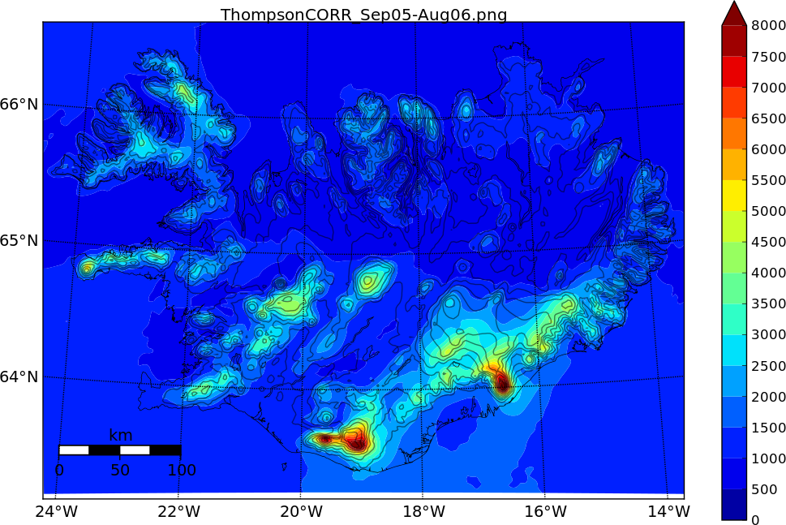
Energy implementation plan
Valuable data for estimating potential hydrological production
Simulated annual precipitation in Iceland 2005-2006

Slide 8
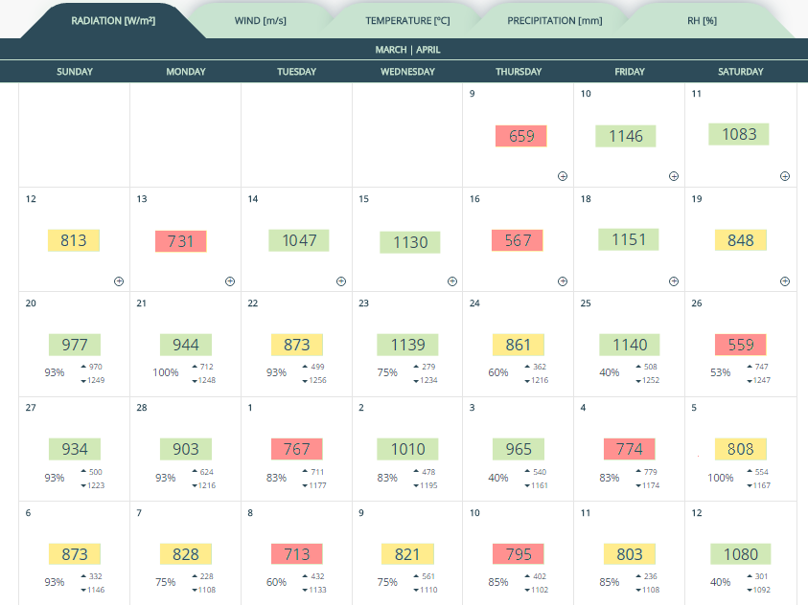
Maintenance schedule
Easily find out the best calendar window to send out the field team
Best days to send a field team to make maintenance
Probabilistic forecast shows the likelihood of the S2S forecast.

Slide 9
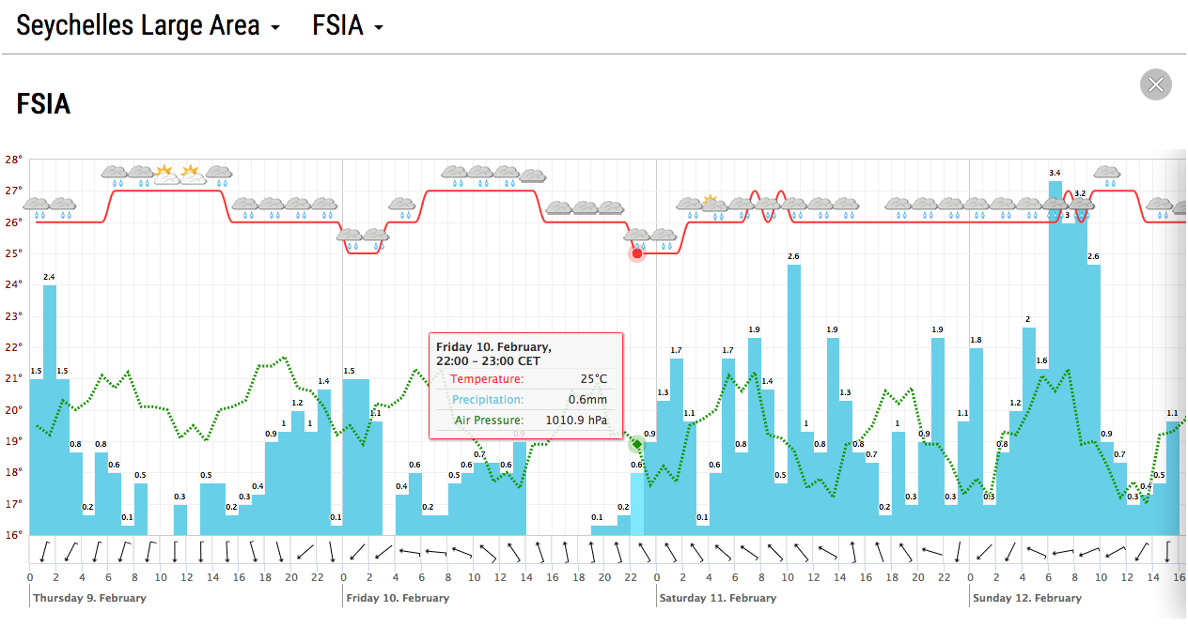
Maintenance schedule
Detailed meteograms for hourly weather forecast (first 10 days)
Day 1 Day 2 Day 3 Day 4

Slide 10
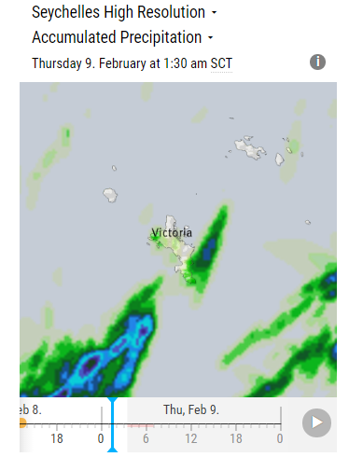
And high resolution maps
Showers for southern Victoria island in the Seychelles

Slide 11
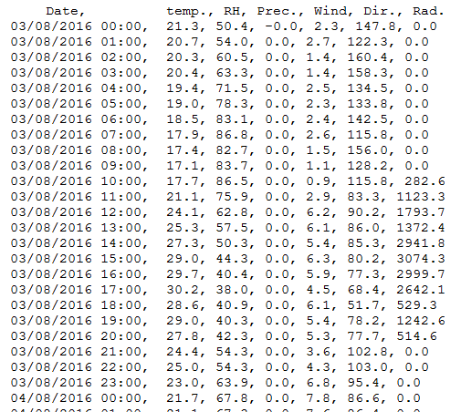
Production forecast
Energy management plan
Environmental forecast as an input in energy production models
Hourly forecast for the next 6 months available under many file formats.

Slide 12
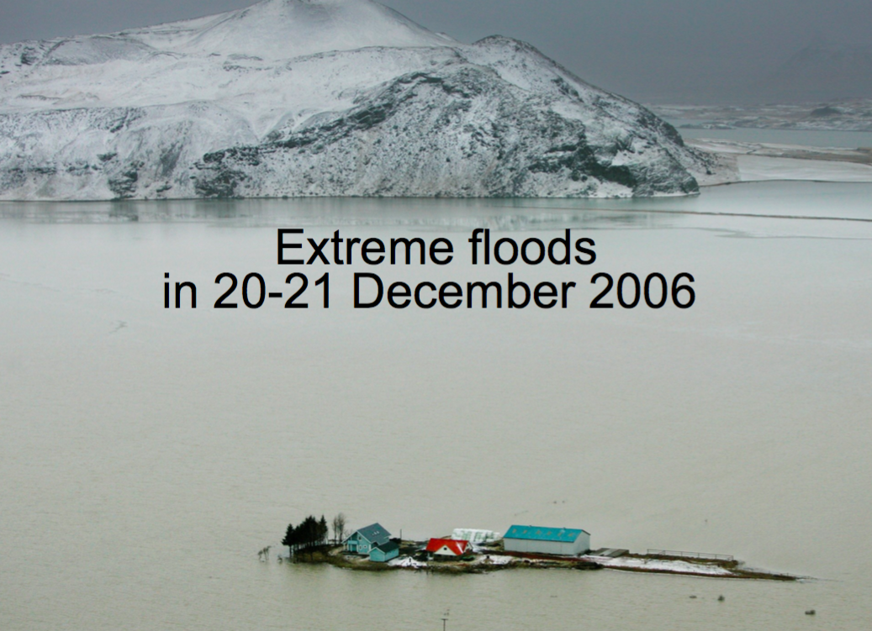
Using output for weather model as input to hydrological model
Leading to costly damages to constructions and loss of power production

Slide 13
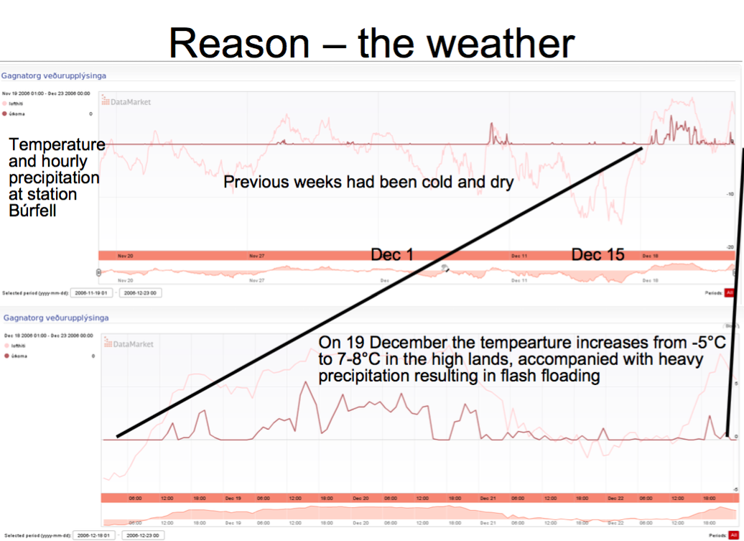

Slide 14
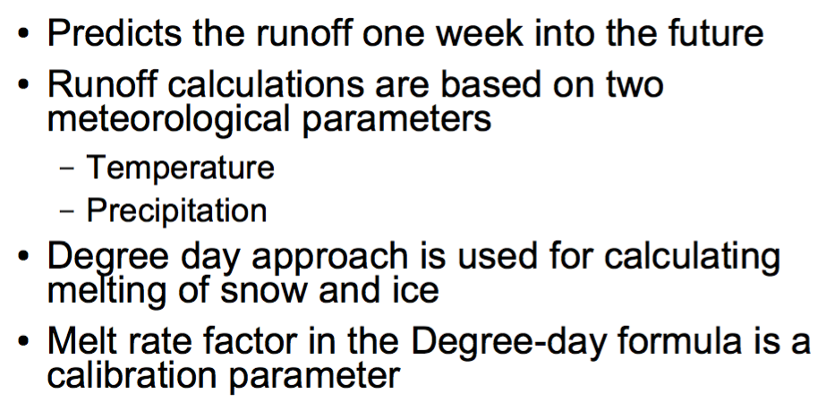
Old runoff model could not simulate this event

Slide 15
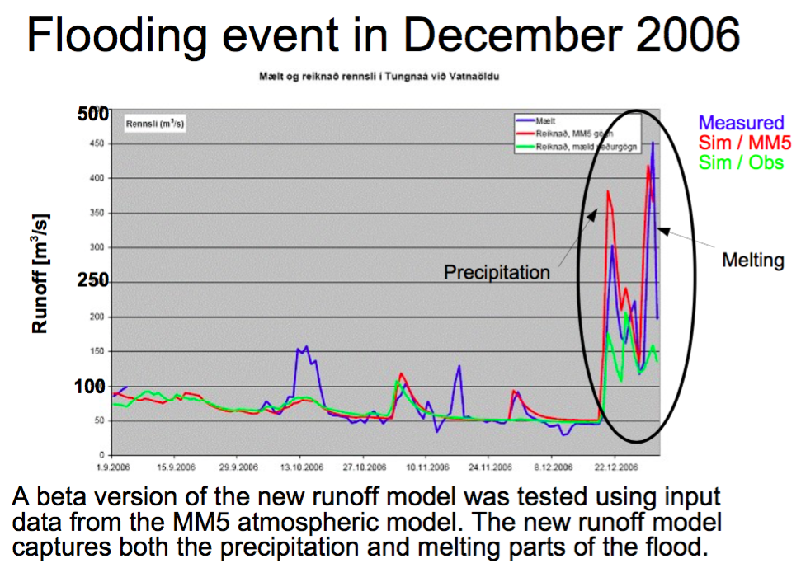

Slide 16
New runoff model has been in operational use since 2009
Forced with weather data from eleven ensemble members twice per day
Also forced with output from a deterministic model
Weather forecasts are run one week into the future
Used for planning and utilization of reservoirs
Model is routinely updated

Slide 17
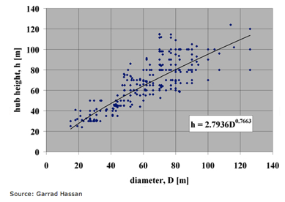
Planning ahead – wind energy
Modern day turbines range from 600kW to 5MW
  1.5-3MW most common commercial setup
Hub height between 20 and 120 meters
  Limited gain by going higher
  Increased wind shear
  Increased foundation loads
Source: Garrad Hassan
Notes:
Vertical wind shear is typically greater over land than off-shore, putting a limit to how large (blades) wind turbines can be. Large turbines are heavy, and a heavy turbine requires more expensive foundation than a light one. This puts a practical limit to the size of off-shore turbines.

Slide 18
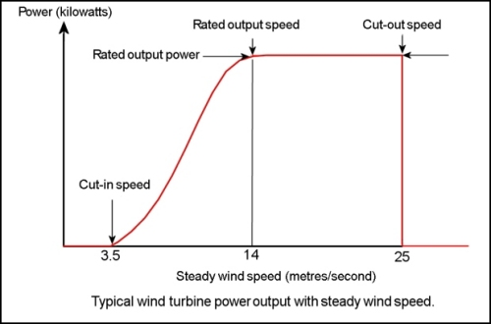
Planning ahead – wind energy
Power is ∝ to the cube of the wind speed
Typical capacity range is between 20-40%
Notes:
Wind power is proportional the the cube of the wind speed. Consequently, errors in predicted wind speed can result in relatively much larger errors in forecasts of power production.

Slide 19
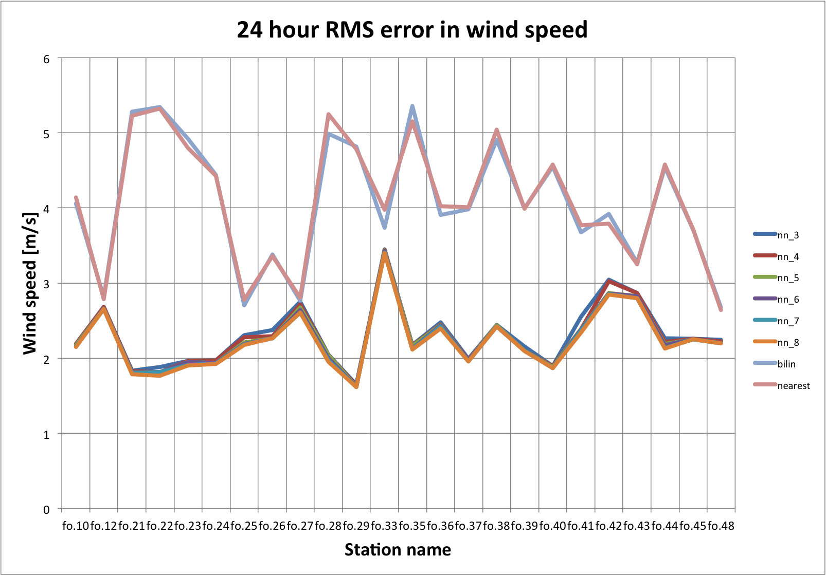
Observations can be used to reduce model error/bias
6
Example for a 24hr
wind forecast in the Faroe Islands. Error reduced by 45% on average
4
2
0

Slide 20
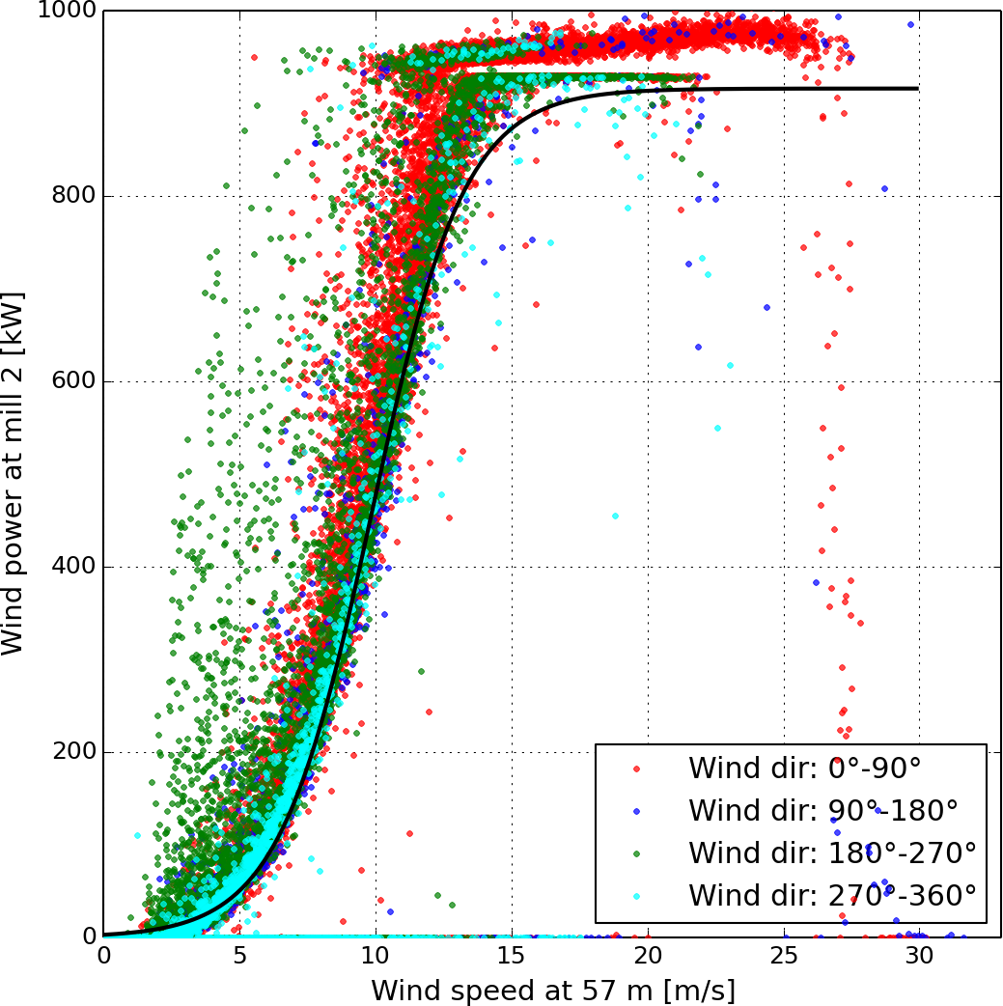
Power production as function of wind speed at hub height
Wind speed is seldom steady
Atmospheric stability is important
Turbulence and icing can reduce production

Slide 21
Planning ahead – wind energy
Different time scales for forecasting volatile renewable energy (e.g. wind and solar)
  3-5 days
  1-2 days
  0-12hrs
From Marquis et al., BAMS, vol 92, September, 2011
Notes:
The cost of poor forecast in the near future (i.e. 0-12 hrs) can be significant. The reason is that the load on the distribution grid needs to be known with fairly good accuracy. If a windpark undershoots, someone else needs to increase the electric production. Likewise, if electric production by VRE is more than estimated/planned, someone else needs to produce less. These modifications of production, made on a short-notice, can be quite costly. It is worth noting that the response time of a hydropowerplant utilizing reservoirs, can be very short (< 10 minutes) in contrast to a gas or a coal power-plant (hours, gas is more responsive than coal, and newer plants are more responsive than older ones). This puts Norway in an excellent position with nearly 30GW of hydropower and only about 450MW of installed wind power.

Slide 22

Planning ahead – wind energy
20MW / 80MWh plant
Notes:
Tesla aims to provide 15 GWh of battery storage by 2020

Slide 23
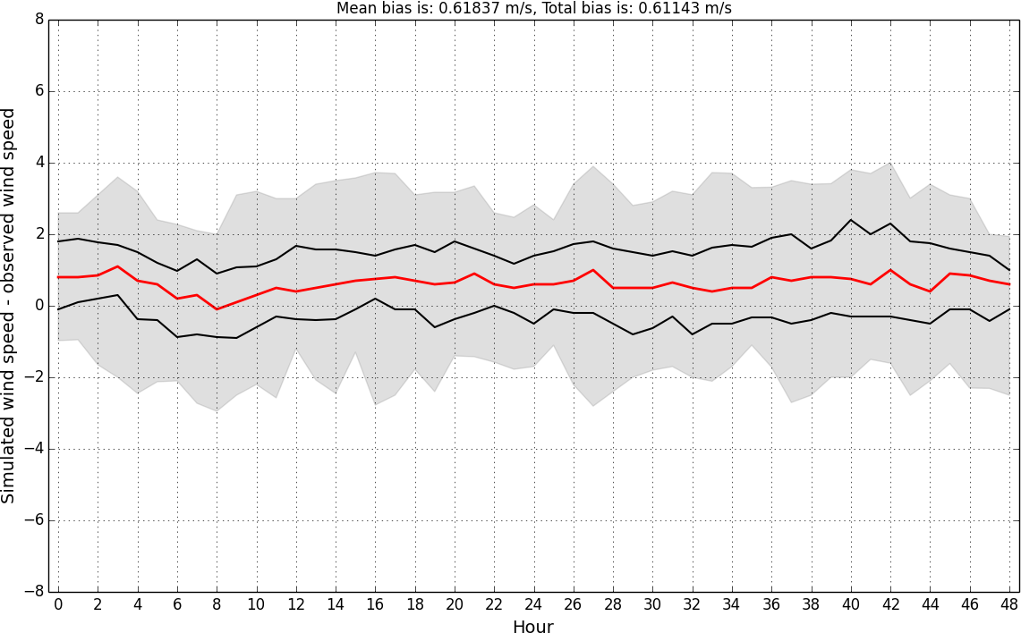
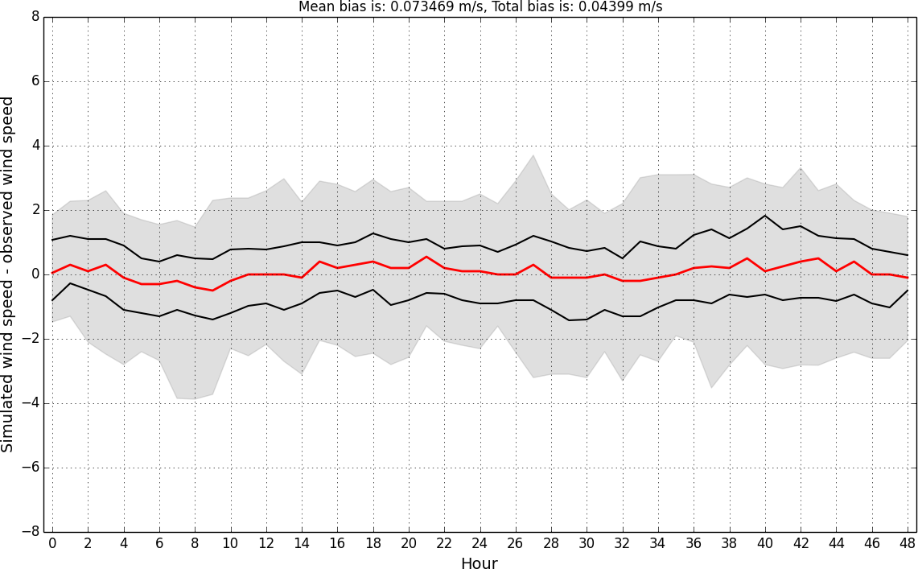
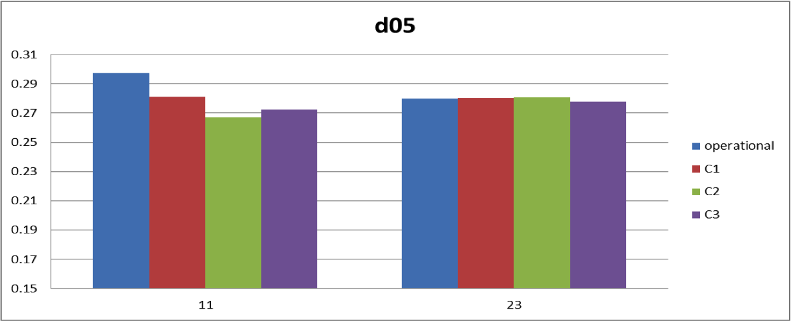
Improved wind forecast does not necessarily improve power forecast
12km resolution
1.3km resolution
Simulated minus observed
Weather forecast
Mean bias = 0.62m/s
Mean bias = 0.07m/s
Power forecast
Average relative error
12km res.
1.3km res.
12km res.
1.3km res.
Windfarm #11 Windfarm #23

Slide 24
Planning ahead – wind energy
Improved and new observation techniques
  Vertical profiles at high temporal resolution
    e.g. UAVs and Doppler Lidar/Sodar/Radar
Improved data assimilation methods
Improved models and model setup
  Better power production models
  High vertical resolution needed in the lowest few hundred meters above ground
  3D-TKE vs. 1D-PBL schemes

Slide 25
Keep in mind that resolution is important
10Km Vs 3km
Altitude (m)

Slide 26
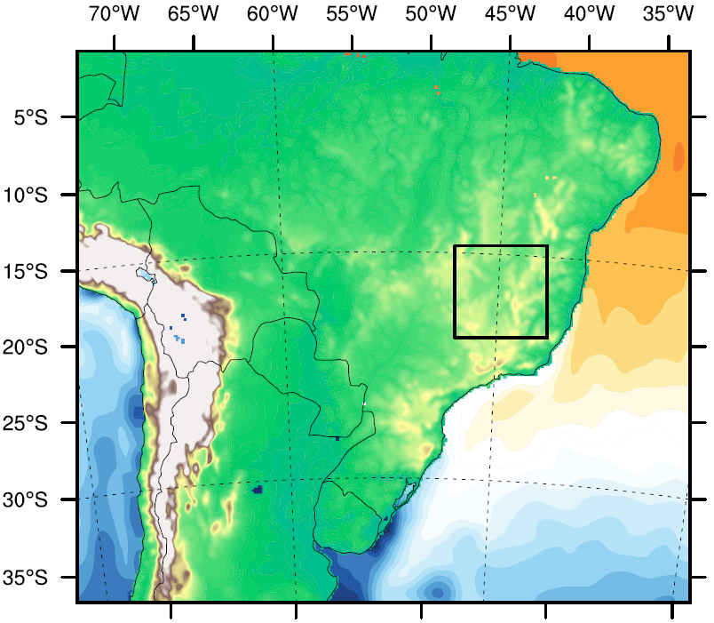
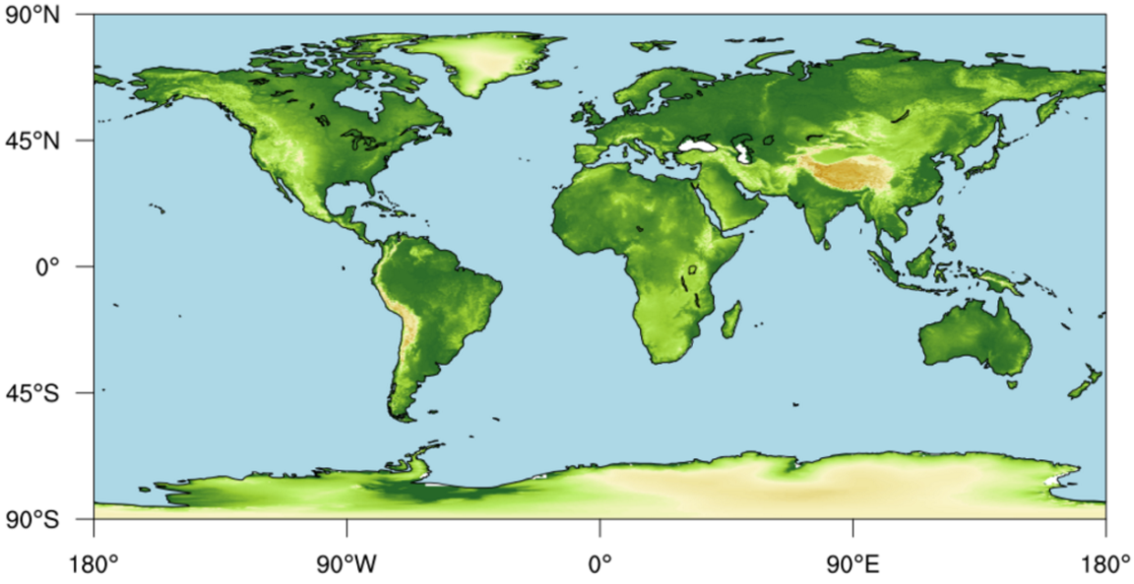
Short range forecast
(1-10 days)
D1: 15Km
D2: 3Km
GFS: 0.25°
Boundary conditions:
GFS / ECMWF
Initial conditions for D1 and D2.
Boundary of D1 updated each 3h.

Slide 27
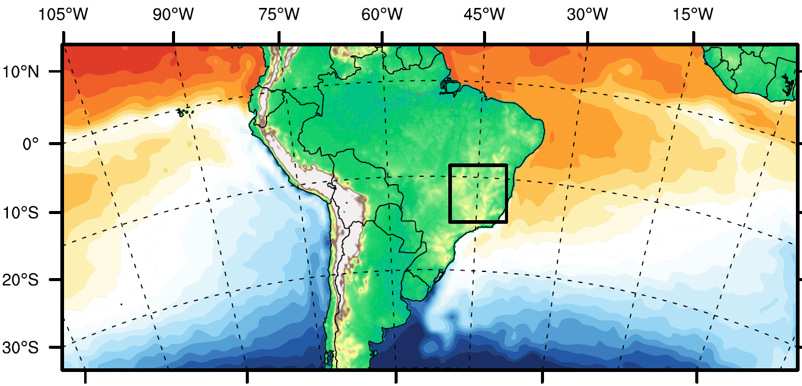
S2S and seasonal forecast
Boundary conditions:
CFS 0.5°
Initial conditions for D1 & D2;
Boundary of D1;
Nudging above PBL for D1;
SST updated.
D2: 4Km
Área útil: 420x420 Km
D1: 20Km

Slide 28
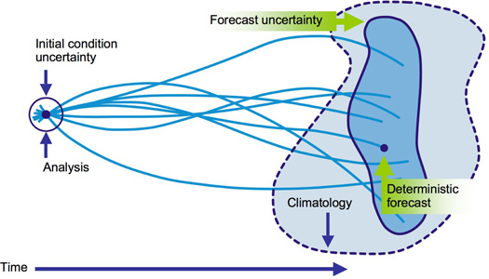
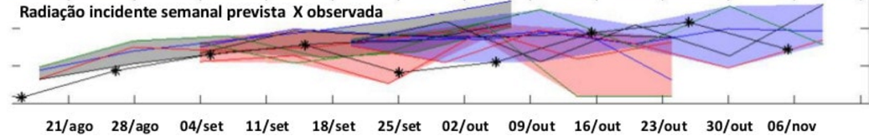
Ensemble forecast
Slingo and Palmer, 2011
Statistical analysis of the different forecasts.
Simulated and observed incoming solar radiation

Slide 29
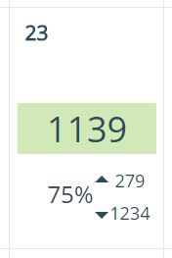
Weighting ensemble system
Alert color based in the highest probability
Average of the results that fall within the range alert with higher probability.
Range of the forecast ensemble members
Probability of the chosen alert
Neighboring points
Simulations started from different times
Different model configurations
Probability is calculated based in results from different simulated datasets:

Slide 30
Starting time weight
-2d
-1d
Today
Forecast
13.75%
27.5%
55%

Slide 31
Neighboring weight
. | . | . | .
. | . | . | .
. | . | . | .
. | . | . | .
Bi-linear interpolation from the farthest cells: 20%
Bi-linear interpolation from nearest grid cells: 80%

Slide 32
Model configuration weight
Compare many different model configurations to observations;
Choose 4 configurations that in average provide different forecast results;
Rank the model configurations based in statistical comparison with observations.
C₁ 48.55%
C₂ 24.25%
C₃ 12.1%
C₄ 6.05%
Best forecast

Slide 33
Energy applications and tools
Ólafur Rögnvaldsson
or@belgingur.is
João Hackerott
Addis Ababa, 10th February, 2017

