Slide 1


Atmos. and Meteorological Instrumentation – EGU 2012
Small unmanned airplanes and their use to improve on-demand local forecasts
forecasts
Ólafur Rögnvaldsson – IMR/UiB
Hálfdán Ágústsson – IMR/UI/IMO
Marius O. Jonassen – UiB/IMR
Haraldur Ólafsson – UI/UiB/IMO

Slide 2
Acknowledgement
Atmos. and Meteorological Instrumentation – EGU 2012
SARWeather is a joint research project led by IMR/Belgingur, in collaboration with NOAA/ESRL, the University of Bergen, and the private companies GreenQloud and DataMarket. To ensure maximum usability for SAR operators, SARWeather is developed in close collaboration with ICE-SAR and the Civil Protection Department of the Icelandic Police.
SARWeather was initially funded in part by grant number 550-025 (Vejrtjeneste for Søberedskab) from NORA and by the European Commission under the 7th Community Framework Programme for Research and Technological Development (GalileoCast). GalileoCast is managed by GSA, the European GNSS Supervisory Authority.
Current development of SARWeather is funded in part by the Icelandic Technical Development Fund – RANNÍS
Development related to the SUMO has in part been funded by the COST project ES0802
SARWeather

Slide 3
Overview
Atmos. and Meteorological Instrumentation – EGU 2012
Importance of resolution
Current Crisis Response System
  SARWeather general description
Use of observations from UAS’s
  The SUMO system
On-going research
  SARWeather and SUMO
Conclusions
SARWeather

Slide 4
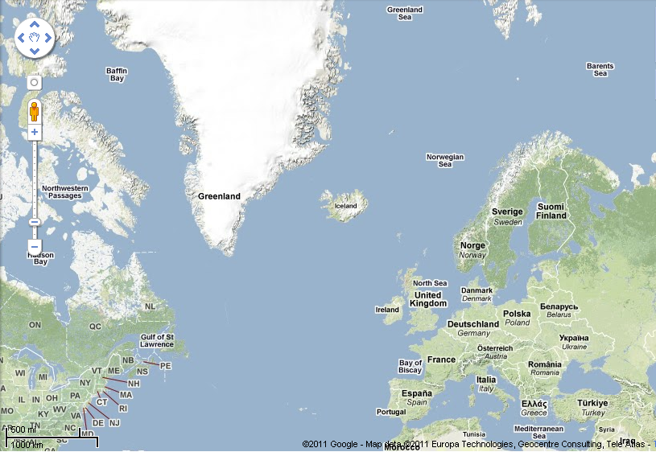
Importance of high resolution
Atmos. and Meteorological Instrumentation – EGU 2012
Global forecasts
15-50 km grid
SARWeather forecasts
9 – 3 – 1 km grids
SARWeather

Slide 5
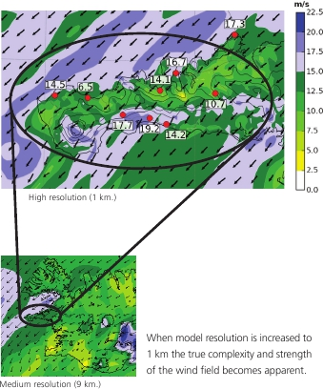
Importance of high resolution
Atmos. and Meteorological Instrumentation – EGU 2012
Very high resolution – 1 km
When model resolution is increased to 1 km the true complexity and strength of the wind field becomes apparent
Medium resolution – 9 km
SARWeather

Slide 6
Why not always use 1km resolution?
Atmos. and Meteorological Instrumentation – EGU 2012
Need 1000-times more CPU power to simulate a 1 km resolution forecast than a 10 km one for the same region!
SARWeather

Slide 7
What if
Atmos. and Meteorological Instrumentation – EGU 2012
You only need high very high resolution once in a while?
Computer clouds (e.g. Azure, EC2 and GreenQloud) are starting to offer HPC service
Offers great scalability
Relatively cheap
And there is already a solution out there ☺
SARWeather

Slide 8
Crisis Response System
Atmos. and Meteorological Instrumentation – EGU 2012
Good weather information help improve decision making
Current CRS uses the WRF model and consists of a
  Backend and Frontend
Frontend is called SARWeather
  Easy to use
  Fast
  Flexible model output and presentation
    CF and ArcGIS compliant output files
    Interactive and static maps
SARWeather

Slide 9
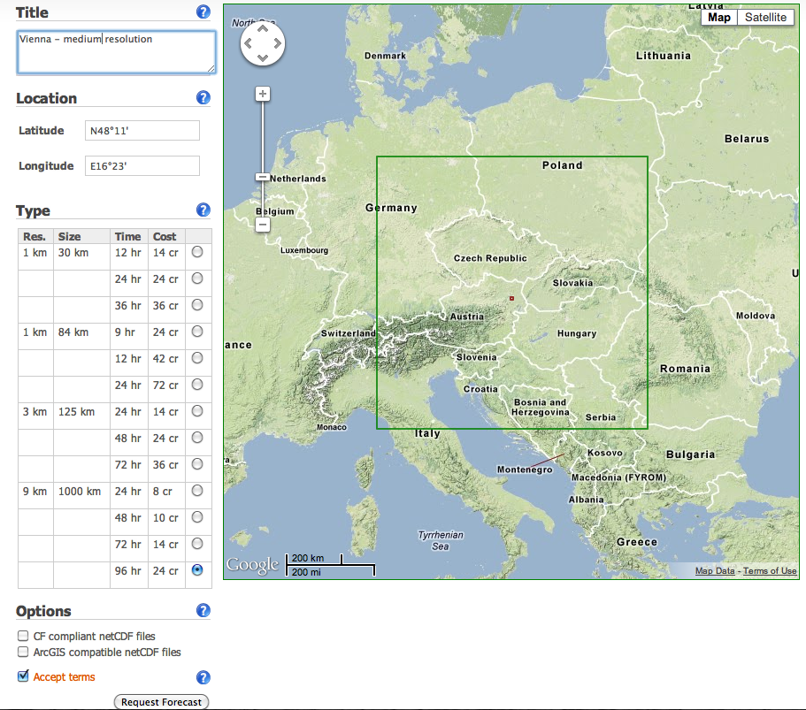
SARWeather
Atmos. and Meteorological Instrumentation – EGU 2012
Give the forecast a name
Type in Lat/Lon or click on the map
Choose resolution:
1, 3, or 9 km
SARWeather

Slide 10
SARWeather
Atmos. and Meteorological Instrumentation – EGU 2012
Give the forecast a name
Type in Lat/Lon or click on the map
Choose domain size
SARWeather

Slide 11
SARWeather
Atmos. and Meteorological Instrumentation – EGU 2012
Give the forecast a name
Type in Lat/Lon or click on the map
Choose forecast duration
SARWeather

Slide 12
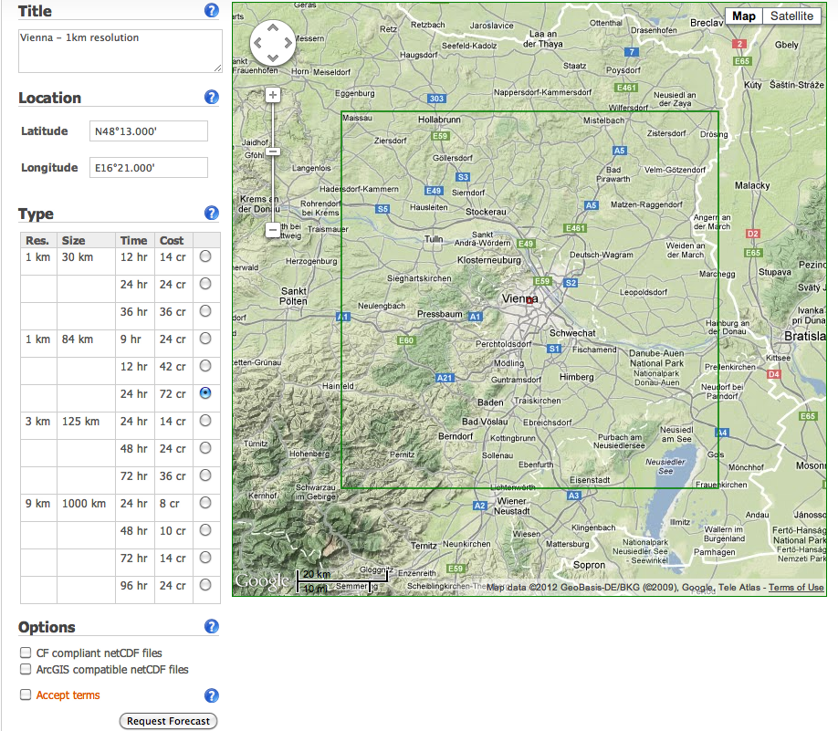
SARWeather
Atmos. and Meteorological Instrumentation – EGU 2012
Give the forecast a name
Type in Lat/Lon or click on the map
1km resolution, 84x84 km domain and 24 hr forecast
Do you need CF or ArcGIS compliant output files?
When all is set, run forecast
SARWeather

Slide 13
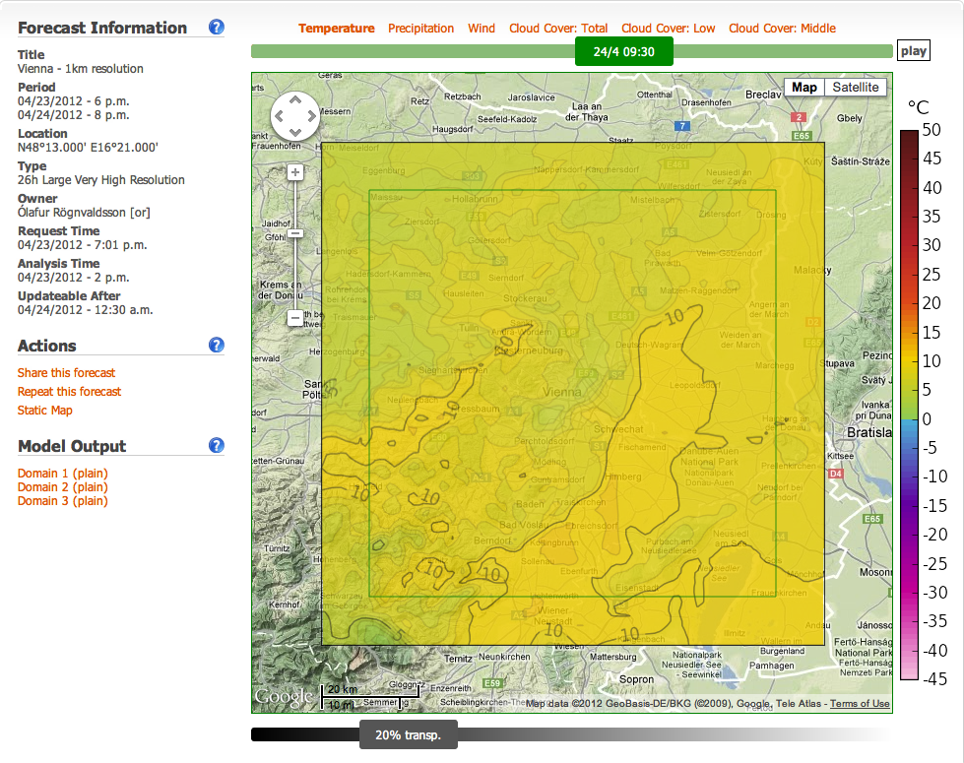
SARWeather
Atmos. and Meteorological Instrumentation – EGU 2012
Time from initiation:
30 sec – computer node up’n running
2 min 40 sec – pre-processing done and model starts running
5 min 50 sec – first frame ready on screen
51 min 50 sec – 24 hr forecast ready
54 min 20 sec – “static” post-processing done
Typical response time for SAR operators is 30 min or less
Time slider
Chose variable
Zoom
SARWeather
Control transparency

Slide 14
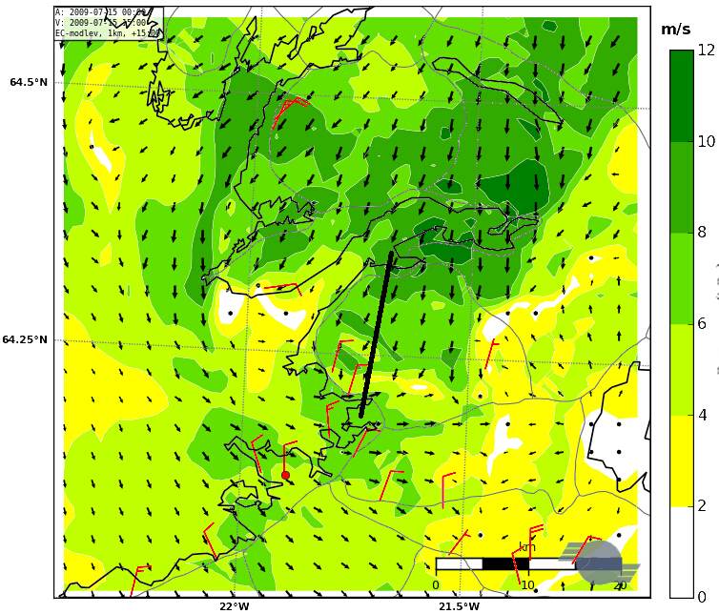
High resolution not always sufficient
Atmos. and Meteorological Instrumentation – EGU 2012
Simulated and observed surface winds
on 15 July 2009 at 13 UTC
Model simulates a see-breeze that is not seen in observations
WRF at a resolution of 500 m forced with ECMWF-data on model levels.
Observed surface winds in red
Mt. Esja
SARWeather

Slide 15
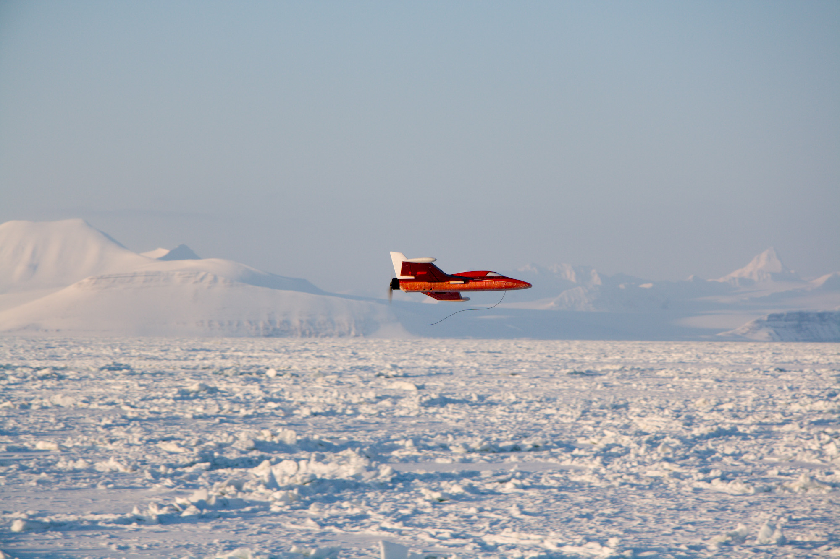
SUMO and WRF
Measurements and simulations of volcanic ash for civil aviation
The SUMO (Small Unmanned Meteorological Observer) can measure winds, humidity, pressure, and temperature in a vertical profile up to a 4km height
SARWeather

Slide 16
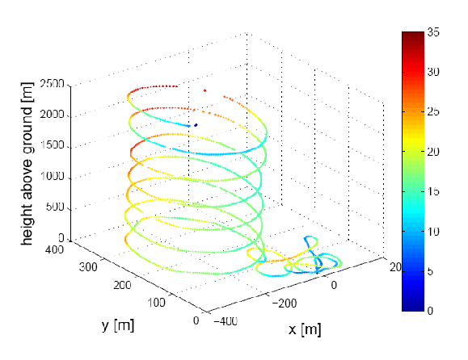
SUMO and WRF
Atmos. and Meteorological Instrumentation – EGU 2012
This data can be assimilated with the WRF weather forecast
More on Friday at 8:45, Room 14: Assimilating data from an unmanned aircraft into a local-scale numerical weather forecast
SARWeather

Slide 17
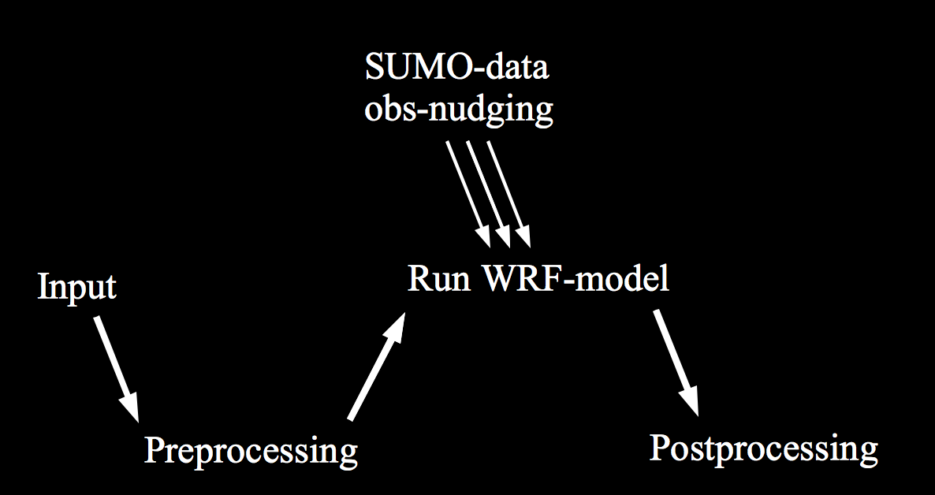
SUMO and WRF
Atmos. and Meteorological Instrumentation – EGU 2012
The SUMO-data is incorporated into the WRF-simulation, via obs-nudging
SARWeather

Slide 18
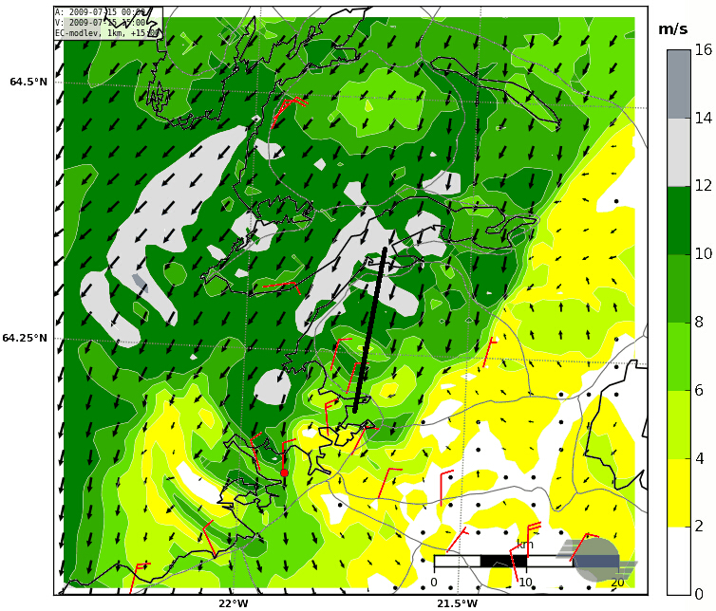
Effects of additional observations
Atmos. and Meteorological Instrumentation – EGU 2012
Simulated and observed surface winds
on 15 July 2009 at 13 UTC
The flow structure is now in much better agreement with available observations
WRF at a resolution of 500 m forced with ECMWF-data on model levels and SUMO data
Observed surface winds in red
Mt. Esja
SARWeather

Slide 19
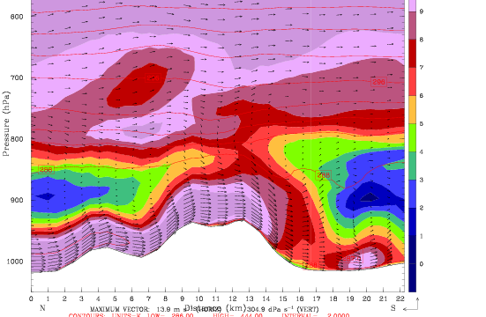
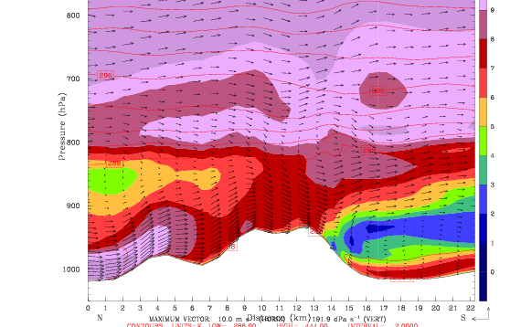
Effects not just at the surface
Atmos. and Meteorological Instrumentation – EGU 2012
Simulated flow in N-S section across Mt. Esja
No extra observations
Wrong!
A major difference in flow pattern extending far above mountain top leve
Wind speed, ranging from 0 to 12 m/s
SARWeather
23 km

Slide 20
Effects can be far reaching
Atmos. and Meteorological Instrumentation – EGU 2012
“Substantial improvements of winds, temperatures and humidity in the region are achieved”
CTRL - ObsNudge
50 km
Marius O. Jonassen, Haraldur Ólafsson,
Hálfdán Ágústsson, Ólafur Rögnvaldsson, and Joachim Reuder (2012). Improving a high resolution numerical weather simulation by assimilating data from an unmanned aerial system.
Monthly Weather Review, in revision
SARWeather

Slide 21
Additional sensors
Atmos. and Meteorological Instrumentation – EGU 2012
The SUMO has been equipped with an optical dust sensor
GP2Y1010AU0F is a dust sensor by optical sensing system:
An infrared emitting diode (IRED) and an phototransistor are diagonally arranged into the device
It detects the reflected light of dust in air
Especially effective to detect very fine particle
In addition it can distinguish smoke from house dust by pulse pattern of output voltage
Saturation at about 500μg/m³
SARWeather

Slide 22
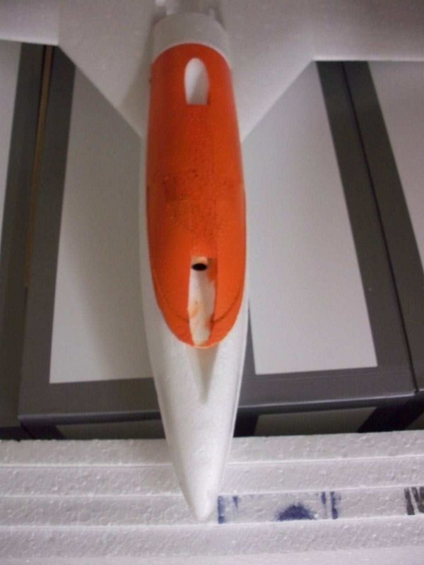
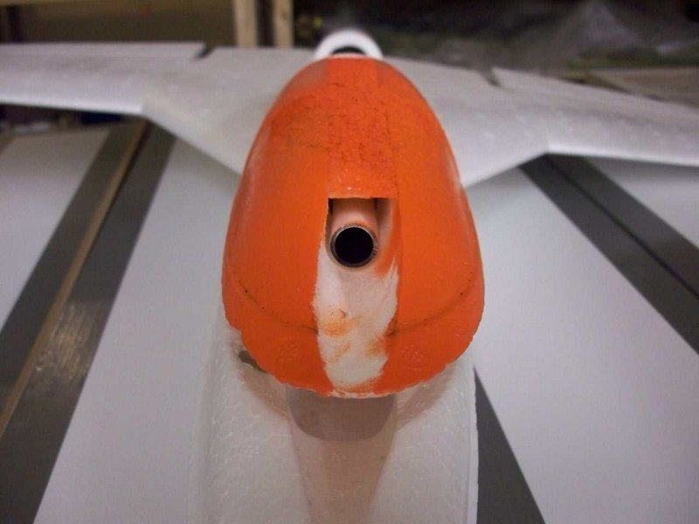
Preliminary results
Atmos. and Meteorological Instrumentation – EGU 2012
The SUMO dust sensor has been tested in France and Iceland
SARWeather

Slide 23
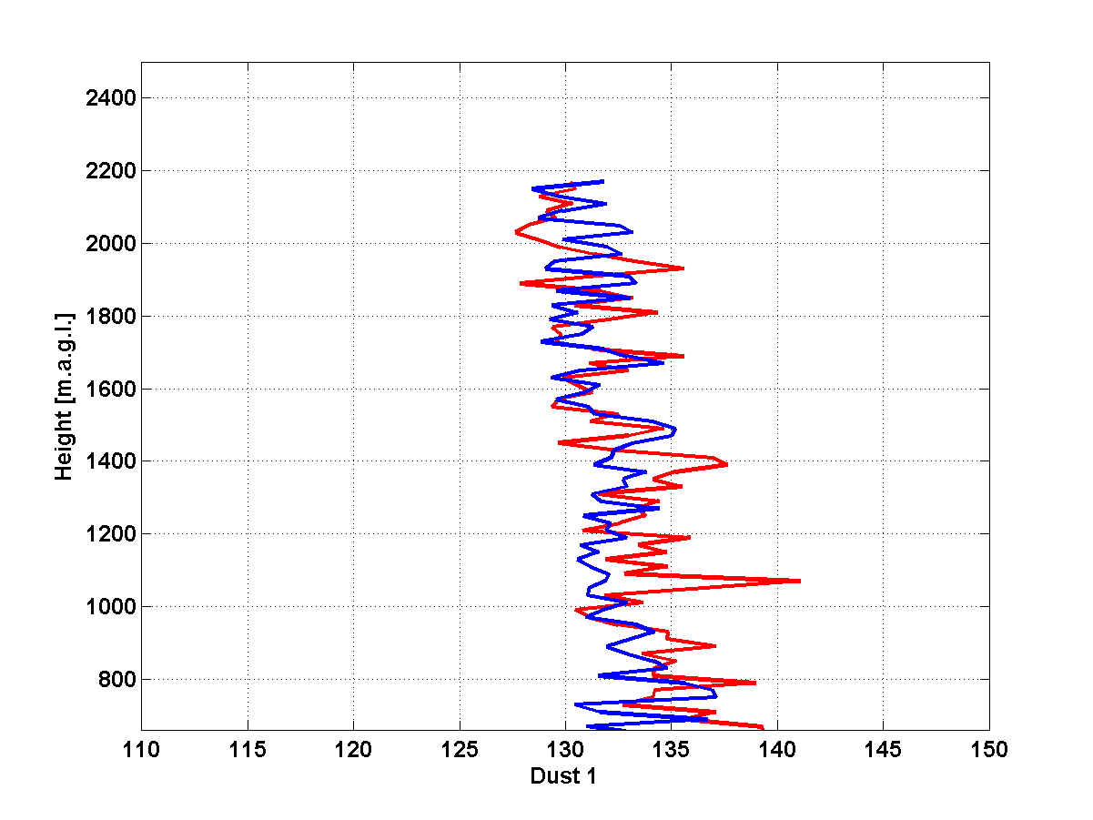
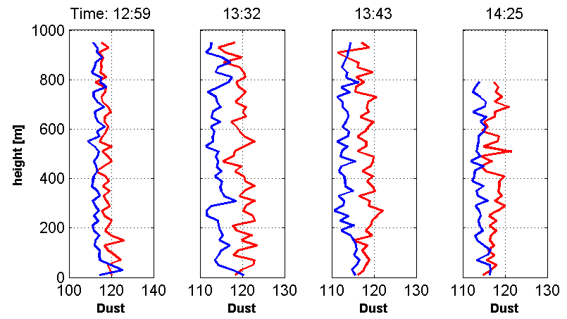


Preliminary results
Atmos. and Meteorological Instrumentation – EGU 2012
The SUMO dust sensor has been tested in France and Iceland
Ascending
Descending
Sensor is now being calibrated and tested
with ash from Mt. Eyjafjallajökull
SARWeather

Slide 24
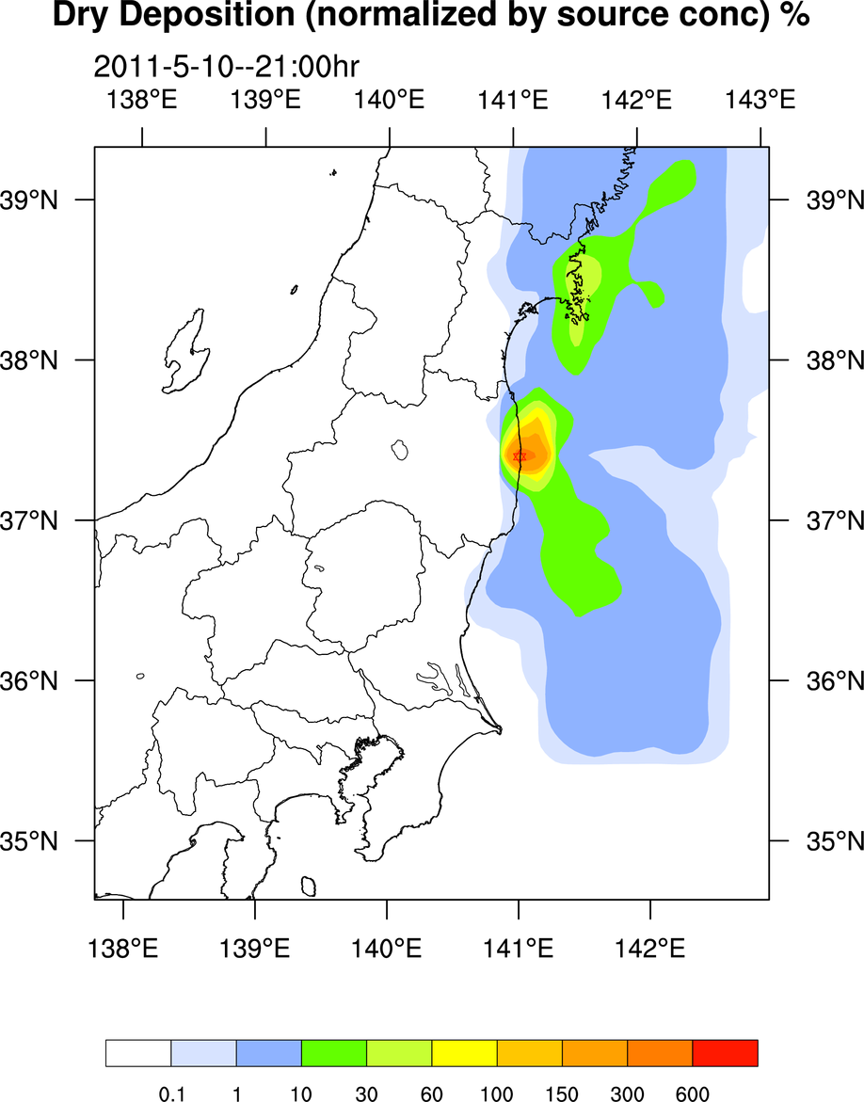
Various uses of model output
Atmos. and Meteorological Instrumentation – EGU 2012
To correctly simulate distribution of pollutants, it is very important to correctly simulate the atmospheric conditions close to the source.
Data courtesy of Prof. Saji Hameed at the University of Aizu, Fukushima.
SARWeather

Slide 25
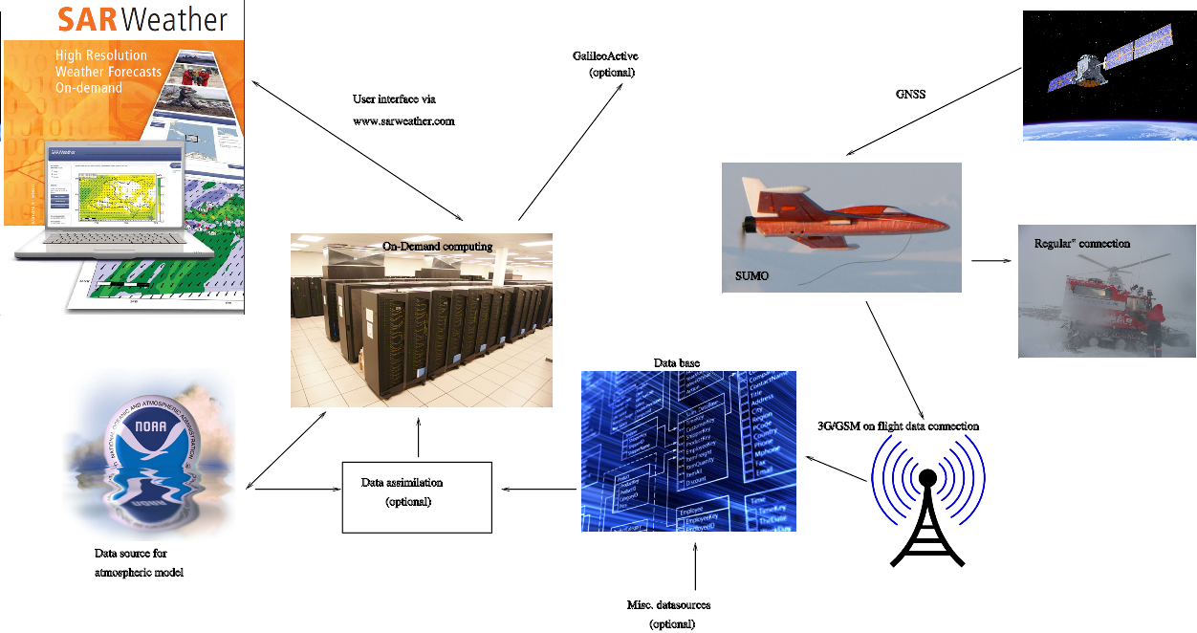
Current research and development
Atmos. and Meteorological Instrumentation – EGU 2012
System schematics
Integration with other systems
D4H
GDACS
MapAction
User interface
Data assimilation
(optional)
Data source for atmospheric model
Misc. datasources (optional)
SARWeather

Slide 26
Current research and development
Atmos. and Meteorological Instrumentation – EGU 2012
System schematics
Integration with other systems
D4H
GDACS
MapAction
Optional module
Still under development
User interface
Data assimilation
(optional)
Data source for atmospheric model
Misc. datasources (optional)
SARWeather

Slide 27
Conclusions
Atmos. and Meteorological Instrumentation – EGU 2012
Model resolution is important
  Especially in the vicinity of complex terrain
Additional observations can improve the simulation
  Vertical profiles made by the SUMO
The SUMO is a low-cost system with many advantages
  Proof of concept before investing in a more durable and expensive UAS
  Additional sensors are being added to the system
Fast response time is crucial in SAR operations
  SARWeather meets these needs
  Good weather information help improve decisions
The SUMO is currently being integrated to the SARWeather, on-demand, Crisis Response System
SARWeather

