Slide 1

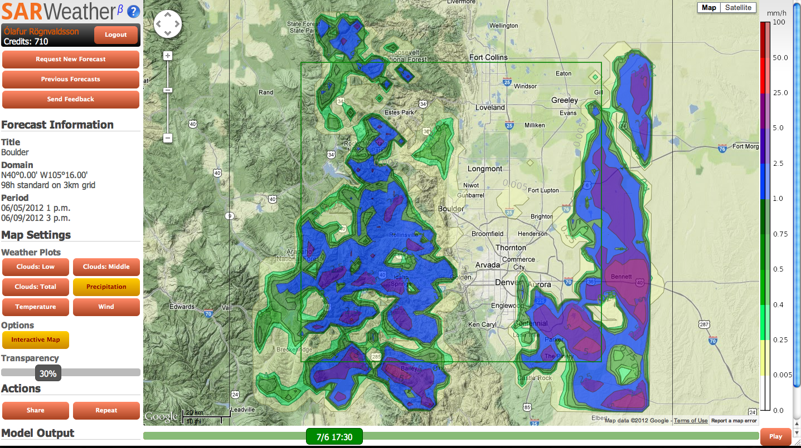
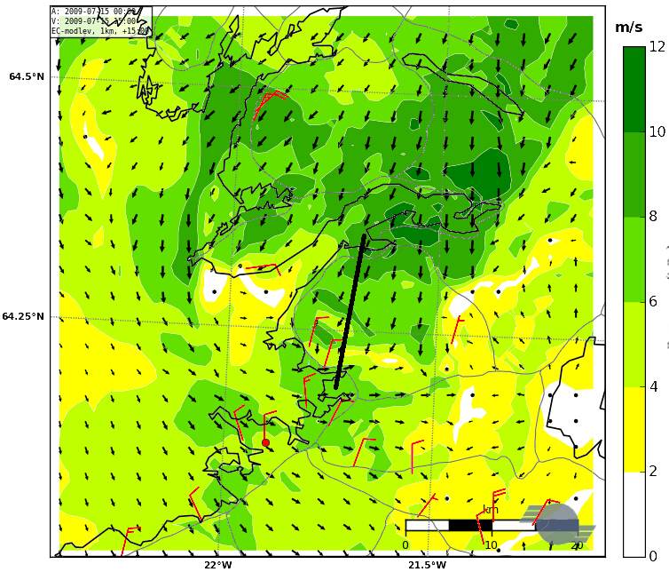
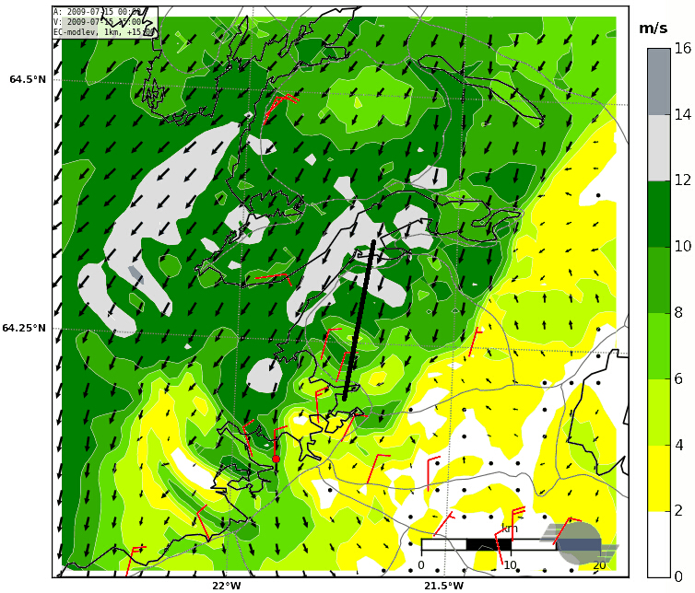
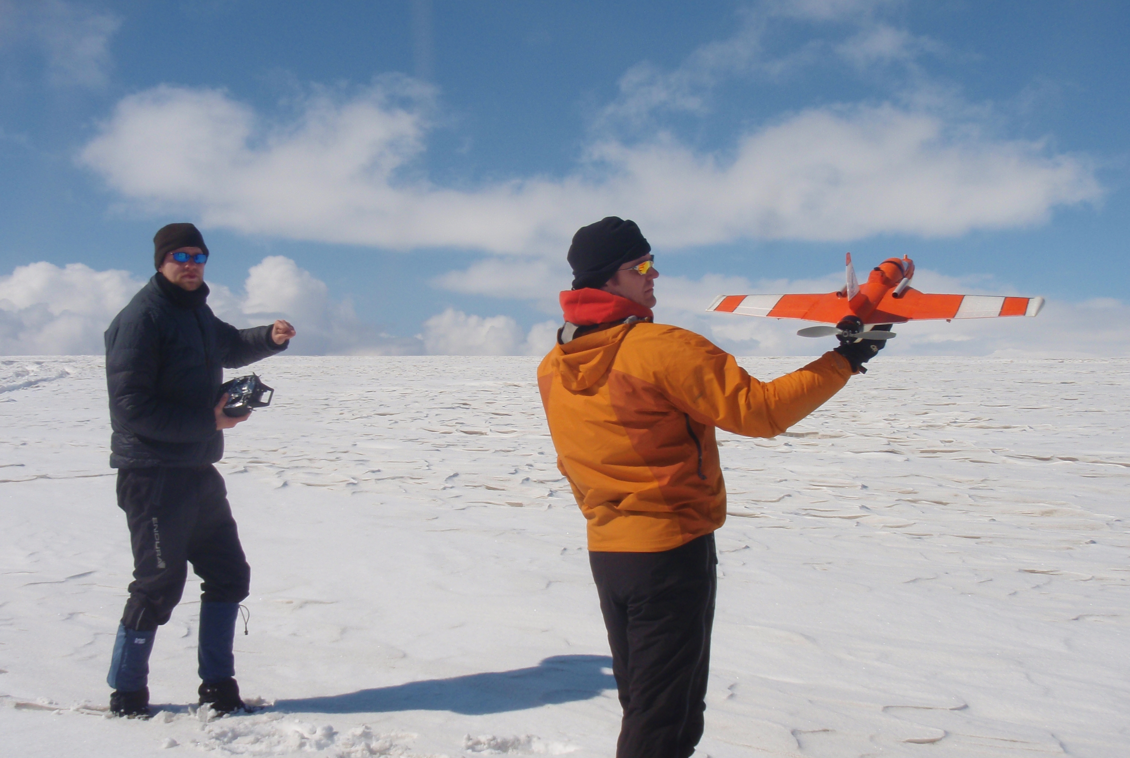
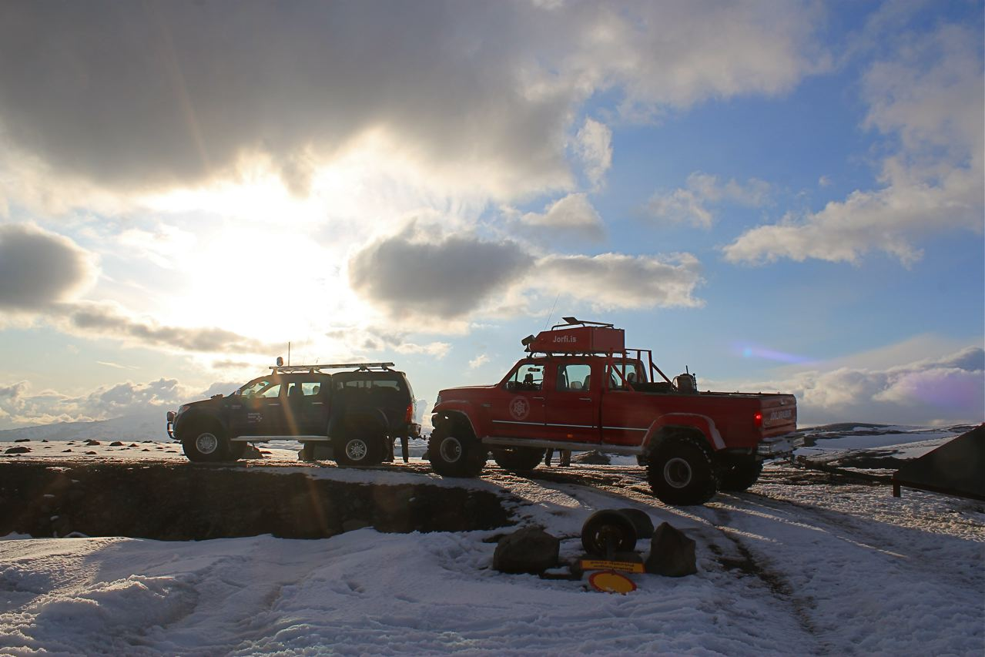
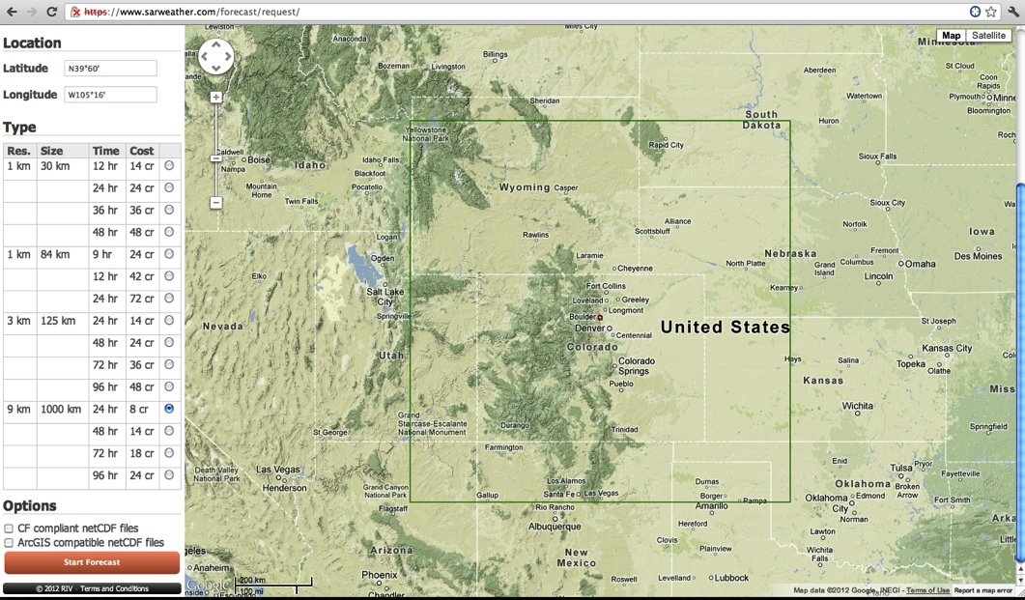

Small unmanned airplanes and their use to improve on-demand local forecasts
Ólafur Rögnvaldsson^{1,2}, Hálfdán Ágústsson^{1,3,4}, Marius O. Jonassen², Haraldur Ólafsson^{2,3,4}
¹Institute for Meteorological Research, ²University of Bergen, ³Icelandic Meteorological Office, ⁴University of Iceland
Introduction
Improving NWP’s by assimilating data from the SUMO
An on-demand weather forecasting system, named SARWeather, has been developed [7]. The system is tailored to meet the demanding needs of Search And Rescue operators world-wide. SARWeather uses the Advanced Research WRF model, initialized and forced on the boundaries with data from the GFS global forecasting system. One of the unique features of the system is that it is run on the Amazon Elastic Compute Cloud (Amazon EC2). This ensures that many individual forecasts can be run simultaneously for any region in the world. Increasing the number of potential forecasts is straight forward, and can be done at a short notice. A second unique feature of SARWeather is that the system does not require any prior knowledge on behalf of the user regarding atmospheric modeling and/or high performance computing. Thirdly, output from SARWeather can be easily integrated with other decision support software, such as ArcGIS.
Data from an unmanned aerial system named SUMO [5] (Small Unmanned Meteorological Observer) have been shown to improve the quality of local atmospheric simulations [1,2]. Ongoing research aims at combining the SUMO with SARWeather by transmitting atmospheric observations from vertical proﬁles, made by the SUMO observer, directly from the ﬁeld to the SARWeather system via 3G mobile transmissions.
In 2011, SARWeather joined GDACS (Global Disaster Alerts and Coordination System –
http://www.gdacs.org) to provide on-demand detailed weather forecasts for disaster areas world-wide. SARWeather is also being integrated with the D4H system
(http://www.decisionsforheroes.com).
The forecasts can both be viewed as static PNG figures or on an interactive map (cf. Fig. 2)
In [1] the authors demonstrated the effects of using profiles from the SUMO to nudge a high resolution simulation. Without using the additional observations made by the SUMO, the AR-WRF weather model, run at 500 meter horizontal resolution, created a week westerly flow in the lee of Mt. Esja, just north of the capital city of Reykjavík, Iceland (cf. Fig 4, left).
local background flow. Erroneously simulated fog over the Reykjanes peninsula on 19 July, that leads to a local temperature underestimation of 8 K, is also corrected by the data assimilation (cf. Fig. 5). Sensitivity experiments showed that both the assimilation of wind data and temperature and humidity data are important for the assimilation results.
Ongoing work
In view of the very promising improvements on high resolution simulations when combining observed profiles with the FDDA method, work is now being carried out to integrate this method with the SARWeather on-demand forecasting system. A recent breakthrough was made when data from the SUMO was successfully sent from the field via 3G modem (cf Fig. 6).
Mt. Esja
Mt. Esja
Figure 4: Simulated and observed (red flags) surface winds at 19 July 2009 at 15:00 UTC. The model simulates a sea-breeze (left) that is not seen in observations. When using five SUMO profiles, taken in the lee of Mt. Esja, to nudge the simulation, the flow structure becomes in much better agreement with available observations (right).
Figure 2: Simulated one hour precipitation at a 3km resolution. Forecast is valid at 6 June 2012, 17:30 local time.
Figure 6: At 17 May 2012, during a field trip with the Icelandic Glaciological Society to the Mýrdalsjökull ice cap in South Iceland, four SUMO profiles were taken. Photo B. L. Kristinsdóttir (left) and V. Leifsson (right).
On-Demand forecasts
Atmospheric profiles from Unmanned Aerial Systems
In [2] a more detailed analysis was carried out on the effects of combining observations from the SUMO with the FDDA nudging technique. In this paper the technique was applied to two case studies of northeasterly flow situations in Southwest Iceland from the international Moso field campaign on 19 and 20 July, 2009. Both situations were characterized by high diurnal boundary layer temperature variation leading to thermally driven flow, predominantly in the form of sea-breeze circulation along the coast. The data assimilation leads to an improvement in the simulation of the horizontal and vertical extension of the sea-breeze as well as of the
References
The procedure to set up and run an on-demand weather forecast via the SARWeather system is straight forward. Once logged on, the user simply chooses his/her region by clicking on a map (cf. Fig. 1).
Unmanned Aerial Systems (UAS) can be used to measure a wide variety of physical parameters in the atmospheric boundary layer. An example of a low-cost UAS is the Small Unmanned Meteorological Observer – SUMO [5,6]. The SUMO system can provide in-situ data that does not rely on similarity or propagation assumptions, and is undisturbed by clouds. Data delivery is fast or even instantaneous. The SUMO’s low infrastructural requirements allows is to be used in otherwise data-sparse regions, such as the polar areas where the SUMO has already been successfully operated [3].
[1] Ágústsson, H., H. Ólafsson, M. O. Jonassen, J. Reuder, D. Rasol, Ó. Rögnvaldsson, 2011. Improving high-resolution atmospheric simulations of local weather using in-situ real-time observations from small unmanned aircraft. Geophysical Research Abstracts, Vol. 13, EGU2011-13216, 2011.
[2] Jonassen, M. O., H. Ólafsson, H. Ágústsson, Ó. Rögnvaldsson, and J. Reuder, 2012. Improving a high resolution numerical weather simulation by assimilating data from an unmanned aerial system. Accepted for publication in Monthly Weather Review.
[3] Mayer, S., A. Sandvik, M. Jonassen, and J. Reuder (2010), Atmospheric profiling with the UAS SUMO: a new perspective for the evaluation of fine-scale atmospheric models, Meteorol. Atmos. Phys., DOI10.1007/s00703-010- 0063-2.
[4] Mayer, S., G. Hattenberger, M. Jonassen, and J. Reuder, 2012. A `no-flow- sensor' wind estimation algorithm for Unmanned Aerial Systems, J. Micro Air Vehicles. Vol 4, Number 1, March 2012. DOI: 10.1260/1756-8293.4.1.15.
[5] Reuder, J., P. Brisset, M. O. Jonassen, M. Müller, and S. Mayer, 2009: The Small Unmanned Meteorological Observer SUMO: A new tool for atmospheric boundary layer research. Meteor. Z., 18, 141 – 147.
[6] Reuder, J., M. O. Jonassen, and H. Ólafsson, 2012: The Small Unmanned Meteorological Observer SUMO: Recent developments and applications of a micro-UAS for atmospheric boundary layer research. Acta Geophys, DOI: 10.2478/s11600-012-0042-8. Available online: http://www.springerlink.com/content/l2q25558253p6375/
[7] Rögnvaldsson, Ó., 2011: Search and rescue, Weather prediction system assists humanitarian aid. Meteorological technology international, September Issue, pages 76 – 78.
Figure 3: The SUMO model frame is small, with wingspan of 0.8 meters (left, photo J. Reuder). The operational weight of the SUMO is less than 0.6 kg and it can reach altitude of more than 4000 m.a.g.l. Right panel shows a schematic of how the SUMO is operated; a combination of a ground station (the paparazzi autopilot) and remote (manual) control.
Figure 1: Domain for a 3km resolution forecast, centered over Boulder, Colorado.
Currently, the SUMO is equipped with two temperature sensors, a humidity and a pressure sensor as well as an optional 3D flow vector sensor (a five hole Aeroprobe). Wind speed and direction are derived by using a “no-flow-sensor” algorithm based on ground speed information given by the autopilot’s GPS under the assumption of constant true air speed while operated on a helical flight path with constant throttle and pitch angle [4].
Acknowledgements
In addition to choosing the location and size of the domain, the user can choose between three types of horizontal resolution and a variety of forecast durations. Depending on forecast type, i.e. domain size, resolution and duration, the total simulation time ranges between 20 and 60 minutes. Once the forecast is done, model output files can be downloaded, both in native AR-WRF netCDF format, and also as CF Compliant and ArcGIS Compliant netCDF files.
The SARWeahter project is in part funded by the Icelandic Technology DevelopmentFund (grant number 110338-0611).
Figure 5: Simulated 10 m wind speed [m/s] and wind direction and specific humidity [g/kg] from the lowermost model half level (approximately 9 m.a.g.l.) at a 1 km horizontal resolution at 1600 UTC on 19 July 2009 for the CTRL simulation (top row), and the FDDA-all simulation (bottom row). Observations of wind speed and wind direction at selected surface stations are included as well (red wind barbs). Each half barb represents 2.5 m/s. Areas with over 98% relative humidity are encircled by a black, dashed line.
Contact
Ólafur Rögnvaldsson, or@belgingur.is
Institute for Meteorological Research / Belgingur
Grensásvegur 9, IS-108 Reykjavík, Iceland

