Slide 1
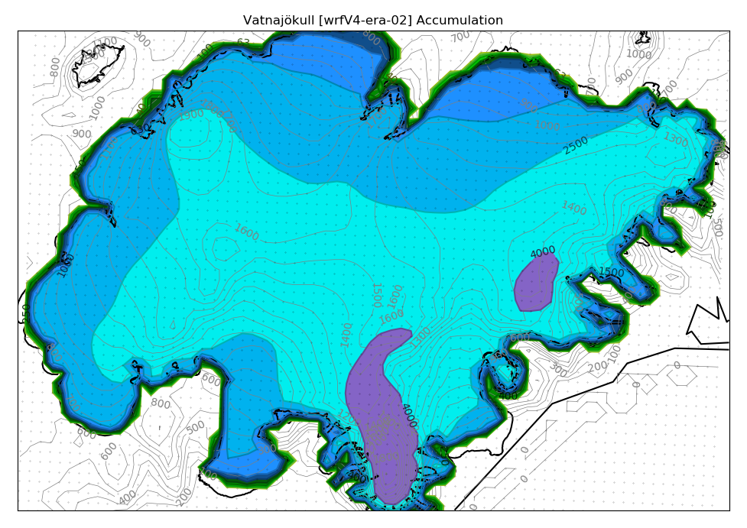
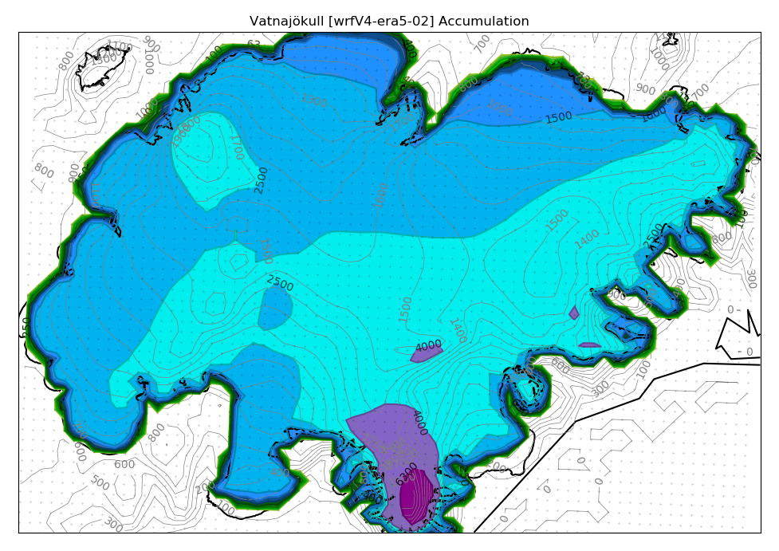
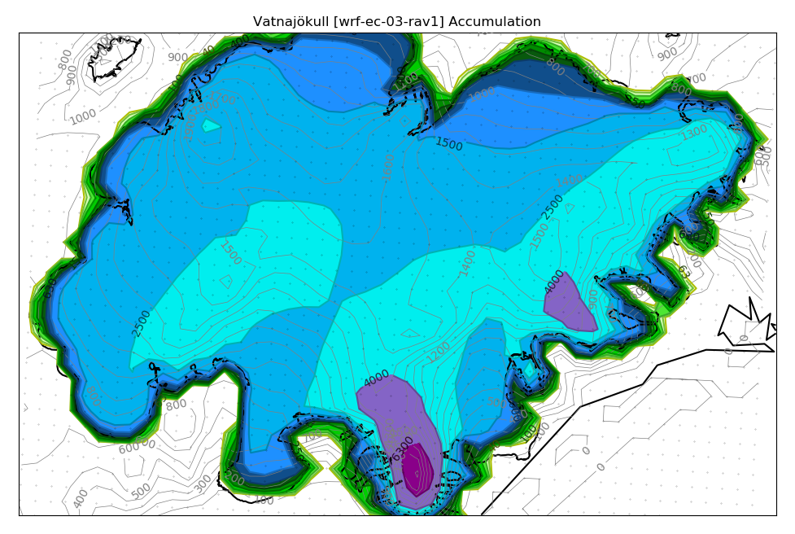
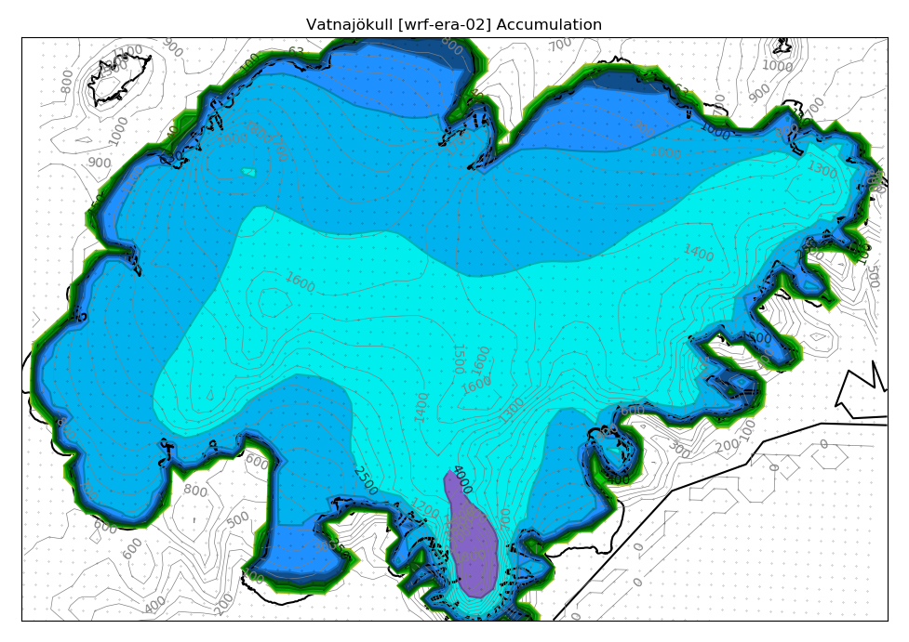
WRFv4-ERA-02 +22% WRFv4-ERA5-02 +19% WRF-EC-03-rav1 +11%
HARMONIE-ERA-2.5 +12% WRF-ERA-02 +11% WRF-GFS-02 +25%
Obs: 2.180 mm
100 150 400 650 1.000 1.500 2.500 4.000 6.500 10.000 15.000 25.000

Slide 2
WRF-ERA10 +6% WRF-GFS10 +19% WRF-GFS05 +26%
WRF-GFS03-fc +29% WRF-GFS01 +25%
Obs: 2.180 mm
100 150 400 650 1.000 1.500 2.500 4.000 6.500 10.000 15.000 25.000

Slide 3
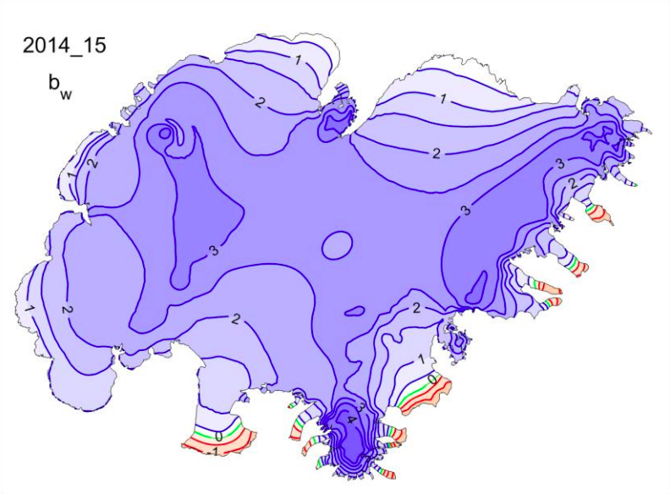

Slide 4
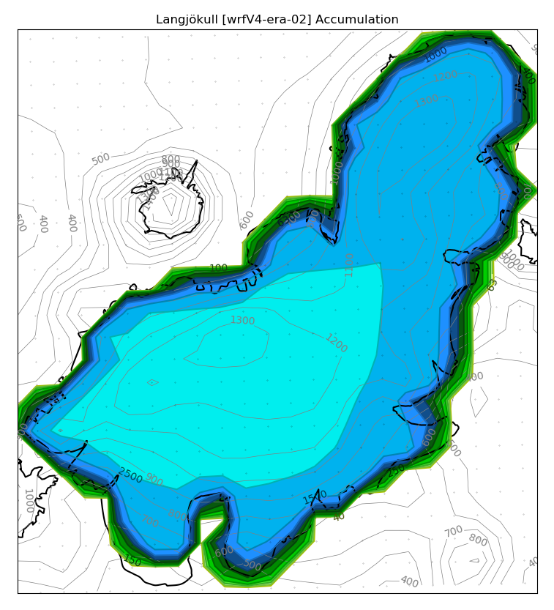
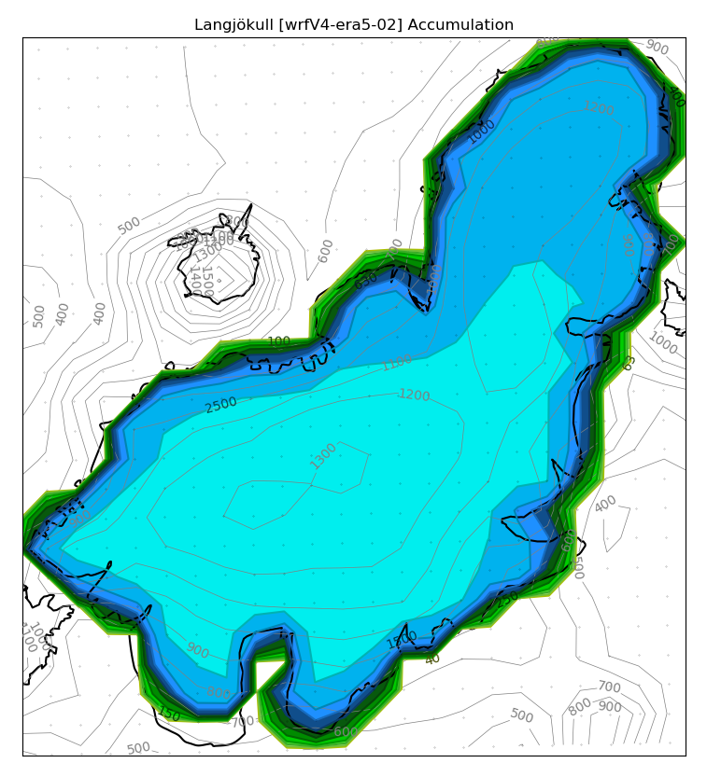
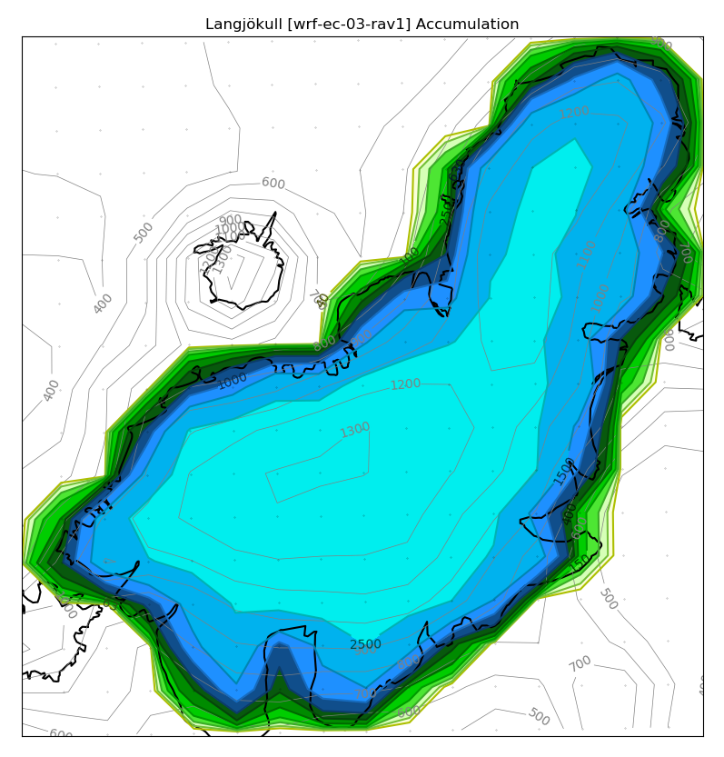
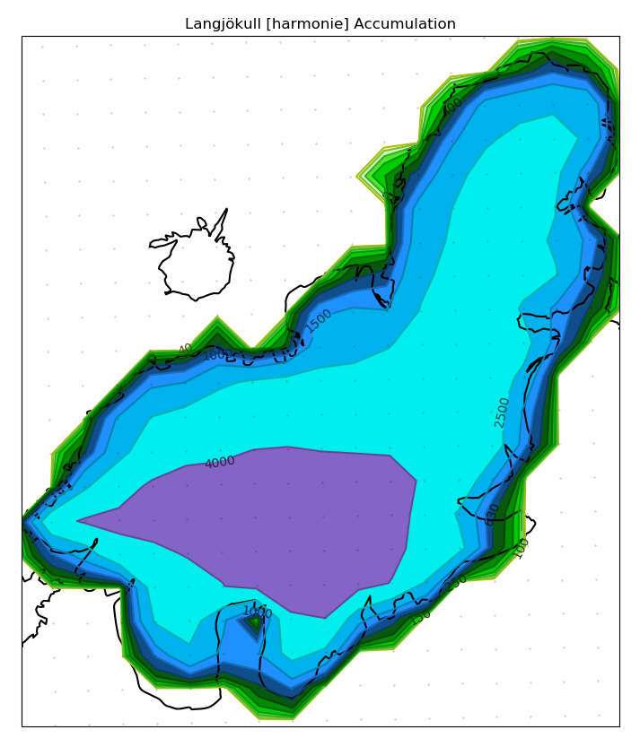
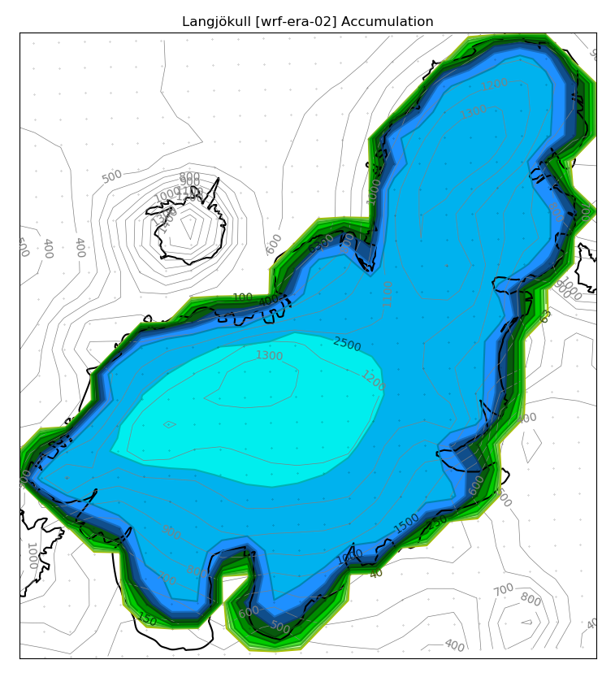

WRFv4-ERA-02 +22% WRFv4-ERA5-02 +19% WRF-EC-03-rav1 +8%
Obs: 2.440 mm
Obs: 2.440 mm
HARMONIE-ERA2.5 +32% WRF-ERA02 -11% WRF-GFS02 -4%
100 150 400 650 1.000 1.500 2.500 4.000 6.500 10.000 15.000 25.000

Slide 5
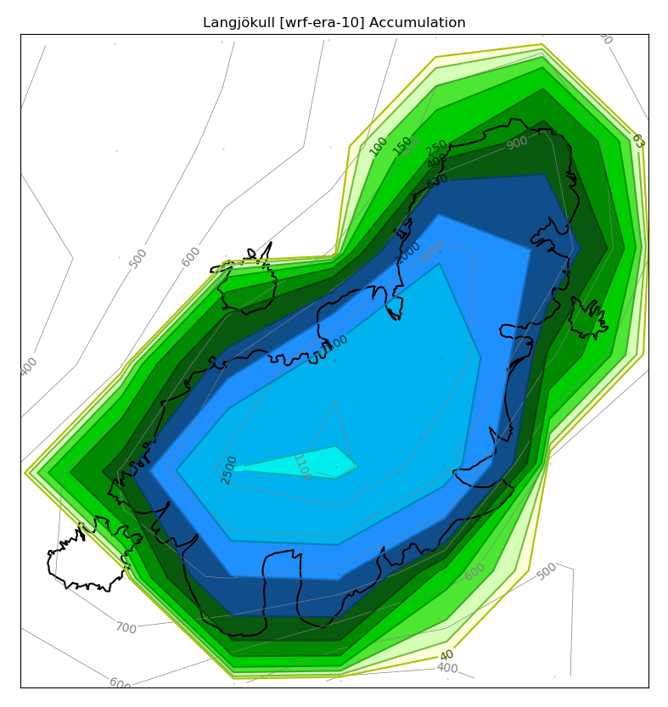
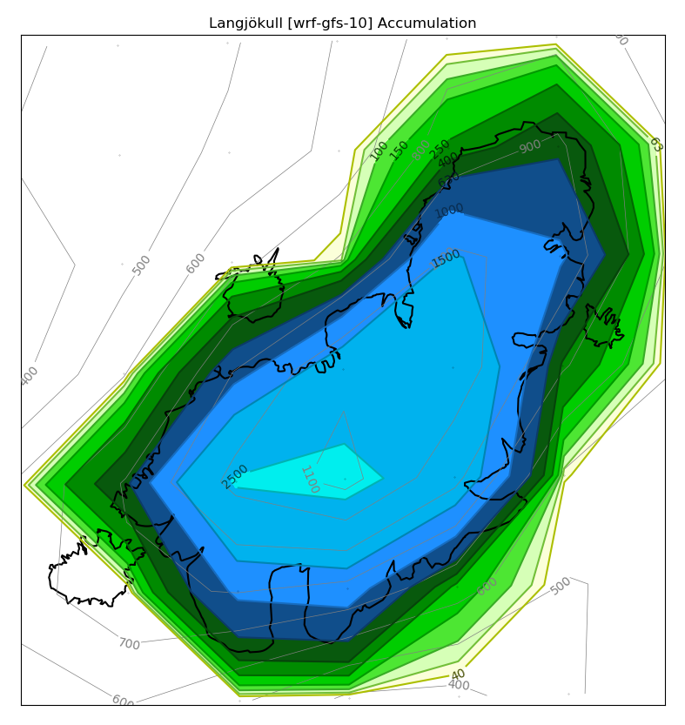
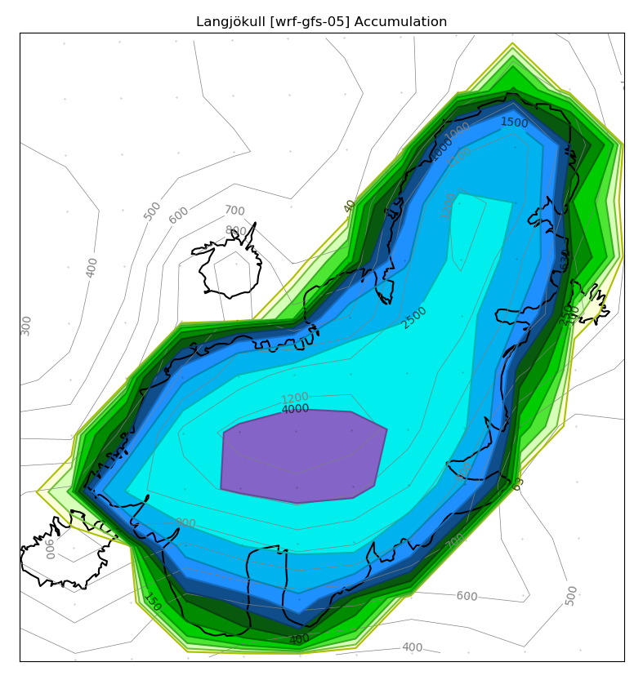

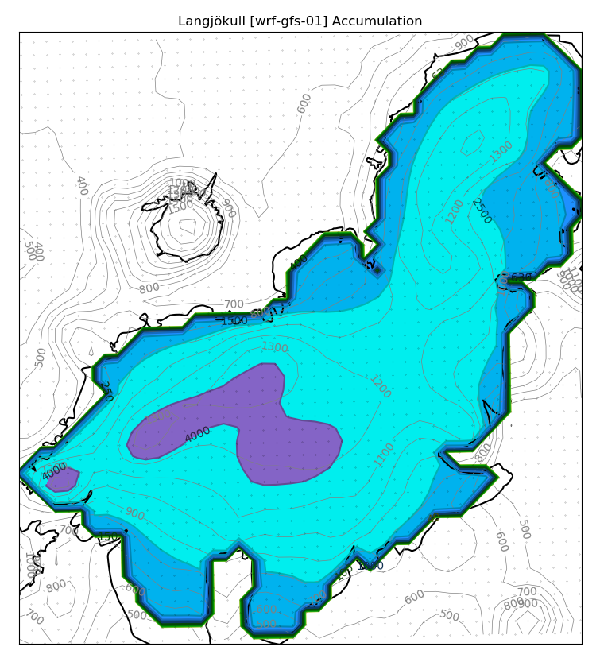
WRF-ERA10 -13% WRF-GFS10 -9% WRF-GFS05 +25%
Obs: 2.440 mm
WRF-GFS03-fc +7% WRF-GFS01 +22%
100 150 400 650 1.000 1.500 2.500 4.000 6.500 10.000 15.000 25.000

Slide 6
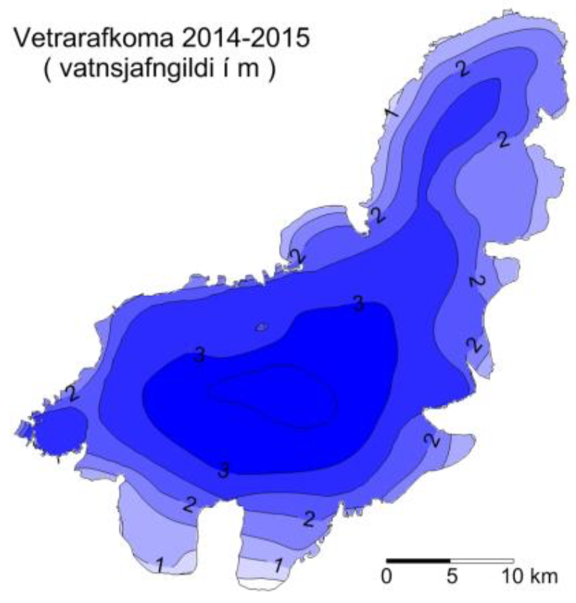

Slide 7
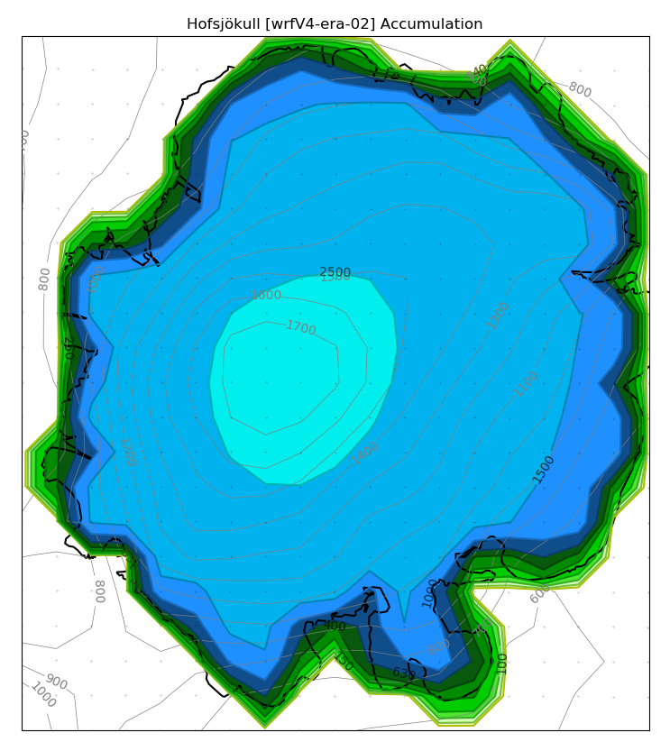
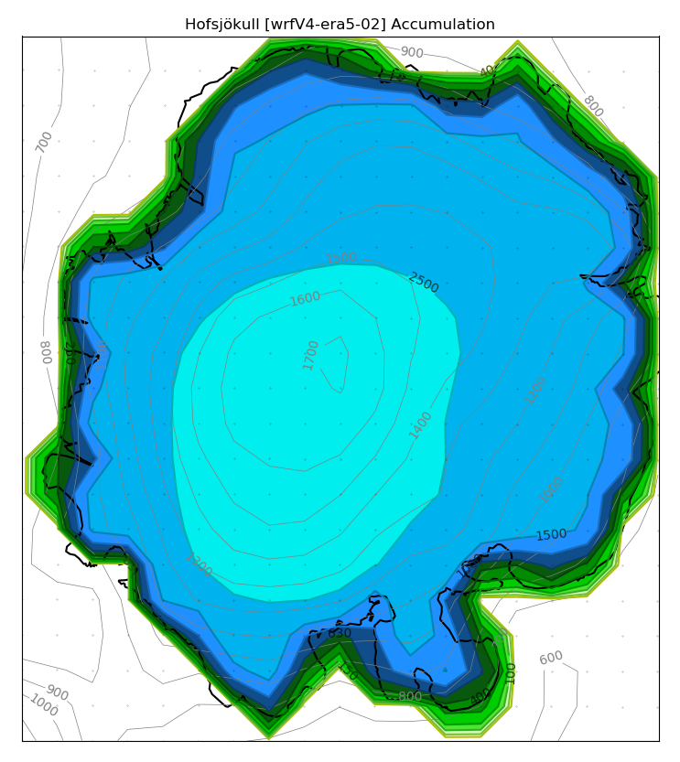
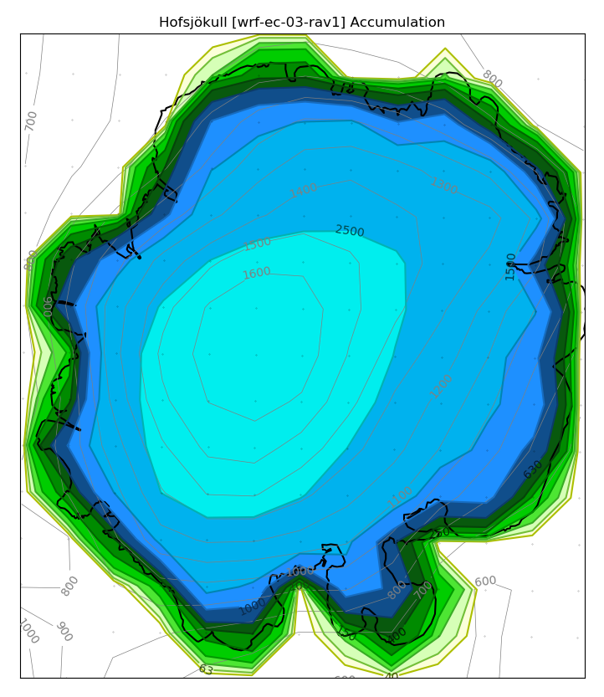
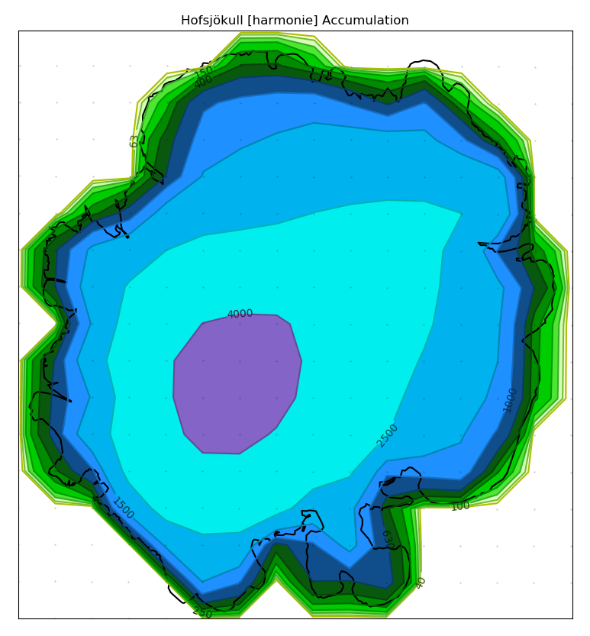
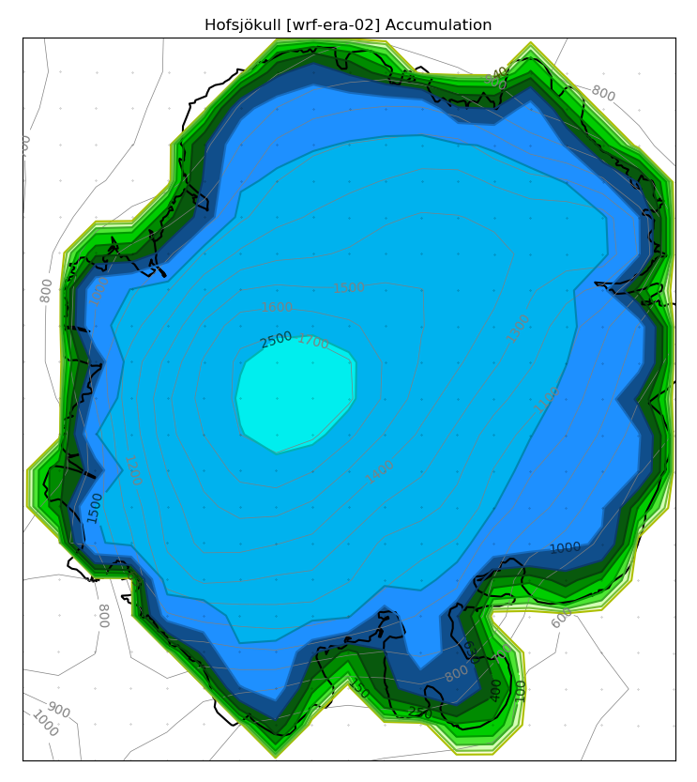
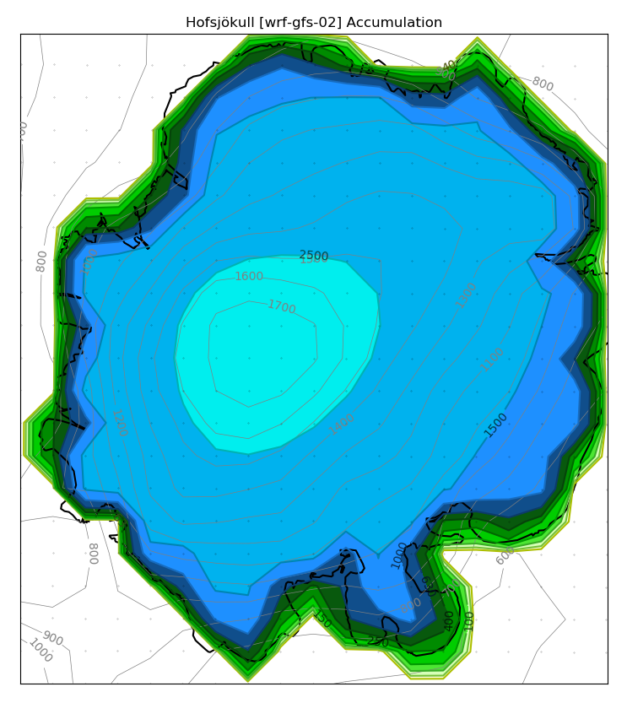
WRFv4-ERA-02 -4% WRFv4-ERA5-02 +9% WRF-EC-03-rav1 +7%
Obs: 2.010 mm
HARMONIE-ERA2.5 +24% WRF-ERA02 -13% WRF-GFS02 -3%
100 150 400 650 1.000 1.500 2.500 4.000 6.500 10.000 15.000 25.000

Slide 8
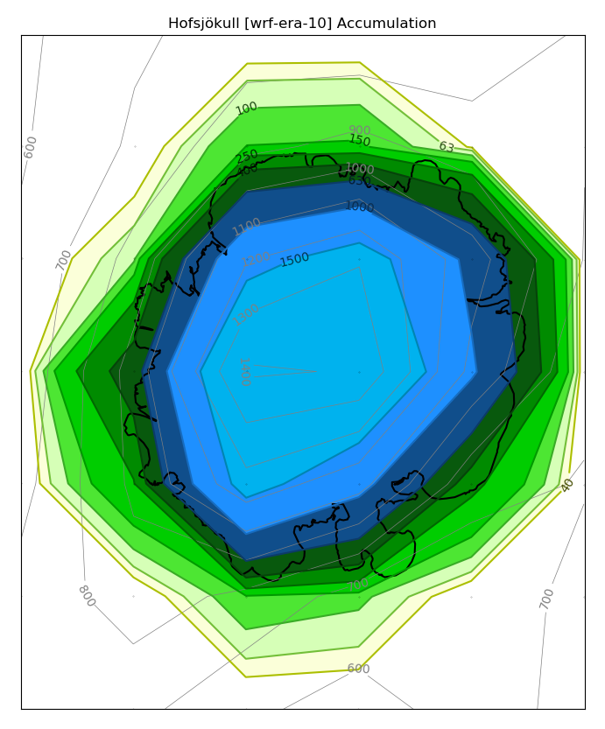
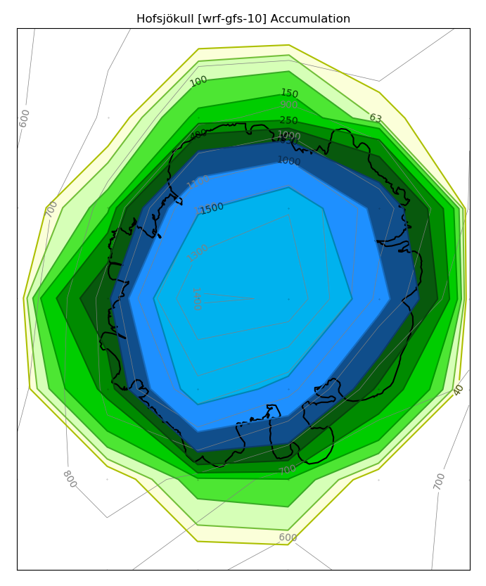
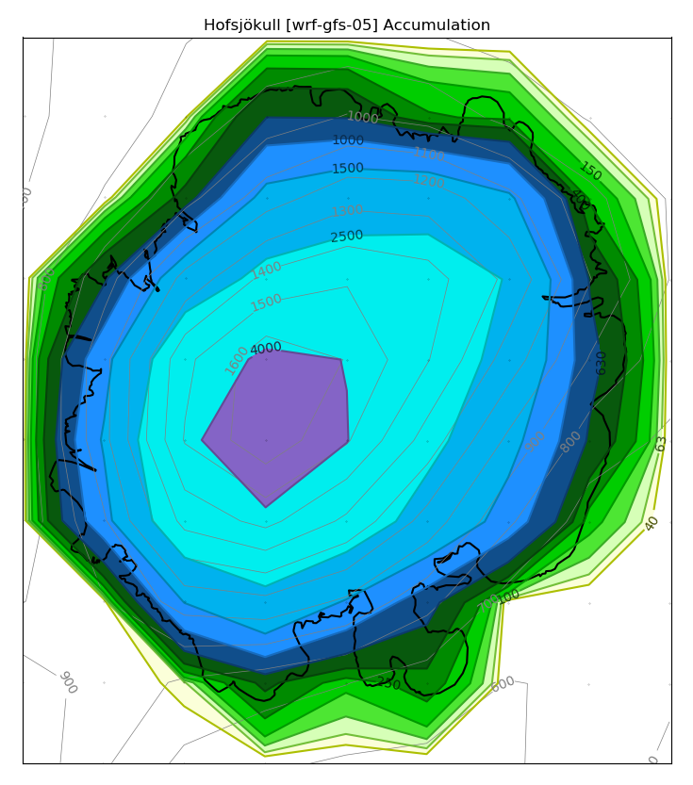
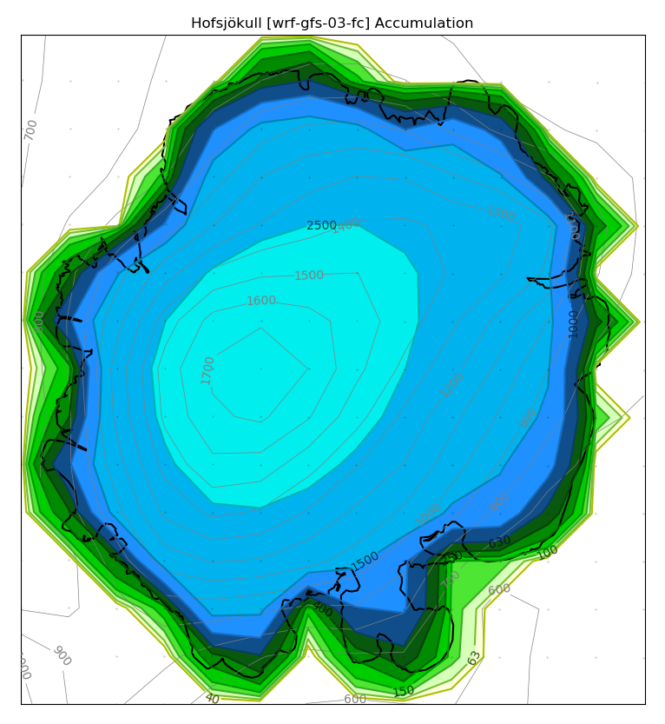
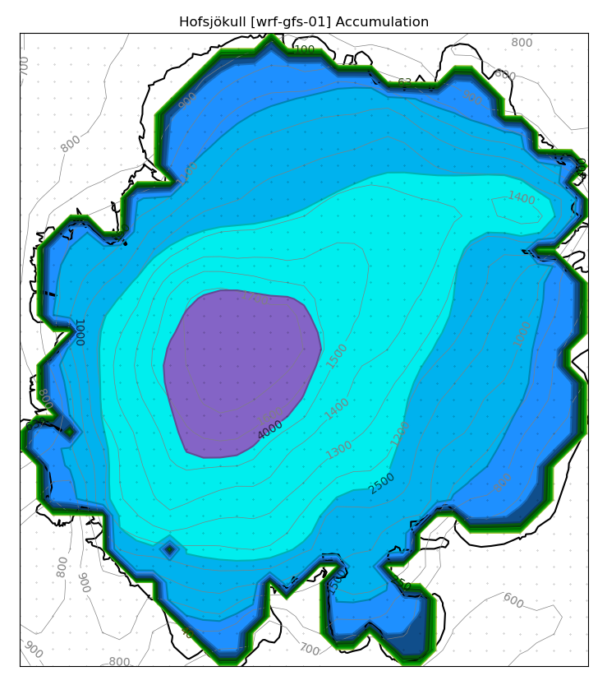
WRF-ERA10 -19% WRF-GFS10 -11% WRF-GFS05 +24%
WRF-GFS03-fc +8% WRF-GFS01 +23%
100 150 400 650 1.000 1.500 2.500 4.000 6.500 10.000 15.000 25.000

Slide 9
